Slide 1

7.05 Multi-Language Extractor
Peter H. Chen

Slide 2
7.05 Multi-Language Extractor
https://www.youtube.com/watch?v=1ICRLYtkmNU&list=PLZoTAELRMXVNbDmGZlcgCA3a8mRQp5axb&index=7
Setup (1:37:37-1:39:40/2:16:34)
We create a MLIE (Multi-Language Invoice Extractor) application.
We input invoice image written in any language and ask question “What is company name”, “What is company address”, “Who to bill?”, “What is the amount of invoice?”, etc.
We will discuss the followings:
1. Multi-Language Invoice Extractor
2. Create conda environment
3. Create Google API Key
4. Install requirement packages
> pip install -r requirements.txt
5. Create Application

Slide 3
7.05.01 MLIE Demo

Slide 4
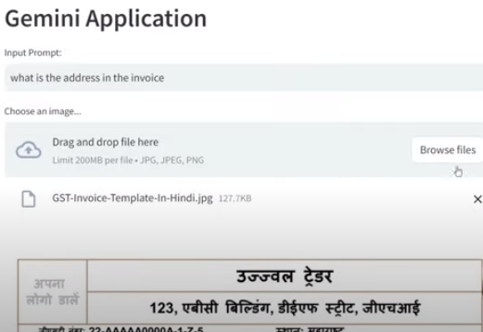
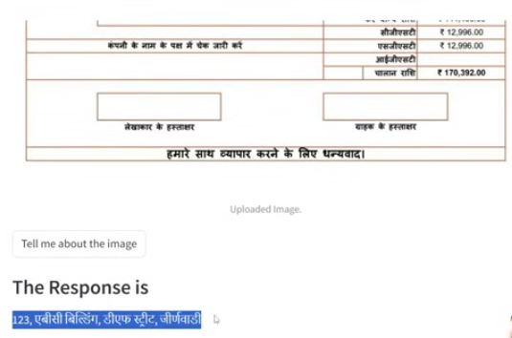
7.05.01 MLIE Demo
https://www.youtube.com/watch?v=1ICRLYtkmNU&list=PLZoTAELRMXVNbDmGZlcgCA3a8mRQp5axb&index=7
MLIE Demo (1:39:41-1:41:00/2:16:34)
The invoice is written in Hindi language.
Question: What is the address of the invoice?

Slide 5
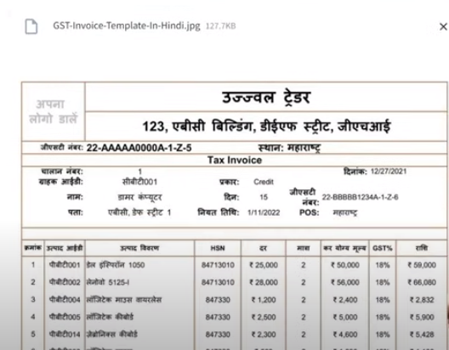
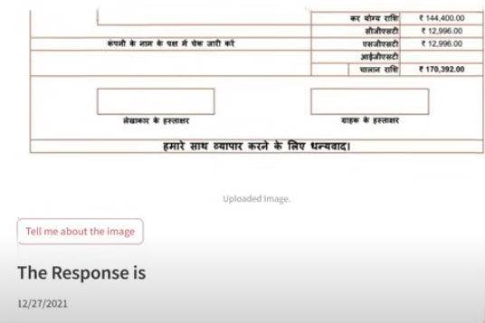
7.05.01 MLIE Demo
https://www.youtube.com/watch?v=1ICRLYtkmNU&list=PLZoTAELRMXVNbDmGZlcgCA3a8mRQp5axb&index=7
MLIE Demo (1:41:01-1:41:20/2:16:34)
The invoice is written in Hindi language.
Question: What is the date of the invoice?

Slide 6
End

