Slide 1

7.05.04 Load API Key
Peter H. Chen

Slide 2
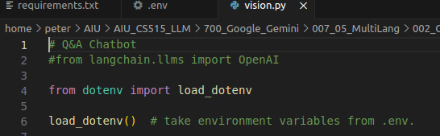
7.05.04 Load API Key
https://www.youtube.com/watch?v=1ICRLYtkmNU&list=PLZoTAELRMXVNbDmGZlcgCA3a8mRQp5axb&index=7
Load API Key (1:44:31-1:44:50/2:16:34)
Python load API Key from “.env” file.

Slide 3
7.05.05 Import Library

Slide 4
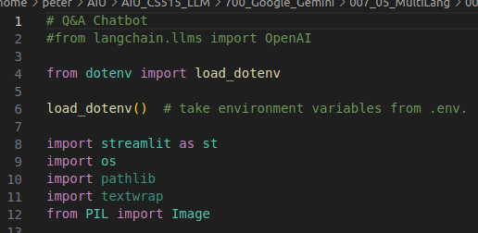
7.05.05 Import Library
https://www.youtube.com/watch?v=1ICRLYtkmNU&list=PLZoTAELRMXVNbDmGZlcgCA3a8mRQp5axb&index=7
Import Library (1:44:51-1:46:30/2:16:34)
Import libraries.

Slide 5
7.05.06 Configure Gemini Model

Slide 6

7.05.06 Configure Gemini Model
https://www.youtube.com/watch?v=1ICRLYtkmNU&list=PLZoTAELRMXVNbDmGZlcgCA3a8mRQp5axb&index=7
Configure Gemini Model (1:44:51-1:47:00/2:16:34)
We configure Gemini Model with Google API Key.

Slide 7
7.05.07 Load Gemini Model and Response

Slide 8
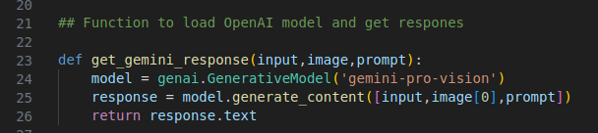
7.05.07 Load Gemini Model and Response
https://www.youtube.com/watch?v=1ICRLYtkmNU&list=PLZoTAELRMXVNbDmGZlcgCA3a8mRQp5axb&index=7
Load Gemini Model and Response (1:47:21-1:50:30/2:16:34)
We
1. Load Gemini-Model: gemini-pro-vision
2. Input text, image, and prompt
3. We get the response text based on Text, Image, and prompt.
See code later on:
1. What is input (input_prompt)?
Answer: User guide information
2. What is prompt?
Answer: Use input question.

Slide 9
7.05.08 Streamlit GUI

Slide 10
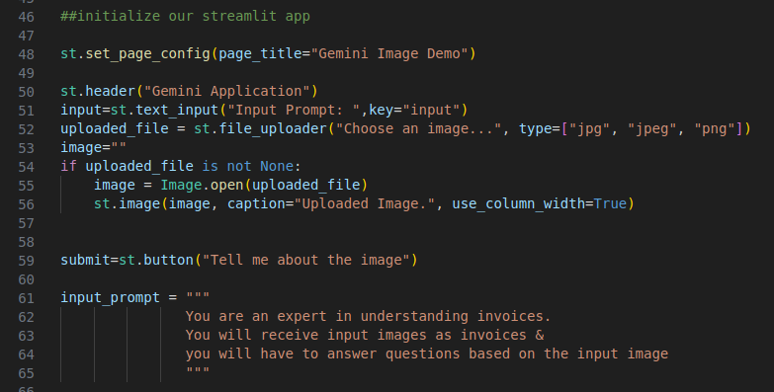
7.05.08 Streamlit GUI
https://www.youtube.com/watch?v=1ICRLYtkmNU&list=PLZoTAELRMXVNbDmGZlcgCA3a8mRQp5axb&index=7
Streamlit GUI (1:50:51-1:54:30/2:16:34)
We
1. Create page title: Gemini Image Demo (Multi-Language Invoice Extractor)
2. Create header: Gemini Application (Multi-Language Invoice Extractor)
3. Upload image file (in “jpg”, “jpeg”, “png” format)
4. Submit button: “Tell me about the image”
5. Input prompt: You are the expert. You ask question of the invoice image.

Slide 11
7.05.09 Load Image Data

Slide 12
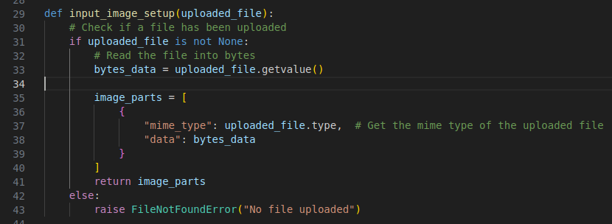
7.05.09 Load Image Data
https://www.youtube.com/watch?v=1ICRLYtkmNU&list=PLZoTAELRMXVNbDmGZlcgCA3a8mRQp5axb&index=7
Load Image Data (1:54:31-1:57:30/2:16:34)
Load the invoice image.

Slide 13
7.05.10 Process Submission

Slide 14
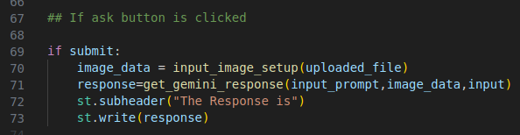
7.05.10 Process Submission
https://www.youtube.com/watch?v=1ICRLYtkmNU&list=PLZoTAELRMXVNbDmGZlcgCA3a8mRQp5axb&index=7
Process Submission (1:57:31-1:58:30/2:16:34)
1. Input prompt: user guide information
2. image: Invoice
3. input: user question.

Slide 15
End

