Slide 1

1 Google Gemini ChatBot
Peter H. Chen

Slide 2
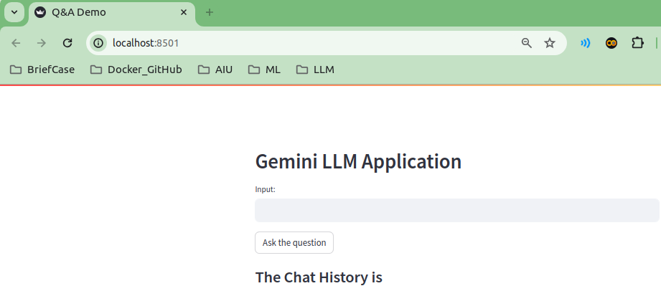
1 Google Gemini ChatBot
https://www.youtube.com/watch?v=o4ZhXSVuPyc&t=16s
Google Gemini ChatBot (00:00-00:40/14:32)
We build the Conversational Q&A ChatBot with Google Gemini-Pro API.
The Google Gemini-Pro API will call Google LLM (Large Language Model) Generative AI.
We also display all the results of the Google Gemini-Pro conversation.
We call this application “Conversational Q&A ChatBot.”

Slide 3
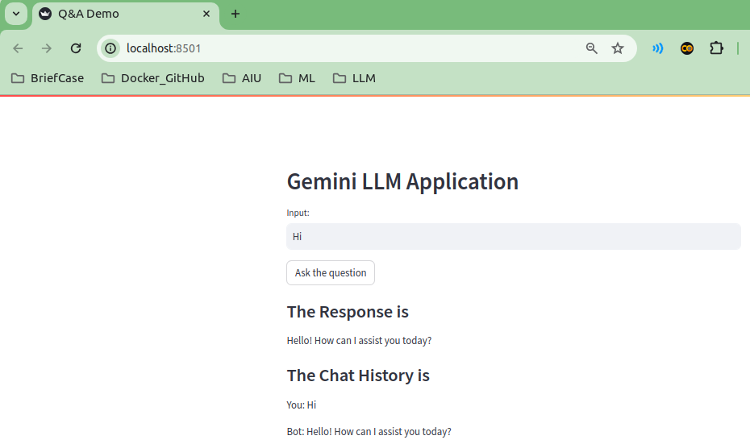
1 Google Gemini ChatBot
https://www.youtube.com/watch?v=o4ZhXSVuPyc&t=16s
Google Gemini ChatBot (00:41-05:00/14:32)
Before we start, we want to show the final demo look like.
We type “Hi” and then click button “Ask the question”.
We get the response “Hello! How can I assist you today?”
The “Chat History is”
You: Hi
Bot: Hello! How can I assist you today?”

Slide 4
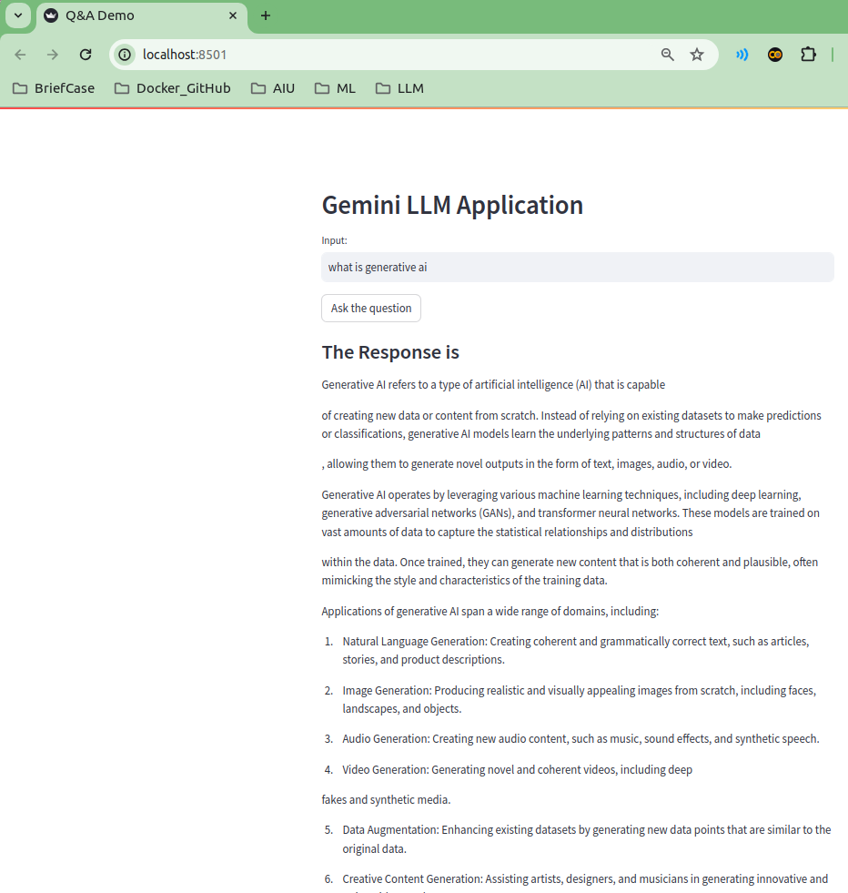
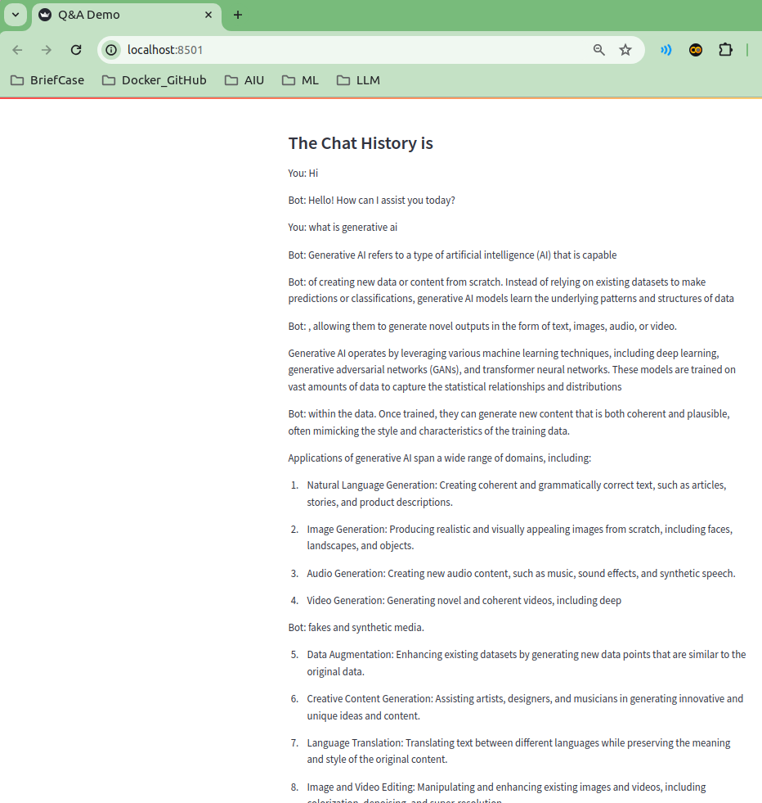
1 Google Gemini ChatBot
https://www.youtube.com/watch?v=o4ZhXSVuPyc&t=16s
Google Gemini ChatBot (00:51-01:20/14:32)
If we ask “What is generative ai?”
We got the response of question.
After that, we have the previous “The Chat History is” information.
This is what we are going to implement.

Slide 5
1.1 Install requirements.txt

Slide 6
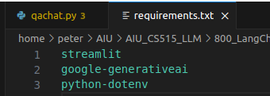
1.1 Install requirements.txt
https://www.youtube.com/watch?v=o4ZhXSVuPyc&t=16s
Install requirements.txt (01:21-01:30/14:32)
1. Create the conda environment
> conda create --name gemini
2. Activate the gemini environment
> conda activate gemini
3. Install the requirements.
> pip install -r requirements.txt
After this, we have all the environments we need.

Slide 7
1.2 .env

Slide 8
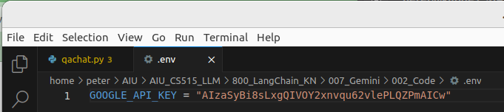
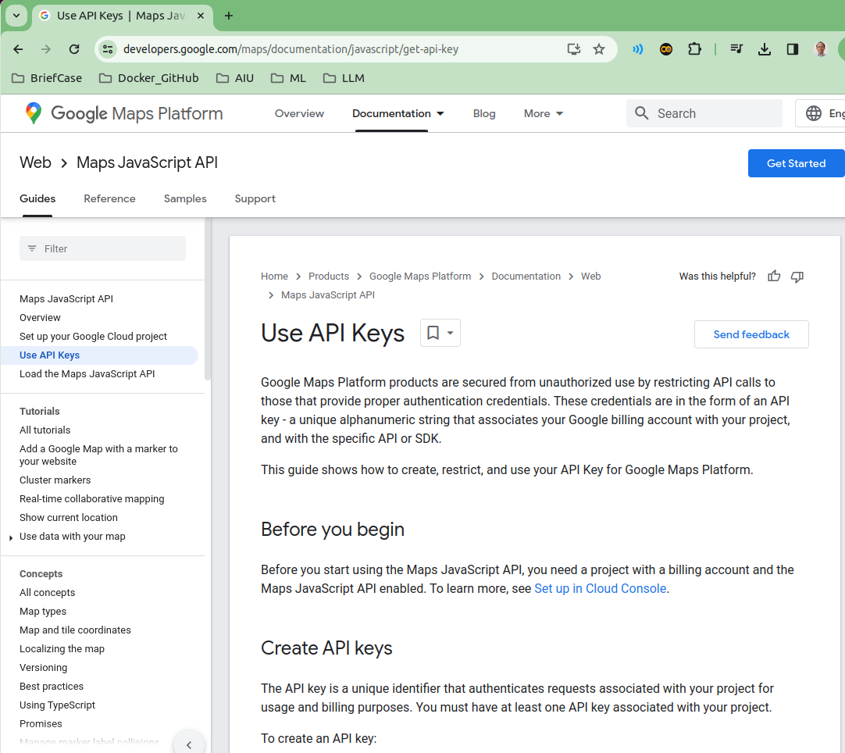
1.2 .env
https://www.youtube.com/watch?v=o4ZhXSVuPyc&t=16s
.env (01:31-02:20/14:32)
We need environment which defines the Google API Key.
Google search “Google API Key” to get the Google API Key for Gemini-Pro.

Slide 9
1.3 Import Library and Get API Key

Slide 10
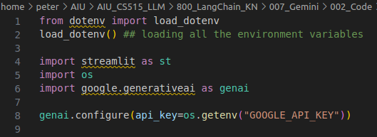
1.3 Import Library and Get API Key
https://www.youtube.com/watch?v=o4ZhXSVuPyc&t=16s
Import Library and Get API Key (02:21-03:50/14:32)
We import libraries and get Google API Key from environment variable.
1. import load_dotenv
load_dotenv() # We load the environment variable GOOGLE_API_KEY.
2. import streamlit
3. import os
4. import google.generativeai as genai
5. We already install all the required libraries.
> pip install -r requirements.txt
6. genai.configure(api_key=os.getenv(“GOOGLE_API_KEY”)

Slide 11
1.4 Load Gemini Model

Slide 12
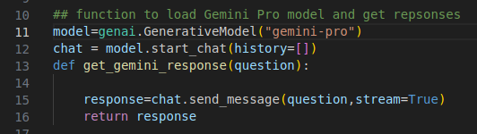
1.4 Load Gemini Model
https://www.youtube.com/watch?v=o4ZhXSVuPyc&t=16s
Load Gemini Model (04:01-05:30/14:32)
We create function to load the Gemini-Pro Model and get response.
1. get model model = genai.GenerativeModel (“gemini-pro”) for conversational Q&A.
2. we execute model.start_chat () and set history=[]. This history keep all our conversation. We also can use streamlit to keep the history.

Slide 13
1.4 Load Gemini Model
https://www.youtube.com/watch?v=o4ZhXSVuPyc&t=16s
Load Gemini Model (05:31-06:30/14:32)
We
1. define get_gemini_response (quesiton) for input question.
The get_gemini_response() get the response from generative model.
2. We sent the question to generative model and get response.
response=chat.sent_message(quesiton)
3. return the chat response.

Slide 14
1.5 Initialize Streamlit App

Slide 15
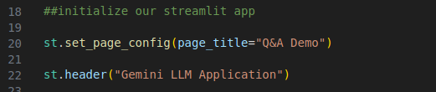
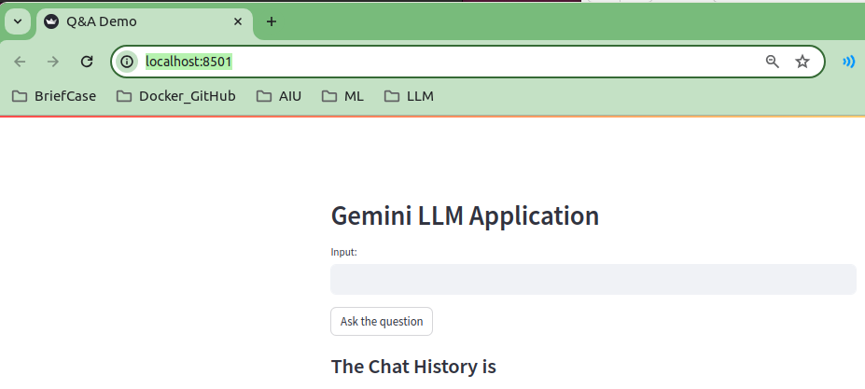
1.5 Initialize Streamlit App
https://www.youtube.com/watch?v=o4ZhXSVuPyc&t=16s
Initialize Streamlit App (06:31-06:40/14:32)
We
1. set Web Page Tab: “Q&A Demo”
2. set header: “Gemini LLM Application”

Slide 16
1.6 Create Input Area and Submit Button

Slide 17
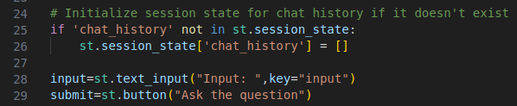
1.6 Create Input Area and Submit Button
https://www.youtube.com/watch?v=o4ZhXSVuPyc&t=16s
Create Input Area and Submit Button (06:45-08:10/14:32)
We create
1. Initialize the streamlit session_state = [].
We will put all the history inside the session_state.
2. Create Input question text area.
3. Create Submit Button “Ask the question”.

Slide 18
1.7 Submit Input

Slide 19

1.7 Submit Input
https://www.youtube.com/watch?v=o4ZhXSVuPyc&t=16s
Submit Input (08:11-08:40/14:32)
If submit is click and input has data, then we
Pass the input data and get response from Gemini-pro Model.

Slide 20
1.8 Append User Input and Gemini Response

Slide 21
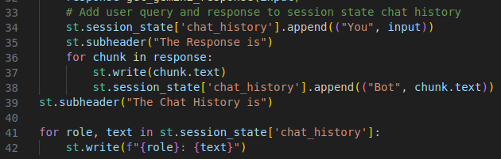
1.8 Append User Input and Gemini Response
https://www.youtube.com/watch?v=o4ZhXSVuPyc&t=16s
Append User Input and Gemini Response (08:41-09:30/14:32)
We Append
1. user input to dictionary ‘chat_history’.
2. Gemini response to dictionary ‘chat_history’.
1
2

Slide 22
1.9 Display Response

Slide 23
1.9 Display Response
https://www.youtube.com/watch?v=o4ZhXSVuPyc&t=16s
Display Response (09:31-11:30/14:32)
We display:
1. header “The Response is”
2. response text message.
1
2

Slide 24
1.10 Display History

Slide 25
1.10 Display History
https://www.youtube.com/watch?v=o4ZhXSVuPyc&t=16s
Display History(11:31-12:20/14:32)
We display history:
1. Display header “The Chat History is” and
2. Display user input and response text message of dictionary ‘chat_history’.
1
2

Slide 26
1.11 Streamlit Run Gemini API

Slide 27
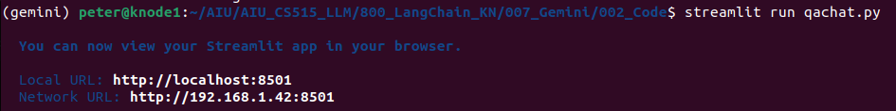
1.11 Streamlit Run Gemini API
https://www.youtube.com/watch?v=o4ZhXSVuPyc&t=16s
Streamlit Run Gemini API (12:21-13:10/14:32)
1. Activate conda gemini environment
> conda activate gemini
2. change directory to code folder:
> cd ~/AIU/AIU*LLM/*KN/*Gemini/002_code
3. streamlit run:
> streamlit run qachat.py

Slide 28
1.11 Streamlit Run Gemini API
https://www.youtube.com/watch?v=o4ZhXSVuPyc&t=16s
Streamlit Run Gemini API (03:11-14:10/14:32)
Before we start, we want to show the final demo look like.
We type “Hi” and then click button “Ask the question”.
We get the response “Hello! How can I assist you today?”
The “Chat History is”
You: Hi
Bot: Hello! How can I assist you today?”

Slide 29
1.11 Streamlit Run Gemini API
https://www.youtube.com/watch?v=o4ZhXSVuPyc&t=16s
Streamlit Run Gemini API (14:11-14:32/14:32)
If we ask “What is generative ai?”
We got the response of question.
After that, we have the previous “The Chat History is” information.
This is what we are going to implement.

Slide 30
End

