Slide 1

34 RNN Type
Peter H. Chen

Slide 2
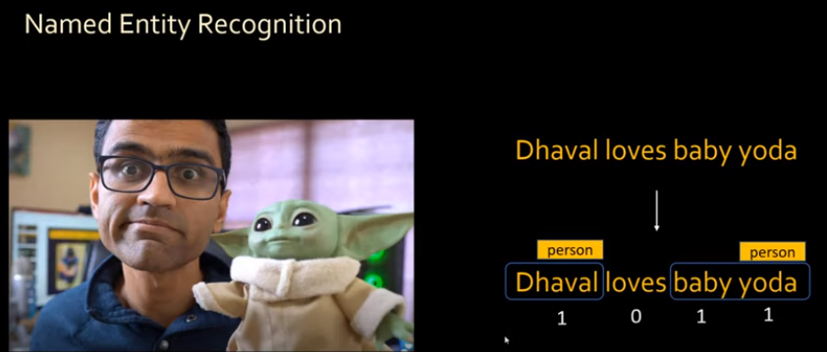
34 RNN Type
https://www.youtube.com/watch?v=EzsXi4WzelI&list=PLeo1K3hjS3uu7CxAacxVndI4bE_o3BDtO&index=34
RNN Type (0:00-0:17/3:42)
In RNN (Recurrent Neural Network), we have NER (Named Entity Recognition).
NER (Named Entity recognition) is a form of natural language processing (NLP) that extracts and identifies essential information from text.
In NER, we can input a statement, “dhaval loves baby yoda”.
The statement is split into words, each words is one of the sequences and will return a sequences of 0 or 1 to identify the word is the person or not.
We can input any size of statement as the input and out the prediction.

Slide 3
34.1 Many to Many RNN

Slide 4
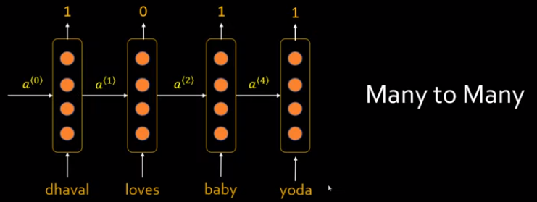
34.1 Many to Many RNN
https://www.youtube.com/watch?v=EzsXi4WzelI&list=PLeo1K3hjS3uu7CxAacxVndI4bE_o3BDtO&index=34
Many to Many RNN (0:18-0:37/3:42)
In RNN, we have “Many to Many” fore input statement and output prediction (person or yoda).

Slide 5
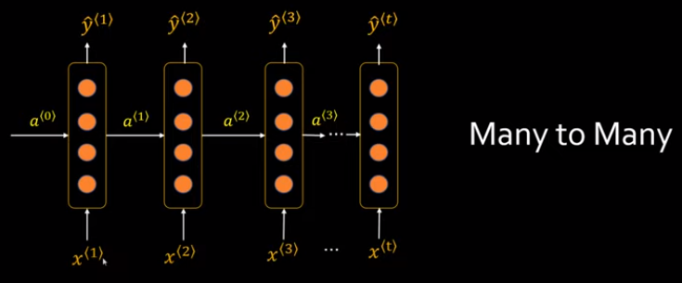
34.1 Many to Many RNN
https://www.youtube.com/watch?v=EzsXi4WzelI&list=PLeo1K3hjS3uu7CxAacxVndI4bE_o3BDtO&index=34
Many to Many RNN (0:38-0:53/3:42)
We expand the NER (Named Entity Recognition) into a more generic way, for multiple input words and multiple output words.
In stead of input statement, we can have sequences of x(1), x(2), etc. for the input statement and ŷ(1), ŷ(2), etc.

Slide 6
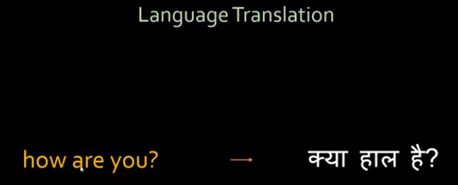
34.1 Many to Many RNN
https://www.youtube.com/watch?v=EzsXi4WzelI&list=PLeo1K3hjS3uu7CxAacxVndI4bE_o3BDtO&index=34
Many to Many RNN (0:54-1:07/3:42)
For language translation, we input the statement “how are you?”.
In this case, there are three input words and three output words.
The output words can be different.
how (kaise)
aap (you)
are (hain)

Slide 7
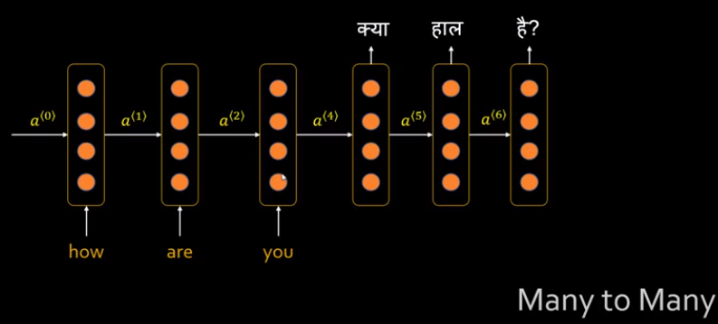
34.1 Many to Many RNN
https://www.youtube.com/watch?v=EzsXi4WzelI&list=PLeo1K3hjS3uu7CxAacxVndI4bE_o3BDtO&index=34
Many to Many RNN (1:08-1:30/3:42)
The architecture for translation can be expressed as below.
In the input layers of RNN, we have input words.
In the output layers of RNN, we have output predictions.
aap (you)
are (hain)
how (kaise)

Slide 8
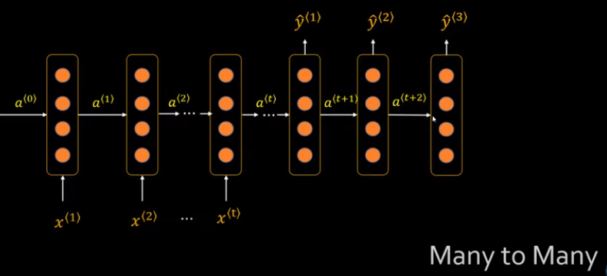
34.1 Many to Many RNN
https://www.youtube.com/watch?v=EzsXi4WzelI&list=PLeo1K3hjS3uu7CxAacxVndI4bE_o3BDtO&index=34
Many to Many RNN (1:39-1:48/3:42)
Below is the generic way to express the “Many to Many” RNN Notation.

Slide 9
34.2 Many to One RNN

Slide 10
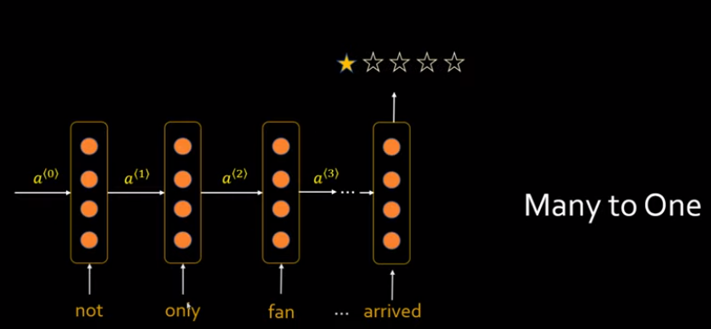
34.2 Many to One RNN
https://www.youtube.com/watch?v=EzsXi4WzelI&list=PLeo1K3hjS3uu7CxAacxVndI4bE_o3BDtO&index=34
Many to One RNN (2:08-2:50/3:42)
The Sentiment Analysis of RNN will be expressed “Many to One”.
We have many input words but we have only one output which is the grade (1/5 or 5/5) of product view.
The generic RNN of “Many to One” is as below.

Slide 11
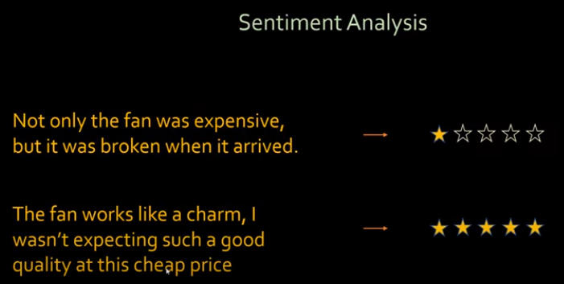
34.2 Many to One RNN
https://www.youtube.com/watch?v=EzsXi4WzelI&list=PLeo1K3hjS3uu7CxAacxVndI4bE_o3BDtO&index=34
Many to One RNN (1:49-2:00/3:42)
In sentiment analysis, the input is a paragraph and the output will be your review.
For example, these are grade (1/5 to 5/5) of product review.

Slide 12
34.3 One to Many RNN

Slide 13
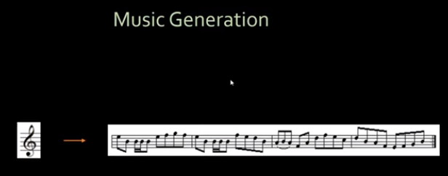
34.3 One to Many RNN
https://www.youtube.com/watch?v=EzsXi4WzelI&list=PLeo1K3hjS3uu7CxAacxVndI4bE_o3BDtO&index=34
One to Many RNN (2:08-2:50/3:42)
In the music generation, we can input a simple seed of music node, we can ask RNN to produce a music melody or a song.
You can also input a single word and ask RNN to produce a poetry (诗歌, collections of poem) or poem (詩, a piece of poetry).

Slide 14
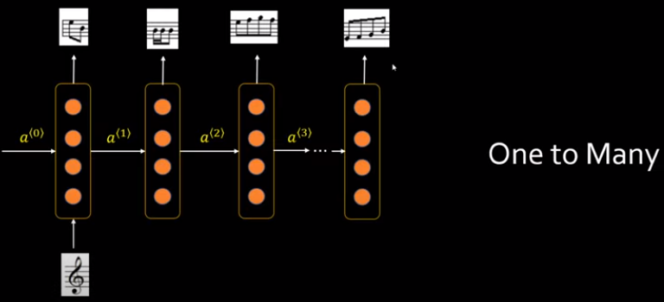
34.3 One to Many RNN
https://www.youtube.com/watch?v=EzsXi4WzelI&list=PLeo1K3hjS3uu7CxAacxVndI4bE_o3BDtO&index=34
One to Many RNN (2:51-3:30/3:42)
Below is the case of “One to Many”.
We have one input music node and output are collections of node.
We can have “none” as the input node and output are collections of node.

Slide 15
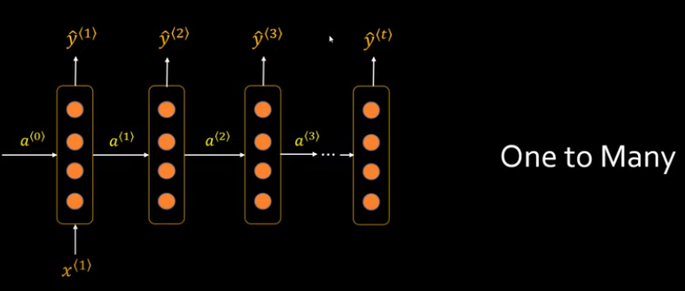
34.3 One to Many RNN
https://www.youtube.com/watch?v=EzsXi4WzelI&list=PLeo1K3hjS3uu7CxAacxVndI4bE_o3BDtO&index=34
One to Many RNN (2:51-3:30/3:42)
Below is the generic way of “One to Many” RNN.

Slide 16
End

