Slide 1

1 RAG URL GUI
Peter H. Chen

Slide 2
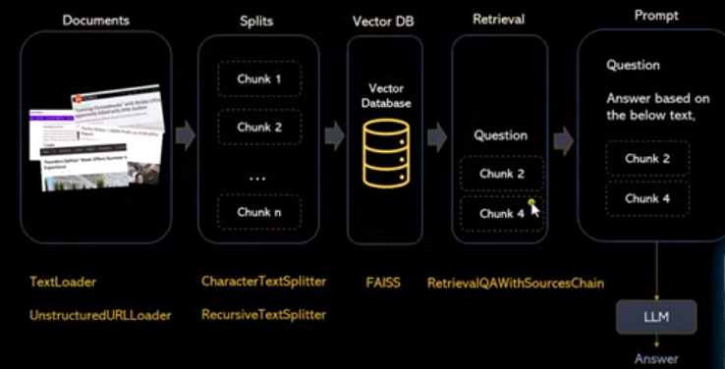
1 RAG URL GUI
https://www.youtube.com/watch?v=MoqgmWV1fm8&list=PLeo1K3hjS3uu0N_0W6giDXzZIcB07Ng_F&index=3
RAG GUI (56:49-57:10/1:14:33)
We discuss the implementation of RAG URL app with streamlit GUI.
We use LangChain, read URL, Text splitter, Gemini, Chromadb Embedding, FAISS, qa_chain.

Slide 3
1.01 Install Requirements

Slide 4
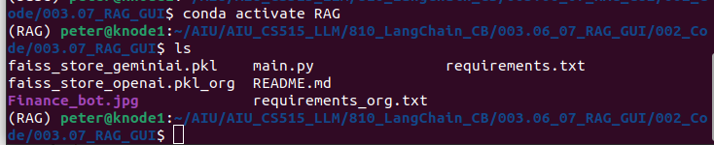
1.01 Install Requirements
https://www.youtube.com/watch?v=MoqgmWV1fm8&list=PLeo1K3hjS3uu0N_0W6giDXzZIcB07Ng_F&index=3
Install Requirements (57:15-57.20/1:14:33)
> conda create --name RAG
> conda activate RAG
> ls

Slide 5
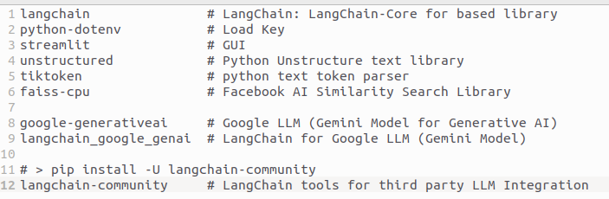
1.01 Install Requirements
https://www.youtube.com/watch?v=MoqgmWV1fm8&list=PLeo1K3hjS3uu0N_0W6giDXzZIcB07Ng_F&index=3
Install Requirements (57:21-57.30/1:14:33)
> pip install -r requirements.txt
Note: The langchain-community is installed after all the packages are installed.
https://medium.com/@akash.hiremath25/unlocking-the-power-of-intelligence-building-an-application-with-gemini-python-and-faiss-for-eb9a055d2429

Slide 6
1.02 Create API Key

Slide 7
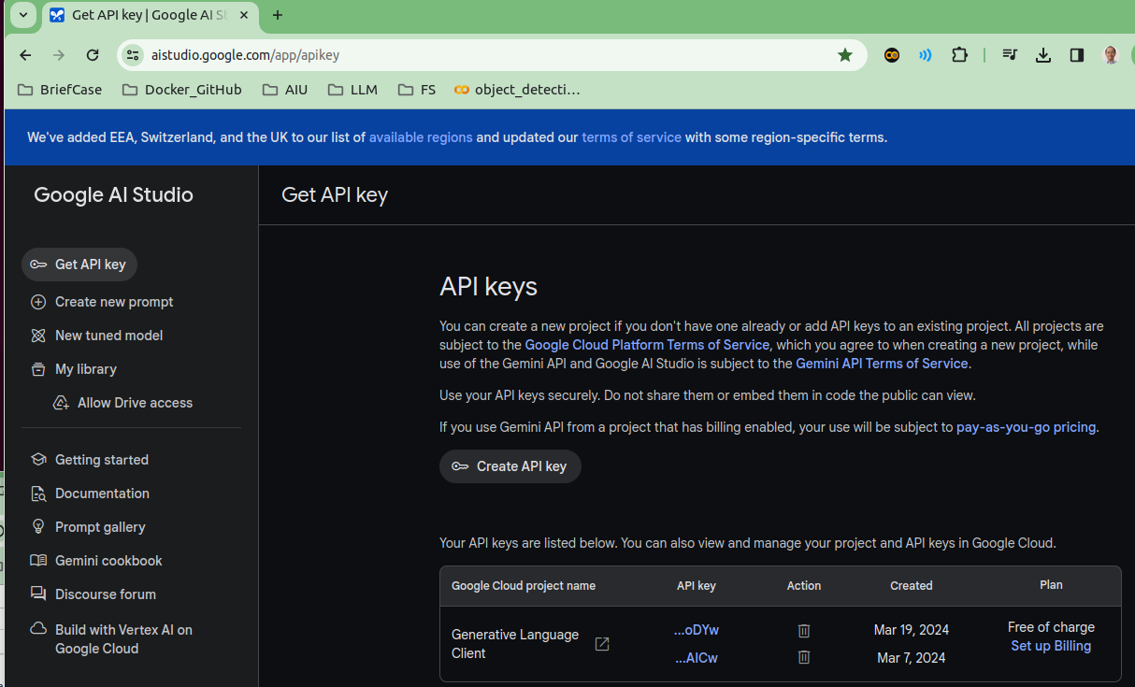
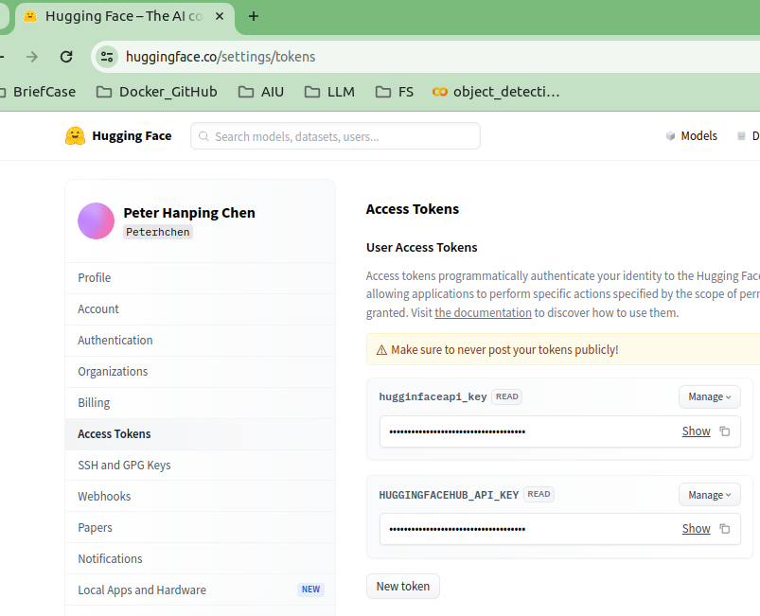

1.02 Create API Key
https://www.youtube.com/watch?v=MoqgmWV1fm8&list=PLeo1K3hjS3uu0N_0W6giDXzZIcB07Ng_F&index=3
Create API Key (57:31-57:40/1:14:33)
You create your own API Key and copy into “.env” file
1. Create Google API Key: https://aistudio.google.com/app/apikey
2. Create HF (HuggingFace) API Key if you need to Host your application on HuggingFace: https://huggingface.co/settings/tokens
Copy Google/HF API Key to “.env” file.
2
1
3

Slide 8
1.03 Import Library

Slide 9
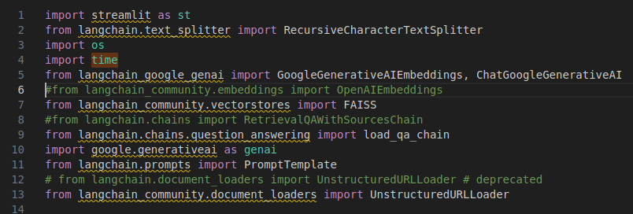
1.03 Import Library
https://www.youtube.com/watch?v=MoqgmWV1fm8&list=PLeo1K3hjS3uu0N_0W6giDXzZIcB07Ng_F&index=3
Import Library (57:47-58:10/1:14:33)
Create main.py.
Import the library.
Note:
1. google.generativeai as genai: Google Gemini Model Configuration with API Key.
2. ChatGoogleGenerativeAI: Create LLM Gemini Model with chat class.
3. GoogleGenerativeAIEmbeddings: Group similar semantic words to reduce dimension of word vectors (one-hot-encoding).
4. RetrievalQAWithSourcesChain: QA (Question and Answer) Chain with log (history).
5. FAISS (Facebook AI Similarity Search): Create structure for efficient search of embedding vectors.

Slide 10
1.04 Load API Key

Slide 11

1.04 Load API Key
https://www.youtube.com/watch?v=MoqgmWV1fm8&list=PLeo1K3hjS3uu0N_0W6giDXzZIcB07Ng_F&index=3
Load API Key (58:11-58:30/1:14:33)
In Jupyter Notebook, we use ‘os.environ’ for API Key.
In Python App, we use “load_dotenv()” to load all key defined in the “.env” file.
We configure the Google Gemini Model (genai) with Google API Key.

Slide 12
1.05 Load API Key

Slide 13
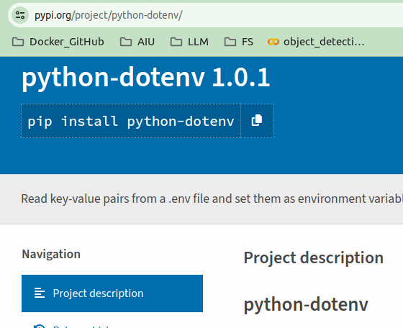
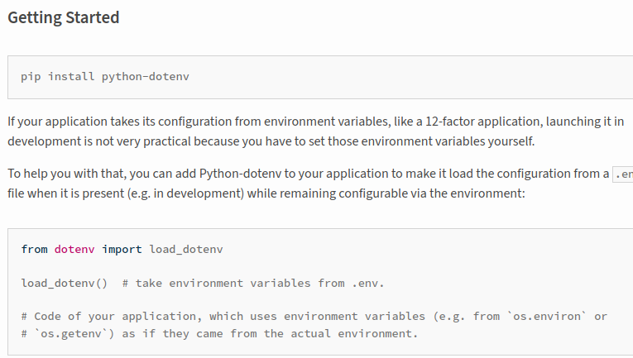
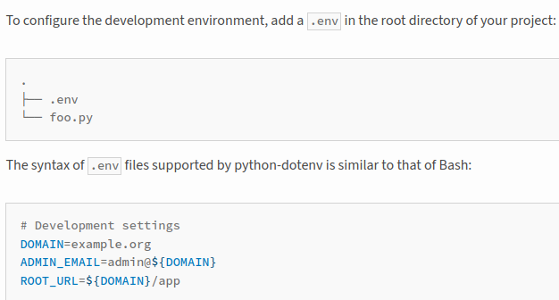
1.04 Load API Key
1
https://www.youtube.com/watch?v=MoqgmWV1fm8&list=PLeo1K3hjS3uu0N_0W6giDXzZIcB07Ng_F&index=3
Load API Key (58:11-58:20/1:14:33)
1. We install the python-dotenv:
> pip install python-dotenv
2. import load_env():
> from dotenv import load_dotenv()
3. We define the API Key in the “.env” file.
https://pypi.org/project/python-dotenv/
2
3

Slide 14
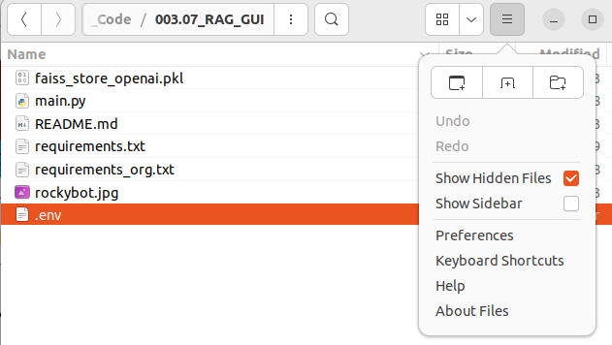

1.04 Load API Key
https://www.youtube.com/watch?v=MoqgmWV1fm8&list=PLeo1K3hjS3uu0N_0W6giDXzZIcB07Ng_F&index=3
Load API Key (58:21-59:10/1:14:33)
In Jupyter Notebook, we use ‘os.environ()’ for API Key.
1. In Python App, we use a better way “load_dotenv()” to load all key defined in the “.env” file. Using this way, we can hide the API Key in the “.env” file by using the following two lines. API Key is not visible in the code. This is a standard and cleaner way that industrial people are using nowadays.
2. We click on “Show Hidden Files” to see the hidden file “.env” file.
3. Here, we define the API Key in the “.env” file.
1
2
3

Slide 15
1.05 Get URLs from GUI

Slide 16
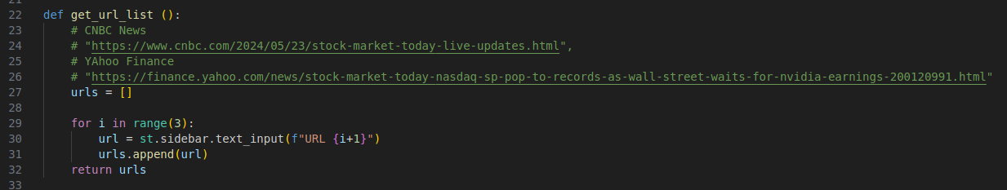
1.05 Get URLs from GUI
https://www.youtube.com/watch?v=MoqgmWV1fm8&list=PLeo1K3hjS3uu0N_0W6giDXzZIcB07Ng_F&index=3
Get URLs from GUI (08:31-09:30/1:14:33)
Get the URL List from GUI input.

Slide 17
1.06 Extract Text from URL List

Slide 18

1.06 Extract Text from URL List
https://www.youtube.com/watch?v=MoqgmWV1fm8&list=PLeo1K3hjS3uu0N_0W6giDXzZIcB07Ng_F&index=3
Extract Text from URL List (08:31-09:30/1:14:33)
URL Reader: Get texts from URL List.

Slide 19
1.07 Split Text into Chunks

Slide 20
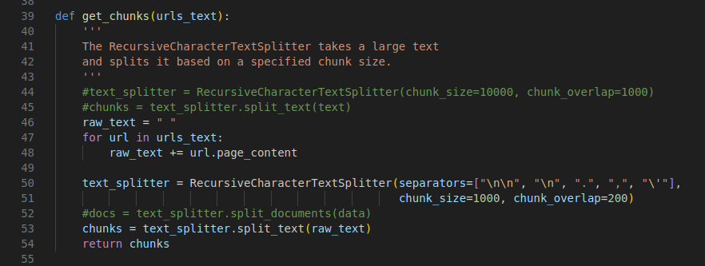
1.07 Split Text into Chunks
https://www.youtube.com/watch?v=MoqgmWV1fm8&list=PLeo1K3hjS3uu0N_0W6giDXzZIcB07Ng_F&index=3
Split Text into Chunks (08:31-09:30/1:14:33)
Gemini cannot process very huge text.
We split into several chunks and ask quesiton one chunk by another chunk.
Each chunk size is 10000 characters and chunk overlap is 1000.

Slide 21
1.08 Vector Database

Slide 22
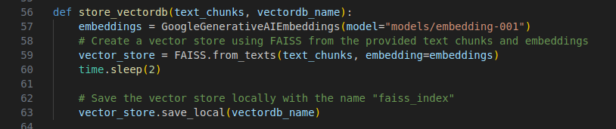
1.08 Vector Database
https://www.youtube.com/watch?v=MoqgmWV1fm8&list=PLeo1K3hjS3uu0N_0W6giDXzZIcB07Ng_F&index=3
Vector Database (08:31-09:30/1:14:33)
1. Embedding: We use Google Chromadb to create Group Semantic with dimension reduction.
2. Create one-hot-encoding vector.
3. Store FAISS File.

Slide 23
1.09 Question and Answer Chain

Slide 24
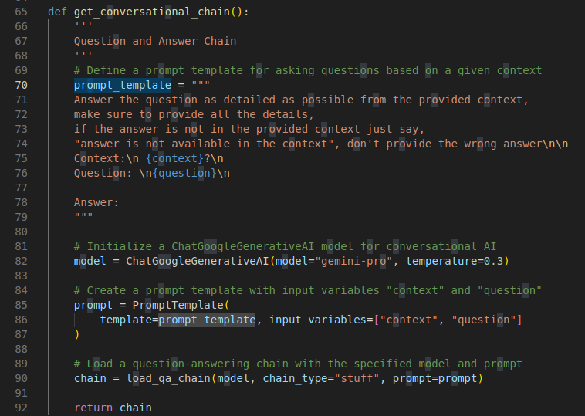
1.09 Question and Answer Chain
https://www.youtube.com/watch?v=MoqgmWV1fm8&list=PLeo1K3hjS3uu0N_0W6giDXzZIcB07Ng_F&index=3
Question and Answer Chain (08:31-09:30/1:14:33)
1. Individual Question and Answer
2. Merge individual Question and Answer into Final Answer.

Slide 25
1.10 Get User Input

Slide 26
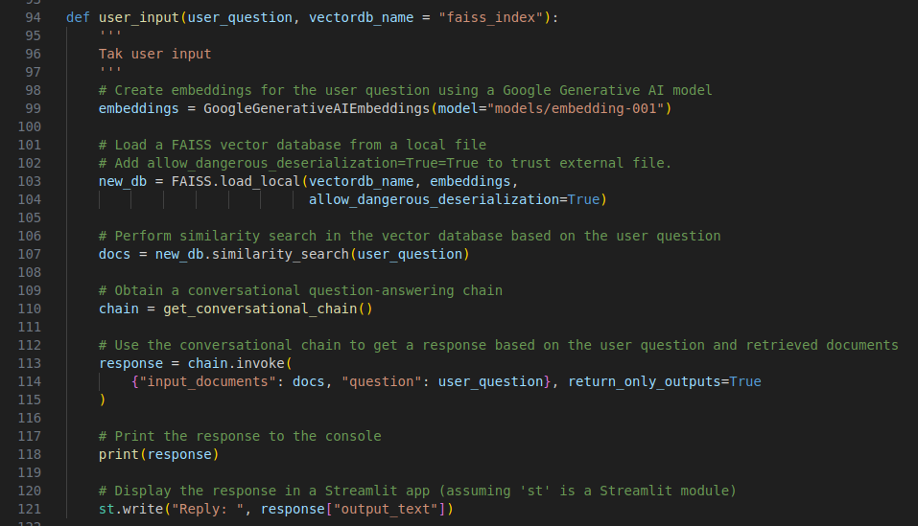
1.10 Get User Input
https://www.youtube.com/watch?v=MoqgmWV1fm8&list=PLeo1K3hjS3uu0N_0W6giDXzZIcB07Ng_F&index=3
Get User Input (08:31-09:30/1:14:33)
1. Get PDF into texts
2. Text Split: Text split into tokens.
3. Store Vector Database
4. Get Q&A (Question and Answer) Chain: Chain will perform individual Q&A and merger for final Q&A for final LLM.
5. Get User input and prompt for Q&A Chain.

Slide 27
1.11 GUI

Slide 28
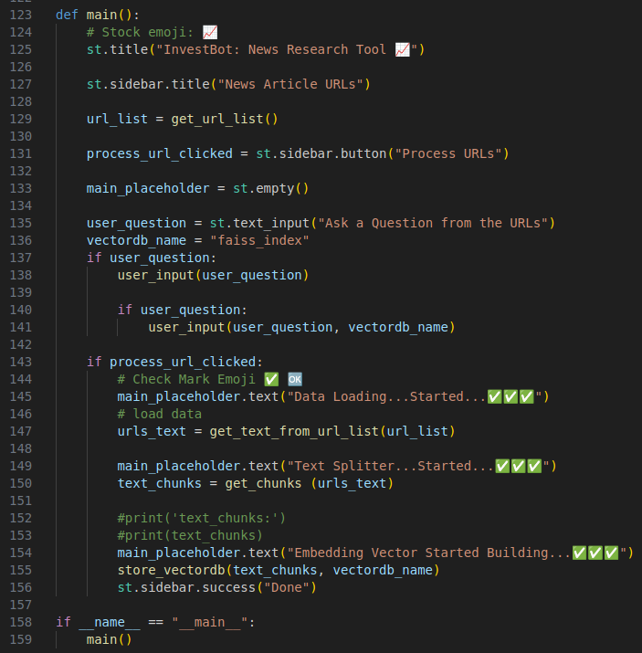
1.11 GUI
https://www.youtube.com/watch?v=MoqgmWV1fm8&list=PLeo1K3hjS3uu0N_0W6giDXzZIcB07Ng_F&index=3
GUI (08:31-09:30/1:14:33)

Slide 29
1.12 Verify Test

Slide 30
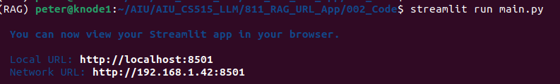
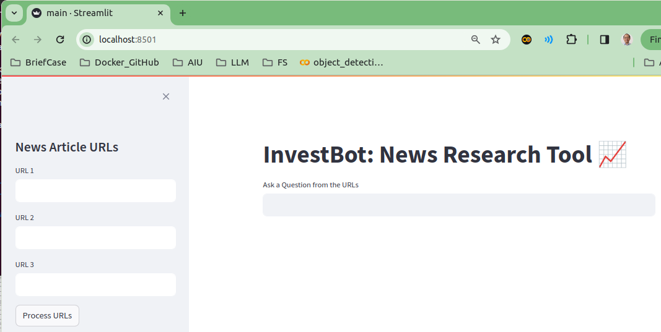
1.12 Verify Test
https://www.youtube.com/watch?v=MoqgmWV1fm8&list=PLeo1K3hjS3uu0N_0W6giDXzZIcB07Ng_F&index=3
Verify Test (08:31-09:30/1:14:33)
1. Start main.py
> streamlit run main.py
2. Check individual chunk Q&A and Final LLM Q&A

Slide 31
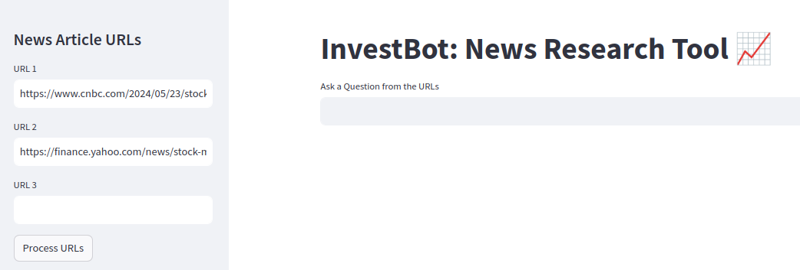
1.12 Verify Test
https://www.youtube.com/watch?v=MoqgmWV1fm8&list=PLeo1K3hjS3uu0N_0W6giDXzZIcB07Ng_F&index=3
Verify Test (08:31-09:30/1:14:33)
Copy and paste urls (web sites):
1. https://www.cnbc.com/2024/05/23/stock-market-today-live-updates.html
2. https://finance.yahoo.com/news/stock-market-today-nasdaq-sp-pop-to-records-as-wall-street-waits-for-nvidia-earnings-200120991.html

Slide 32
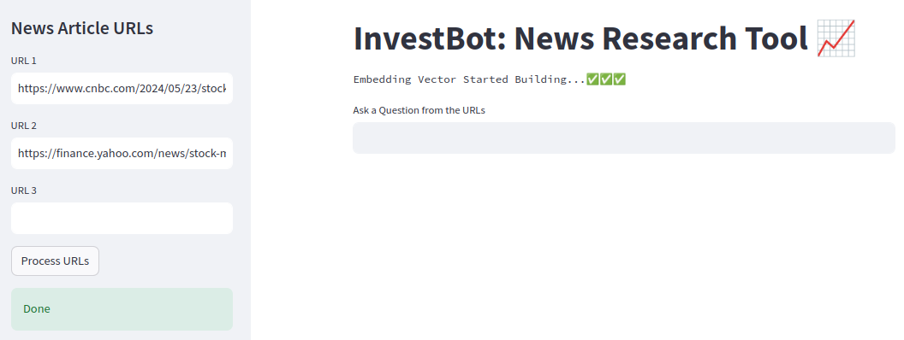
1.12 Verify Test
https://www.youtube.com/watch?v=MoqgmWV1fm8&list=PLeo1K3hjS3uu0N_0W6giDXzZIcB07Ng_F&index=3
Verify Test (08:31-09:30/1:14:33)
Click button “Process URLs”

Slide 33
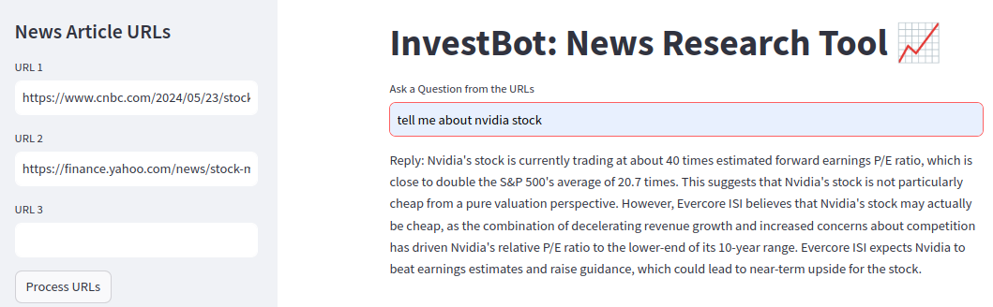
1.12 Verify Test
https://www.youtube.com/watch?v=MoqgmWV1fm8&list=PLeo1K3hjS3uu0N_0W6giDXzZIcB07Ng_F&index=3
Verify Test (08:31-09:30/1:14:33)
> tell me nvidia stock
Type <Enter> to process

Slide 34
End

