Slide 1

3 Investment Chatbot
Peter H. Chen

Slide 2
3 Investment Chatbot
https://www.youtube.com/watch?v=MoqgmWV1fm8&list=PLeo1K3hjS3uu0N_0W6giDXzZIcB07Ng_F&index=3
Investment Chatbot (00:00-00:10/1:14:33)
We are going to create a Investment Chatbot to answer the user query about the investment.
This Investment Chatbot integrate vector database which we converted from unstructured documents/data (such as, URLs, Pdf, texts, or excel) with LLM Gemini Model.
We will use LangChain to integrate LLM (free Gemini-1.3 Model/GPT-4o) and private database for Fiance Projects.

Slide 3
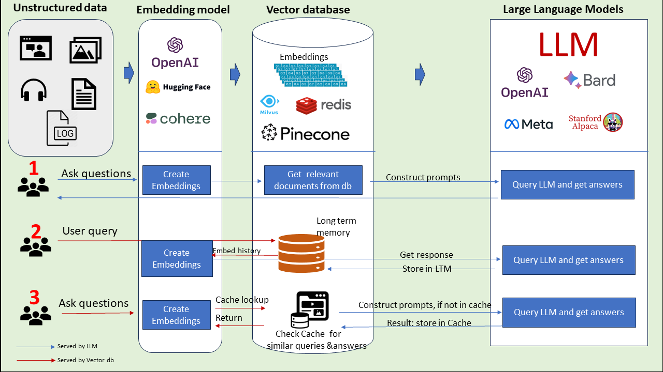
3 Investment Chatbot
https://www.youtube.com/watch?v=MoqgmWV1fm8&list=PLeo1K3hjS3uu0N_0W6giDXzZIcB07Ng_F&index=3
Investment Chatbot (00:11-00:20/1:14:33)
Unstructured Data Embedding: LangChain provides the document reader which read in documents (excel, raw texts, pdf, etc) unstructured data and transform into vector database. The vector database is used for queries.
https://www.datacamp.com/blog/the-top-5-vector-databases

Slide 4
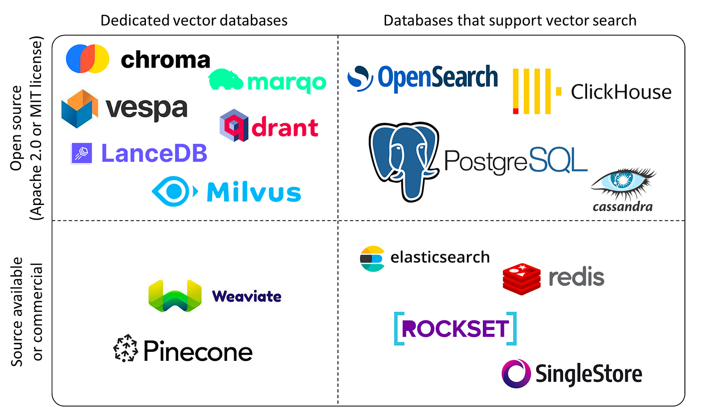
3 Investment Chatbot
https://www.youtube.com/watch?v=MoqgmWV1fm8&list=PLeo1K3hjS3uu0N_0W6giDXzZIcB07Ng_F&index=3
Investment Chatbot (00:21-01:20/1:14:33)
There are Open Source and Commercial Vector Database: Chroma, Pinecone, etc.
https://www.datacamp.com/blog/the-top-5-vector-databases

Slide 5
3.1 Specification and Architecture

Slide 6
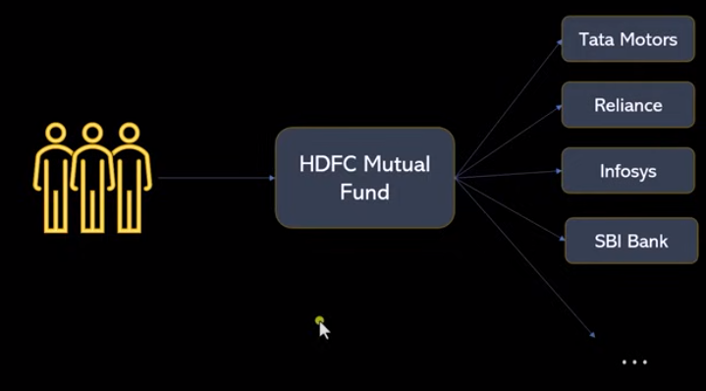
3.1 Specification and Architecture
https://www.youtube.com/watch?v=MoqgmWV1fm8&list=PLeo1K3hjS3uu0N_0W6giDXzZIcB07Ng_F&index=3
Specification and Architecture (1:24-01:40/1:14:33)
Below, three people invest the HDFC (Housing Development Finance Corporation) Mutual Fund.

Slide 7
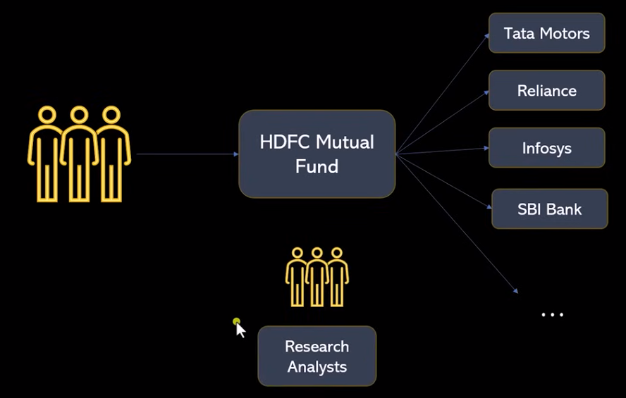
3.1 Specification and Architecture
https://www.youtube.com/watch?v=MoqgmWV1fm8&list=PLeo1K3hjS3uu0N_0W6giDXzZIcB07Ng_F&index=3
Specification and Architecture (1:41-02:00/1:14:33)
HDFC have three more researchers.
These three researchers in the HDFC company.
The job of researchers is to do the research analysis on the company and invest money to stocks, such as, Tata Motors, Reliance (India Energy Company), Infosys (Indian Business Consulting Company), SBI (State Bank of India) Bank, and etc.
How of these companies will be profit next year? How are these companies management? Are those companies good stock to buy?

Slide 8
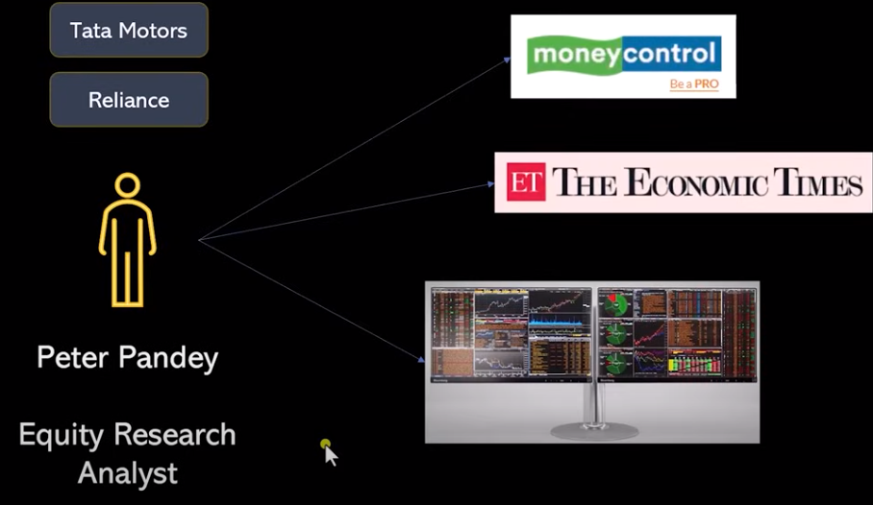
3.1 Specification and Architecture
https://www.youtube.com/watch?v=MoqgmWV1fm8&list=PLeo1K3hjS3uu0N_0W6giDXzZIcB07Ng_F&index=3
Specification and Architecture (02:01-02:40/1:14:33)
In the HDFC research team, Peter Pandey, analyze the information based on stocks, quarter report, money control, economic times, and etc.
His job is to do the research on these stock. He read a lot of magazine, economic times, Bloomberg earning quarterly reports.

Slide 9
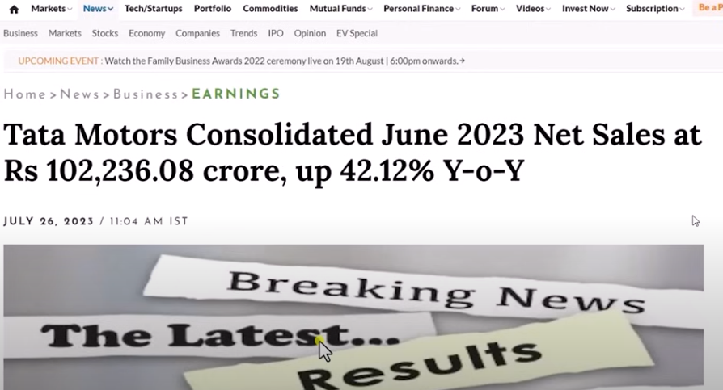
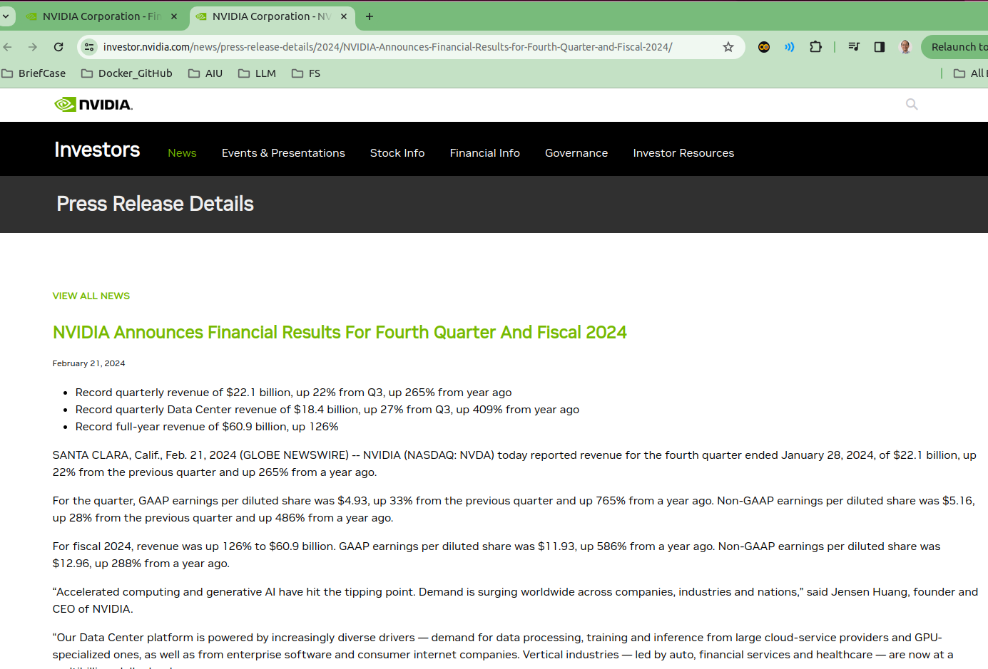
3.1 Specification and Architecture
https://www.youtube.com/watch?v=MoqgmWV1fm8&list=PLeo1K3hjS3uu0N_0W6giDXzZIcB07Ng_F&index=3
Specification and Architecture (02:41-02:50/1:14:33)
Now, we can understand reading the articles from various website is really tedious.

Slide 10
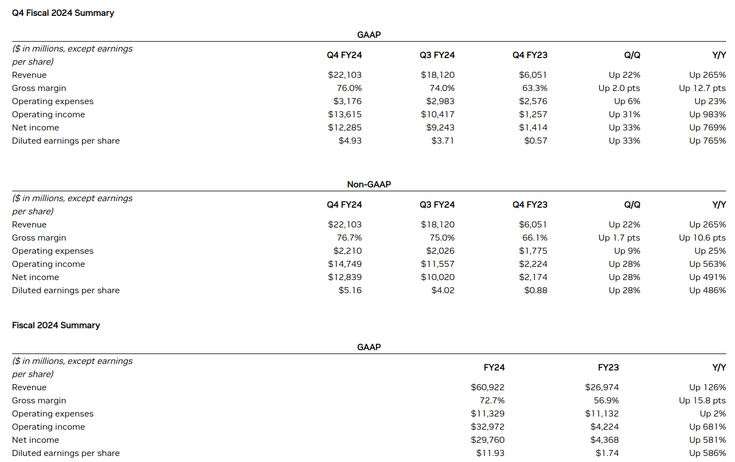
3.1 Specification and Architecture
https://www.youtube.com/watch?v=MoqgmWV1fm8&list=PLeo1K3hjS3uu0N_0W6giDXzZIcB07Ng_F&index=3
Specification and Architecture (02:51-02:55/1:14:33)
There are equity, revenue, dividend, Gross margins, etc.

Slide 11
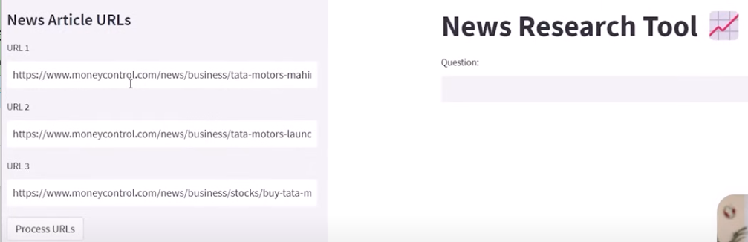
3.1 Specification and Architecture
https://www.youtube.com/watch?v=MoqgmWV1fm8&list=PLeo1K3hjS3uu0N_0W6giDXzZIcB07Ng_F&index=3
Specification and Architecture (02:56-03:00/1:14:33)
Why don’t we build a tool to look at these information?
1. You can put a bunch of “News Article URLs” on the left hand side.
2. When you ask a question on the right hand side and search
3. You can know the answer.

Slide 12
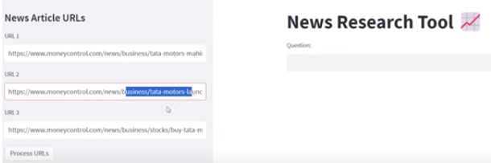
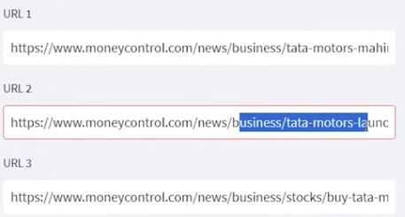
3.1 Specification and Architecture
https://www.youtube.com/watch?v=MoqgmWV1fm8&list=PLeo1K3hjS3uu0N_0W6giDXzZIcB07Ng_F&index=3
Specification and Architecture (03:01-03:10/1:14:33)
We will build end-to-end (From start to finish) LLM Project for finance research and investment.
Below is example:
URL1: https:///www.moneycontrol.com/news/business/tata-motors-machine
URL2: https:///www.moneycontrol.com/news/business/tata-motors-lanuch
URL3: https:///www.moneycontrol.com/news/business/stocks/buy-tata-motors

Slide 13
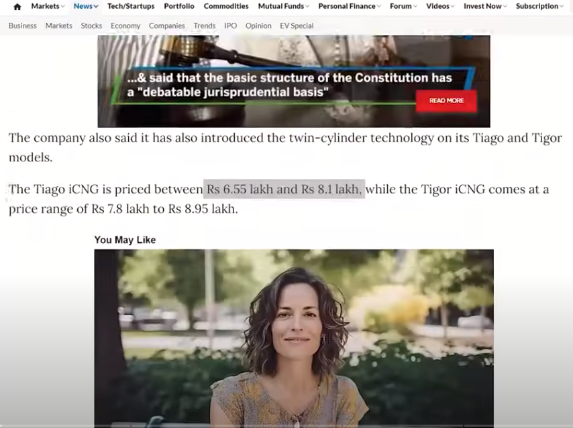
3.1 Specification and Architecture
https://www.youtube.com/watch?v=MoqgmWV1fm8&list=PLeo1K3hjS3uu0N_0W6giDXzZIcB07Ng_F&index=3
Specification and Architecture (03:11-03:30/1:14:33)
We can view the content of article.

Slide 14
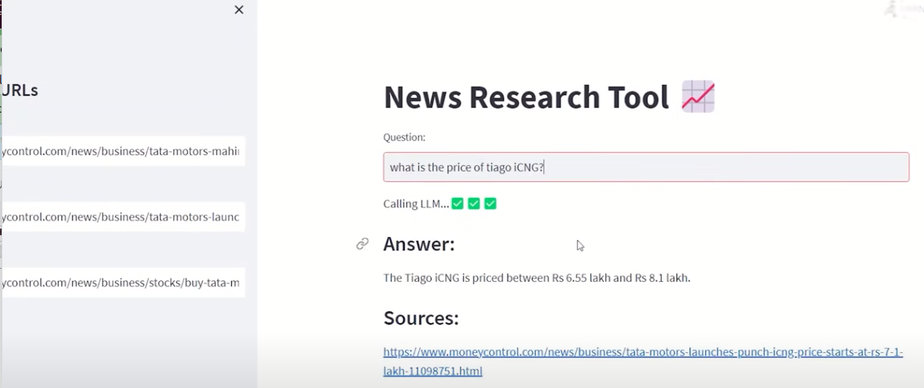
3.1 Specification and Architecture
https://www.youtube.com/watch?v=MoqgmWV1fm8&list=PLeo1K3hjS3uu0N_0W6giDXzZIcB07Ng_F&index=3
Specification and Architecture (03:31-04:00/1:14:33)
Then, we can get the answers from the articles we read.
The investment chatbot will summarize answers based on the news.
Question: “What is the price of tiago.iCNG?”
1. “Tiago” is the car model made by India company Tata Motor.
2. iCNG: Innovative Compressed Natural Gas
Answer: “The Tiago.iCNG is priced between Rs 6.55 lakh and Rs 8.1 lakh”
1. lakh or lac: Indian number system = 100,000 (1.E+5)
2. Rs: Indian currency Rupees

Slide 15

3.1 Specification and Architecture
https://www.youtube.com/watch?v=MoqgmWV1fm8&list=PLeo1K3hjS3uu0N_0W6giDXzZIcB07Ng_F&index=3
Specification and Architecture (04:01-04:10/1:14:33)
How to build the Technical Architecture for Investment Chatbot?
What tools are required?

Slide 16
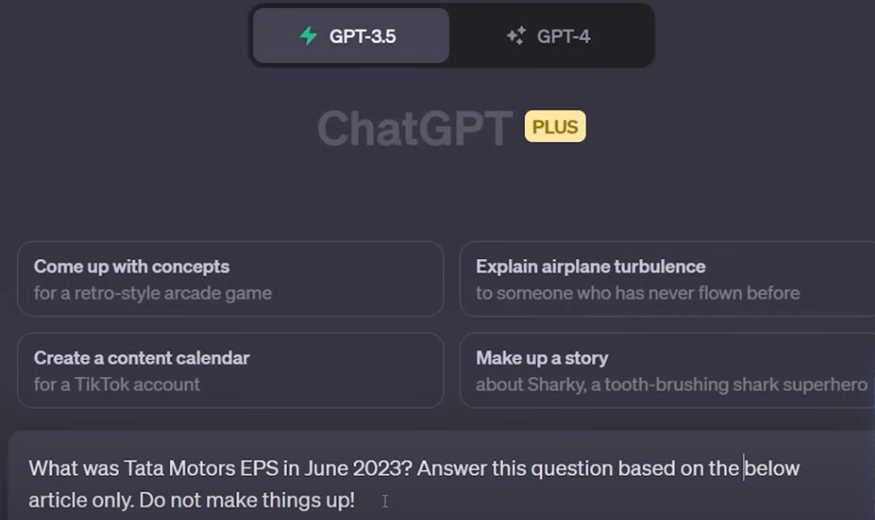
3.1 Specification and Architecture
https://www.youtube.com/watch?v=MoqgmWV1fm8&list=PLeo1K3hjS3uu0N_0W6giDXzZIcB07Ng_F&index=3
Specification and Architecture (04:11-04:30/1:14:33)
Below is the chatGPT example.
Can we use chatGPT because chatGPT is free.
Yes. We can use chatGPT to ask question.
We can type question in chatGPT.

Slide 17
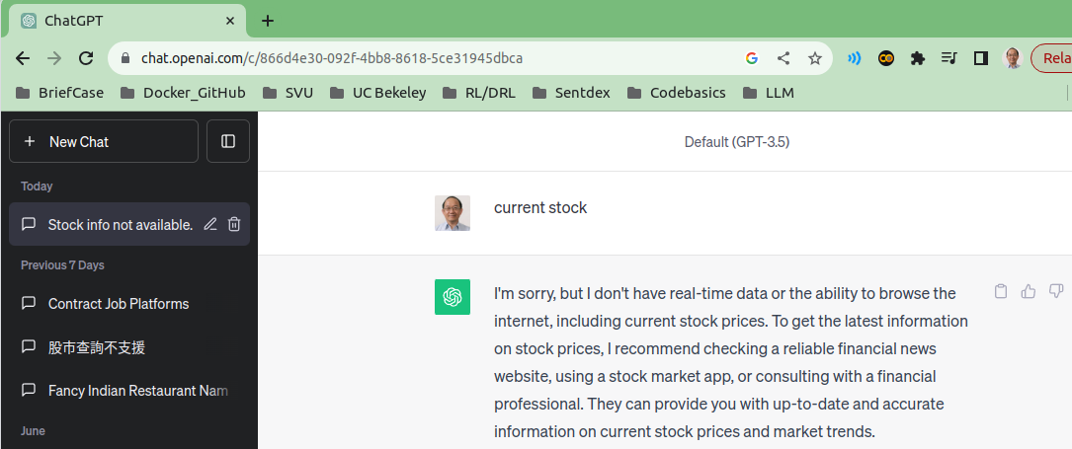
3.1 Specification and Architecture
https://www.youtube.com/watch?v=MoqgmWV1fm8&list=PLeo1K3hjS3uu0N_0W6giDXzZIcB07Ng_F&index=3
Specification and Architecture (04:33-04:50/1:14:33)
Because ChatGPT is built before November 30, 2023.
ChatGPT does not provide the real-time stock information.
Below, we ask the current NVIDIA stock information.
ChatGPT will answer “I am sorry. I do not know current stock market….”
Why don’t we create Investment Chatbot?

Slide 18
3.1 Specification and Architecture
https://www.youtube.com/watch?v=MoqgmWV1fm8&list=PLeo1K3hjS3uu0N_0W6giDXzZIcB07Ng_F&index=3
Specification and Architecture (04:51-05:00/1:14:33)
We copy/paste the article from web site to Gemini chatbot or ChatGPT is tedious.
Issue # 1:
Copy-Pasting Articles in Gemini chatbot or ChatGPT is Tedious

Slide 19
3.1 Specification and Architecture
https://www.youtube.com/watch?v=MoqgmWV1fm8&list=PLeo1K3hjS3uu0N_0W6giDXzZIcB07Ng_F&index=3
Specification and Architecture (05:01-05:30/1:14:33)
We also need to aggregate the knowledge base from different sources and then summaries the knowledge.
If they do not have the knowledge, they cannot answer the question correctly.
They may have the NVIDIA revenue in the previously years before the Gemini or GPT are built but they don’t have current real-time information.
Issue # 2:
We Also need to Aggregate Knowledge Base from Different Sources and Summarize the Knowledge

Slide 20
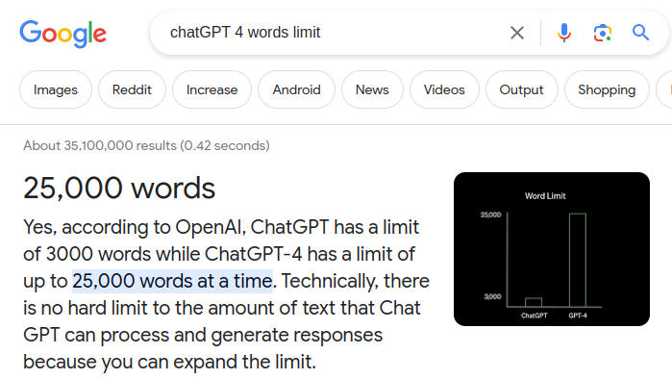
3.1 Specification and Architecture
https://www.youtube.com/watch?v=MoqgmWV1fm8&list=PLeo1K3hjS3uu0N_0W6giDXzZIcB07Ng_F&index=3
Specification and Architecture (05:31-05:40/1:14:33)
Third issue is ChatGPT-3 has 3000 words limit and
ChatGPT-4 has 25,000 words.
Technically, there is no hard limit but there is some restriction.
Issue # 3:
Gemini and GPT have Word Limitation

Slide 21
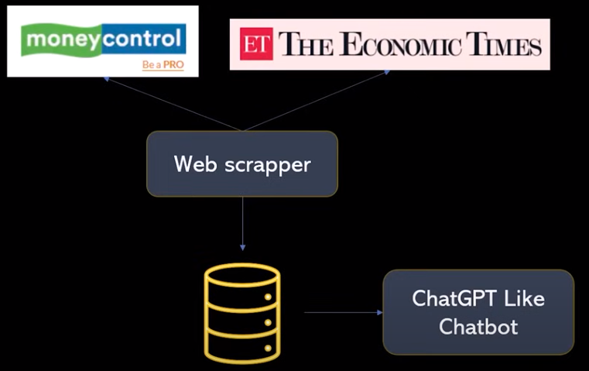
3.1 Specification and Architecture
https://www.youtube.com/watch?v=MoqgmWV1fm8&list=PLeo1K3hjS3uu0N_0W6giDXzZIcB07Ng_F&index=3
Specification and Architecture (05:49-06:10/1:14:33)
We need to build real-time Chatbot which is similar to chatGPT.
We can search for news website and get the information and build the the knowledge base.

Slide 22
End

