Slide 1

3.3 LangChain Document Reader
Peter H. Chen

Slide 2
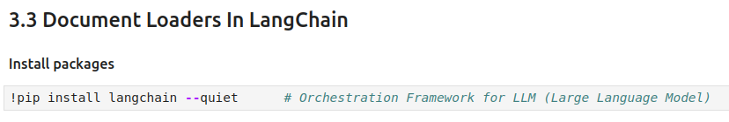
3.3 Text Loader
https://www.youtube.com/watch?v=MoqgmWV1fm8&list=PLeo1K3hjS3uu0N_0W6giDXzZIcB07Ng_F&index=3
Text Loader (13:51-14:00/1:14:33)
Install the LangChain Package

Slide 3
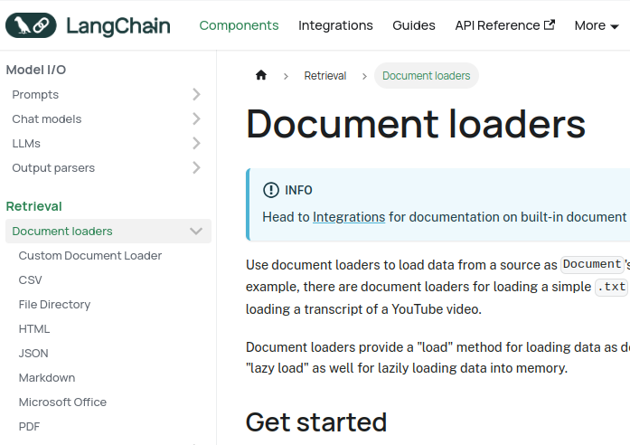
3.3 LangChain Document Loader
https://www.youtube.com/watch?v=MoqgmWV1fm8&list=PLeo1K3hjS3uu0N_0W6giDXzZIcB07Ng_F&index=3
LangChain Document Loader (13:41-13:42/1:14:33)
Google Search “LangChain Document Loader”
LangChain Document Loader reads the below formats:
1. Text Loader (Custom Document Reader),
2. CSV,
3. File Directory,
4. HTML,
5. JASON,
6. Markdown,
7. Microsoft Office,
8. PDF
We start from the “1. Text Loader”.
https://python.langchain.com/v0.1/docs/modules/data_connection/document_loaders/custom/

Slide 4
3.3.1 LangChain: Text Loader

Slide 5

3.3.1 Text Loader
https://www.youtube.com/watch?v=MoqgmWV1fm8&list=PLeo1K3hjS3uu0N_0W6giDXzZIcB07Ng_F&index=3
Text Loader (13:43-13:50/1:14:33)
We already discussed the basics of LangChain Orchestration Framework for application development using LLM (Large Language Model).
Now, we discussed the Text Loaders.

Slide 6
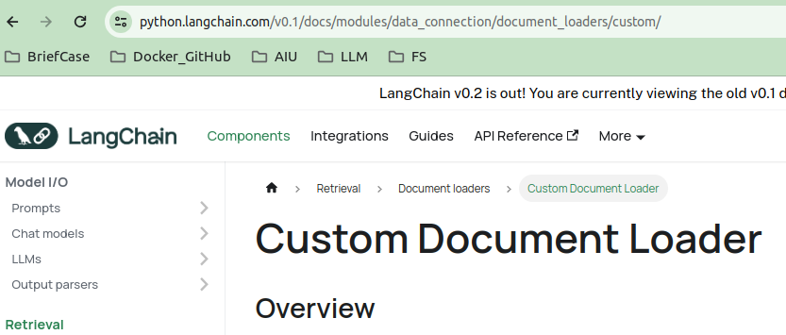
3.3 Text Loader
https://www.youtube.com/watch?v=MoqgmWV1fm8&list=PLeo1K3hjS3uu0N_0W6giDXzZIcB07Ng_F&index=3
Text Loader (13:51-14:00/1:14:33)
In LangChain, “Text Loader” is also called “Custom Document Loader”.
https://python.langchain.com/v0.1/docs/modules/data_connection/document_loaders/custom/

Slide 7
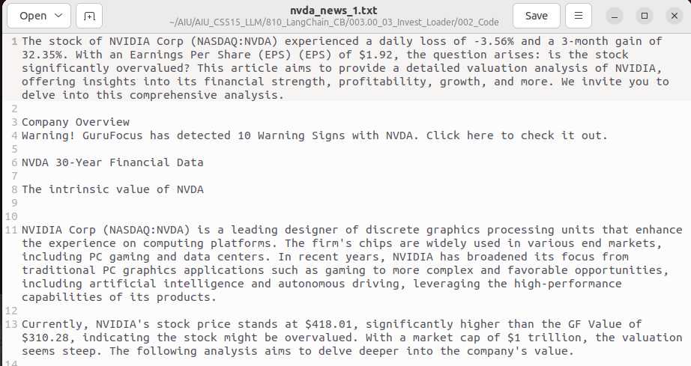
3.3 Text Loader
https://www.youtube.com/watch?v=MoqgmWV1fm8&list=PLeo1K3hjS3uu0N_0W6giDXzZIcB07Ng_F&index=3
Text Loader (14:01-14:10/1:14:33)
nvda_news_1.txt: text file from NVIDIA new for testing.

Slide 8
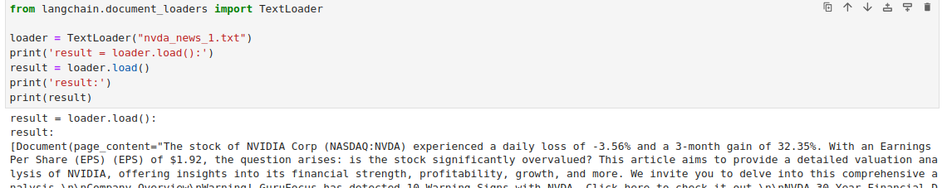
3.3 Text Loader
https://www.youtube.com/watch?v=MoqgmWV1fm8&list=PLeo1K3hjS3uu0N_0W6giDXzZIcB07Ng_F&index=3
Text Loader (14:11-15:00/1:14:33)
We want to know TextLoader():
> loader = TextLoader (“nvda_news_1.txt”)
> result = loader.load() # dump to result.
> print(result)
we can see there are
1. page_content: content of text file and
2. metadata: file name

Slide 9
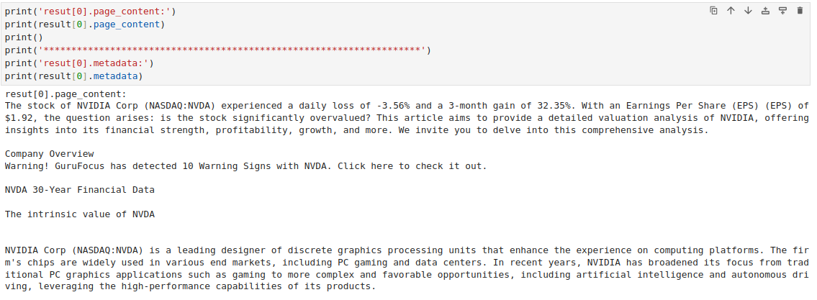

3.3 Text Loader
https://www.youtube.com/watch?v=MoqgmWV1fm8&list=PLeo1K3hjS3uu0N_0W6giDXzZIcB07Ng_F&index=3
Text Loader (15:01-16:00/1:14:33)
The Text Loader parse the result into two attributes:
1. page_content: text content
2. metadata: file name “nvda_news_1.txt”.

Slide 10
3.3.2 CSV Loader

Slide 11
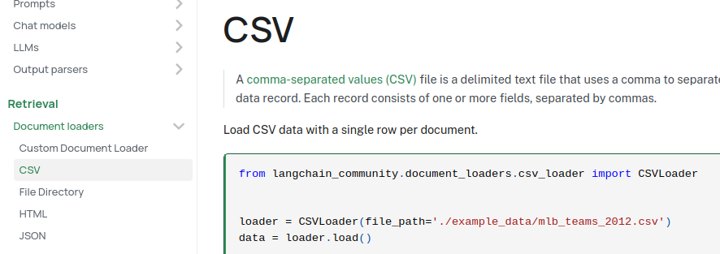
3.3.2 CSV Loader
https://www.youtube.com/watch?v=MoqgmWV1fm8&list=PLeo1K3hjS3uu0N_0W6giDXzZIcB07Ng_F&index=3
CSV Loader (16:01-16:02/1:14:33)
Next, we look at the CSV Loader.
https://python.langchain.com/v0.1/docs/modules/data_connection/document_loaders/csv/

Slide 12
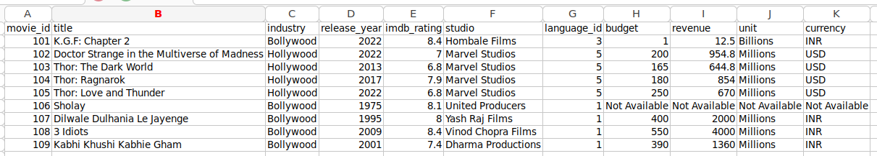
3.3.2 CSV Loader
https://www.youtube.com/watch?v=MoqgmWV1fm8&list=PLeo1K3hjS3uu0N_0W6giDXzZIcB07Ng_F&index=3
CSV Loader (16:03-17:00/1:14:33)
Check content of “movies.csv”.
1. movie_id,
2. title,
3. industry: Bollywood, Hollywood
4. release year,
5. imdb_rating (Internet Movie Database Rating)
6. studio: Hombale, Marvel
7. language ID:
8. budget:
9. Revenue:
10. Unit: Million, billion
11. currency: INR (India Rupee, 1 USD= 83.30 India Rupee), USD
https://python.langchain.com/v0.1/docs/modules/data_connection/document_loaders/csv/

Slide 13
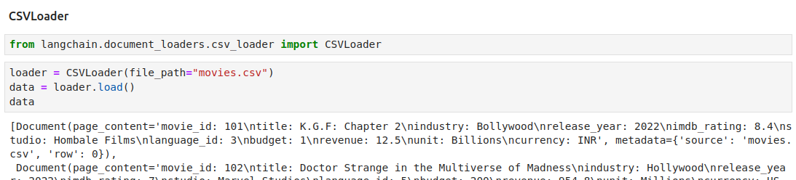
3.3.2 CSV Loader
https://www.youtube.com/watch?v=MoqgmWV1fm8&list=PLeo1K3hjS3uu0N_0W6giDXzZIcB07Ng_F&index=3
CSV Loader (17:01-17:30/1:14:33)
We read in CSV file “movies.csv”.
We can see LangChain parse into attributes:
1. page_content: text content
2. metadata: file name “movies/csv”
https://python.langchain.com/v0.1/docs/modules/data_connection/document_loaders/csv/

Slide 14
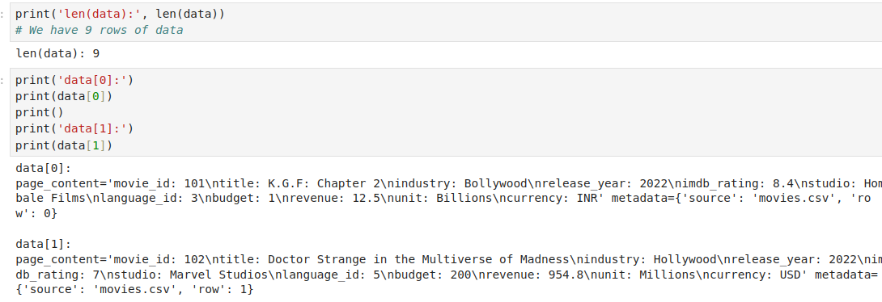
3.3.2 CSV Loader
https://www.youtube.com/watch?v=MoqgmWV1fm8&list=PLeo1K3hjS3uu0N_0W6giDXzZIcB07Ng_F&index=3
CSV Loader (17:31-18:00/1:14:33)
We have 9 rows of data.
https://python.langchain.com/v0.1/docs/modules/data_connection/document_loaders/csv/

Slide 15
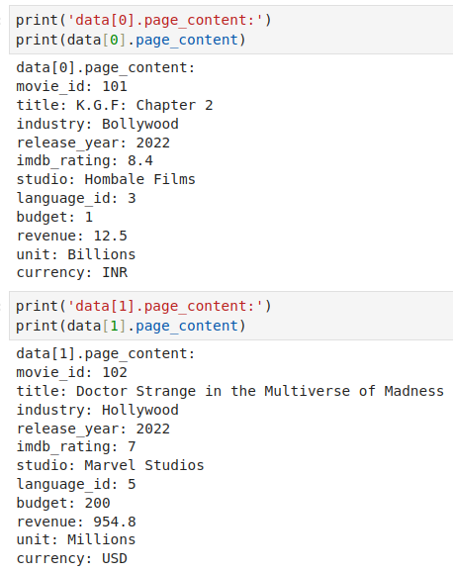
3.3.2 CSV Loader
https://www.youtube.com/watch?v=MoqgmWV1fm8&list=PLeo1K3hjS3uu0N_0W6giDXzZIcB07Ng_F&index=3
CSV Loader (18:01-18:10/1:14:33)
Print the page_content
https://python.langchain.com/v0.1/docs/modules/data_connection/document_loaders/csv/

Slide 16
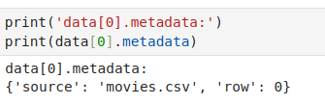
3.3.2 CSV Loader
https://www.youtube.com/watch?v=MoqgmWV1fm8&list=PLeo1K3hjS3uu0N_0W6giDXzZIcB07Ng_F&index=3
CSV Loader (18:11-18:50/1:14:33)
Here, we have the file name in metadata (後設資料). We will other information, such as, the reference (source) link in the meta data.
What is Metadata?
Metadata can include information, such as:
1. How the data was created
2. When the data was created
3. Why the data was created
4. Who created the data
5. Where the data was created
6. How big the data is
7. The title
8. The author name
9.The subject
10. Keywords
https://python.langchain.com/v0.1/docs/modules/data_connection/document_loaders/csv/

Slide 17
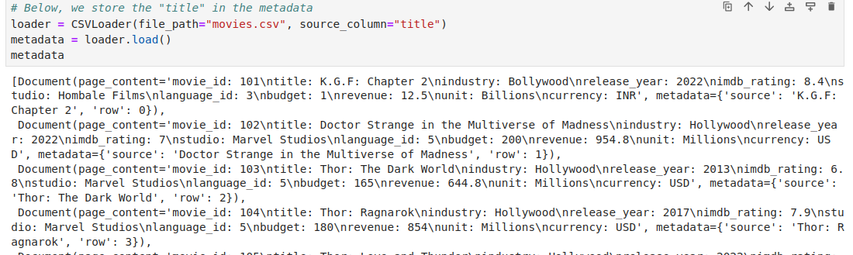
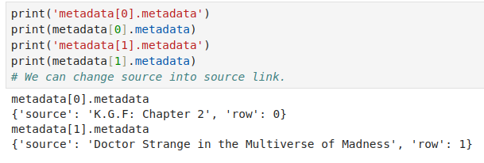
3.3.2 CSV Loader
https://www.youtube.com/watch?v=MoqgmWV1fm8&list=PLeo1K3hjS3uu0N_0W6giDXzZIcB07Ng_F&index=3
CSV Loader (18:51-19:10/1:14:33)
Here, we store the [“title”] in the metadata.
We can store the source link in csv and put in the metadata.
https://python.langchain.com/v0.1/docs/modules/data_connection/document_loaders/csv/

Slide 18
3.3.3 Unstructured HTML Loader

Slide 19
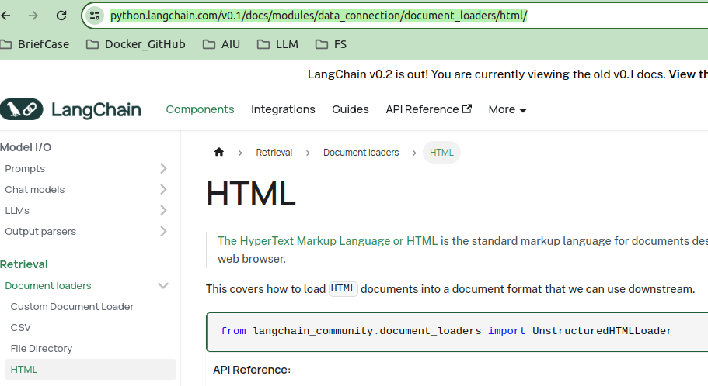
3.3.3 Unstructured HTML Loader
https://www.youtube.com/watch?v=MoqgmWV1fm8&list=PLeo1K3hjS3uu0N_0W6giDXzZIcB07Ng_F&index=3
Unstructured HTML Loader (18:51-19:10/1:14:33)
Let’s talk about the Unstructured Data (or HTML) Loader.
We will use unstructured Data loader for our project.
https://python.langchain.com/v0.1/docs/modules/data_connection/document_loaders/html/

Slide 20
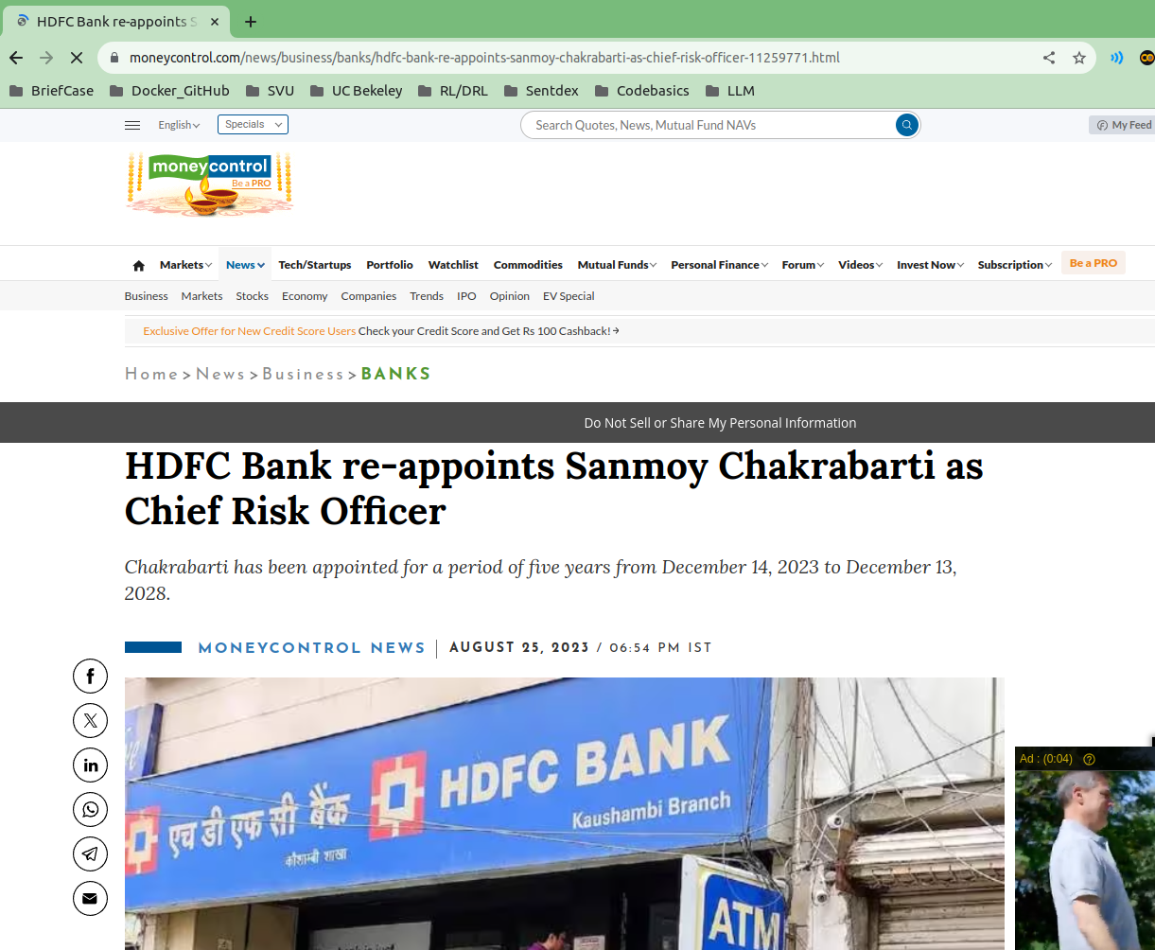
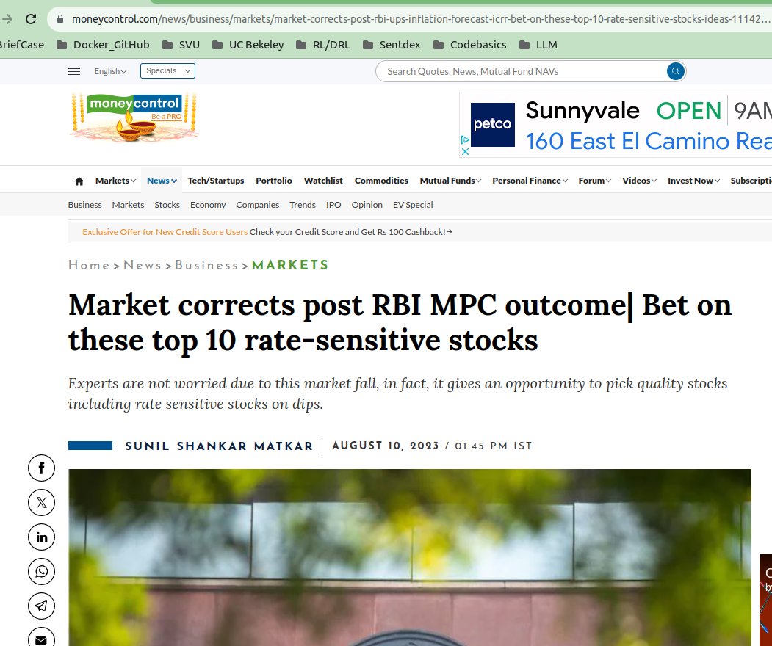
3.3.3 Unstructured HTML Loader
https://www.youtube.com/watch?v=MoqgmWV1fm8&list=PLeo1K3hjS3uu0N_0W6giDXzZIcB07Ng_F&index=3
Unstructured HTML Loader (19:11-19:20/1:14:33)
In our project, we will read URL/HTML data from links, for example,
1. https://www.moneycontrol.com/news/business/banks/hdfc-bank-re-appoints-sanmoy-chakrabarti-as-chief-risk-officer-11259771.html
2. https://www.moneycontrol.com/news/business/markets/market-corrects-post-rbi-ups-inflation-forecast-icrr-bet-on-these-top-10-rate-sensitive-stocks-ideas-11142611.html

Slide 21
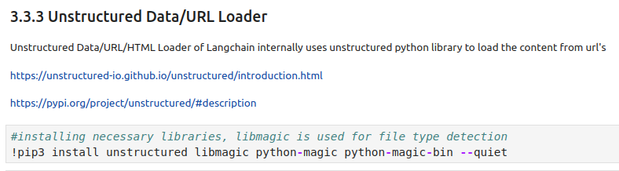
3.3.3 Unstructured HTML Loader
https://www.youtube.com/watch?v=MoqgmWV1fm8&list=PLeo1K3hjS3uu0N_0W6giDXzZIcB07Ng_F&index=3
Unstructured HTML Loader (19:21-20:10/1:14:33)
Here, we install the Unstructured Data/URL/HTML Loader.
https://python.langchain.com/v0.1/docs/modules/data_connection/document_loaders/html/

Slide 22
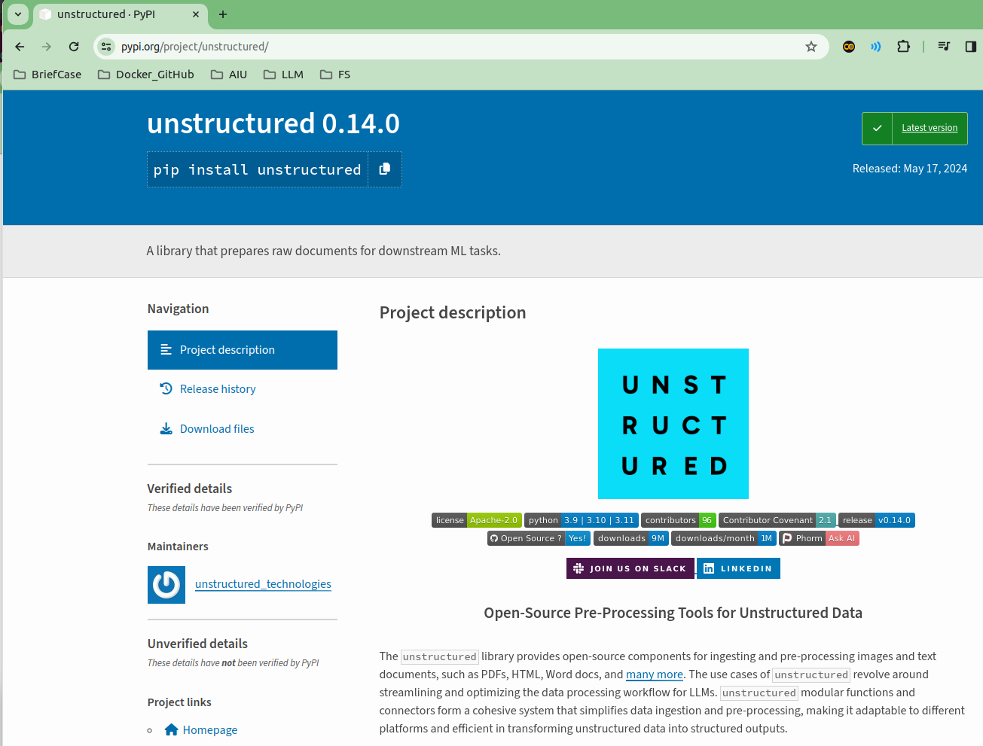
3.3.3 Unstructured HTML Loader
https://www.youtube.com/watch?v=MoqgmWV1fm8&list=PLeo1K3hjS3uu0N_0W6giDXzZIcB07Ng_F&index=3
Unstructured HTML Loader (20:11-20:20/1:14:33)
The Unstructured Library Loader is from Python Project.
https://pypi.org/project/unstructured/

Slide 23
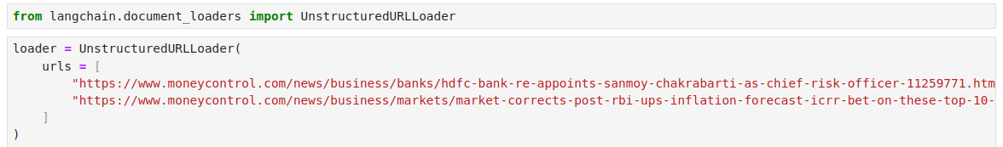
3.3.3 Unstructured HTML Loader
https://www.youtube.com/watch?v=MoqgmWV1fm8&list=PLeo1K3hjS3uu0N_0W6giDXzZIcB07Ng_F&index=3
Unstructured HTML Loader (20:21-21:00/1:14:33)
We provide two URL source links for UnstructuredURLLoader Library:
Loader = UnsctructuredURLLoader (
urls = [
“https://www.moneycontrol.com/news/business/banks/...html”,
“https://www.moneycontrol.com/news/business/markets/....html”
]
)

Slide 24

3.3.3 Unstructured HTML Loader
https://www.youtube.com/watch?v=MoqgmWV1fm8&list=PLeo1K3hjS3uu0N_0W6giDXzZIcB07Ng_F&index=3
Unstructured HTML Loader (21:01-21:10/1:14:33)
We have two data length is 2 because we have two URL Links of articles.

Slide 25
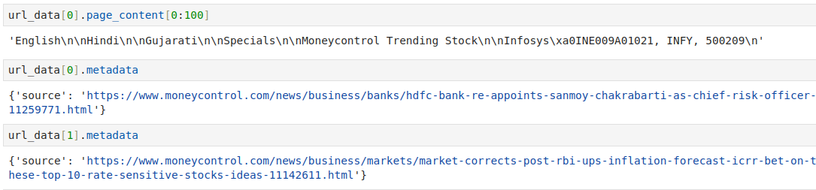
3.3.3 Unstructured HTML Loader
https://www.youtube.com/watch?v=MoqgmWV1fm8&list=PLeo1K3hjS3uu0N_0W6giDXzZIcB07Ng_F&index=3
Unstructured HTML Loader (21:01-21:30/1:14:33)
We print the meta data of first article and second article which store the URL (source links).

Slide 26
End

