Slide 1

11 Gemini Health App
Peter H. Chen

Slide 2
11 Gemini Health App
https://www.youtube.com/watch?v=qZWymdgDLv0&list=PLZoTAELRMXVNbDmGZlcgCA3a8mRQp5axb&index=11
Gemini Health App (00:00-02:10/19:21)
We create a chat for Calorie Advisor.
Whatever food you eat. Take a photo and give to the Calorie Advisor App.
This Calorie Advisor app will response with respect
1. How much calories you eat.
2. Whether the food is health or not, and
3. What all contents are in the food: Carbohydrates, Fats,Fibers, Protein, etc. Some research paper say, for every Kg of weight need consume around 0.8 gram of proteins. I am around 70 Kg, I need around 56 grams of proteins everyday.
This app will help you whether you get all nutrients you need.

Slide 3
11.01 Gemini Health App Demo

Slide 4
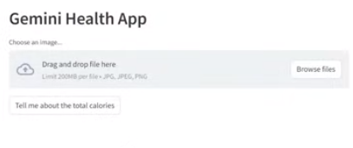
11.01 Gemini Health App Demo
https://www.youtube.com/watch?v=qZWymdgDLv0&list=PLZoTAELRMXVNbDmGZlcgCA3a8mRQp5axb&index=11
Gemini Health App Demo (02:11-02:15/19:21)
We start the Health App.

Slide 5
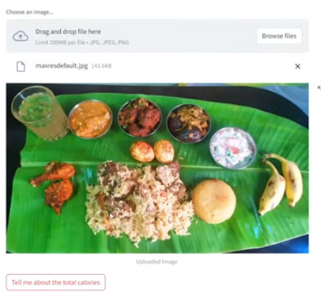
11.01 Gemini Health App Demo
https://www.youtube.com/watch?v=qZWymdgDLv0&list=PLZoTAELRMXVNbDmGZlcgCA3a8mRQp5axb&index=11
Gemini Health App Demo (02:16-02:20/19:21)
We upload some Food picture.

Slide 6
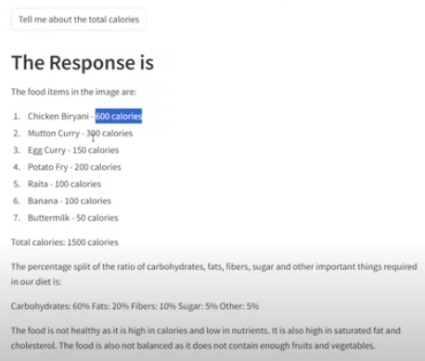
11.01 Gemini Health App Demo
https://www.youtube.com/watch?v=qZWymdgDLv0&list=PLZoTAELRMXVNbDmGZlcgCA3a8mRQp5axb&index=11
Gemini Health App Demo (02:21-04:00/19:21)
Click button “Tell me about the total Calorie”.
Each individual calorie
Total amount of calorie.
Carbohydrates is 60%, fats is 20%, fiber is 10%, sugar is 5%.
The food is not healthy because it has high calorie and low nutrients. It has high saturated fat and cholesterol. Food does not enough fruits and vegetable.

Slide 7
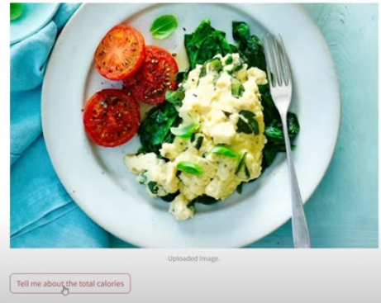
11.01 Gemini Health App Demo
https://www.youtube.com/watch?v=qZWymdgDLv0&list=PLZoTAELRMXVNbDmGZlcgCA3a8mRQp5axb&index=11
Gemini Health App Demo (04:01-04:30/19:21)
We look at another food.

Slide 8
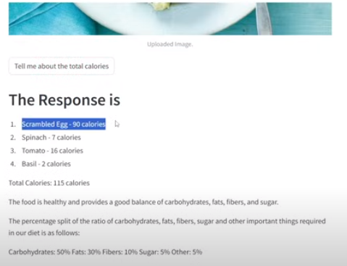
11.01 Gemini Health App Demo
https://www.youtube.com/watch?v=qZWymdgDLv0&list=PLZoTAELRMXVNbDmGZlcgCA3a8mRQp5axb&index=11
Gemini Health App Demo (04:31-05:15/19:21)
We look at another food.
This is good balance of nutrients

Slide 9
End

