Slide 1

11.03 Get API Key
Peter H. Chen

Slide 2
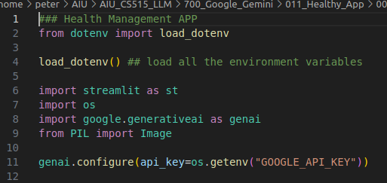
11.03 Get API Key
https://www.youtube.com/watch?v=qZWymdgDLv0&list=PLZoTAELRMXVNbDmGZlcgCA3a8mRQp5axb&index=11
Get API Key (08:21-11:00/19:21)
In the application, we load the image and image will interact with Gemini-pro-vision. We also need to write the custom prompt.
1. First, we import library: streamlit, os, generative AI, PIL (Python Image Library)
2. Then, we get the API Key: load_dotenv().
3. Configure Gemini Model with API Key.

Slide 3
11.04 Get Gemini Response

Slide 4
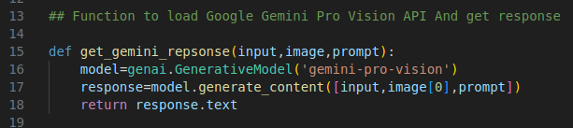
11.04 Get Gemini Response
https://www.youtube.com/watch?v=qZWymdgDLv0&list=PLZoTAELRMXVNbDmGZlcgCA3a8mRQp5axb&index=11
Get Gemini Response (11:01-12:30/19:21)
Define get_gemini_response (input, image, prompt).
1. Load mode: gemini-pro-vision
2. get response = generate_content ([input, image[0], prompt])
3. return response.txt

Slide 5
11.05 Input Image Setup

Slide 6
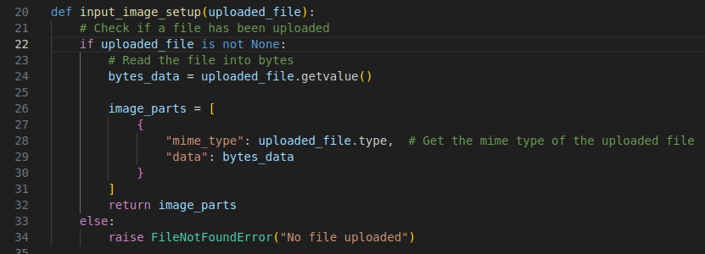
11.05 Input Image Setup
https://www.youtube.com/watch?v=qZWymdgDLv0&list=PLZoTAELRMXVNbDmGZlcgCA3a8mRQp5axb&index=11
Input Image Setup (11:01-14:00/19:21)
Input PDF file and return image data.

Slide 7
11.06 Streamlit GUI

Slide 8
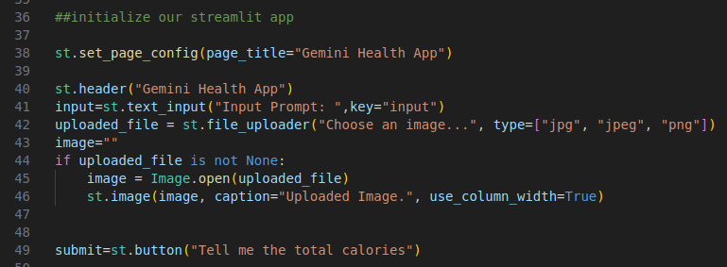
11.06 Streamlit GUI
https://www.youtube.com/watch?v=qZWymdgDLv0&list=PLZoTAELRMXVNbDmGZlcgCA3a8mRQp5axb&index=11
Streamlit GUI (14:01-15:00/19:21)
1. Page Title: Gemini Health App
2. Header: Gemini Health App.
3. Get the user input text.
4. Load PDF GUI
5. Display image
6. Create Button: Tell me the total calories

Slide 9
11.07 Define Input Prompt

Slide 10
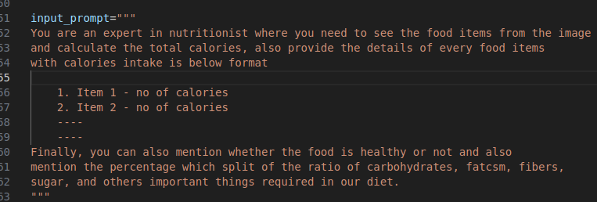
11.07 Define Input Prompt
https://www.youtube.com/watch?v=qZWymdgDLv0&list=PLZoTAELRMXVNbDmGZlcgCA3a8mRQp5axb&index=11
Define Input Prompt (15:01-16:20/19:21)
We define the input prompt.
What you want to see the content is up to you.
You can define anything you want to see and let Gemini know what do you want to see.
The gemini will response based on the the information you provided in the input prompt.
The content is up to you. Whatever yo want to see. You can put them there.

Slide 11
11.08 Process Submission

Slide 12
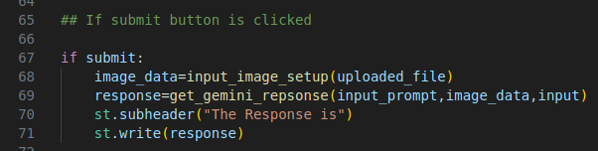
11.08 Process Submission
https://www.youtube.com/watch?v=qZWymdgDLv0&list=PLZoTAELRMXVNbDmGZlcgCA3a8mRQp5axb&index=11
Process Submission (16:21-17:30/19:21)
We have
1. input: get from user input
2. image: get from upload image.
3. input_prompt: We just defined which we want to see.
4. Get the response from get_gemini_response (input_prompt, image_data, input)
5. Display the response.
We can put the result in space server of HuggingFace.

Slide 13
End

