Slide 1

35 Vanish and Explode Gradient
Peter H. Chen

Slide 2
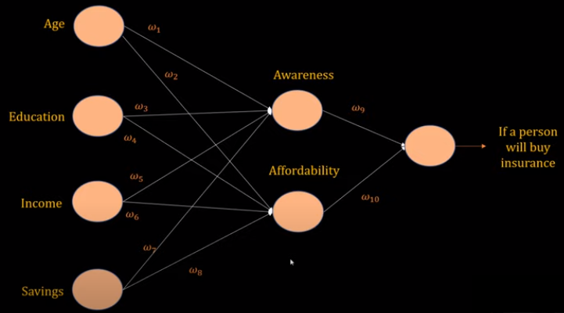
35 Vanish and Explode Gradient
https://www.youtube.com/watch?v=qowp6SQ9_Oo&list=PLeo1K3hjS3uu7CxAacxVndI4bE_o3BDtO&index=35
Vanishing and Exploding Gradients (0:00-0:30/9:52)
The Vanishing and Exploding Gradients is a common problem encountered during the training of neural network.
We will look at how vanishing and exploding affect the RNN (Recurrent Neural Network).
We have inputs features: Age, Education, Income, Savings, and predict whether this person will buy the insurance or not.
When we look at the hidden layers, the age and education affect the awareness. The income and savings affect the affordability.

Slide 3
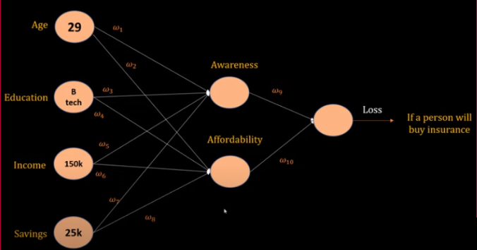
35 Vanish and Explode Gradient
https://www.youtube.com/watch?v=qowp6SQ9_Oo&list=PLeo1K3hjS3uu7CxAacxVndI4bE_o3BDtO&index=35
Vanishing and Exploding Gradients (0:36-1:10/9:52)
When we train the network, we have age 29, education is BS in Technology, income is 150K, and Savings is 25K, we have these value for forward pass in in training.
Initially, we have the weight assigned with random value, or maybe zero values.
And at the output node, we compare the predicted output with target and compute the loss.
Then, we do the back propagation to update the weights.

Slide 4
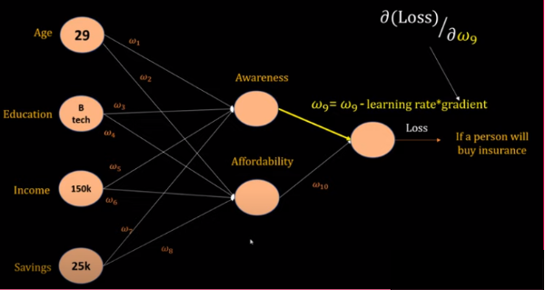
35 Vanish and Explode Gradient
https://www.youtube.com/watch?v=qowp6SQ9_Oo&list=PLeo1K3hjS3uu7CxAacxVndI4bE_o3BDtO&index=35
Vanishing and Exploding Gradients (1:11-2:20/9:52)
In backward propagation, for example, we will subtract a small factor from w9.
w9 = w9 – (learning rate) * gradient
We subtract a small factor from w9.
The gradient is the most important part. Gradient is the derivative of w9 in vector form.
Gradient is how much loss is change due to w9 is changed.
In this case, gradient is how much loss change due to the awareness is changed.

Slide 5
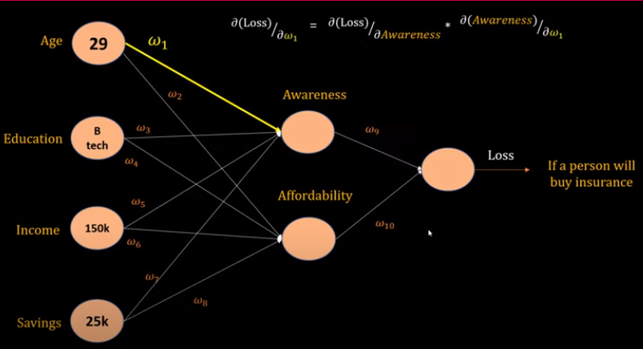
35 Vanish and Explode Gradient
https://www.youtube.com/watch?v=qowp6SQ9_Oo&list=PLeo1K3hjS3uu7CxAacxVndI4bE_o3BDtO&index=35
Vanishing and Exploding Gradients (2:23-3:00/9:52)
Now, when we think about the w1. We want to update the w9, w10, …, w1.
What is the loss change due to the w1? We have the chain rule for w1, w9, and loss.
We have the derivative of loss relative to awareness and derivative of awareness relative to w1.
How much change of loss due to awareness and how much change of awareness due to w1?

Slide 6
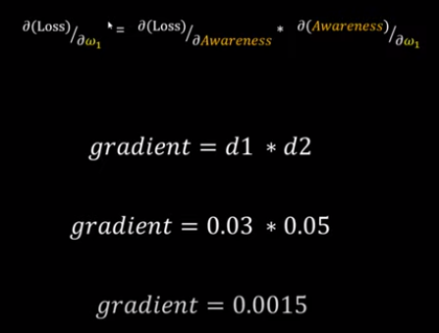
35 Vanish and Explode Gradient
https://www.youtube.com/watch?v=qowp6SQ9_Oo&list=PLeo1K3hjS3uu7CxAacxVndI4bE_o3BDtO&index=35
Vanishing and Exploding Gradients (3:09-3:30/9:52)
When we have multiple layers of neural network, the multiplication of derivative will be increase.
The change are small.
When we multiply the small number together, the number can be vanished.

Slide 7
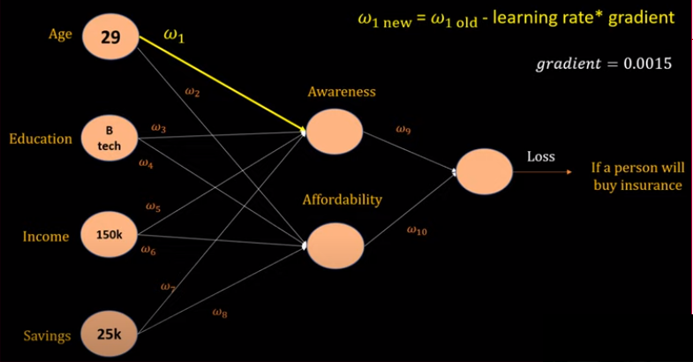
35 Vanish and Explode Gradient
https://www.youtube.com/watch?v=qowp6SQ9_Oo&list=PLeo1K3hjS3uu7CxAacxVndI4bE_o3BDtO&index=35
Vanishing and Exploding Gradients (3:33-4:00/9:52)
When you have very small number of gradient, the update of weight w1 will be very slow.
If the original w1(old) = 0.001, gradient = 0.0015, learning rate = 0.01, then the new w1(new) is almost no change.

Slide 8
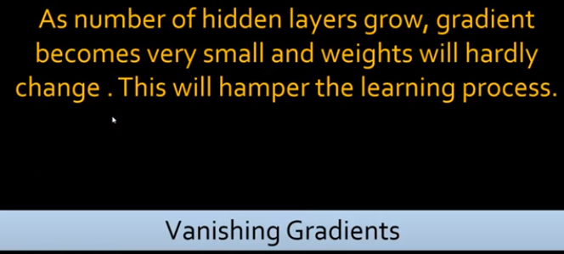
35 Vanish and Explode Gradient
https://www.youtube.com/watch?v=qowp6SQ9_Oo&list=PLeo1K3hjS3uu7CxAacxVndI4bE_o3BDtO&index=35
Vanishing and Exploding Gradients (4:16-4:30/9:52)
When the number of hidden layers become bigger, gradient become very small.
If one of the gradient close to zero, the multiplication of chain rule causes results of update close to 0.
The weight become very difficult to change. We call this concept is “Vanishing Gradient”.
When we have very big neural network, the update of weight will become very small and very slow. The neural network is very hard to learn anything. It just like a dump student in the class and did not learn anything.

Slide 9
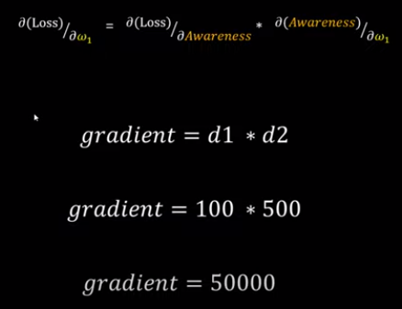
35 Vanish and Explode Gradient
https://www.youtube.com/watch?v=qowp6SQ9_Oo&list=PLeo1K3hjS3uu7CxAacxVndI4bE_o3BDtO&index=35
Vanishing and Exploding Gradients (4:43-5:00/9:52)
On the other hand, if the derivatives d1 and d2 are big, then the gradient due to multiplication of chain rule of derivative become very big.
The overall product become huge.

Slide 10
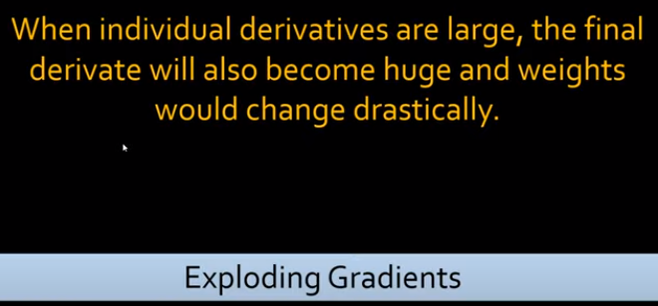
35 Vanish and Explode Gradient
https://www.youtube.com/watch?v=qowp6SQ9_Oo&list=PLeo1K3hjS3uu7CxAacxVndI4bE_o3BDtO&index=35
Vanishing and Exploding Gradients (5:03-5:10/9:52)
When the individual derivatives are big, the overall multiplication of chain rule of individual derivatives become very huge. The weights will change extremely.
We call this concept is “Exploding Gradients”.

Slide 11
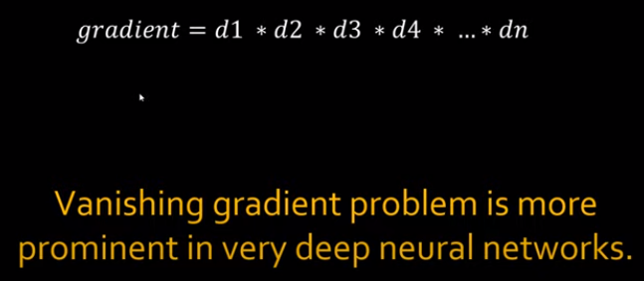
35 Vanish and Explode Gradient
https://www.youtube.com/watch?v=qowp6SQ9_Oo&list=PLeo1K3hjS3uu7CxAacxVndI4bE_o3BDtO&index=35
Vanishing and Exploding Gradients (5:12-5:20/9:52)
Now, when we think about deep neural network, the derivative is small (small change) is very common.
The vanishing gradient problem is very common in deep neural network.

Slide 12
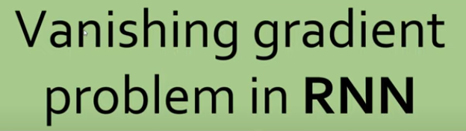
35 Vanish and Explode Gradient
https://www.youtube.com/watch?v=qowp6SQ9_Oo&list=PLeo1K3hjS3uu7CxAacxVndI4bE_o3BDtO&index=35
Vanishing and Exploding Gradients (5:25-5:30/9:52)
Now, we discuss the vanishing gradient problem in RNN.
We also see the exploding problem in RNN but more often in vanishing.

Slide 13
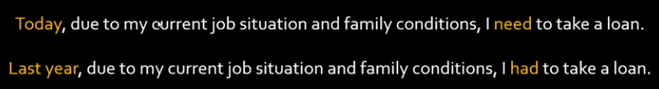
35 Vanish and Explode Gradient
https://www.youtube.com/watch?v=qowp6SQ9_Oo&list=PLeo1K3hjS3uu7CxAacxVndI4bE_o3BDtO&index=35
Vanishing and Exploding Gradients (5:34-6:30/9:52)
Below, we have two statements:
1. Input: “Today, …”, output: “I need to take a loan”
2. Input: “Last year, …”, output “I had to take a loan”.
We can see the two statements only change very small.

Slide 14
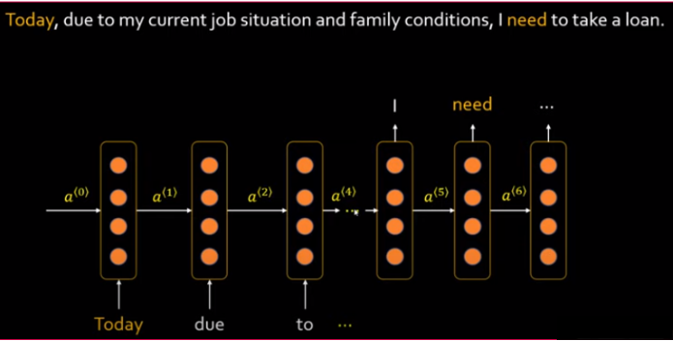
35 Vanish and Explode Gradient
https://www.youtube.com/watch?v=qowp6SQ9_Oo&list=PLeo1K3hjS3uu7CxAacxVndI4bE_o3BDtO&index=35
Vanishing and Exploding Gradients (6:43-8:30/9:52)
We can convert the statements to “Many to Many” RNN model.
Below is a simple one layer of RNN. It is not many layers of RNN.
In this case, we have change from “Today” into “Last year”, but the others have no change.
We can see there is a vanishing gradient problem due to the multiplication of chain riule of derivatives.

Slide 15
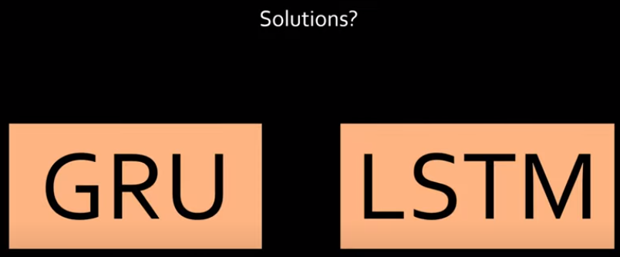
35 Vanish and Explode Gradient
https://www.youtube.com/watch?v=qowp6SQ9_Oo&list=PLeo1K3hjS3uu7CxAacxVndI4bE_o3BDtO&index=35
Vanishing and Exploding Gradients (9:21-9:52/9:52)
Most of the sequences are small very short.
We have two solutions:
1. GRU (Gated Recurrent Unit)
2. LSTM (Long Short Term Memory)
GRU and LSTM are both types of recurrent neural network (RNN) layers designed to handle sequential data.
They address the vanishing gradient problem in traditional RNNs by introducing gating mechanisms that allow them to capture long-term dependencies more effectively

Slide 16
End

