Slide 1

07 LC: PAL Model
Peter H. Chen

Slide 2
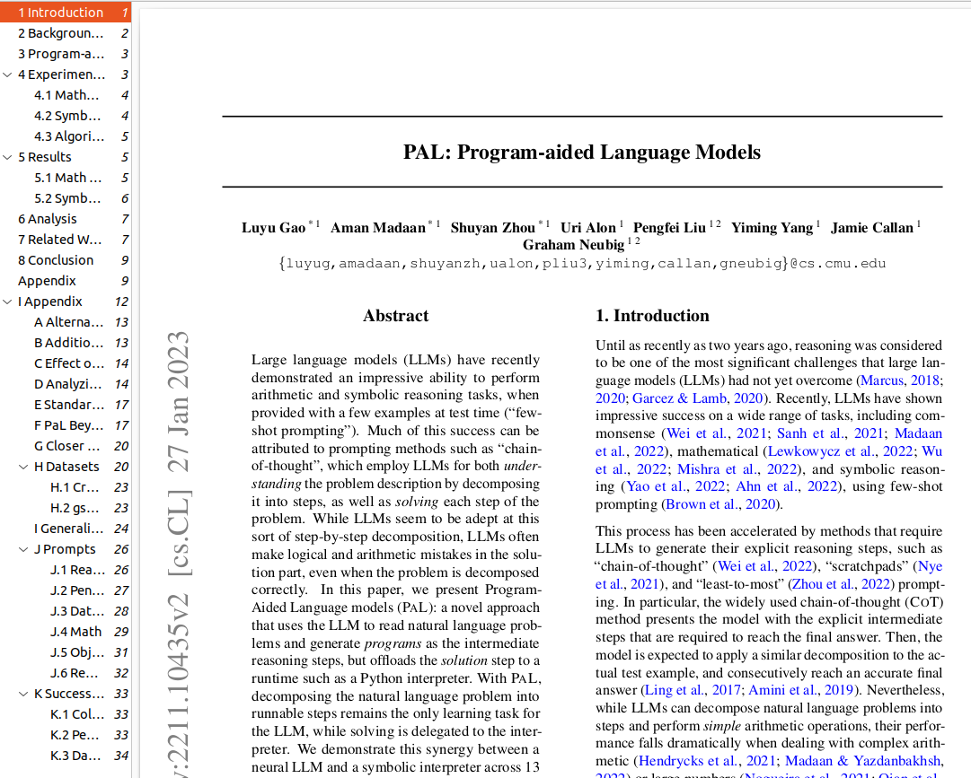
07 LC: PAL Model
https://www.youtube.com/watch?v=dy7-LvDu-3s&list=PL8motc6AQftk1Bs42EW45kwYbyJ4jOdiZ&index=7
LC: PAL Model (00:00-02:30/18:59)
We discuss LangChain PAL Model Paper and Code.
This paper is published by Carnegie Mellon University.

Slide 3
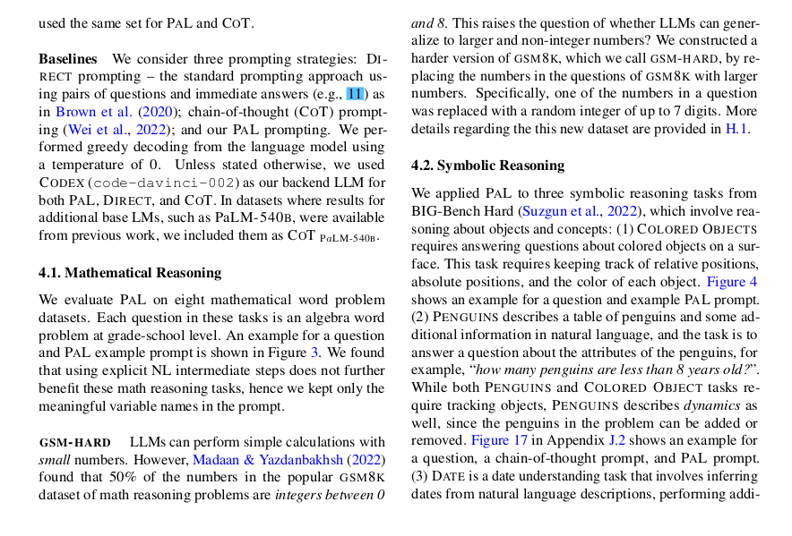
07 LC: PAL Model
https://www.youtube.com/watch?v=dy7-LvDu-3s&list=PL8motc6AQftk1Bs42EW45kwYbyJ4jOdiZ&index=7
LC: PAL Model (02:31-07:00/18:59)
Instead of train model, it uses the context learning and few shot prompting to manipulate model.
It does the mathematical computing.

Slide 4
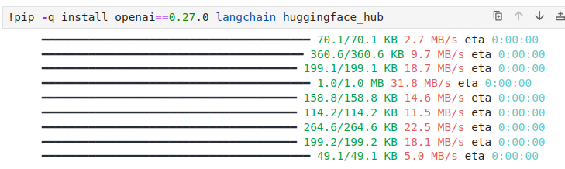
07 LC: PAL Model
https://www.youtube.com/watch?v=dy7-LvDu-3s&list=PL8motc6AQftk1Bs42EW45kwYbyJ4jOdiZ&index=7
LC: PAL Model (07:01-08:30/18:59)
Install the libraries.

Slide 5
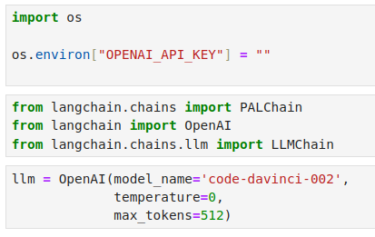
07 LC: PAL Model
https://www.youtube.com/watch?v=dy7-LvDu-3s&list=PL8motc6AQftk1Bs42EW45kwYbyJ4jOdiZ&index=7
LC: PAL Model (08:31-09:30/18:59)
Load LLM.

Slide 6
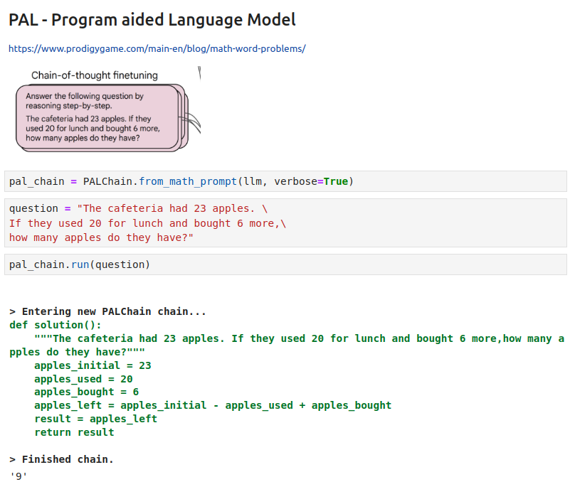
07 LC: PAL Model
https://www.youtube.com/watch?v=dy7-LvDu-3s&list=PL8motc6AQftk1Bs42EW45kwYbyJ4jOdiZ&index=7
LC: PAL Model (08:31-09:30/18:59)
Use prompt to ask questions.

Slide 7
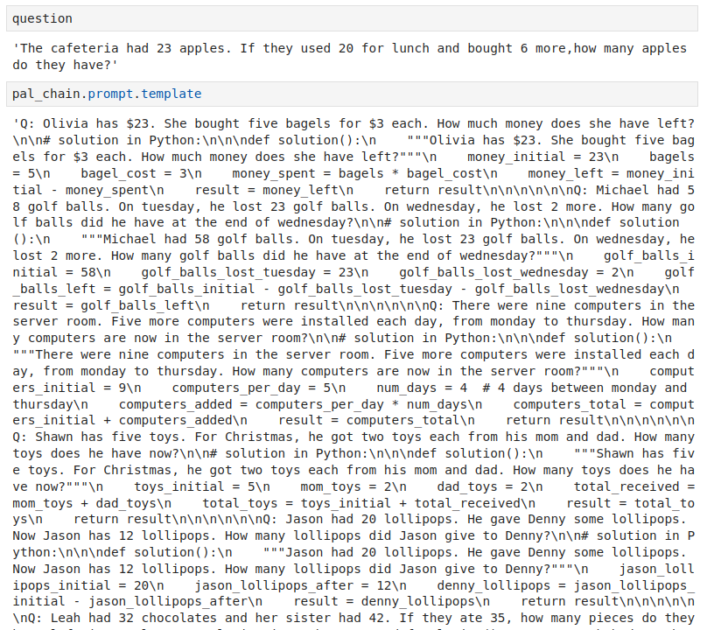
07 LC: PAL Model
https://www.youtube.com/watch?v=dy7-LvDu-3s&list=PL8motc6AQftk1Bs42EW45kwYbyJ4jOdiZ&index=7
LC: PAL Model (09:31-12:30/18:59)
Use prompt to ask questions.

Slide 8
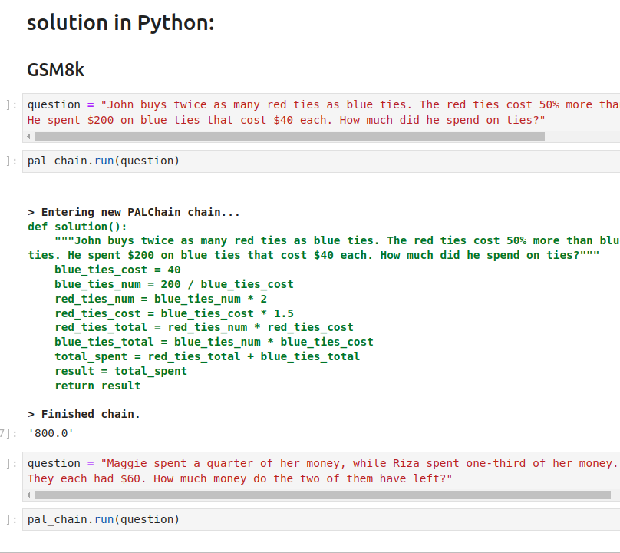
07 LC: PAL Model
https://www.youtube.com/watch?v=dy7-LvDu-3s&list=PL8motc6AQftk1Bs42EW45kwYbyJ4jOdiZ&index=7
LC: PAL Model (12:31-14:30/18:59)
Use prompt to ask questions.

Slide 9
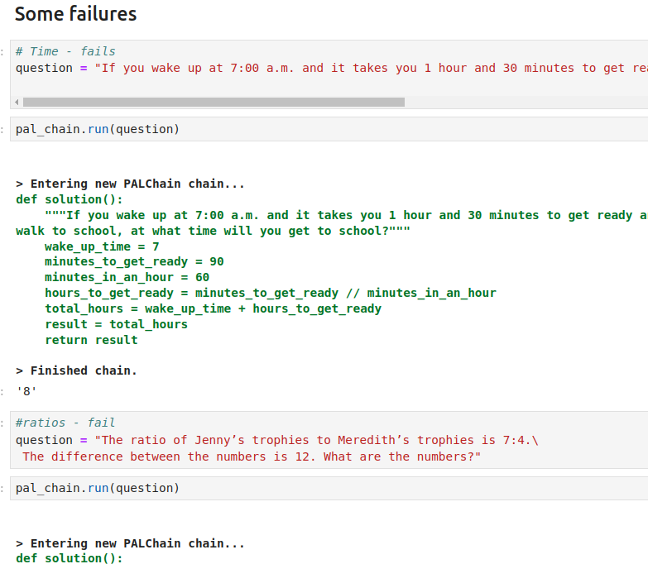
07 LC: PAL Model
https://www.youtube.com/watch?v=dy7-LvDu-3s&list=PL8motc6AQftk1Bs42EW45kwYbyJ4jOdiZ&index=7
LC: PAL Model (14:31-18:59/18:59)
Some questions failed.

Slide 10
End

