Slide 1

2.02 Tasks To Do
Peter H. Chen

Slide 2
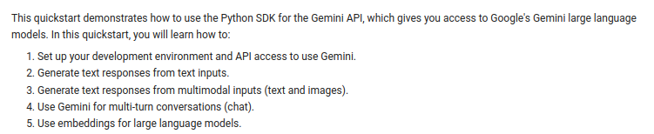
2.02 Tasks To Do
https://www.youtube.com/watch?v=W0rNUAfqGFc&list=PLZoTAELRMXVNbDmGZlcgCA3a8mRQp5axb&index=2
Tasks To Do (04:48-05:00/28:32)
Gemini is a Multi-Modal. This means that we have model in texts, images, video, audio, etc.
We will do the followings:
1. Setup environment for API Key.
2. Generate Text Response from Text inputs.
3. Generate text Response from Multi-Modal inputs (text and images).
4. Use Gemini for multi-turn conversations (chat).
5. How to apply embedding for Large Language Models.

Slide 3
2.03 Install Generative AI

Slide 4
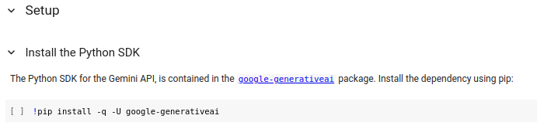
2.03 Install Generative AI
https://www.youtube.com/watch?v=W0rNUAfqGFc&list=PLZoTAELRMXVNbDmGZlcgCA3a8mRQp5axb&index=2
Install Generative AI (05:01-05:24/28:32)
First, we install generative AI.
The library is called “google-generativeai.”
With the help of API, we can use the features of Gemini-pro models.

Slide 5
2.04 Import Packages

Slide 6
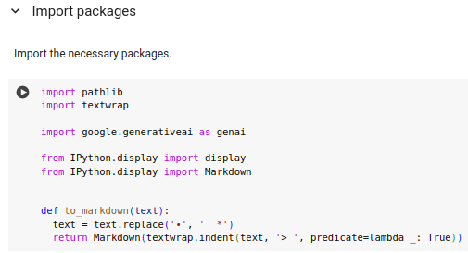
2.04 Import Packages
https://www.youtube.com/watch?v=W0rNUAfqGFc&list=PLZoTAELRMXVNbDmGZlcgCA3a8mRQp5axb&index=2
Import Packages (05:51-06:45/28:32)
Here, we import
1. pathlib
2. textwrap
3. google.generativeai
4. from google.colab import userdata. Inside userdata, we can store the API Key.
5. import display and markdown to display information with markup language.
6. We define function to_markdown(). We replace “.’ into ‘*’ from generative AI response to markdown format. Then, we return the entire data to markdown format.

Slide 7
2.05 Setup API Key

Slide 8
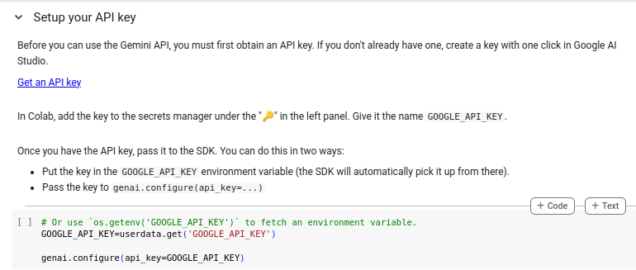
2.05 Setup API Key
https://www.youtube.com/watch?v=W0rNUAfqGFc&list=PLZoTAELRMXVNbDmGZlcgCA3a8mRQp5axb&index=2
Setup API Key (06:46-06:48/28:32)
Now, we setup API Key.
Click “Get an API Key”.

Slide 9
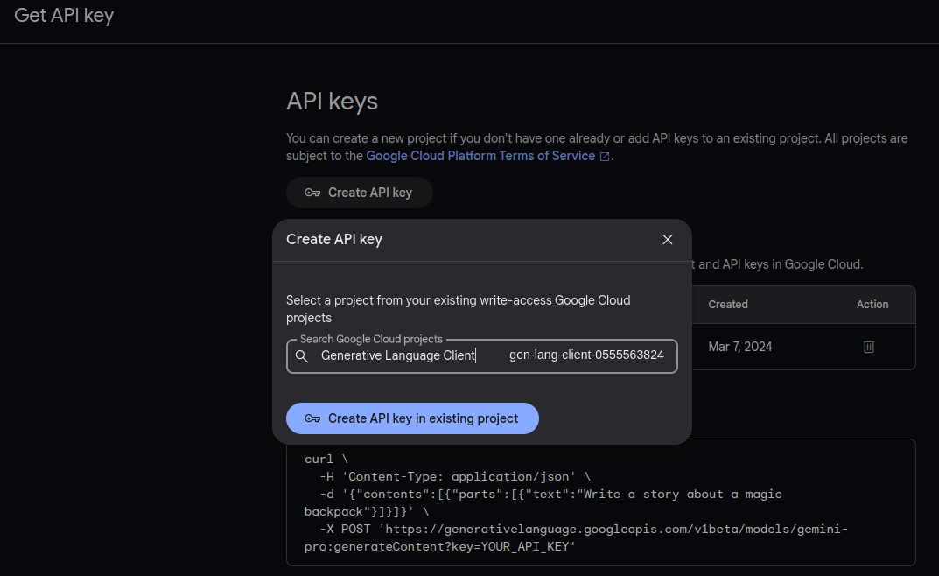
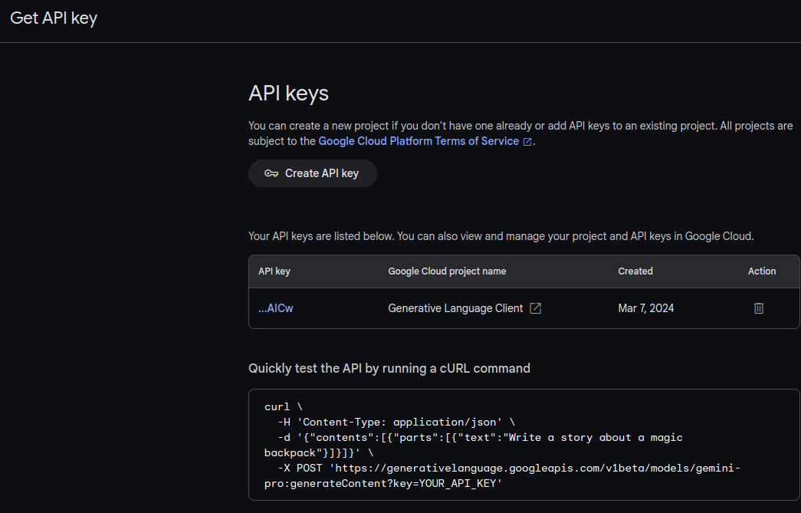
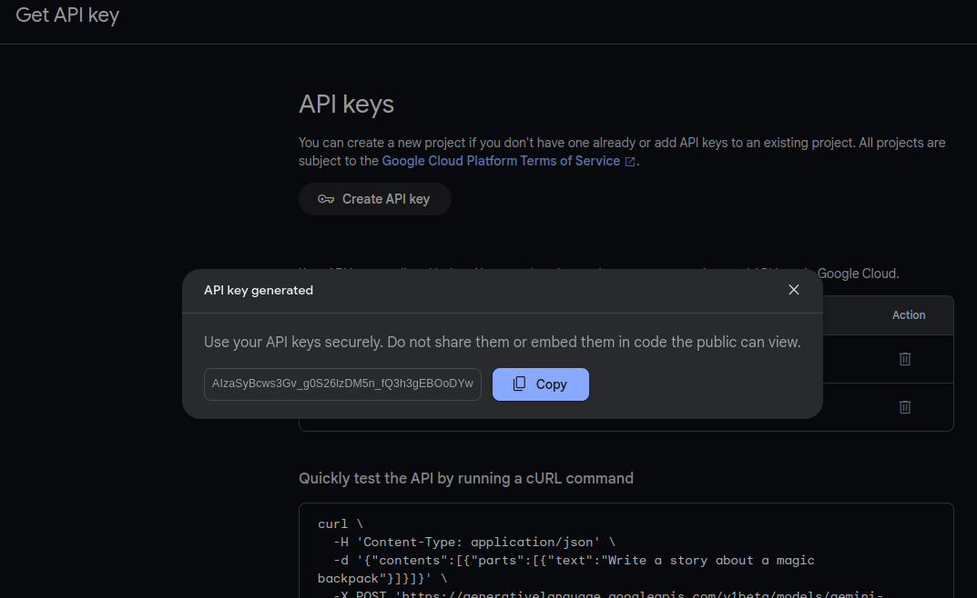
2.05 Setup API Key
https://www.youtube.com/watch?v=W0rNUAfqGFc&list=PLZoTAELRMXVNbDmGZlcgCA3a8mRQp5axb&index=2
Setup API Key (06:46-06:48/28:32)
Now, we setup API Key.
Click “Get an API Key”.

Slide 10
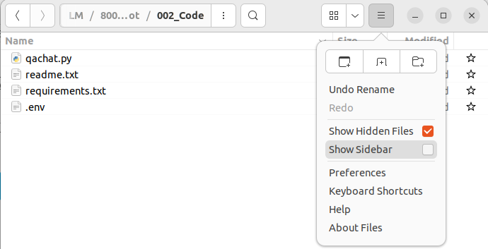
2.05 Setup API Key
https://www.youtube.com/watch?v=W0rNUAfqGFc&list=PLZoTAELRMXVNbDmGZlcgCA3a8mRQp5axb&index=2
Setup API Key (06:49-07:50/28:32)
If we use local computer, we store the API key in “.env” file.
Click “Show Hidden Files” to see the “.env” file.
We can save the created API Key in the “.env” file if you use local computer.
We will need load_dotenv() to load the API key from “.env’.

Slide 11
2.06 Setup API Key for Generative AI

Slide 12
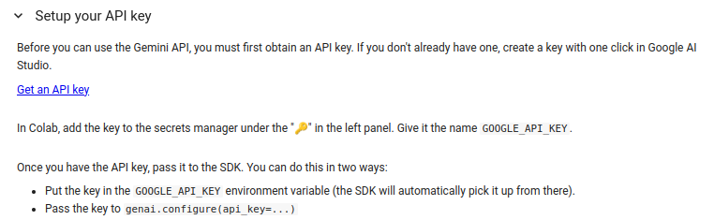
2.06 Setup API Key for Generative AI
https://www.youtube.com/watch?v=W0rNUAfqGFc&list=PLZoTAELRMXVNbDmGZlcgCA3a8mRQp5axb&index=2
Setup API Key for Generative AI (07:51-08:00/28:32)
Since we use the Google Colab. Google save the API key in Google way.
I maybe delete my API Key. You cannot use my API Key. You have to create your own API Key

Slide 13
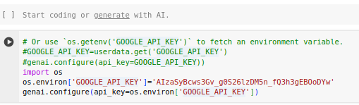
2.06 Setup API Key for Generative AI
https://www.youtube.com/watch?v=W0rNUAfqGFc&list=PLZoTAELRMXVNbDmGZlcgCA3a8mRQp5axb&index=2
Setup API Key for Generative AI (07:51-08:00/28:32)
1. Now, we define the GOOGLE_API_KEY
> import os
> os.environ[‘GOOGLE_API_KEY’] = ’AI…..’ # we define the API Key
2. Then, we get API Key for generative AI model.
> genai.configure(api_key=os.environ[‘GOOGLE_API+KEY’’])

Slide 14
2.07 List Model

Slide 15
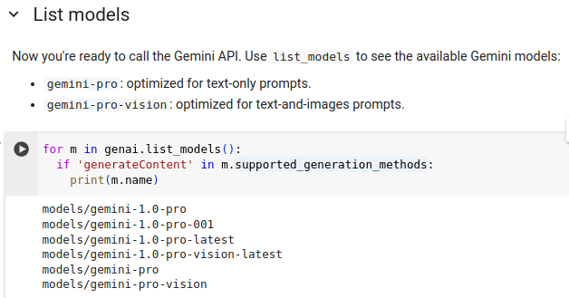
2.07 List Model
https://www.youtube.com/watch?v=W0rNUAfqGFc&list=PLZoTAELRMXVNbDmGZlcgCA3a8mRQp5axb&index=2
List Model (08:01-09:20/28:32)
What all models do we get from Gemini API?
Here, we have 2 Gemini models.
1. models/gemini-pro: Gemini-pro is the optimized for text prompt, summarization, Q&A, chat, etc. Anything related to text, we have to use gemini-pro model.
2. models/gemini-pro-vision” Gemini-pro-vision is the optimized for text and image prompt. For text and prompt, we use gemini-pro-vision.
We also have 4 additional-1.0 versions.

Slide 16
End

