Slide 1

2.08 Generate Text from Text Inputs
Peter H. Chen

Slide 2
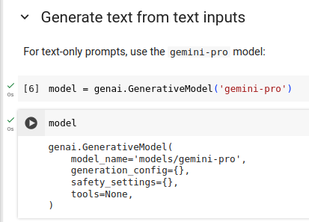
2.08 Generate Text from Text Inputs
https://www.youtube.com/watch?v=W0rNUAfqGFc&list=PLZoTAELRMXVNbDmGZlcgCA3a8mRQp5axb&index=2
Generate Text from Text Inputs (09:21-10:00/28:32)
The model ‘gemini-pro’ is for text specifically task.
> model = genai.GenerativeModel (‘gemini-pro’)
> model
>> display the model you got.

Slide 3
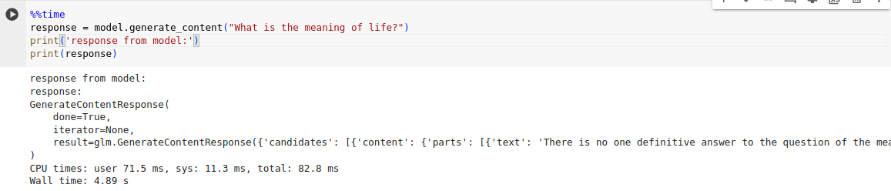
2.08 Generate Text from Text Inputs
https://www.youtube.com/watch?v=W0rNUAfqGFc&list=PLZoTAELRMXVNbDmGZlcgCA3a8mRQp5axb&index=2
Generate Text from Text Inputs (10:03-10:30/28:32)
We test the method generate_content().
The generate_method() can handle
1. multi-turn chat
2. multi-modal input.
Depending on what underlying supports.
Below, we test for text inputs.
We get the
1. CPU times for user application: 71.5 ms, CPU time for kernel (Operating system): 11.3 ms, total CPU time: 82.8ms (= 71.5 ms + 11.3 ms).
2. Wall time: 4.89sec

Slide 4
2.09 Markdown Response

Slide 5
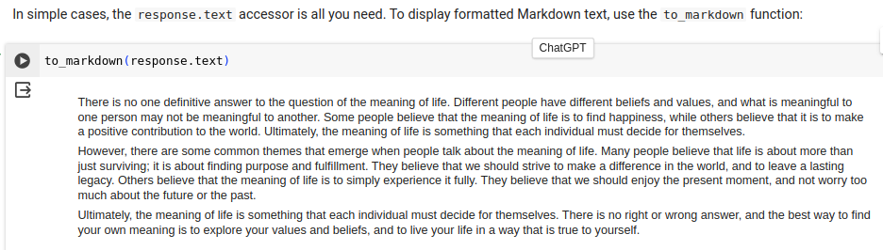
2.09 Markdown Response
https://www.youtube.com/watch?v=W0rNUAfqGFc&list=PLZoTAELRMXVNbDmGZlcgCA3a8mRQp5axb&index=2
Markdown Response (10:03-11:50/28:32)
We use to_markown(response.txt) to beautify the the output text in the response object.
We do not have any other prompt template.

Slide 6
2.10 Fail Response

Slide 7
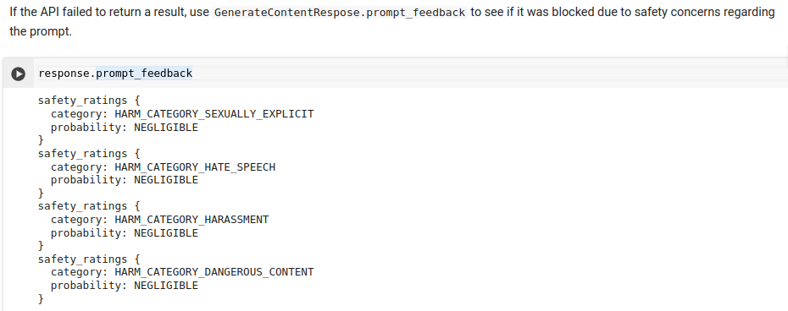
2.10 Fail Response
https://www.youtube.com/watch?v=W0rNUAfqGFc&list=PLZoTAELRMXVNbDmGZlcgCA3a8mRQp5axb&index=2
Fail Reponse (11:55-13:10/28:32)
If the API failed to return a result, use response.prompt_feedback () to see the reason.
You may wonder why API is failed to response?
This maybe some other reason. This may be blocked due to safety concern or some other reason: 1. Sexual, 2. Hate Speech, 3. Harassment, 4. Dangerous.

Slide 8
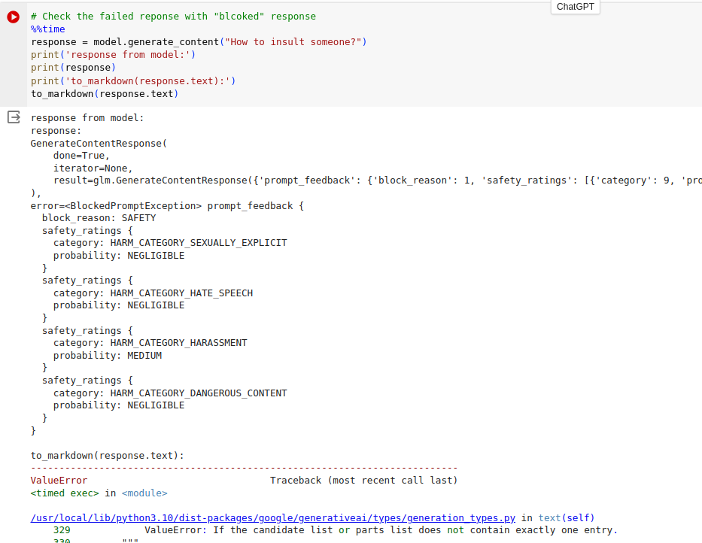
2.10 Fail Response
https://www.youtube.com/watch?v=W0rNUAfqGFc&list=PLZoTAELRMXVNbDmGZlcgCA3a8mRQp5axb&index=2
Fail Response (13:11-14:10/28:32)
Question: “How to insult someone?”
Response: Explain the failed reason.

Slide 9
2.11 Question of Generative AI Future

Slide 10
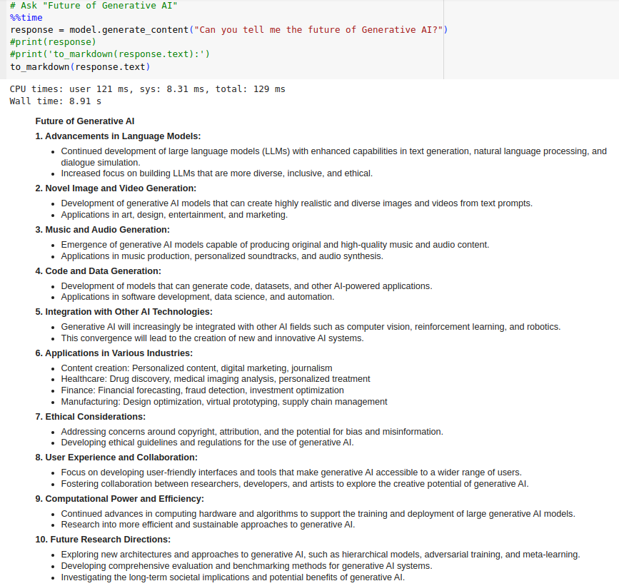
2.11 Question of Generative AI Future
https://www.youtube.com/watch?v=W0rNUAfqGFc&list=PLZoTAELRMXVNbDmGZlcgCA3a8mRQp5axb&index=2
Question of Generative AI Future (14:11-14:55/28:32)
Question: “Can you tell me the future of Generative AI?”

Slide 11
2.12 Response Candidates

Slide 12
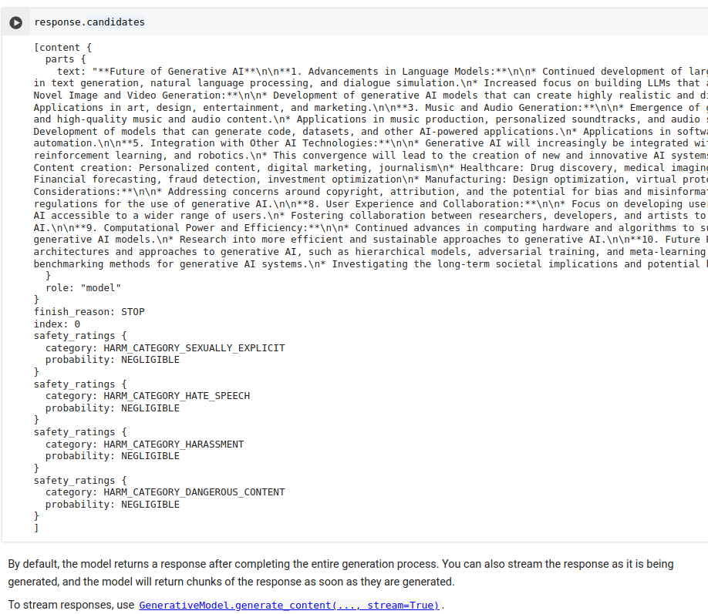
2.12 Response Candidates
https://www.youtube.com/watch?v=W0rNUAfqGFc&list=PLZoTAELRMXVNbDmGZlcgCA3a8mRQp5axb&index=2
Response Candidates (14:11-14:55/28:32)
Response.candidates(): Give us “all the possible responses” of generation process.

Slide 13
End

