Slide 1

06 LC: HF Model
Peter H. Chen

Slide 2
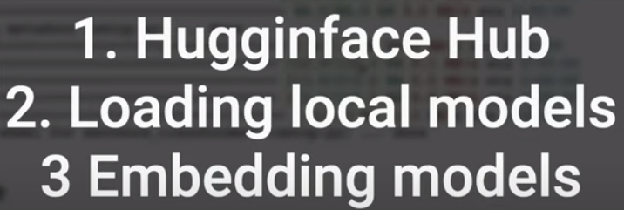
06 LC: HF Model
https://www.youtube.com/watch?v=Kn7SX2Mx_Jk&list=PL8motc6AQftk1Bs42EW45kwYbyJ4jOdiZ&index=6
LC: HF Model (00:00-00:30/10:21)
We discuss the Model hosted on the HuggingFace.
Colab free only have 12GB VRAM. Google/flan-t5-xxx need 24GB.
1. HuggingFace Hub
2. Load Local Models
3. Embedding Models

Slide 3
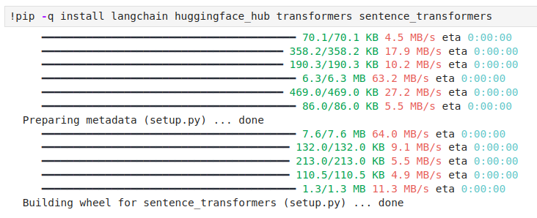
06 LC: HF Model
https://www.youtube.com/watch?v=Kn7SX2Mx_Jk&list=PL8motc6AQftk1Bs42EW45kwYbyJ4jOdiZ&index=6
LC: HF Model (00:31-01:00/10:21)
We install the langchain, huggingface_hub, transformers, sentence_transformers

Slide 4
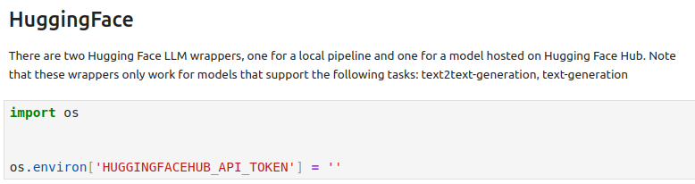
06 LC: HF Model
https://www.youtube.com/watch?v=Kn7SX2Mx_Jk&list=PL8motc6AQftk1Bs42EW45kwYbyJ4jOdiZ&index=6
LC: HF Model (01:01-01:30/10:21)
We install the langchain, huggingface_hub, transformers, sentence_transformers

Slide 5
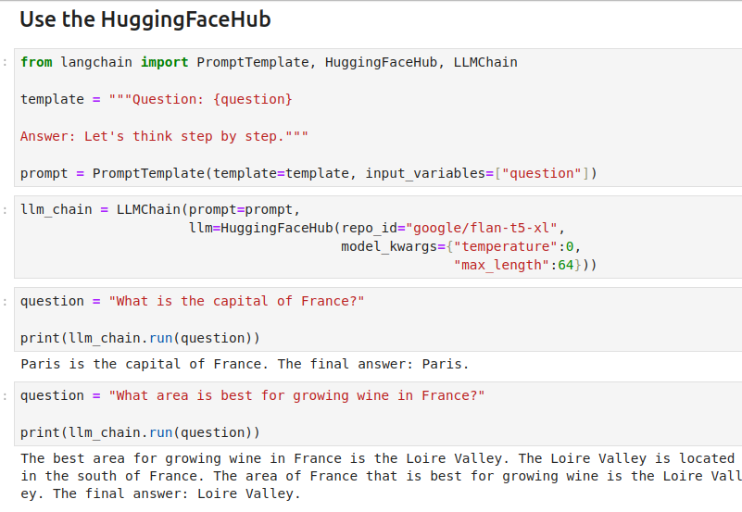
06 LC: HF Model
https://www.youtube.com/watch?v=Kn7SX2Mx_Jk&list=PL8motc6AQftk1Bs42EW45kwYbyJ4jOdiZ&index=6
LC: HF Model (01:31-02:00/10:21)
Use HuggingFace Hub: XL model required 45GB which is too big for my computer. I can only use “small” and “base” on my local computer and colab,

Slide 6
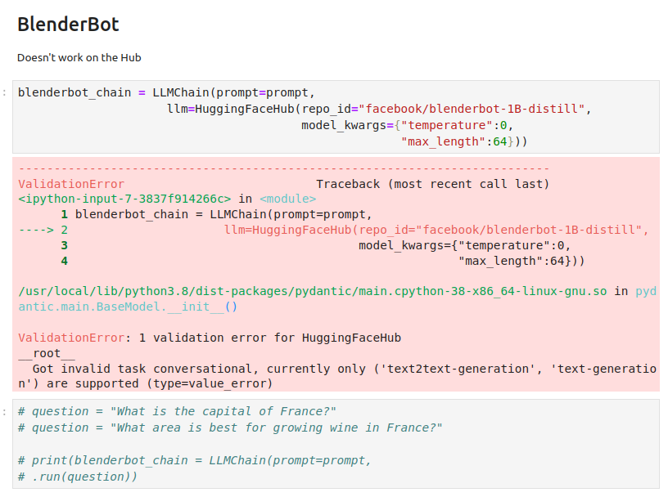
06 LC: HF Model
https://www.youtube.com/watch?v=Kn7SX2Mx_Jk&list=PL8motc6AQftk1Bs42EW45kwYbyJ4jOdiZ&index=6
LC: HF Model (02:01-03:30/10:21)
Blender model is created by facebook. It only works for text to text.

Slide 7
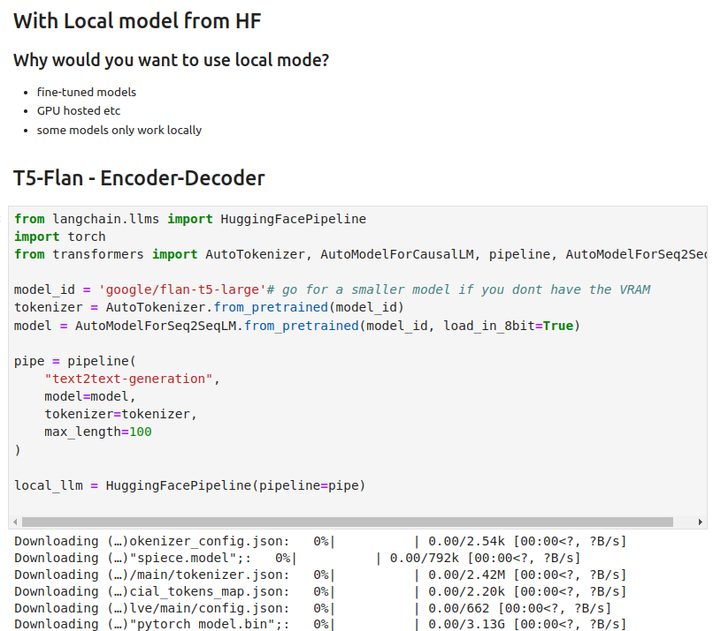
06 LC: HF Model
https://www.youtube.com/watch?v=Kn7SX2Mx_Jk&list=PL8motc6AQftk1Bs42EW45kwYbyJ4jOdiZ&index=6
LC: HF Model (03:31-05:30/10:21)
T5-Flan-xxx needs bigger 45GB VRAM.
It has pipeline for model training.

Slide 8
06 LC: HF Model
https://www.youtube.com/watch?v=Kn7SX2Mx_Jk&list=PL8motc6AQftk1Bs42EW45kwYbyJ4jOdiZ&index=6
LC: HF Model (05:31-06:30/10:21)
T5-Flan-xxx needs bigger 45GB VRAM.
It has pipeline for model training.

Slide 9
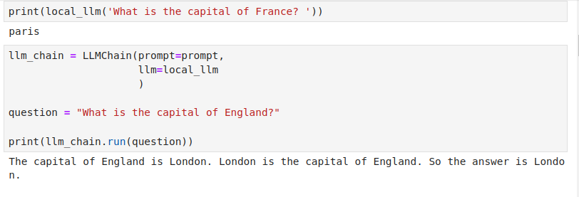
06 LC: HF Model
https://www.youtube.com/watch?v=Kn7SX2Mx_Jk&list=PL8motc6AQftk1Bs42EW45kwYbyJ4jOdiZ&index=6
LC: HF Model (05:31-06:30/10:21)
T5-Flan-xxx needs bigger 45GB VRAM.
It has pipeline for model training.

Slide 10
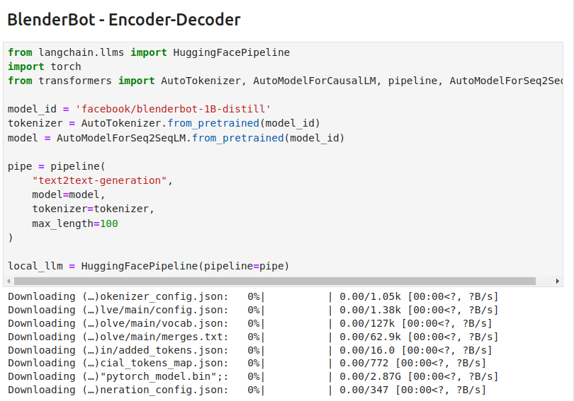
06 LC: HF Model
https://www.youtube.com/watch?v=Kn7SX2Mx_Jk&list=PL8motc6AQftk1Bs42EW45kwYbyJ4jOdiZ&index=6
LC: HF Model (06:31-08:30/10:21)

Slide 11
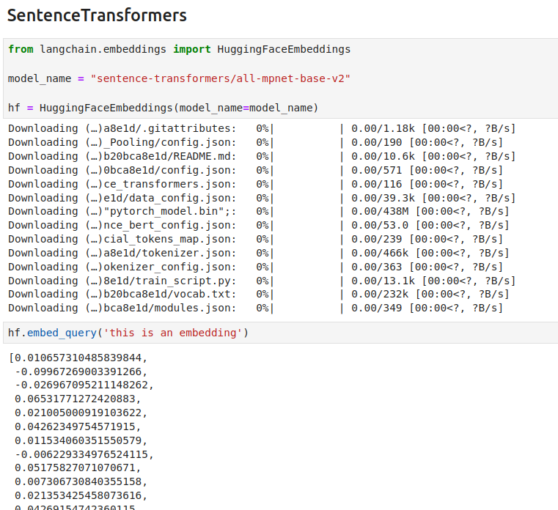
06 LC: HF Model
https://www.youtube.com/watch?v=Kn7SX2Mx_Jk&list=PL8motc6AQftk1Bs42EW45kwYbyJ4jOdiZ&index=6
LC: HF Model (08:31-10:20/10:21)

Slide 12
End

