Slide 1

09.02 Create Environment
Peter H. Chen

Slide 2

09.02 Create Environment
https://www.youtube.com/watch?v=EECUXqFrwbc&list=PLZoTAELRMXVNbDmGZlcgCA3a8mRQp5axb&index=9
Create Environment (05:51-07:30/34:26)
> conda create --name gemini
> conda activate gemini

Slide 3
09.03 Install Library

Slide 4
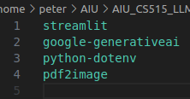
09.03 Install Library
https://www.youtube.com/watch?v=EECUXqFrwbc&list=PLZoTAELRMXVNbDmGZlcgCA3a8mRQp5axb&index=9
Install Library (07:31-07:40/34:26)
We use four libraries
1. streamlit: GUI
2. google-generativeai: Gemini-pro
3. python-dotenv: load API Key
4. pdf2image: read PDF convert into image

Slide 5
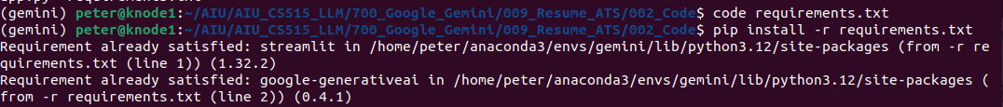
09.03 Install Library
https://www.youtube.com/watch?v=EECUXqFrwbc&list=PLZoTAELRMXVNbDmGZlcgCA3a8mRQp5axb&index=9
Install Library (07:41-08:10/34:26)
> pip install -r requirements.txt

Slide 6
09.04 Implement Specification

Slide 7
09.04 Implement Specification
https://www.youtube.com/watch?v=EECUXqFrwbc&list=PLZoTAELRMXVNbDmGZlcgCA3a8mRQp5axb&index=9
Implement Specification (08:51-09:10/34:26)
What do we need to implement?
1. Input Text Field: Field to put the Job Description:
2. Upload PDF
3. PDF to Image ---> Processing --> based on “Google Gemini-pro”
4. Create Prompts Template [Multiple Prompt]

Slide 8
End

