Slide 1

09.13 Test Resume ATS
Peter H. Chen

Slide 2
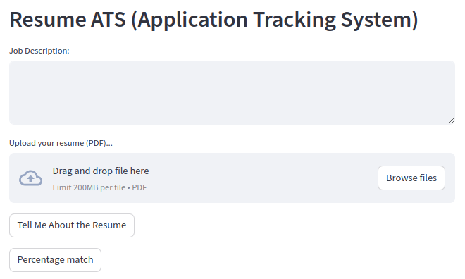
09.13 Test Resume ATS
https://www.youtube.com/watch?v=EECUXqFrwbc&list=PLZoTAELRMXVNbDmGZlcgCA3a8mRQp5axb&index=9
Test Resume ATS (27:51-30:00/34:26)
> streamlit run Resume_ATS.py

Slide 3
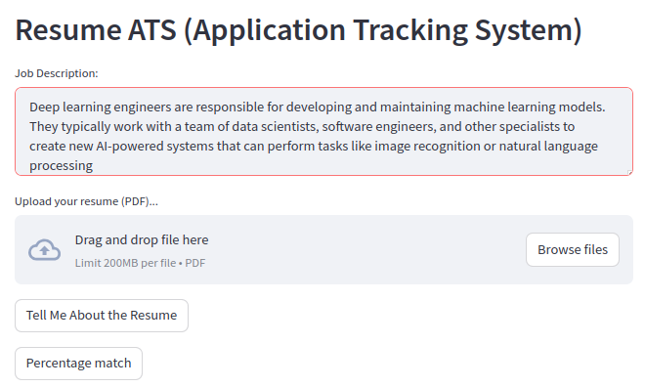
09.13 Test Resume ATS
https://www.youtube.com/watch?v=EECUXqFrwbc&list=PLZoTAELRMXVNbDmGZlcgCA3a8mRQp5axb&index=9
Test Resume ATS (30:01-31:00/34:26)
Job Description:
Deep learning engineers are responsible for developing and maintaining machine learning models. They typically work with a team of data scientists, software engineers, and other specialists to create new AI-powered systems that can perform tasks like image recognition or natural language processing

Slide 4
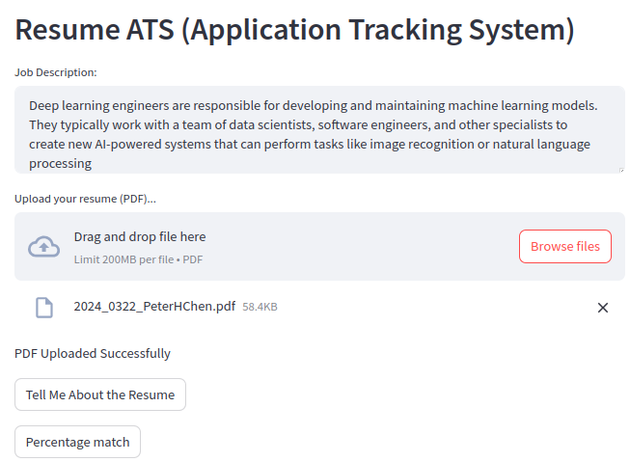
09.13 Test Resume ATS
https://www.youtube.com/watch?v=EECUXqFrwbc&list=PLZoTAELRMXVNbDmGZlcgCA3a8mRQp5axb&index=9
Test Resume ATS (31:01-32:00/34:26)
Load pdf resume: If you resume in word format. Export into pdf format.

Slide 5
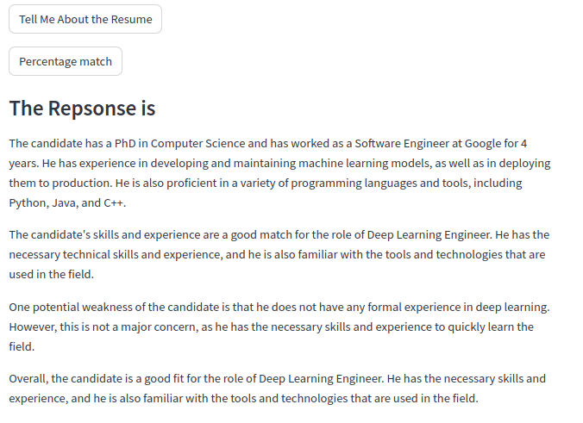
09.13 Test Resume ATS
https://www.youtube.com/watch?v=EECUXqFrwbc&list=PLZoTAELRMXVNbDmGZlcgCA3a8mRQp5axb&index=9
Test Resume ATS (32:01-33:00/34:26)
Click “Tell me about Resume”

Slide 6
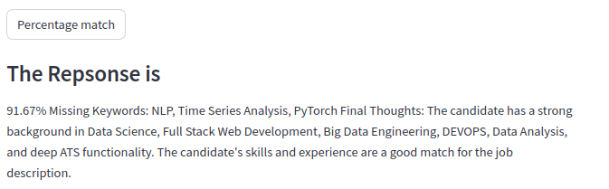
09.13 Test Resume ATS
https://www.youtube.com/watch?v=EECUXqFrwbc&list=PLZoTAELRMXVNbDmGZlcgCA3a8mRQp5axb&index=9
Test Resume ATS (23:01-34:26/34:26)
Click “Percentage match”: 91.8% match keywords.

Slide 7
End

