Slide 1

03 LC/GPT to LC/Gemini
Peter H. Chen

Slide 2


03 LC/GPT to LC/Gemini
https://www.youtube.com/watch?v=phHqvLHCwH4&list=PL8motc6AQftk1Bs42EW45kwYbyJ4jOdiZ&index=3
LC/GPT to LC/Gemini (00:00-00:10/11:15)
We migrates the code from LangChain/(OpenAI GPT) into LangChain/(Google Gemini).

Slide 3
03.01 LC/GPT

Slide 4

03.01 LC/GPT
https://www.youtube.com/watch?v=phHqvLHCwH4&list=PL8motc6AQftk1Bs42EW45kwYbyJ4jOdiZ&index=3
LC/GPT (00:00-00:10/11:15)
First, we look at LangChain/OpenAI GPT API.

Slide 5
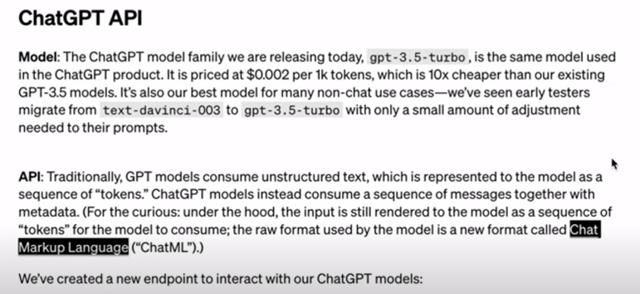
03.01 LC/GPT
https://www.youtube.com/watch?v=phHqvLHCwH4&list=PL8motc6AQftk1Bs42EW45kwYbyJ4jOdiZ&index=3
LC/GPT (01:11-02:50/11:15)
Price $0.002/(1K Token).

Slide 6
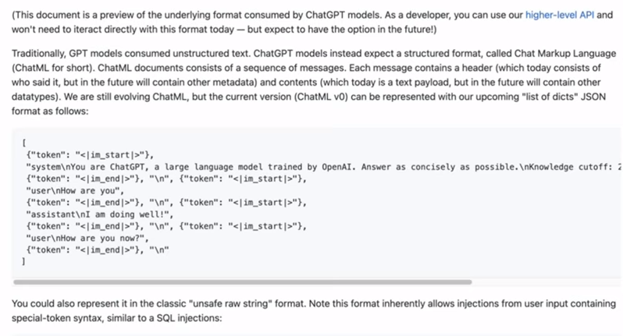
03.01 LC/GPT
https://www.youtube.com/watch?v=phHqvLHCwH4&list=PL8motc6AQftk1Bs42EW45kwYbyJ4jOdiZ&index=3
LC/GPT (01:01-01:30/11:15)

Slide 7
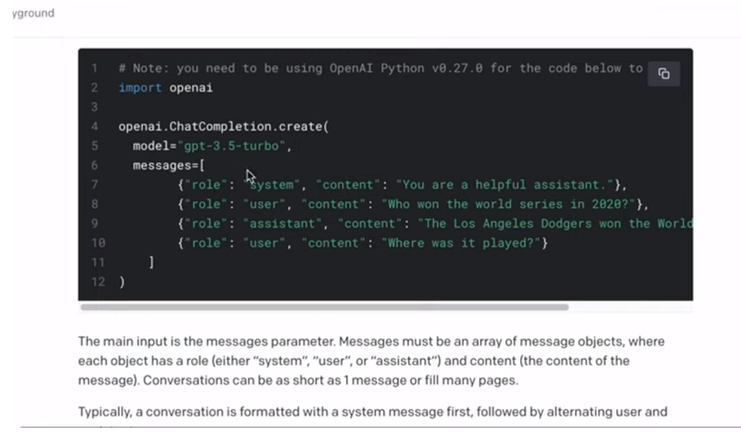
03.01 LC/GPT
https://www.youtube.com/watch?v=phHqvLHCwH4&list=PL8motc6AQftk1Bs42EW45kwYbyJ4jOdiZ&index=3
LC/GPT (02:51-03:30/11:15)
Price $0.002/(1K Token).

Slide 8
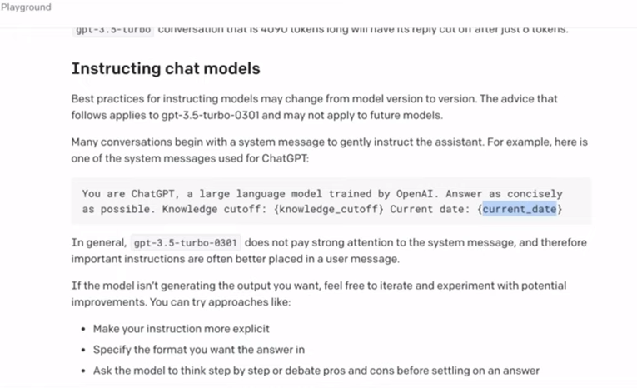
03.01 LC/GPT
https://www.youtube.com/watch?v=phHqvLHCwH4&list=PL8motc6AQftk1Bs42EW45kwYbyJ4jOdiZ&index=3
LC/GPT (03:31-04:30/11:15)

Slide 9
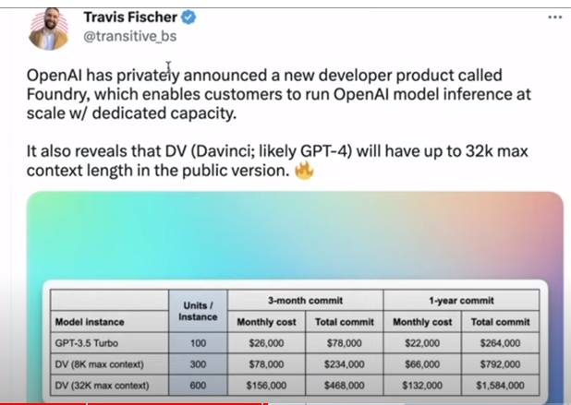
03.01 LC/GPT
https://www.youtube.com/watch?v=phHqvLHCwH4&list=PL8motc6AQftk1Bs42EW45kwYbyJ4jOdiZ&index=3
LC/GPT (04:31-05:00/11:15)

Slide 10
03.01 ChatGPT API Code Example

Slide 11
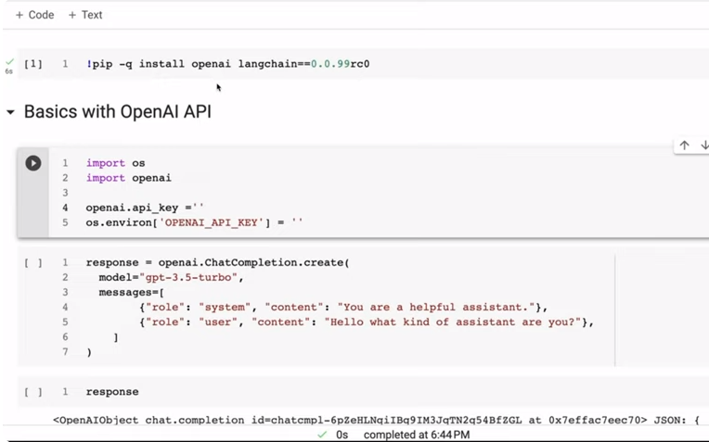
03.01 ChatGPT API Code Example
https://www.youtube.com/watch?v=phHqvLHCwH4&list=PL8motc6AQftk1Bs42EW45kwYbyJ4jOdiZ&index=3
ChatGPT API Code Example (04:31-05:30/11:15)

Slide 12
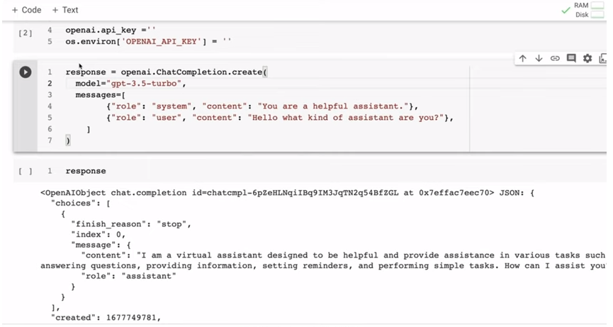
03.01 ChatGPT API Code Example
https://www.youtube.com/watch?v=phHqvLHCwH4&list=PL8motc6AQftk1Bs42EW45kwYbyJ4jOdiZ&index=3
ChatGPT API Code Example (05:31-05:30/11:15)

Slide 13
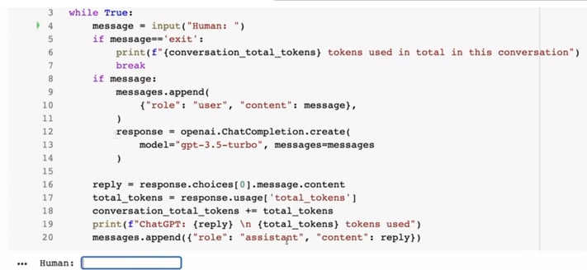
03.01 ChatGPT API Code Example
https://www.youtube.com/watch?v=phHqvLHCwH4&list=PL8motc6AQftk1Bs42EW45kwYbyJ4jOdiZ&index=3
ChatGPT API Code Example (05:31-07:30/11:15)

Slide 14
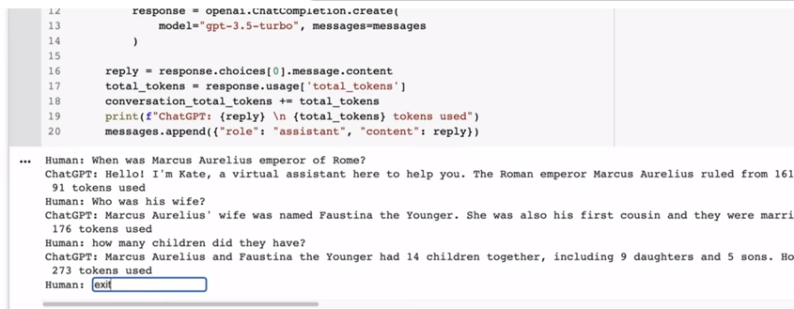
03.01 ChatGPT API Code Example
https://www.youtube.com/watch?v=phHqvLHCwH4&list=PL8motc6AQftk1Bs42EW45kwYbyJ4jOdiZ&index=3
ChatGPT API Code Example (07:31-08:30/11:15)

Slide 15
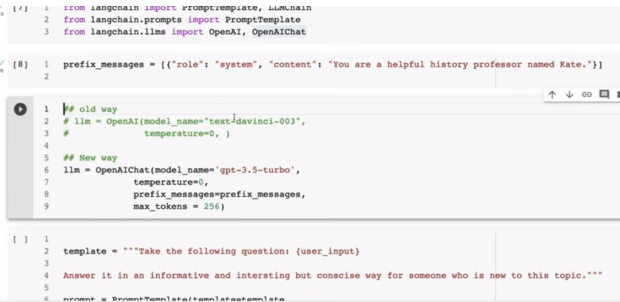
03.01 ChatGPT API Code Example
https://www.youtube.com/watch?v=phHqvLHCwH4&list=PL8motc6AQftk1Bs42EW45kwYbyJ4jOdiZ&index=3
ChatGPT API Code Example (08:31-09:30/11:15)

Slide 16
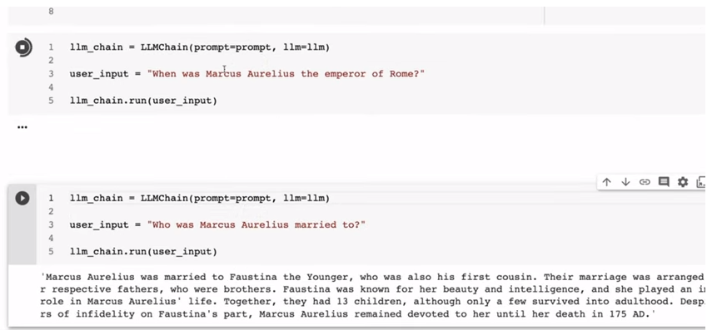
03.01 ChatGPT API Code Example
https://www.youtube.com/watch?v=phHqvLHCwH4&list=PL8motc6AQftk1Bs42EW45kwYbyJ4jOdiZ&index=3
ChatGPT API Code Example (09:31-10:30/11:15)

Slide 17
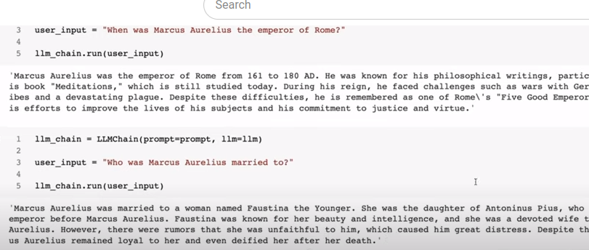
03.01 ChatGPT API Code Example
https://www.youtube.com/watch?v=phHqvLHCwH4&list=PL8motc6AQftk1Bs42EW45kwYbyJ4jOdiZ&index=3
ChatGPT API Code Example (10:31-11:30/11:15)

Slide 18
End

