Slide 1

03.01 LC/GPT to LC/Gem Code
Peter H. Chen

Slide 2
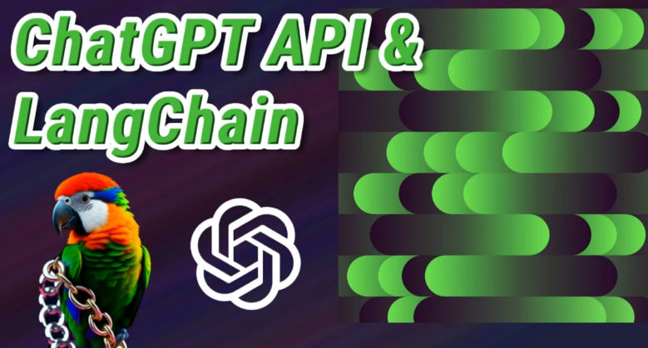

03.01 LC/GPT to LC/Gem Code
https://www.youtube.com/watch?v=phHqvLHCwH4&list=PL8motc6AQftk1Bs42EW45kwYbyJ4jOdiZ&index=3
LC/GPT to LC/Gem Code (04:31-05:30/11:15)
# LC/GPT is commented out.
We only migrate into Google Gemini.

Slide 3
03.02 Install Gemini and LC/Gemini

Slide 4
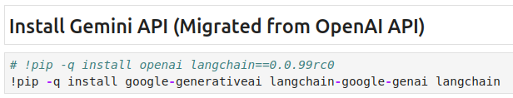
03.02 Install Gemini and LC/Gemini
https://www.youtube.com/watch?v=phHqvLHCwH4&list=PL8motc6AQftk1Bs42EW45kwYbyJ4jOdiZ&index=3
Install Gemini and LC/Gemini (05:31-06:00/11:15)
> !pip -q install google-generativeai langchain-google-genai langchain
1. Install google-generativeai: Google LLM (Large Language Model) Gemini
2. langchain-google-genai: LangChain API for Google Gemini Model.

Slide 5
03.03 Basic with Gemini API

Slide 6
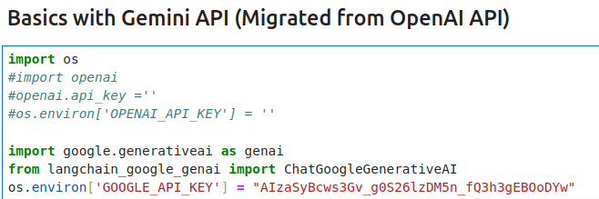
03.03 Basic with Gemini API
https://www.youtube.com/watch?v=phHqvLHCwH4&list=PL8motc6AQftk1Bs42EW45kwYbyJ4jOdiZ&index=3
Basic with Gemini API (06:01-06:30/11:15)
Import libraries

Slide 7
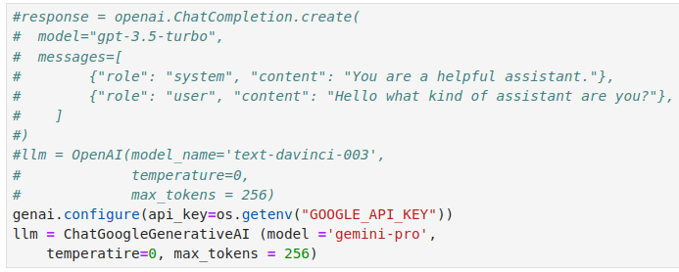
03.03 Basic with Gemini API
https://www.youtube.com/watch?v=phHqvLHCwH4&list=PL8motc6AQftk1Bs42EW45kwYbyJ4jOdiZ&index=3
Basic with Gemini API (06:31-07:00/11:15)
1. Get API Key
2. Load LLM Google Gemini

Slide 8
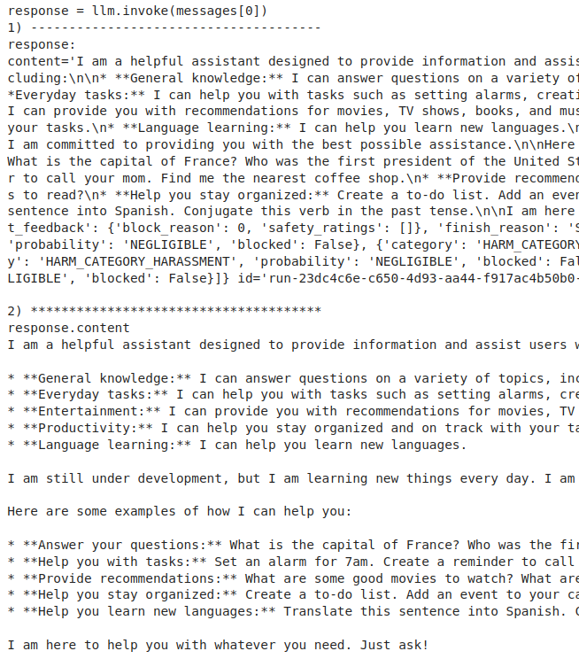
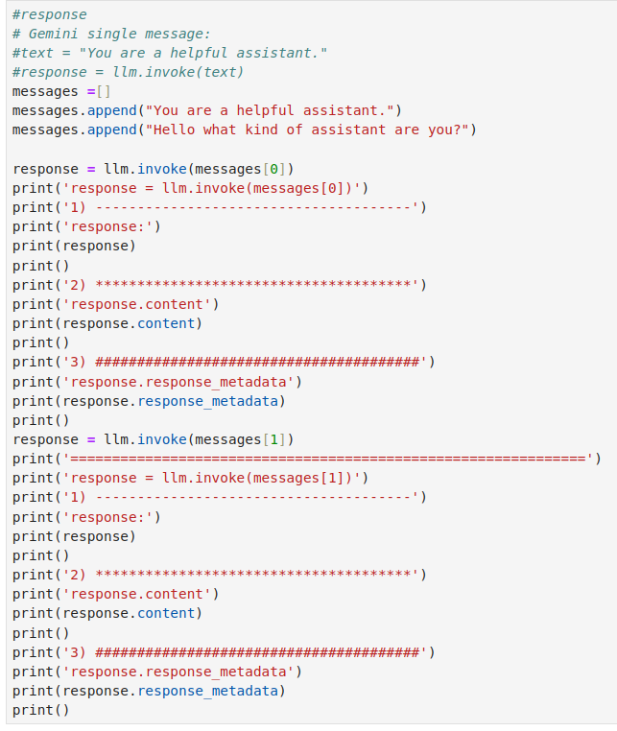
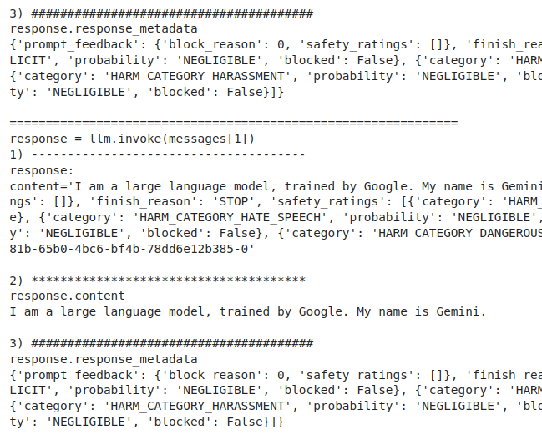
03.03 Basic with Gemini API
https://www.youtube.com/watch?v=phHqvLHCwH4&list=PL8motc6AQftk1Bs42EW45kwYbyJ4jOdiZ&index=3
Basic with Gemini API (07:01-07:30/11:15)
Test input and response.

Slide 9
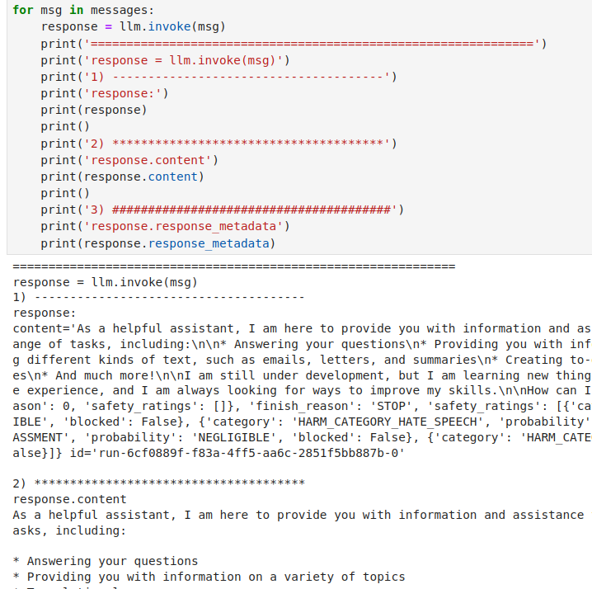
03.03 Basic with Gemini API
https://www.youtube.com/watch?v=phHqvLHCwH4&list=PL8motc6AQftk1Bs42EW45kwYbyJ4jOdiZ&index=3
Basic with Gemini API (07:31-08:00/11:15)
Test looping list for input and response.

Slide 10
03.04 Gemini with LangChain

Slide 11
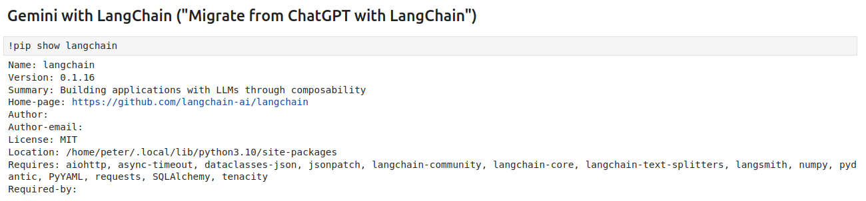
03.04 Gemini with LangChain
https://www.youtube.com/watch?v=phHqvLHCwH4&list=PL8motc6AQftk1Bs42EW45kwYbyJ4jOdiZ&index=3
Gemini with LangChain (08:01-08:30/11:15)

Slide 12
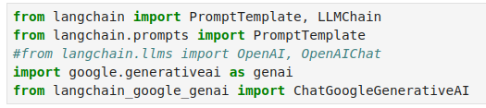
03.04 Gemini with LangChain
https://www.youtube.com/watch?v=phHqvLHCwH4&list=PL8motc6AQftk1Bs42EW45kwYbyJ4jOdiZ&index=3
Gemini with LangChain (08:31-09:00/11:15)
Import LangChain Libraries

Slide 13
03.05 Setup Gemini Model

Slide 14
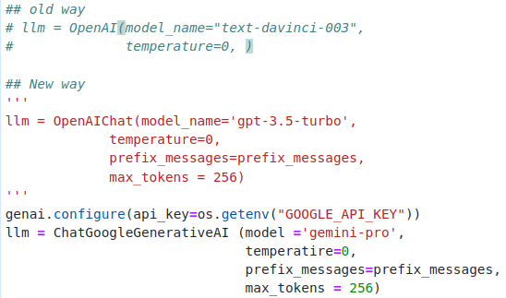
03.05 Setup Gemini Model
https://www.youtube.com/watch?v=phHqvLHCwH4&list=PL8motc6AQftk1Bs42EW45kwYbyJ4jOdiZ&index=3
Setup Gemini Model (09:01-09:30/11:15)
Setup model, temperature, prefix messages, max_tokens.

Slide 15
03.06 Setup Template and Prompt

Slide 16
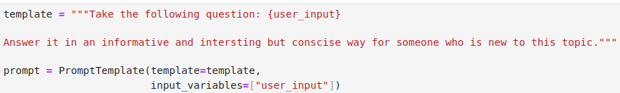
03.06 Setup Template and Prompt
https://www.youtube.com/watch?v=phHqvLHCwH4&list=PL8motc6AQftk1Bs42EW45kwYbyJ4jOdiZ&index=3
Setup Template and Prompt (09:01-09:30/11:15)
Setup template and prompt (= template + input_variables)

Slide 17
03.07 LangChain with LLM

Slide 18
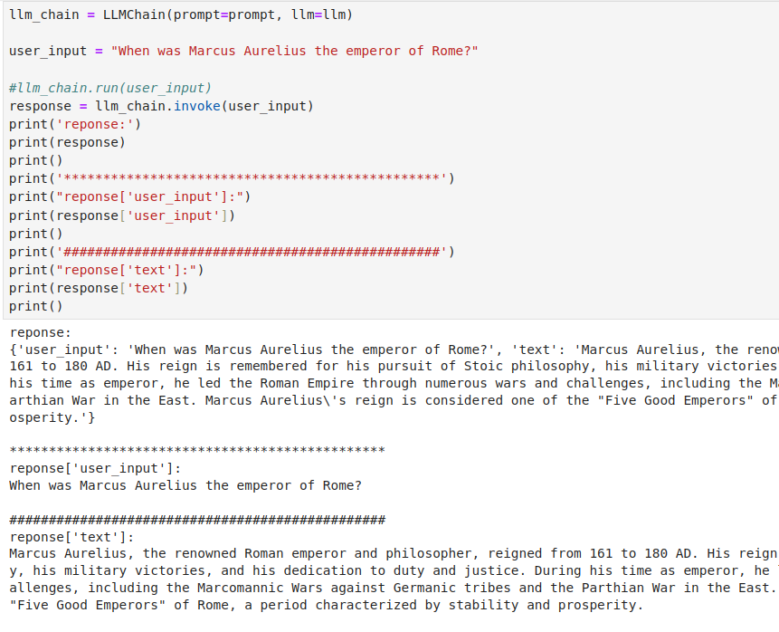
03.07 LangChain with LLM
https://www.youtube.com/watch?v=phHqvLHCwH4&list=PL8motc6AQftk1Bs42EW45kwYbyJ4jOdiZ&index=3
LangChain with LLM (1) (09:31-10:30/11:15)
Use LangChain with Gemini Model.

Slide 19
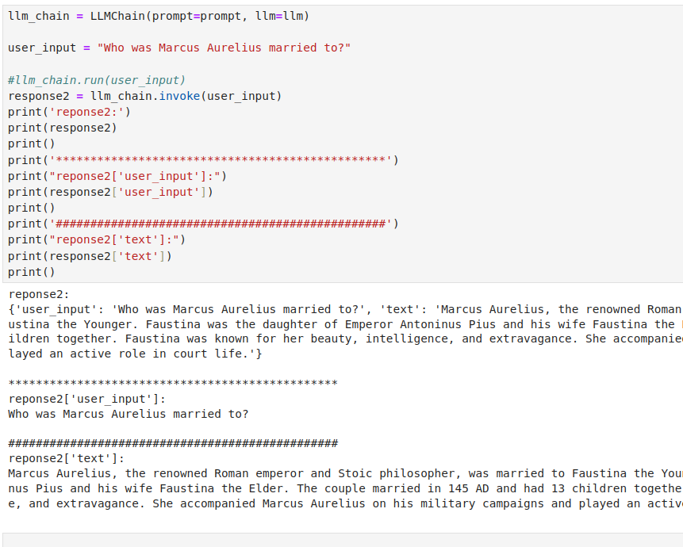
03.07 LangChain with LLM
https://www.youtube.com/watch?v=phHqvLHCwH4&list=PL8motc6AQftk1Bs42EW45kwYbyJ4jOdiZ&index=3
LangChain with LLM (10:31-11:15/11:15)
Another test of LangChain with Gemini Model.

Slide 20
End

