Slide 1

1.02 Install and Setup
Peter H. Chen

Slide 2
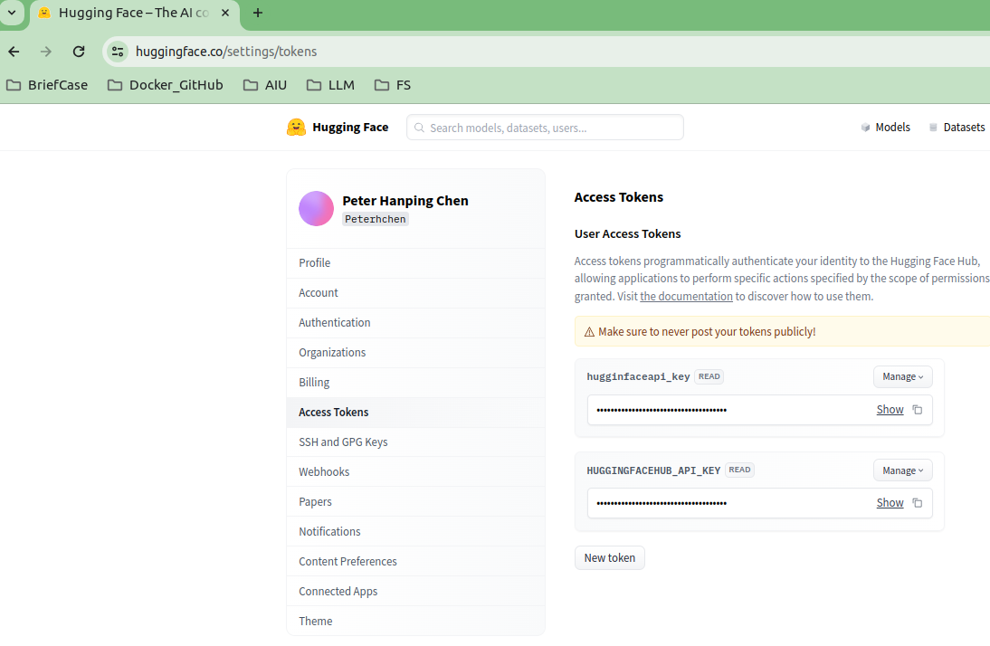
1.02 Install and Setup
https://www.youtube.com/watch?v=nAmC7SoVLd8&list=PLeo1K3hjS3uu0N_0W6giDXzZIcB07Ng_F&index=1
Setup API Key (04:34-04:50/46:07)
HuggingFace Store and Host LLM models. To use LangChain to access all the LLM Models and Tools, we need to create HuggingFace Token Key.

Slide 3
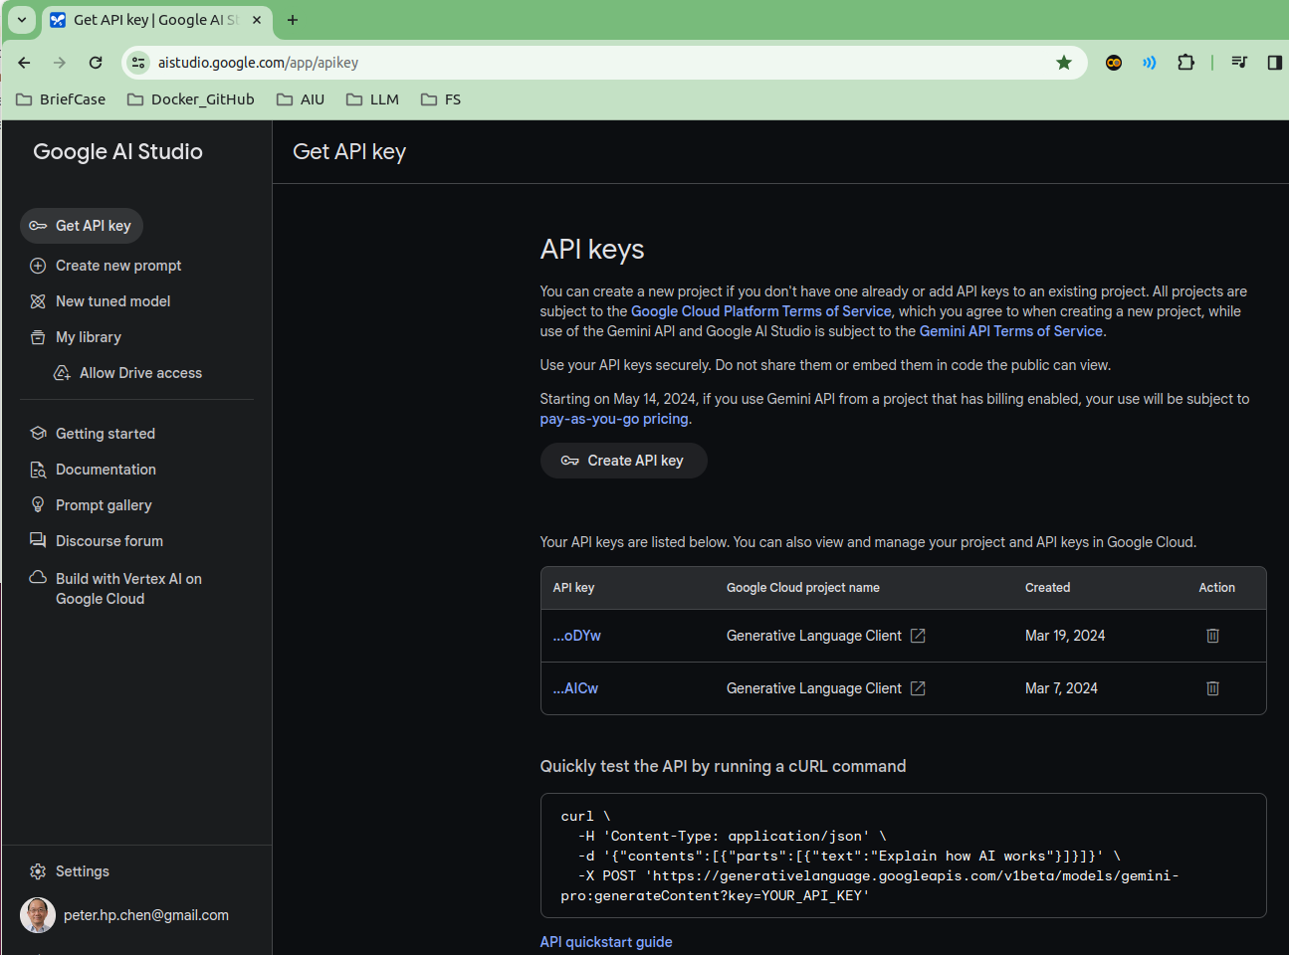
1.02 Install and Setup
https://www.youtube.com/watch?v=nAmC7SoVLd8&list=PLeo1K3hjS3uu0N_0W6giDXzZIcB07Ng_F&index=1
Setup API Key (04:51-05:00/46:07)
To use Google Gemini, we need to create Google API Key.

Slide 4
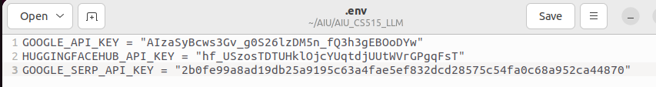
1.02 Install and Setup
https://www.youtube.com/watch?v=nAmC7SoVLd8&list=PLeo1K3hjS3uu0N_0W6giDXzZIcB07Ng_F&index=1
Setup API Key (05:01-05:02/46:07)
We copy and paste to the environment variables
1. GOOGLE_API_KEY
2. HUGGINGFACEHUB_API_KEY
3. GOOGLE_SERP_API_KEY # Google Search platform.
to the “.env” file

Slide 5
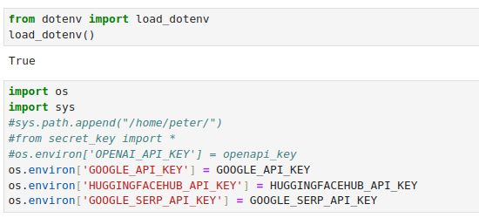
1.02 Install and Setup
https://www.youtube.com/watch?v=nAmC7SoVLd8&list=PLeo1K3hjS3uu0N_0W6giDXzZIcB07Ng_F&index=1
Setup API Key (05:03-05:04/46:07)
In your application, we use load_dotenv() (or import secret_key.py) to load the defined environment variables, GOOGLE_API_KEY and HUGGINGFACEHUB_API_KEY, respectively.
load_dotenv()
os.envision [‘GOOGLE_API_KEY’] = GOOGLE_API_KEY

Slide 6
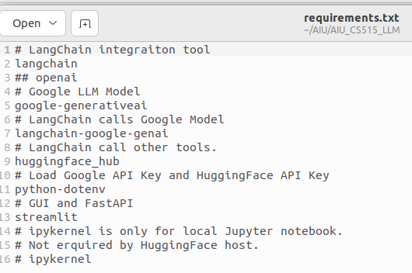
1.02 Install and Setup
https://www.youtube.com/watch?v=nAmC7SoVLd8&list=PLeo1K3hjS3uu0N_0W6giDXzZIcB07Ng_F&index=1
Install Requirements.txt (05:05-05:06/46:07)
Create conda environment and activate conda environment
> conda create --name gemini
> conda activate gemini
Below are the requirements.txt
> pip install -r requirements.txt

Slide 7
1.03 LLM and Prompt Template

Slide 8
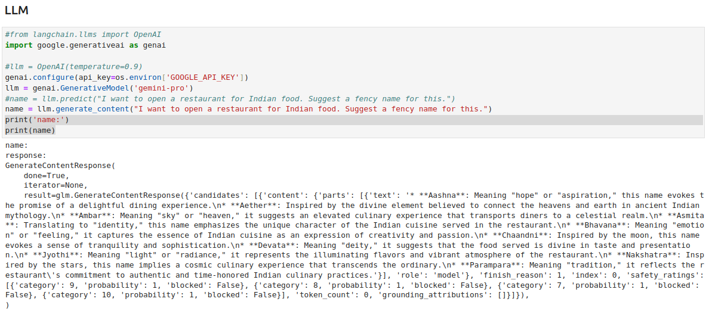
1.03 LLM and Prompt Template
https://www.youtube.com/watch?v=nAmC7SoVLd8&list=PLeo1K3hjS3uu0N_0W6giDXzZIcB07Ng_F&index=1
LLM (06:21-06:30/46:07)
Configure Gemini

Slide 9
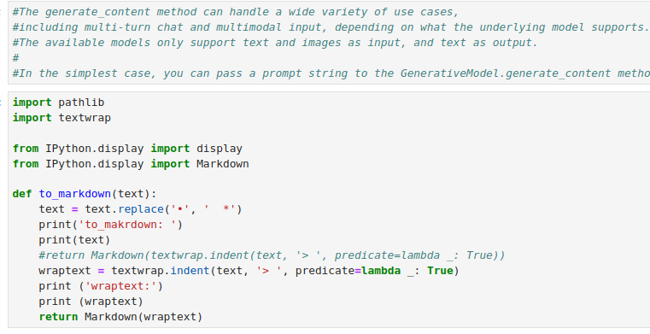
1.03 LLM and Prompt Template
https://www.youtube.com/watch?v=nAmC7SoVLd8&list=PLeo1K3hjS3uu0N_0W6giDXzZIcB07Ng_F&index=1
LLM (06:31-07:00/46:07)
Define text to print the markdown

Slide 10
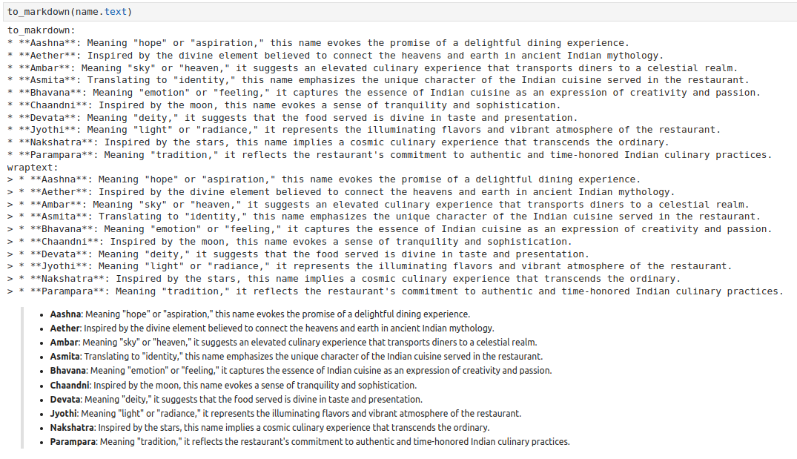
1.03 LLM and Prompt Template
https://www.youtube.com/watch?v=nAmC7SoVLd8&list=PLeo1K3hjS3uu0N_0W6giDXzZIcB07Ng_F&index=1
LLM (07:01-08:30/46:07)
Print the result:

Slide 11
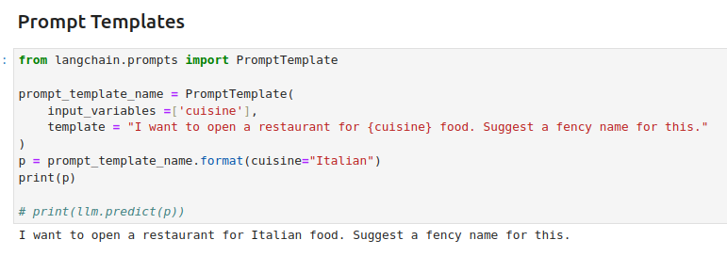
1.03 LLM and Prompt Template
https://www.youtube.com/watch?v=nAmC7SoVLd8&list=PLeo1K3hjS3uu0N_0W6giDXzZIcB07Ng_F&index=1
Prompt Template (08:31-10:10/46:07)

Slide 12
1.04 Chain

Slide 13
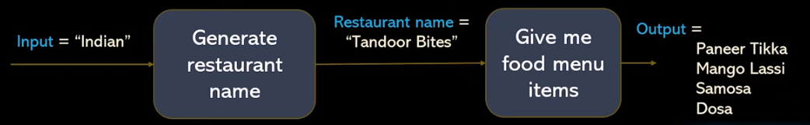
1.04 Chain
https://www.youtube.com/watch?v=nAmC7SoVLd8&list=PLeo1K3hjS3uu0N_0W6giDXzZIcB07Ng_F&index=1
Chain (10:11-10:12/46:07)
LangChain Concept
1. Schema: LangChain has several abstractions to make working with agents easy.
2. Agent:
2.1 Agent is the chain responsible for deciding what step to take next. This is usually powered by a language model, a prompt, and an output parser.
2.2 Different agents have different prompting styles for reasoning, different ways of encoding inputs, and different ways of parsing the output. For a full list of built-in agents see agent types. You can also easily build custom agents, should you need further control.
3. Tools:
3.1 Tools are functions that an agent can invoke. The Tool abstraction consists of two components:
3.2 The input schema for the tool. This tells the LLM what parameters are needed to call the tool. Without this, it will not know what the correct inputs are. These parameters should be sensibly named and described.
3.3 The function to run. This is generally just a Python function that is invoked.
https://python.langchain.com/v0.1/docs/modules/agents/concepts/#:~:text=Agent%E2%80%8B,ways%20of%20parsing%20the%20output.
Agent
(chain)
Tool
(Function)

Slide 14
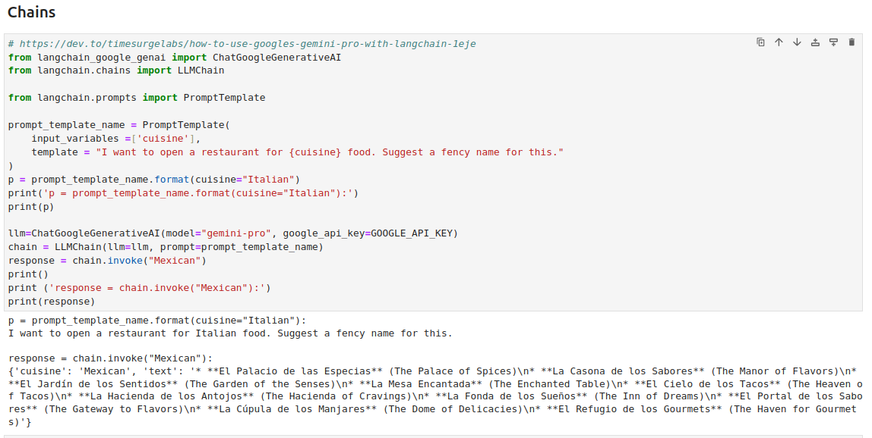
1.04 Chain
https://www.youtube.com/watch?v=nAmC7SoVLd8&list=PLeo1K3hjS3uu0N_0W6giDXzZIcB07Ng_F&index=1
Chain (10:13-11:20/46:07)
1. Define prompt
2. Load Google chat Model
3. Use LangChain function LLMChain to integrate input prompt and Google Chat Model.

Slide 15
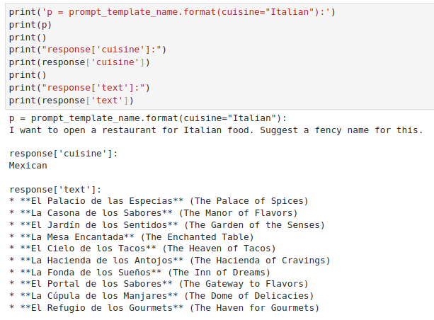
1.04 Chain
https://www.youtube.com/watch?v=nAmC7SoVLd8&list=PLeo1K3hjS3uu0N_0W6giDXzZIcB07Ng_F&index=1
Chain (10:21-10:30/46:07)
Print the response.

Slide 16
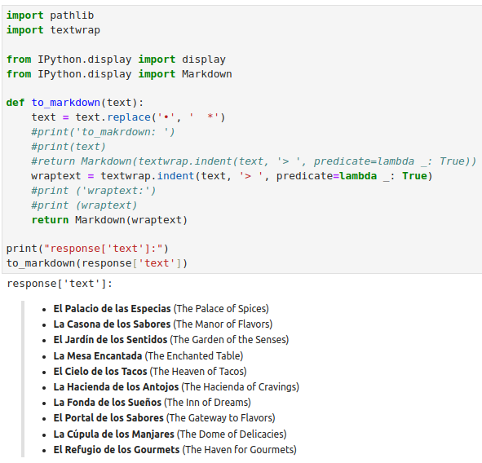
1.04 Chain
https://www.youtube.com/watch?v=nAmC7SoVLd8&list=PLeo1K3hjS3uu0N_0W6giDXzZIcB07Ng_F&index=1
Chain (10:31-11:50/46:07)
Convert the text into Markdown.

Slide 17
End

