Slide 1

01.05 Install LC, Gemini, and HF
Peter H. Chen

Slide 2
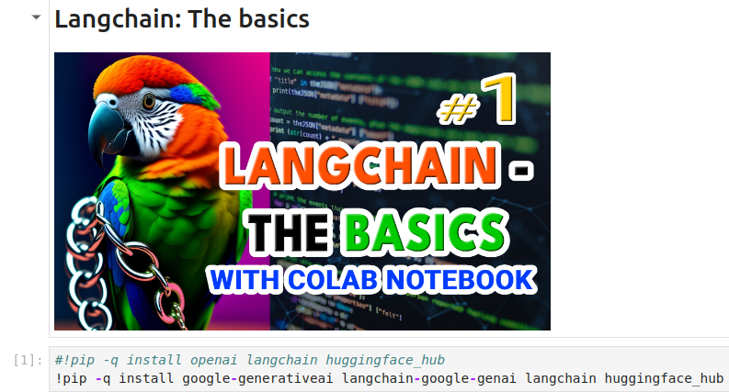
01.05 Install LC, Gemini, and HF
https://www.youtube.com/watch?v=J_0qvRt4LNk&list=PL8motc6AQftk1Bs42EW45kwYbyJ4jOdiZ&index=1
Install LC, Gemini, and HF (08:31-09:00/19:38)
Let’s jump into the code. Below is the Python Jupyter Notes run under Colab.
We install
1. google-generativeai: Gemini Model
2. langchain-google-genai:LangChain Google interface
3. LangChain: Frame for LangChain framework functions
4. huggingface_hub: HuggingFace provides the end point space (storage and server) of Gemini Model and other language models.

Slide 3
01.06 API Key for Gemini and HF

Slide 4
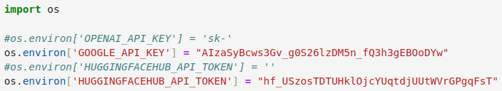
01.06 API Key for Gemini and HF
https://www.youtube.com/watch?v=J_0qvRt4LNk&list=PL8motc6AQftk1Bs42EW45kwYbyJ4jOdiZ&index=1
API Key for Gemini and HF (08:31-09:10/19:38)
Get API Key for Google LLM Gemini and HuggingFace Hub for LangChain Language model.

Slide 5
01.07 Plain Gemini Model

Slide 6
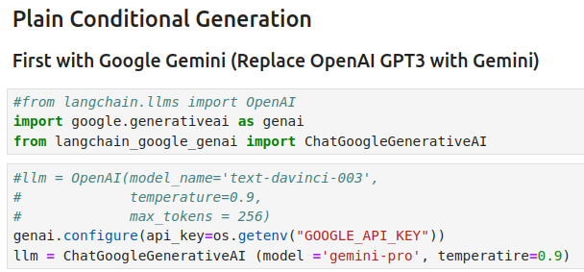
01.07 Plain Gemini Model
https://www.youtube.com/watch?v=J_0qvRt4LNk&list=PL8motc6AQftk1Bs42EW45kwYbyJ4jOdiZ&index=1
Plain Gemini Model (09:11-09:30/19:38)
We replace OpenAI GPT with Google Gemini Model.
We set high temperature for very random output.

Slide 7
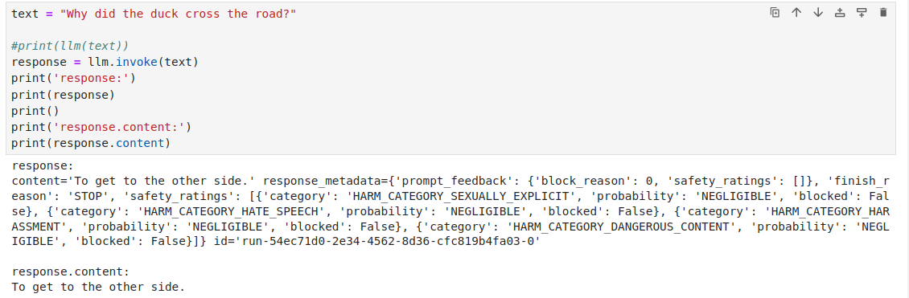
01.07 Plain Gemini Model
https://www.youtube.com/watch?v=J_0qvRt4LNk&list=PL8motc6AQftk1Bs42EW45kwYbyJ4jOdiZ&index=1
Plain Gemini Model (09:11-10:40/19:38)
We input the question: “Why did the ducks cross the road?”
Answer: To get to the other side.

Slide 8
01.08 T5-Flan-SMALL/LARGE/XL

Slide 9
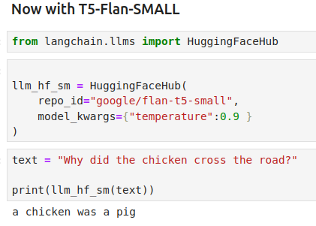
01.08 T5-Flan-SMALL/LARGE
https://www.youtube.com/watch?v=J_0qvRt4LNk&list=PL8motc6AQftk1Bs42EW45kwYbyJ4jOdiZ&index=1
T5-Flan-SMALL/LARGE (09:41-10:30/19:38)
T5-Flan-SMALL is a very small language model from google.
Different language model may get different response. Here answer is “a chicken was a pig”. Maybe the incorrect answer.

Slide 10
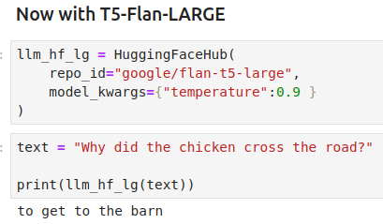
01.08 T5-Flan-SMALL/LARGE
https://www.youtube.com/watch?v=J_0qvRt4LNk&list=PL8motc6AQftk1Bs42EW45kwYbyJ4jOdiZ&index=1
T5-Flan-SMALL/LARGE (10:31-11:30/19:38)
We try T5-Flan-LARGE is large language model from google.
The answer is better, “To get toe the barn.”
Since T5-Flan-XL requires 10 GB memory which is exceed the colab limit, we do not try it here.

Slide 11
01.09 Prompt Templates

Slide 12
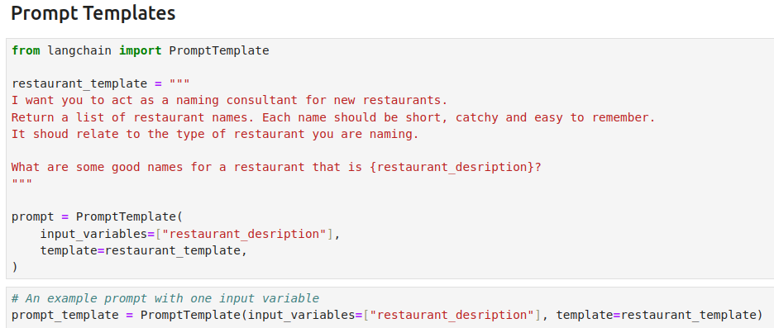
01.09 Prompt Templates
https://www.youtube.com/watch?v=J_0qvRt4LNk&list=PL8motc6AQftk1Bs42EW45kwYbyJ4jOdiZ&index=1
Prompt Templates (11:31-12:30/19:38)
Now, we create a restaurant template. This make LangChain to become very useful.
We want to create an app. The app taking a description of a restaurant and create a name of the restaurant.
Below is our restaurant prompt:
“I want you to be the naming consultant of restaurant. You give me a good name for restaurant....”

Slide 13
01.09 Prompt Templates
https://www.youtube.com/watch?v=J_0qvRt4LNk&list=PL8motc6AQftk1Bs42EW45kwYbyJ4jOdiZ&index=1
Prompt Templates (12:31-13:17/19:38)
1. Here, we put the restaurant description in {restaurant_description}
2. We add [“restaurant_description”] in the PromptTemplates
3. We add restaurant_template in the PromptTemplates.
1
3
2

Slide 14
01.10 User Question

Slide 15
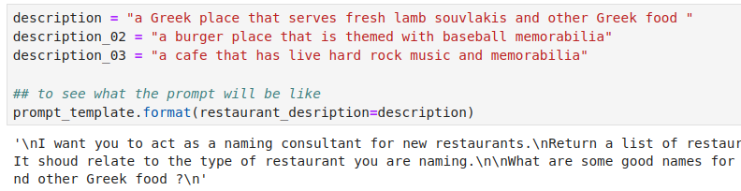
01.10 User Question
https://www.youtube.com/watch?v=J_0qvRt4LNk&list=PL8motc6AQftk1Bs42EW45kwYbyJ4jOdiZ&index=1
User Quesiton (13:21-14:00/19:38)
1. After we define the prompt templates, now, the user can input any question and ask for creation of restaurant name.
2. Check the prompt format with different questions

Slide 16
01.11 Chain Different Model/Question

Slide 17
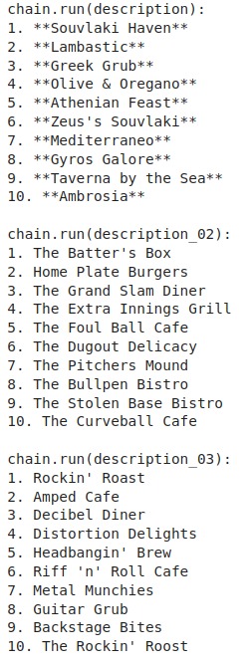
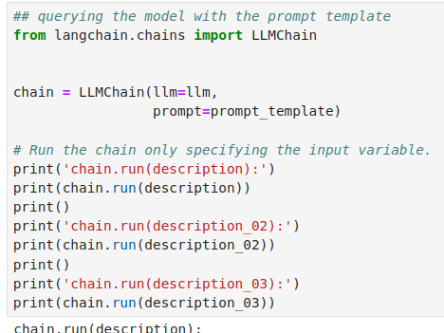
01.11 Chain Different Model/Question
https://www.youtube.com/watch?v=J_0qvRt4LNk&list=PL8motc6AQftk1Bs42EW45kwYbyJ4jOdiZ&index=1
Chain with Model/Question (13:21-16:10/19:38)
Here, we chain with the same language and promptTemplate with different quesiton.

Slide 18
01.12 Few Shot Prompt Template

Slide 19
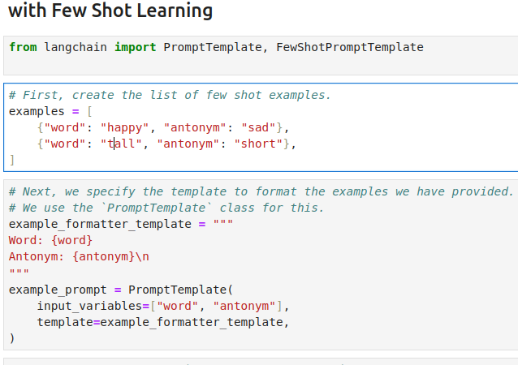
01.12 Few Shot Promt Template
https://www.youtube.com/watch?v=J_0qvRt4LNk&list=PL8motc6AQftk1Bs42EW45kwYbyJ4jOdiZ&index=1
Few Shot Prompt Template (16:21-17:30/19:38)
1. Define input variables: {word} (antonym}
2. Define input variables {word} and {Antonym} for prompt format.
3. We add input variables and template format in the PromptTemplates.
Note:
Antonym:反义词;反語(アントニム).

Slide 20
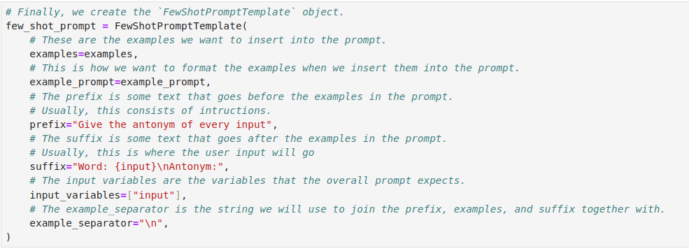
01.12 Few Shot Promt Template
https://www.youtube.com/watch?v=J_0qvRt4LNk&list=PL8motc6AQftk1Bs42EW45kwYbyJ4jOdiZ&index=1
Few Shot Prompt Template (17:31-18:30/19:38)
Here, we define the private quesiton and answer.

Slide 21
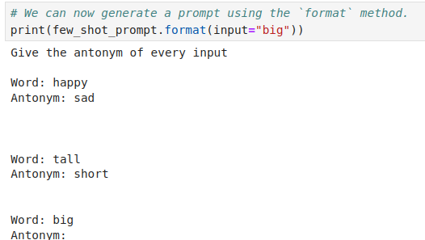
01.12 Few Shot Promt Template
https://www.youtube.com/watch?v=J_0qvRt4LNk&list=PL8motc6AQftk1Bs42EW45kwYbyJ4jOdiZ&index=1
Few Shot Prompt Template (17:31-18:00/19:38)
In private database, we only define happy and tail.
So, there is no answer for ‘big’ for private database. The answer is empty (‘’).

Slide 22
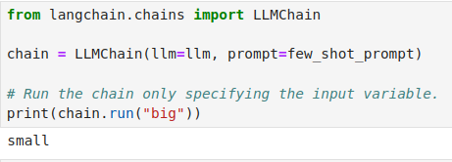
01.12 Few Shot Promt Template
https://www.youtube.com/watch?v=J_0qvRt4LNk&list=PL8motc6AQftk1Bs42EW45kwYbyJ4jOdiZ&index=1
Few Shot Prompt Template (18:01-19:38/19:38)
We ask for the LLM to answer for the other quesiton.
How to come up all question and answer with all the tools chain together?
We will discuss the tool chains in the next.

Slide 23
End

