Slide 1

07.06 Health Management App
Peter H. Chen

Slide 2
07.06 Health Management App
https://www.youtube.com/watch?v=1ICRLYtkmNU&list=PLZoTAELRMXVNbDmGZlcgCA3a8mRQp5axb&index=7
Health Management App (02:03:26-02:03:25/2:16:34)
We develop the Health Management App which is responsible in counting our calories that we eat, for example, breakfast, lunch, or dinner.
We develop the App with the help of the Gemini-pro-vision Model API.
We download the image of the food we eat, then ask Google Gemini-pro-vision Model how much calories we consume. Based on the input, Gemini-pro-vision should response the answer.

Slide 3
07.06.01 Create API Key

Slide 4

07.06.01 Create API Key
https://www.youtube.com/watch?v=1ICRLYtkmNU&list=PLZoTAELRMXVNbDmGZlcgCA3a8mRQp5axb&index=7
Create API Key (02:03:26-02:04:20/2:16:34)
Paste API Key to GOOGLE_API_KEY = “…”
Save in the “.env” file.

Slide 5
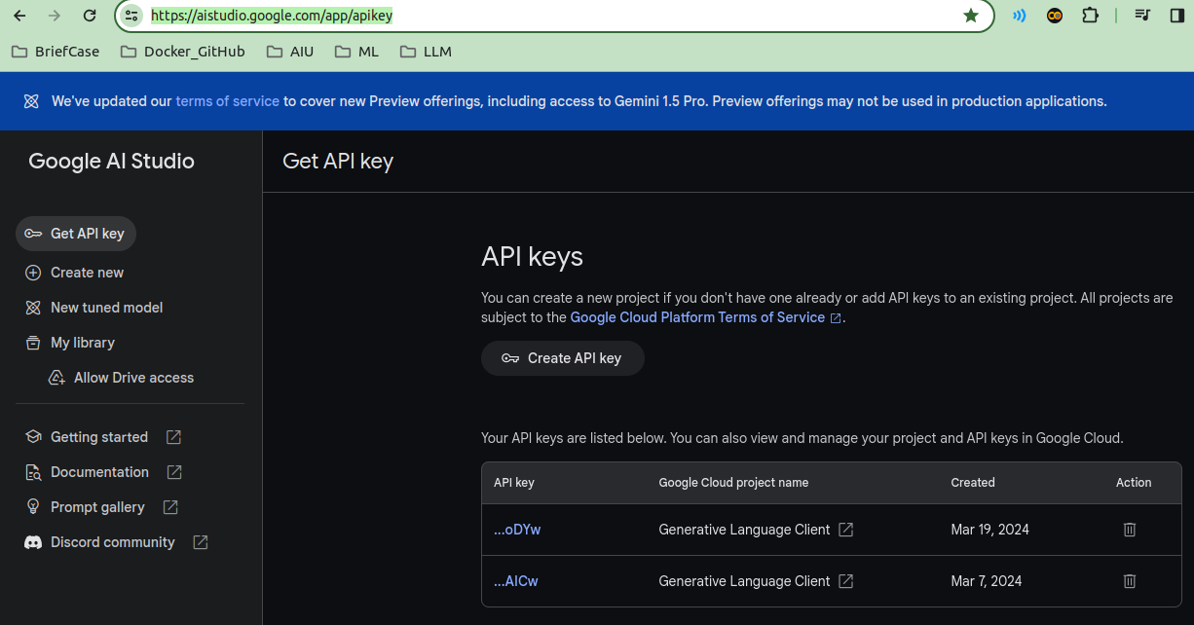
07.06.01 Create API Key
https://www.youtube.com/watch?v=1ICRLYtkmNU&list=PLZoTAELRMXVNbDmGZlcgCA3a8mRQp5axb&index=7
Create API Key (02:03:26-02:04:20/2:16:34)
Google Search “Get API Key”.
Copy the API Key.
https://aistudio.google.com/app/apikey

Slide 6
End

