Slide 1

07.06.02 Load API Key and Import Library
Peter H. Chen

Slide 2
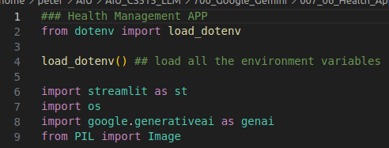
07.06.02 Load API Key and Import Library
https://www.youtube.com/watch?v=1ICRLYtkmNU&list=PLZoTAELRMXVNbDmGZlcgCA3a8mRQp5axb&index=7
Load API Key and Import Library (02:04:21-02:04:50/2:16:34)
1. Load API Key with python load_dotenv().
2. streamlit: GUI
3. os: os for get API Key from GOOGLE_API_KEY.
4. google.generativeai: Gemini Model
5. PIL (Python Image Library)

Slide 3
07.06.03 Configure Gemini Model

Slide 4
07.06.03 Configure Gemini Model
https://www.youtube.com/watch?v=1ICRLYtkmNU&list=PLZoTAELRMXVNbDmGZlcgCA3a8mRQp5axb&index=7
Configure Gemini Model (02:04:51-02:05:30/2:16:34)
1. os.getenv(“GOOGLE_API_KEY”)
2. configure Gemini Model: genai.configure (api_key = os.getenv(“GOOGLE_API_KEY”))

Slide 5
07.06.04 Load Gemini Model

Slide 6
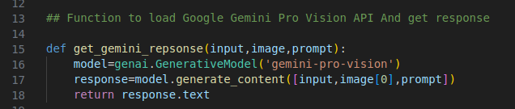
07.06.04 Load Gemini Model
https://www.youtube.com/watch?v=1ICRLYtkmNU&list=PLZoTAELRMXVNbDmGZlcgCA3a8mRQp5axb&index=7
Load Gemini Model (02:05:31-02:07:20/2:16:34)
1. Load Gemini-pro-vision
2. response = model.generate_content ([input, image[0], prompt])
2.1 Input: user input guide
2.2 Image[0]: Uploaded image
2.3 prompt: user question
3. return response.text

Slide 7
07.06.05 Read Input Image

Slide 8
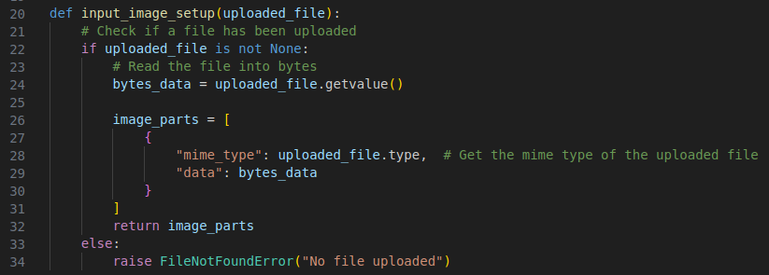
07.06.05 Read Input Image
https://www.youtube.com/watch?v=1ICRLYtkmNU&list=PLZoTAELRMXVNbDmGZlcgCA3a8mRQp5axb&index=7
Read Input Image (02:07:21-02:08:30/2:16:34)
1. Download Image and read the image.
2. Return the image data.

Slide 9
07.06.06 Create Streamlit GUI

Slide 10
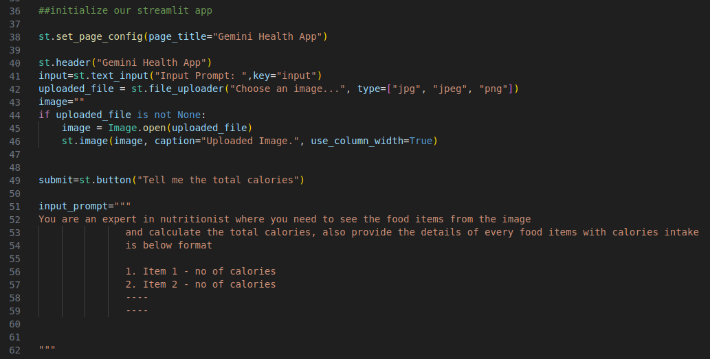
07.06.06 Create Streamlit GUI
https://www.youtube.com/watch?v=1ICRLYtkmNU&list=PLZoTAELRMXVNbDmGZlcgCA3a8mRQp5axb&index=7
Create Streamlit GUI (02:08:21-02:11:00/2:16:34)
1. Create Page Title: Gemini Health App
2. Create header: “Gemini Health App
3. Download the image: jpg, jpeg, png
4. Create submit button: Tell me the total Calories
5. input_prompt: User Guide

Slide 11
07.06.07 Process Submission

Slide 12
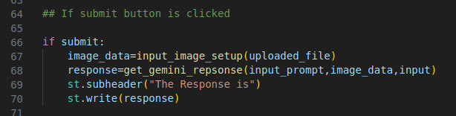
07.06.07 Process Submission
https://www.youtube.com/watch?v=1ICRLYtkmNU&list=PLZoTAELRMXVNbDmGZlcgCA3a8mRQp5axb&index=7
Create Streamlit GUI (02:11:01-02:12:20/2:16:34)
If submit is clicked:
1. get image data
2. response = get_gemini_response (user guide, image, and user question)
3. Display the response data.

Slide 13
End

