Slide 1

07.06.08 Test Health App
Peter H. Chen

Slide 2
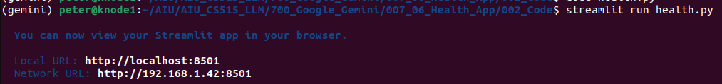
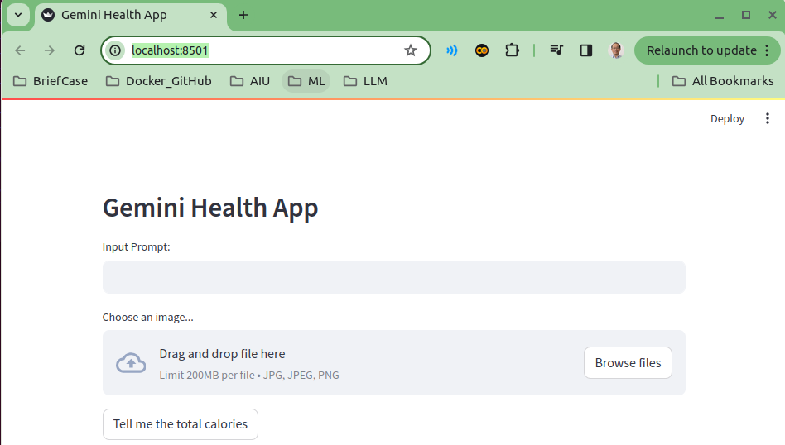
07.06.08 Test Health App
https://www.youtube.com/watch?v=1ICRLYtkmNU&list=PLZoTAELRMXVNbDmGZlcgCA3a8mRQp5axb&index=7
Test Health App (02:12:21-02:13:30/2:16:34)
> streamlit run health.py

Slide 3
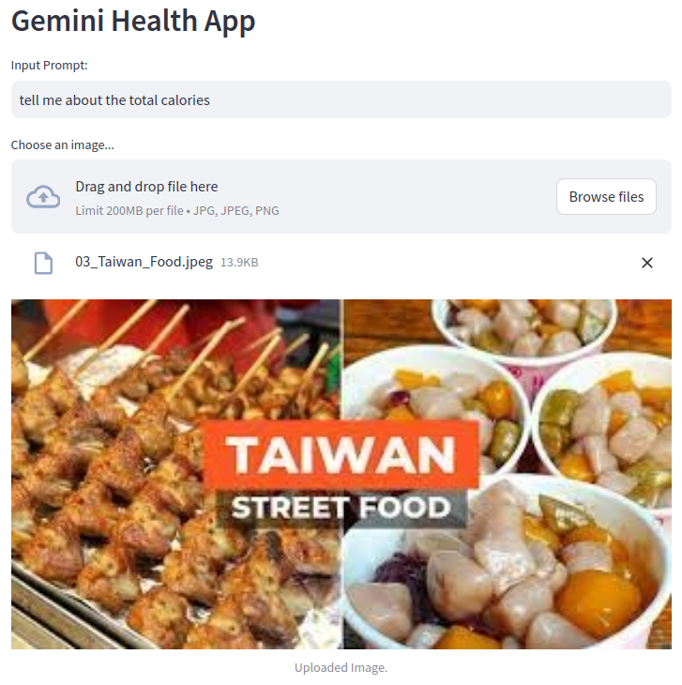
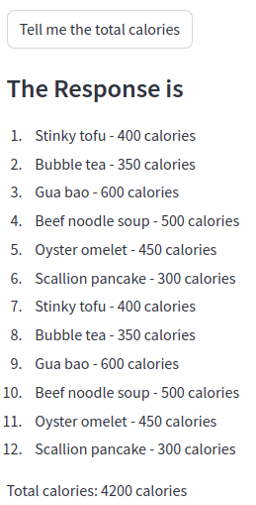
07.06.08 Test Health App
https://www.youtube.com/watch?v=1ICRLYtkmNU&list=PLZoTAELRMXVNbDmGZlcgCA3a8mRQp5axb&index=7
Test Health App (02:13:31-02:13:50/2:16:34)
1. Load Taiwanese Food
2. Question: Tell me the total calories
3. response: 200 calories

Slide 4
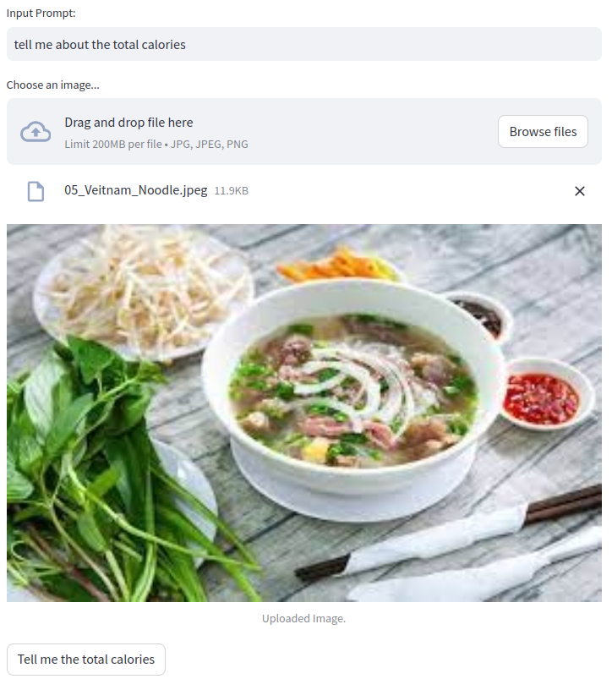
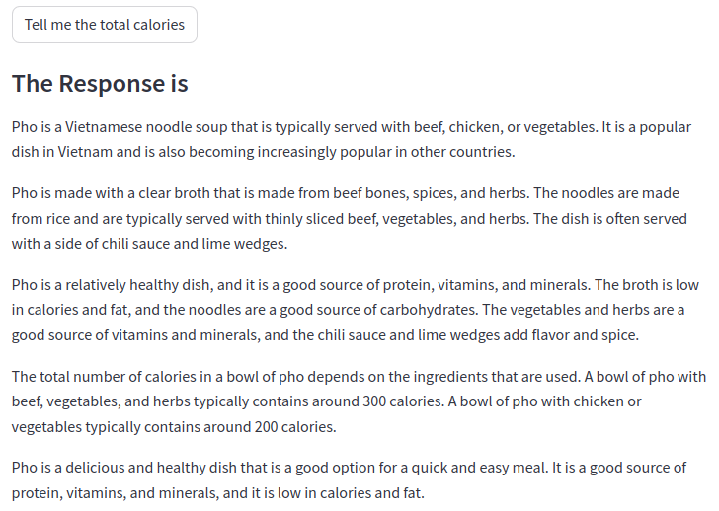
07.06.08 Test Health App
https://www.youtube.com/watch?v=1ICRLYtkmNU&list=PLZoTAELRMXVNbDmGZlcgCA3a8mRQp5axb&index=7
Test Health App (02:13:51-02:14:20/2:16:34)
1. Load Vietnamese Noodle
2. Question: Tell me the total calories
3. response: 200 calories

Slide 5
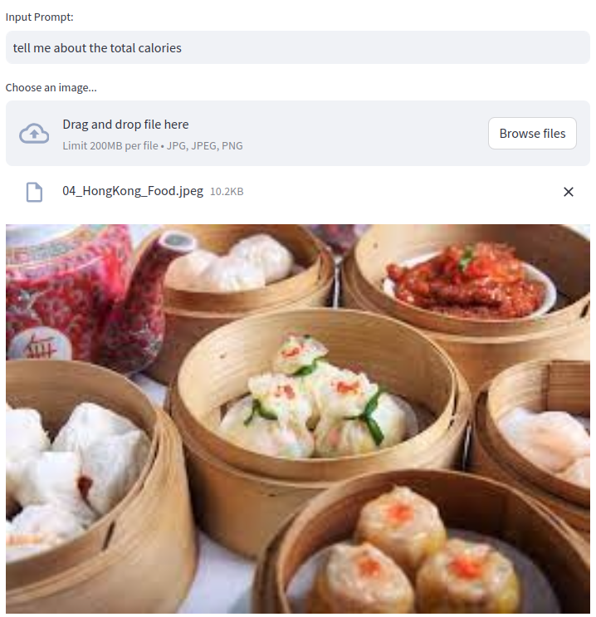
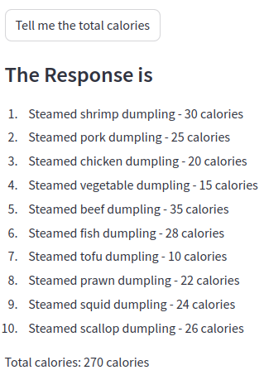
07.06.08 Test Health App
https://www.youtube.com/watch?v=1ICRLYtkmNU&list=PLZoTAELRMXVNbDmGZlcgCA3a8mRQp5axb&index=7
Test Health App (02:14:21-02:15:30/2:16:34)
1. Load Hong Kong Food
2. Question: Tell me the total calories
3. response: 270 Calories

Slide 6
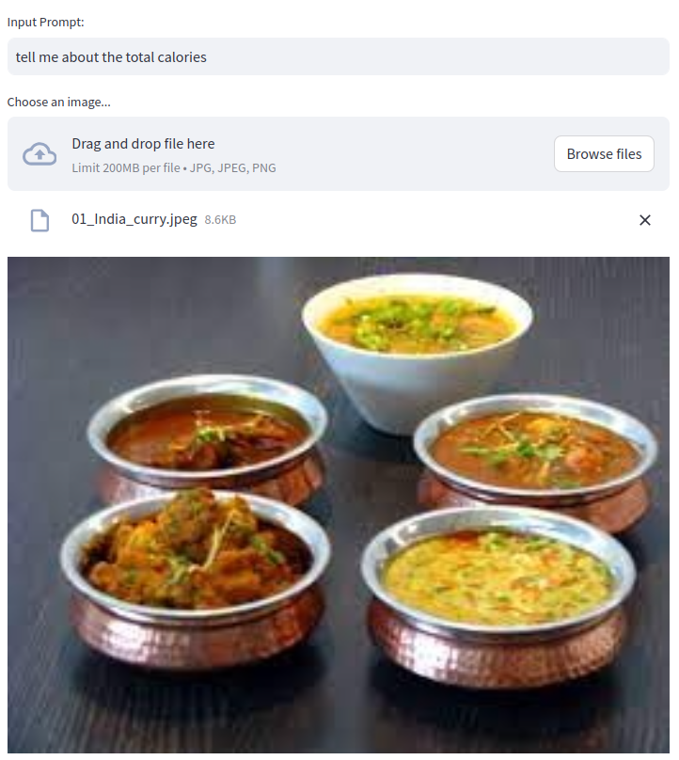
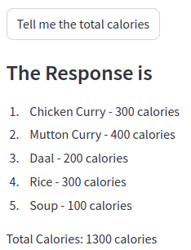
07.06.08 Test Health App
https://www.youtube.com/watch?v=1ICRLYtkmNU&list=PLZoTAELRMXVNbDmGZlcgCA3a8mRQp5axb&index=7
Test Health App (02:15:31-02:16:00/2:16:34)
1. Load India Food
2. Question: Tell me the total calories
3. response: 1300 Calories

Slide 7
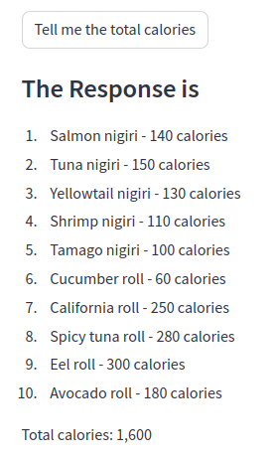
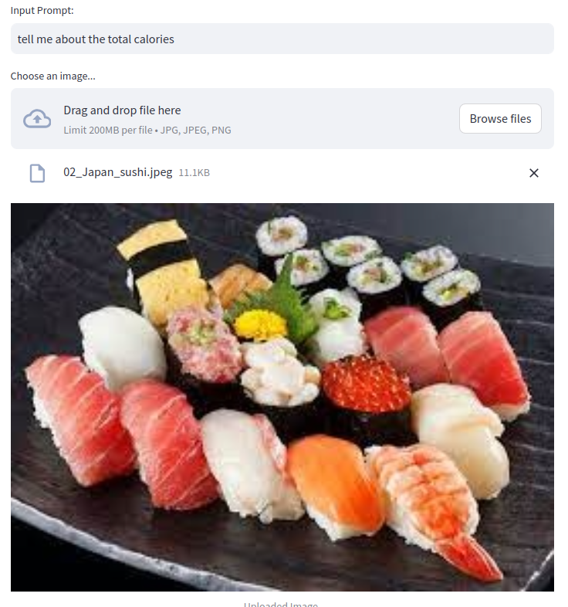
07.06.08 Test Health App
https://www.youtube.com/watch?v=1ICRLYtkmNU&list=PLZoTAELRMXVNbDmGZlcgCA3a8mRQp5axb&index=7
Test Health App (02:16:01-02:16:34/2:16:34)
1. Load Japanese sushi
2. Question: Tell me the total calories
3. response: 1600 Calories

Slide 8
End

