Slide 1

5.06 HF API: Google flan-t5
Peter H. Chen

Slide 2
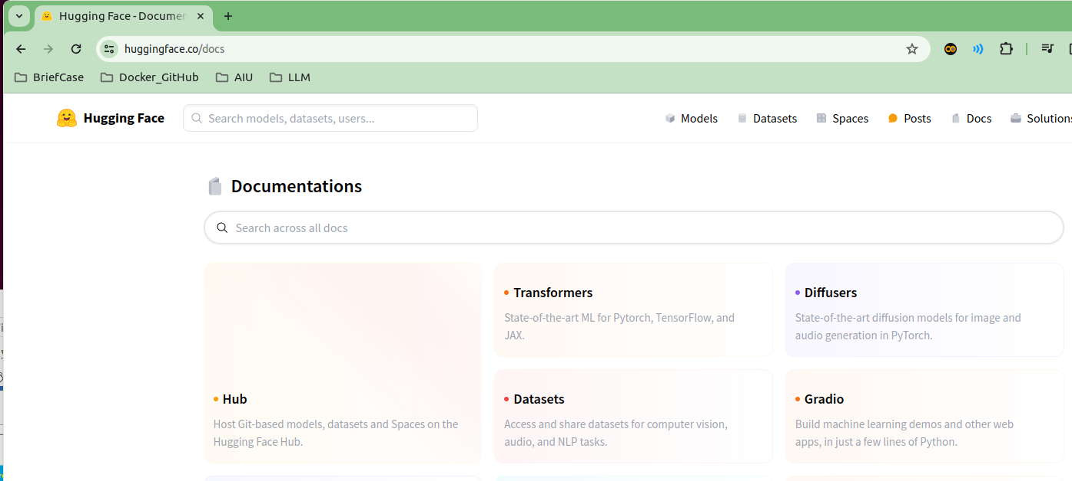
5.06 HF API: Google flan-t5
https://www.youtube.com/watch?v=qMIM7dECAkc&list=PLZoTAELRMXVORE4VF7WQ_fAl0L1Gljtar&index=5
HF API: Google flan-t5 (17:01-17:30/1:18:23)
Google Gemini, OpenAI GPT, Meta Llama are pre-trained LLM (Large Language Model).
For fine-tune customized language model for real-time and private application,
HuggingFace provides Hub spaces, Language Model Transformers. Dataset, competitions for application developer to host or develop their own language model.
We will use Google flan-t5 Transformer as the example.
https://huggingface.co/docs

Slide 3
5.06 HF API: Google flan-t5
https://www.youtube.com/watch?v=qMIM7dECAkc&list=PLZoTAELRMXVORE4VF7WQ_fAl0L1Gljtar&index=5
HF API: Google flan-t5 (17:31-18:30/1:18:23)
Quesiton 1: Why do we need google flan-t5?
Answer:
1.1 Flan-t5 is small, very fast, and efficiency.
1.2 Flan-5 is attractive option for real-time applications.
1.3 Additionally, FLAN-T5 is highly customized. Developers can fine-tune it to meet their specific needs.
Quesiton 2: What is the use of google flan-t5?
Answer: Once trained, FLAN-T5 can be used to perform a variety of NLP tasks, such as text generation, language translation, sentiment analysis, and text classification.

Slide 4
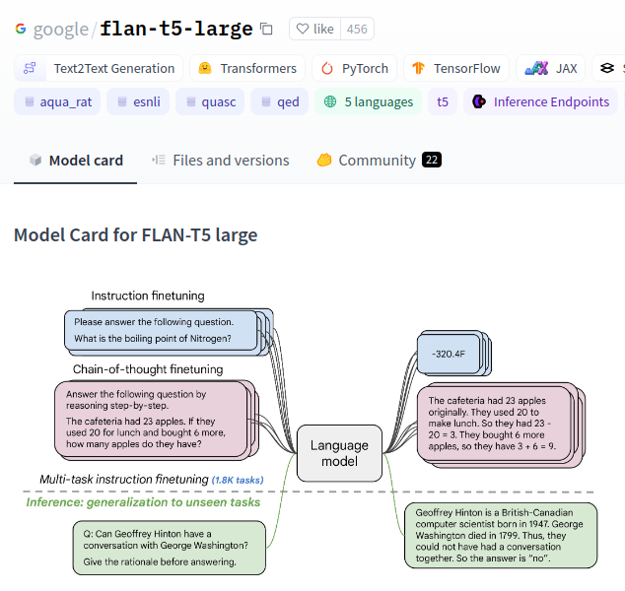
5.06 HF API: Google flan-t5
https://www.youtube.com/watch?v=qMIM7dECAkc&list=PLZoTAELRMXVORE4VF7WQ_fAl0L1Gljtar&index=5
Google flan-t5 (18:31-19:30/1:18:23)
Why do we need fine-tune library?
Fine-tuning thus provides the best of:
1. narrow down the broad knowledge and
2. provide the stability gained from pre-training on a massive set of data and honing the model's understanding of more detailed for specific concepts

Slide 5
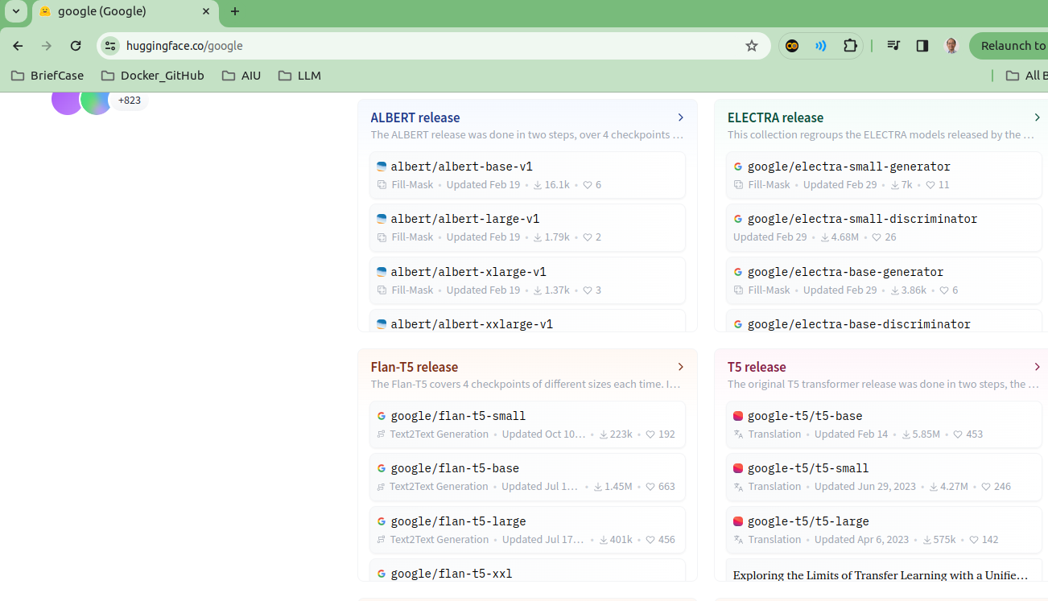
5.06 HF API: Google flan-t5
https://www.youtube.com/watch?v=qMIM7dECAkc&list=PLZoTAELRMXVORE4VF7WQ_fAl0L1Gljtar&index=5
Google flan-t5 (17:01-18:30/1:18:23)
In the huggingface, we can find “google/flan-t5”.
Flan-t5 is a google fine-tune library and open-source.
https://huggingface.co/google

Slide 6
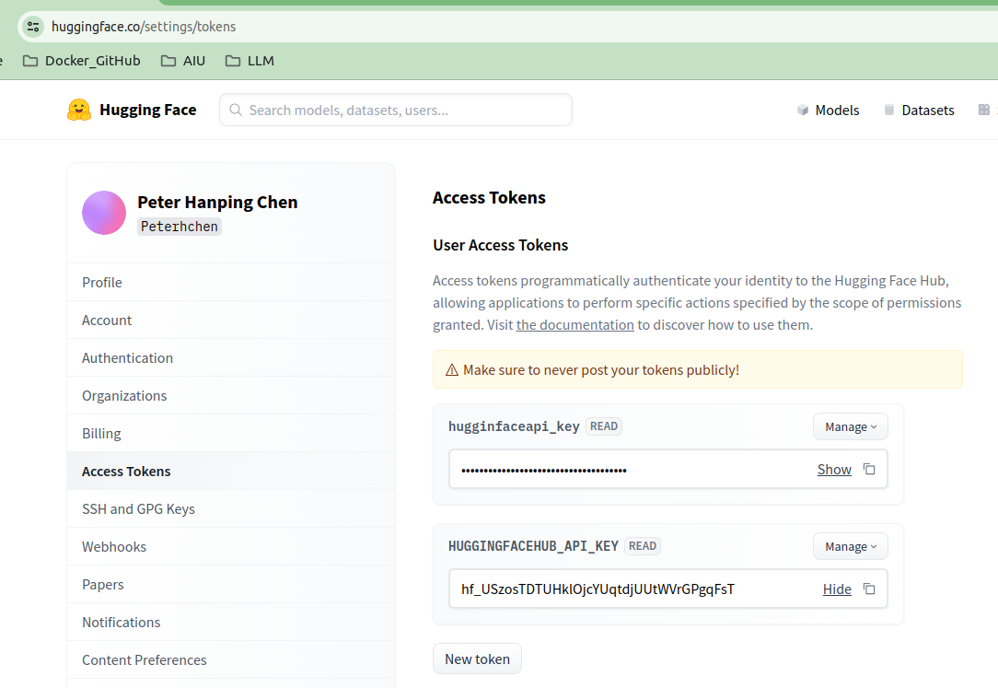

5.06 HF API: Google flan-t5
https://www.youtube.com/watch?v=qMIM7dECAkc&list=PLZoTAELRMXVORE4VF7WQ_fAl0L1Gljtar&index=5
Setup HuggingFace API Key (19:31-21:30/1:18:23)
Search for “HuggingFace Setting/tokens”. Copy HuggingFace API Key.
https://huggingface.co/settings/tokens

Slide 7
5.06 HF API: Google flan-t5
https://www.youtube.com/watch?v=qMIM7dECAkc&list=PLZoTAELRMXVORE4VF7WQ_fAl0L1Gljtar&index=5
Load Google flan-t5 (21:31-22:30/1:18:23)
In the requirements.txt, we have install the huggingface_hub.
1. Import HuggingFace Endpoint library
2. Load HuggingFace Large Language Model “flan-t5-large”.
Flan-t5 is a open-source library for fine-tune library.
We create the llm_huggingface for google flan-t5.
https://python.langchain.com/docs/integrations/llms/huggingface_endpoint/

Slide 8

5.06 HF API: Google flan-t5
https://www.youtube.com/watch?v=qMIM7dECAkc&list=PLZoTAELRMXVORE4VF7WQ_fAl0L1Gljtar&index=5
Test HF/Google flan-t5 (22:31-25:30/1:18:23)
1. Test HF Google-t5 Model: “Capital of Russia”
The google flan-t5 output is a simple word instead of very long sentences.
2. Test HF Google-t5 Model: “Write a poem about AI”
The google flan-t5 is very short also.

Slide 9
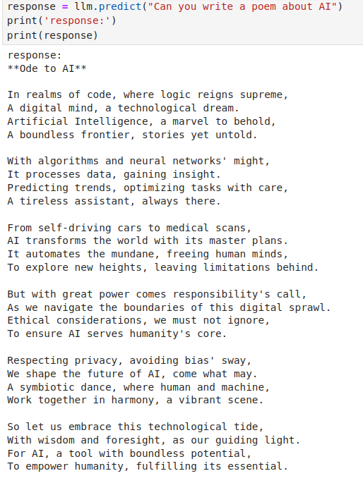
5.06 HF API: Google flan-t5
https://www.youtube.com/watch?v=qMIM7dECAkc&list=PLZoTAELRMXVORE4VF7WQ_fAl0L1Gljtar&index=5
Test Gemini (25:31-26:00/1:18:23)
Test Gemini Model: “Write a poem about AI”

Slide 10
5.07 Summary: flan-t5

Slide 11
5.07 Summary: flan-t5
https://www.youtube.com/watch?v=qMIM7dECAkc&list=PLZoTAELRMXVORE4VF7WQ_fAl0L1Gljtar&index=5
Summary: flan-t5 (26:01-26:50/1:18:23)
HuggingFace provide a lot of transformers for application developer.
What is the main role of Google LLM (Large Language Model) flan-t5?
1. Google LLM (Large Language Model) Gemini Model is very long and very slow.
The flan-t5 output is very short and very fast.
2. Google LLM Gemini are pre-trained and does not support real-time and private database fine-tune.
Google flan-t5 is good for real-time search and fine-tune training for customized LLM instead of pre-trained Large Language Model, such as, Google Gemini.

Slide 12
End

