Slide 1
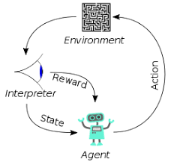
1 Pile of Law
Peter H. Chen

Slide 2
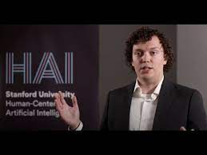
1 Pile of Law
https://www.youtube.com/watch?v=CnGrp23iEws&t=31s
Pile of Law (00:00-00:01/48:34)
Peter Henderson discuss the machine learning for legal dataset and model he provides on HuggingFace.
https://huggingface.co/datasets/pile-of-law/pile-of-law
https://arxiv.org/abs/2207.00220
Peter Henderson is a joint JD (Jury Doctor)-PhD (Computer Science) candidate at Stanford University.
Peter discusses the HuggingFace dataset “Pile of Law” of political science and computer science.
Pile of Law is a machine learning dataset. The dataset contain 256GB open-source Legal Dataset filtering from Law.

Slide 3
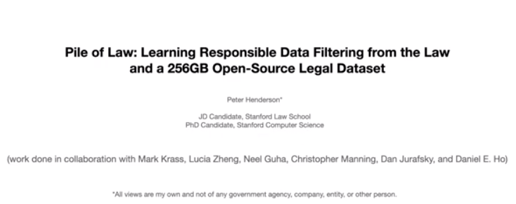
1 Pile of Law
https://www.youtube.com/watch?v=CnGrp23iEws&t=31s
Pile of Law (00:02-04:30/48:34)
Peter Henderson discuss the machine learning for legal dataset and model he provides on HuggingFace.
https://huggingface.co/datasets/pile-of-law/pile-of-law
https://arxiv.org/abs/2207.00220
Peter Henderson is a joint JD (Jury Doctor)-PhD (Computer Science) candidate at Stanford University.
Peter discusses the HuggingFace dataset “Pile of Law” of political science and computer science.
Pile of Law is a machine learning dataset. The dataset contain 256GB open-source Legal Dataset filtering from Law.

Slide 4
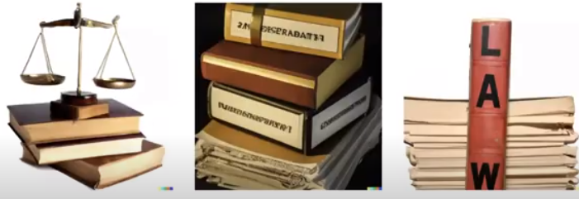
1 Pile of Law
https://www.youtube.com/watch?v=CnGrp23iEws&t=31s
Pile of Law (04:41-05:20/48:34)
When we talk about “Pile of Law”. There is a lot of Artificial Intelligence.
The “Pile of Law” is a 256GB Open-Source Dataset. It contains English-Language Legal and Administrative Data.
It is important to think in Dataset and application.
The Deep Learning Model renders (present) the thinking of Pile of Law.
The Pile of Law is based on the knowledge of Law books.

Slide 5
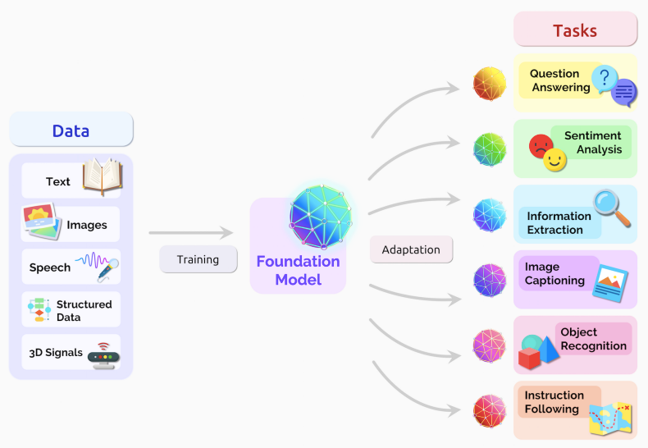
1 Pile of Law
https://www.youtube.com/watch?v=CnGrp23iEws&t=31s
Pile of Law (05:21-06:10/48:34)
https://arxiv.org/pdf/2108.07258.pdf
https://www.labellerr.com/blog/beginners-guide-using-foundation-models-in-ml-projects/
When we think about pre-trained models, we have input training data.
We take a bunch of input training dat. The data can be text, images, speech, structured data, or unstructured data, 3D-signals, etc.
The input data contained unsupervised data (data without target label).
During the model training, we can learn a lot of information from the input data, we can get the relations of the words, we can predict the word from the word sequences, etc. we can train the neural network.
After the model is trained, we can encode these data and produce the downstream output:
1. Question and Answer
2. Image Generation
3. Sentiment Analysis
4. Information Extraction
5. Image Caption
6. Object Recognition and Detection
7. Instruction Following and Prediction
8. Generate Documents

Slide 6
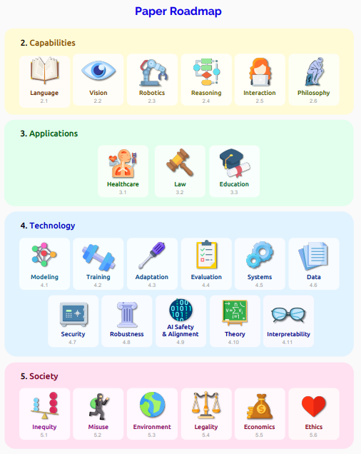
1 Pile of Law
https://www.youtube.com/watch?v=CnGrp23iEws&t=31s
Pile of Law (06:11-06:20/48:34)
https://arxiv.org/pdf/2108.07258.pdf
There are road-map of the Pile of Law:
1. Dataset:
2. Capability:
3. Application:
4. Technology:
5. Society:

Slide 7
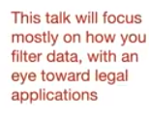

1 Pile of Law
https://www.youtube.com/watch?v=CnGrp23iEws&t=31s
Pile of Law (06:11-06:20/48:34)
https://arxiv.org/pdf/2108.07258.pdf
We focus on the applications: 1. Healthcare, 2. Law, 3. Education.
They are all very important.
This discussion focuses on filter data and legal application.

Slide 8
End

