Slide 1
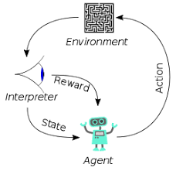
2 Part I: Data
Peter H. Chen

Slide 2
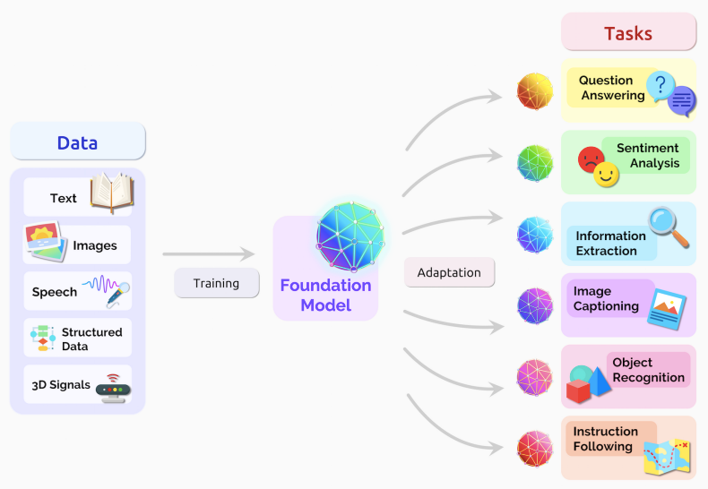

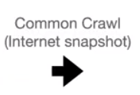
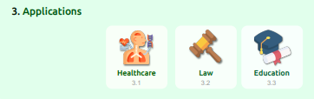
2 Part I: Data
https://www.youtube.com/watch?v=CnGrp23iEws&t=31s
Part I: Data (06:11-07:30/48:34)
https://arxiv.org/pdf/2108.07258.pdf
Common Crawl: The web crawler over very large data from internet, index the data and use data to train. There is a big problem: The data may contains a lot of in-appropriate data, such as, Anti-Muslin content, Private contents, We need to filter out these data and prevent these data go into the model.

Slide 3
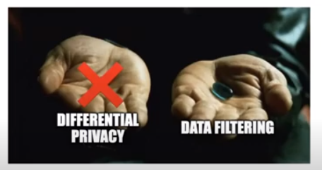
2 Part I: Data
https://www.youtube.com/watch?v=CnGrp23iEws&t=31s
Part I: Data (07:32-08:10/48:34)
https://arxiv.org/pdf/2108.07258.pdf
We can differential privacy and Data Filtering. Differential Privacy is hard to do in model training.
Most Data Engineers use “Data Filtering” to filter out the inappropriate data.
What is Differential Privacy?
Differential privacy adds noise to data to protect the privacy of individuals. Still, this noise can also reduce the utility of the data, making it less accurate or useful for certain types of analysis. This trade-off can be difficult to manage and requires careful balancing to balance privacy and utility.

Slide 4
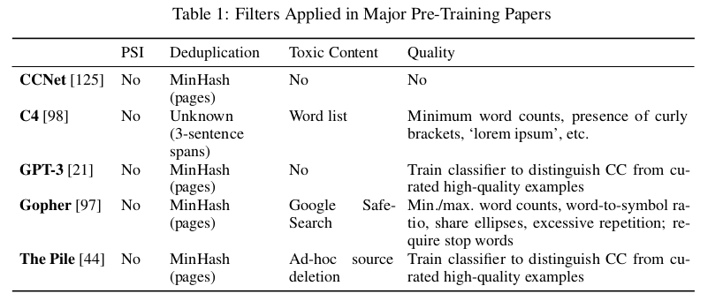
2 Part I: Data
https://www.youtube.com/watch?v=CnGrp23iEws&t=31s
Part I: Data (08:11-08:45/48:34)
https://arxiv.org/pdf/2108.07258.pdf
Table 1 shows the Filters applied in major pre-training publications. The filters do not filter out the PSI (Potential Sensitive Information) but filter out the duplication, federated learning, differential privacy (Add noise to protect individual privacy), etc.
What is Federated Learning?
Federated learning enables multiple actors to build a common, robust machine learning model without sharing data, thus addressing critical issues such as data privacy, data security, data access rights and access to heterogeneous data.
What is MinHash?
MinHash is a technique for quickly estimating how similar two sets are. MinHash detect the duplicate pages and delete them.
Toxic Content: Content contains nudity, pornography, political incorrectness, profanity (亵渎), slurs (诽谤), graphic violence, etc. Create word list to filter out.

Slide 5

2 Part I: Data
https://www.youtube.com/watch?v=CnGrp23iEws&t=31s
Part I: Data (08:49-09:20/48:34)
https://arxiv.org/pdf/2108.07258.pdf
How to have ground (build foundation of) advanced filtering but get more participatory (参与性的)?
We make advanced filter group by group and get more participatory.
What about the law for the participatory system?

Slide 6
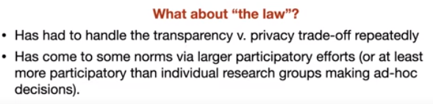
2 Part I: Data
https://www.youtube.com/watch?v=CnGrp23iEws&t=31s
Part I: Data (08:49-10:20/48:34)
https://arxiv.org/pdf/2108.07258.pdf
How to add the participatory?
We use agencies, Courts, etc. to improve the participatory system.
These agencies and courts have transparency vs. privacy protection trade-off repeatedly in the history
They have developed the norms (规范) and laws to handle the trade-off.
In Canada, these agencies and courts have evolved the ad-hoc (advanced) transparency vs. privacy protection system.
Now, Canada courts are allowing commercial entities to to republish data as well.
The transparency versus privacy trad-off have norms (规范) put in place already.

Slide 7
1.2 Part I.A: Data Privacy

Slide 8


1.1 Part I.A: Data Privacy
https://www.youtube.com/watch?v=CnGrp23iEws&t=31s
Part I.A: Data Filtering/Data Privacy (10:26-11:20/48:34)
https://arxiv.org/pdf/2108.07258.pdf
There are the norms (规范) of privacy and legal standards.
The courts have different ceiling standards or pseudonymity (假名) standards.
The standards consider the trade-off between the potential harms of release private information and the need for public transparency.
So, the transparency and openness is the key to fight for corruption and ensure the safety.
We want to put the data in the model but we also want to respect the privacy.
We want to balance the transparency to fight for corruption and respect the private information.

Slide 9
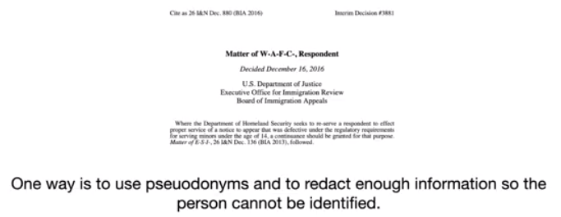
1.1 Part I.A: Data Privacy
https://www.youtube.com/watch?v=CnGrp23iEws&t=31s
Part I.A: Data Filtering/Data Privacy (10:26-11:20/48:34)
https://arxiv.org/pdf/2108.07258.pdf
So, the office of immigration office of US review and define the standards for pseudonymity (假名).
The immigration office react (remove the name, use the initial names, or change the name) to make sure the person cannot be identified or found.
What is redact?10
1. Redact is to remove words or modified words or information from a text before it is printed or made available to the public.
2. Officers' names are routinely redacted from any publicly released reports.
3. Some parts of secret files are available to the public, but heavily reacted.

Slide 10
End

