Slide 1
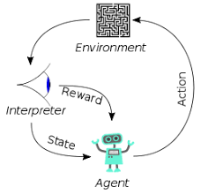
3 Data Privacy

Slide 2

3 Data Privacy
https://www.youtube.com/watch?v=CnGrp23iEws&t=31s
Data Privacy (10:26-11:00/48:34)
https://arxiv.org/pdf/2108.07258.pdf
There are the norms (规范) of privacy and legal standards.
The courts have different ceiling standards or pseudonymity (假名) standards.
The standards consider the trade-off between the potential harms of release private information and the need for public transparency.
What country is best for privacy?
Switzerland. Switzerland has guaranteed its citizens the right to privacy under its constitution and enacted regulations. The Swiss Federal Data Protection Act (DPA) prohibits personal data processing without the individual's consent the data relates to.
Which countries has the strictest data privacy laws?
The country with the strictest data privacy laws related to the internet is Iceland. Many people have referred to Iceland as Switzerland for data. It has incredibly strict privacy laws, and these laws were passed in 2000.
Which countries have the strongest privacy laws?
Which country is considered to be the leader in privacy and data protection? Scandinavian countries are generally regarded as having some of the best data and privacy protection laws in the world. This includes Sweden, Norway, Denmark, and Finland.

Slide 3

3 Data Privacy
https://www.youtube.com/watch?v=CnGrp23iEws&t=31s
Data Privacy (11:01-11:20/48:34)
https://arxiv.org/pdf/2108.07258.pdf
The transparency and openness is the key to fight for corruption and ensure the safety.
We want to put the data in the model but we also want to respect the privacy.
We want to balance the transparency to fight for corruption and respect the private information.
Which country has the least corruption (most transparency) or most corruption (least transparency) ?
1. Least corruption (most transparency): Denmark, Finland, New Zealand, Norway, Singapore, and Sweden are perceived as the least corrupt nations in the world, ranking consistently high among international financial transparency.
2. Most corruption (least Transparency): The most apparently corrupt are Syria and South Sudan (both scoring 13), as well as Somalia (scoring 12).

Slide 4
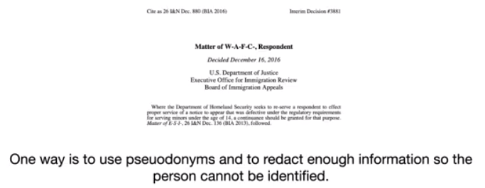
3 Data Privacy
https://www.youtube.com/watch?v=CnGrp23iEws&t=31s
Data Privacy (10:26-12:18/48:34)
https://arxiv.org/pdf/2108.07258.pdf
We want to have more accurate data to train the model. We also want to respect the privacy.
So, the office of immigration office of US review and define the standards for pseudonymity (假名).
The immigration office redact (remove the name, use the initial names, or change the name) to make sure the person cannot be identified or found.
This is a very contextualized (情境化) standard for court and agencies in both Canada and US.
What is redact?10
1. Redact is to remove words or modified words or information from a text before it is printed or made available to the public.
2. Officers' names are routinely redacted from any publicly released reports.
3. Some parts of secret files are available to the public, but heavily redacted.

Slide 5
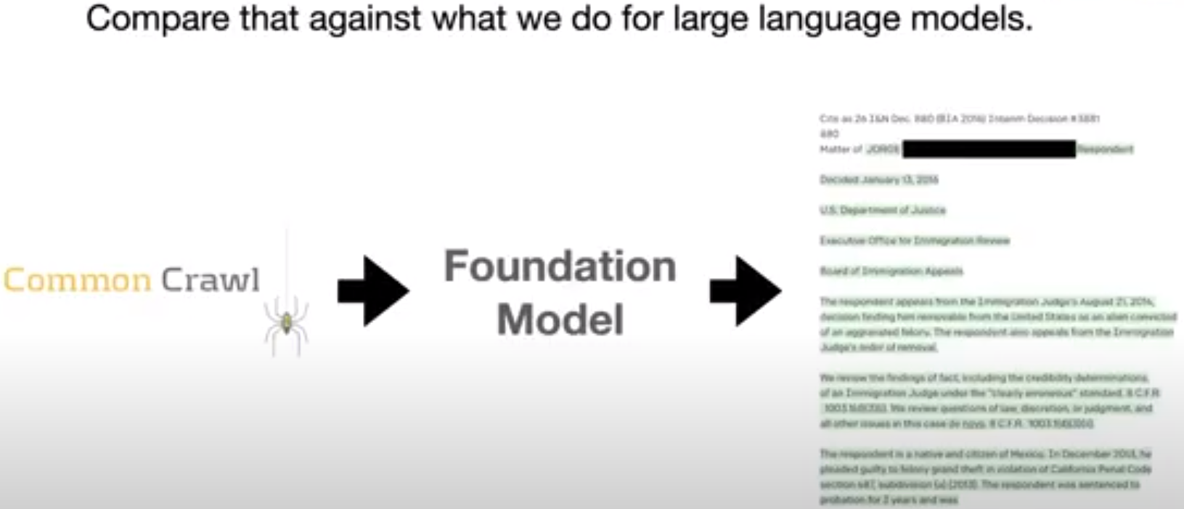
3 Data Privacy
https://www.youtube.com/watch?v=CnGrp23iEws&t=31s
Data Privacy (12:19-12:20/48:34)
https://arxiv.org/pdf/2108.07258.pdf
In Law Model, if content has the people name, it is very sensitive to privacy. We take the case out.
This is different from the large language model.

Slide 6
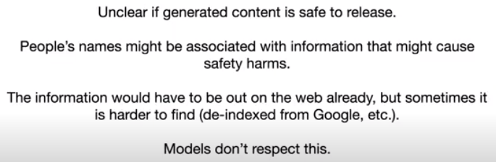
3 Data Privacy
https://www.youtube.com/watch?v=CnGrp23iEws&t=31s
Data Privacy (12:19-14:10/48:34)
https://arxiv.org/pdf/2108.07258.pdf
It is not clear if the generated content is safe.
If people name associate with information may cause safety harms.
The people name may be on the web already by google search. It is hard to redact all of them.

Slide 7
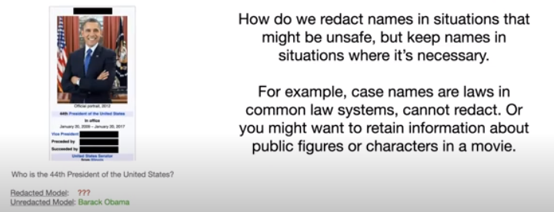
3 Data Privacy
https://www.youtube.com/watch?v=CnGrp23iEws&t=31s
Data Privacy (14:15-15:20/48:34)
https://arxiv.org/pdf/2108.07258.pdf
How fo we redact names in situation?
In some situation, the unsafe names need to remove.
In some situation, they are not necessary to remove.
The case name are laws in common law system. They are legal content. We do not need to redact.
We can retain information in the public figures or characters in movie.
For example, who is the president of United State in 2016? Barack Obama.
We need a very contextualized perspective just like court does before you feed into the model.

Slide 8
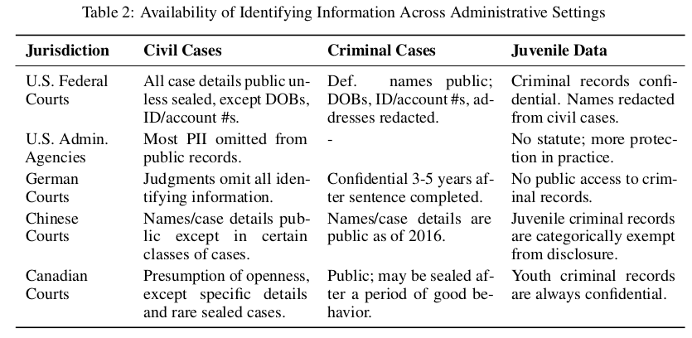

3 Data Privacy
https://www.youtube.com/watch?v=CnGrp23iEws&t=31s
Data Privacy (14:15-16:50/48:34)
https://arxiv.org/pdf/2108.07258.pdf
For example, the youth criminal is confidential in US and Canada. There is a baseline standard, we have to remove the date of birth, social security number, address, phone number, etc.
US and Canada have the most transparency dataset. Germany dataset
What is age of youth/juvenile criminal?
Youth under the age of 18 who are accused of committing a delinquent or criminal act are typically processed through a juvenile justice system.

Slide 9
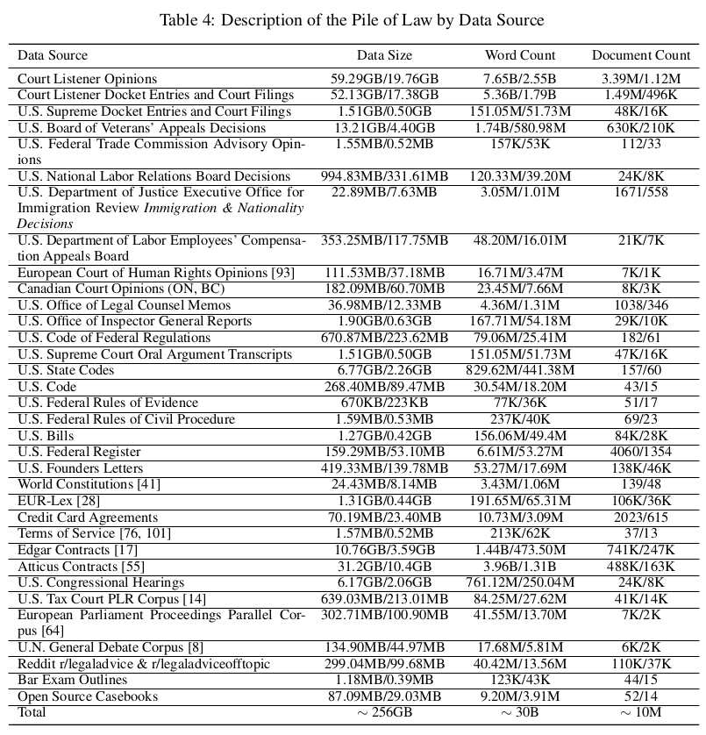
3 Data Privacy
https://www.youtube.com/watch?v=CnGrp23iEws&t=31s
Data Privacy (16:53-17:10/48:34)
https://arxiv.org/pdf/2108.07258.pdf
We have a very large dataset. We categorize the dataset by Data Source:
1. US Court
2. Trade Commission
3. Labor Department
4. European Court
5. Canada Court, etc.
We can train for legal model and bring it to the world.
It is very important to have the legal domain to help the lawyer, clients, and bring in the social benefit.
We have very range of source.

Slide 10
End

