Slide 1
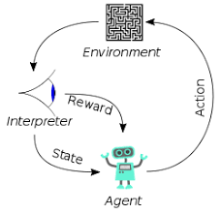
4 Toxicity

Slide 2
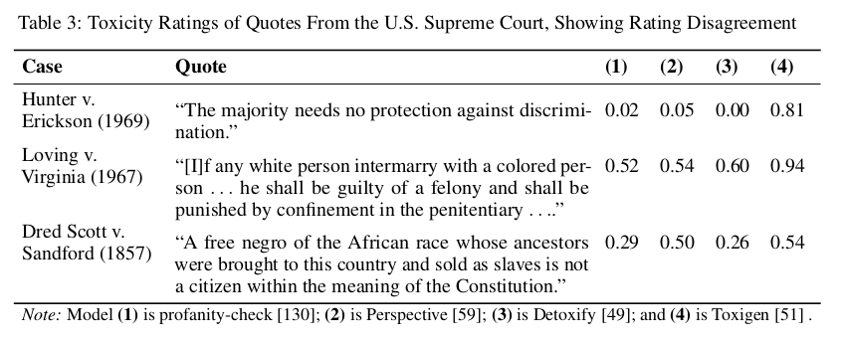
4 Toxicity
https://www.youtube.com/watch?v=CnGrp23iEws&t=31s
Toxicity (17:11-17:50/48:34)
https://arxiv.org/pdf/2108.07258.pdf
What is the toxicity in speech?
Toxic speech categories include:
1. Profanity (亵渎)
2. Speech that contains words, phrases, or acronyms that are impolite, vulgar (庸俗), or offensive.

Slide 3
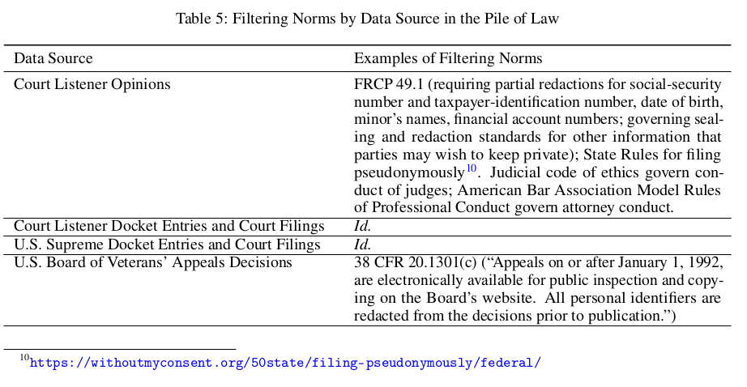
4 Toxicity
https://www.youtube.com/watch?v=CnGrp23iEws&t=31s
Toxicity (18:01-16:33/48:34)
https://arxiv.org/pdf/2108.07258.pdf
We have the filtering norms (standards) implemented by Data Science for Dataset of Pile of Law .

Slide 4
End

