Slide 1
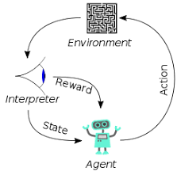
5 Contextual Privacy Rule

Slide 2
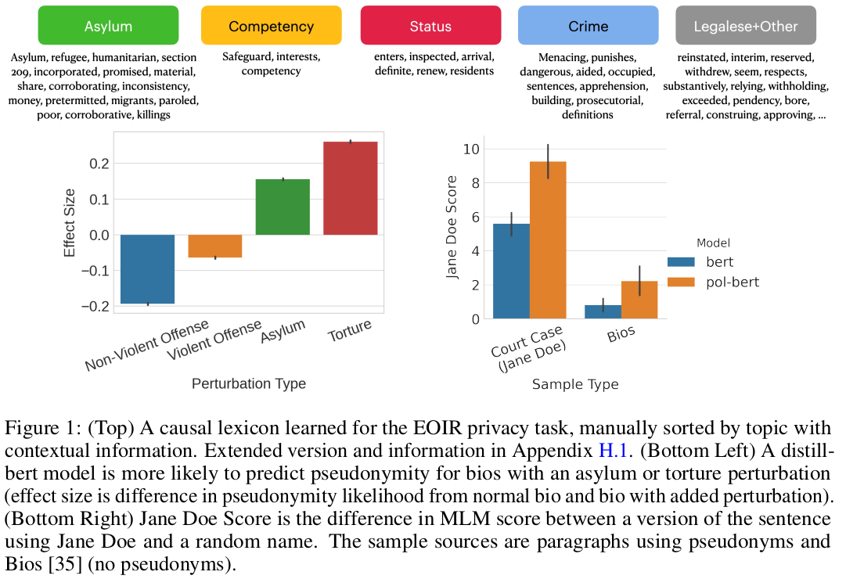
5 Contextual Privacy Rule
https://www.youtube.com/watch?v=CnGrp23iEws&t=31s
Contextual Privacy Rule (17:11-18:20/48:34)
https://arxiv.org/pdf/2108.07258.pdf
Case 1: Pseudonymity (假名) in Immigration Court
Figure 1 shows the Asylum, Torture sentences, non-violent more likely to use Pseudonymity.
Crimes not likely to use Pseudonymity.

Slide 3
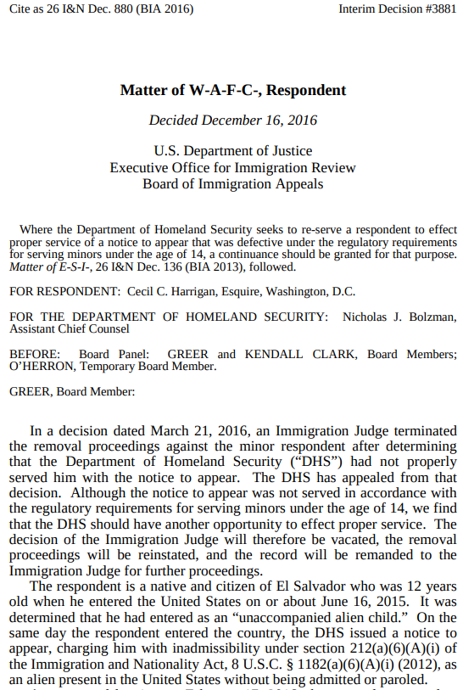
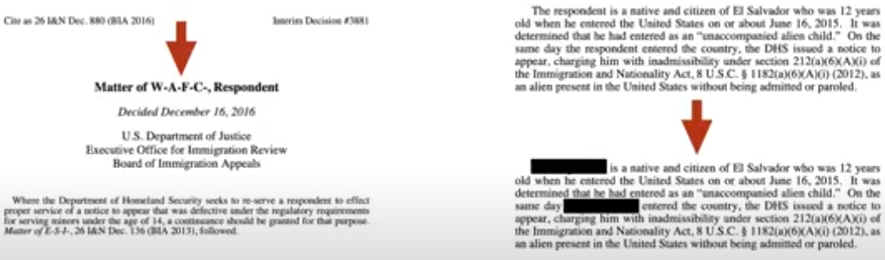
5 Contextual Privacy Rule
https://www.youtube.com/watch?v=CnGrp23iEws&t=31s
Contextual Privacy Rule (18:23-18:50/48:34)
https://arxiv.org/pdf/2108.07258.pdf
Respondent (受访者)
The immigration office want to determine what context (情境) or situation the agency decides not to reveal somebody’s name.
We mask out the references (respondent). The respondent is masked out.
We use model to predict whether the court would require Pseudonymity in this context.

Slide 4
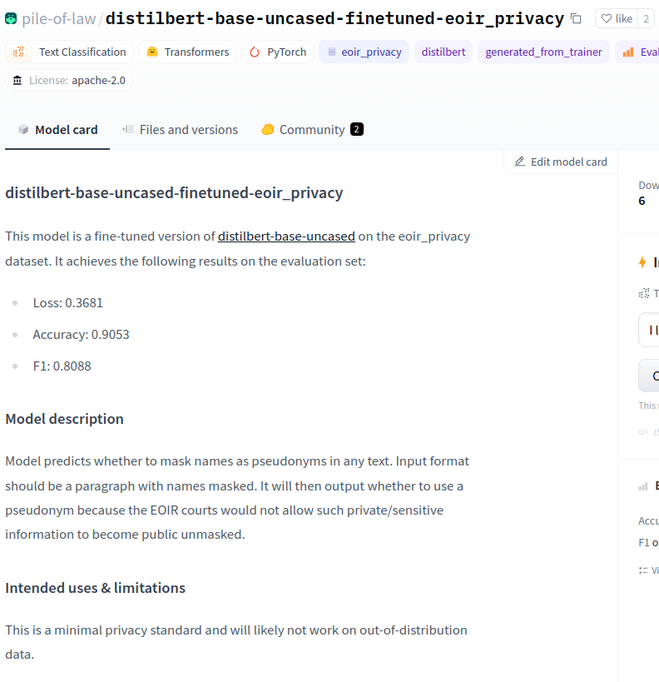
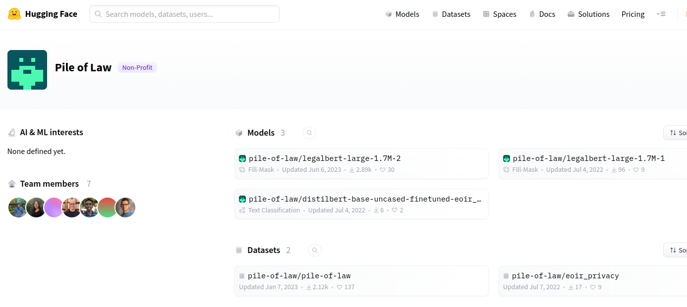
5 Contextual Privacy Rule
https://www.youtube.com/watch?v=CnGrp23iEws&t=31s
Contextual Privacy Rule (19:03-19:30/48:34)
https://huggingface.co/pile-of-law/distilbert-base-uncased-finetuned-eoir_privacy
This model is online, we can try this model out.
What is EOIR?
EOIR (Executive Office for Immigration Review)
The primary mission of the EOIR (Executive Office for Immigration Review) is to adjudicate immigration cases by fairly, expeditiously, and uniformly interpreting and administering the Nation's immigration laws.
.

Slide 5
End

