Slide 1
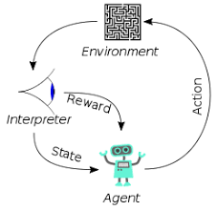
6 Mask Prediction

Slide 2
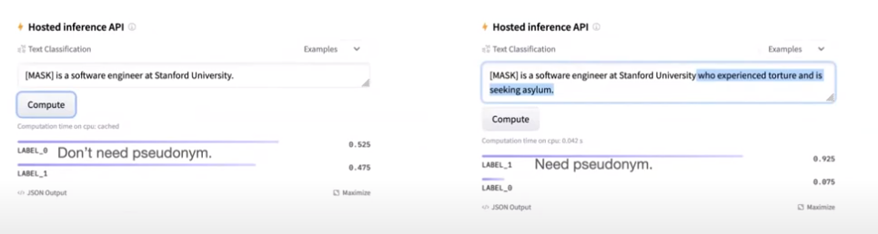
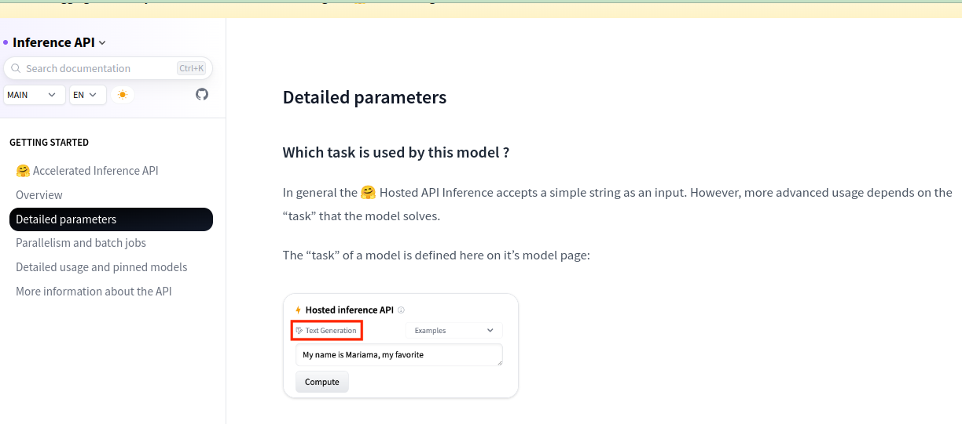
6 Mask Prediction
https://www.youtube.com/watch?v=CnGrp23iEws&t=31s
Mask Prediction by Inference API of Pile of Law (19:39-19:45/48:34)
https://huggingface.co/docs/api-inference/detailed_parameters
HuggingFace provides the Hosted Inference API and Model to check whether your input words need Pseudonymity or not.
1. Question: “[MASK] is a software engineer at Stanford University.”
Answer: “Don’t need pseudonym”
2. Quesiton: “[MASK] is a software engineer at Stanford University who experienced torture and is seeking for asylum.”
Answer: “Need pseudonym”
You need to do “Pseudonymity” or filter out the data in the content.

Slide 3
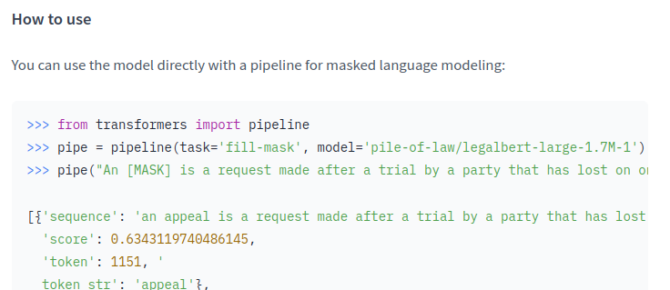
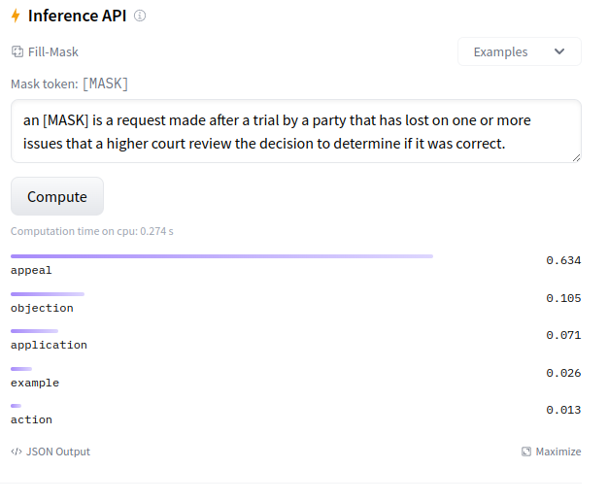
6 Mask Prediction
https://www.youtube.com/watch?v=CnGrp23iEws&t=31s
Mask Prediction by Inference API of Pile of Law (19:46-19:50/48:34)
pile-of-law/legalbert-large-1.7M-1
Legal BERT words prediction:
You can input the question and answer in the left, then you [MASK] word and click compute and get the answer.

Slide 4
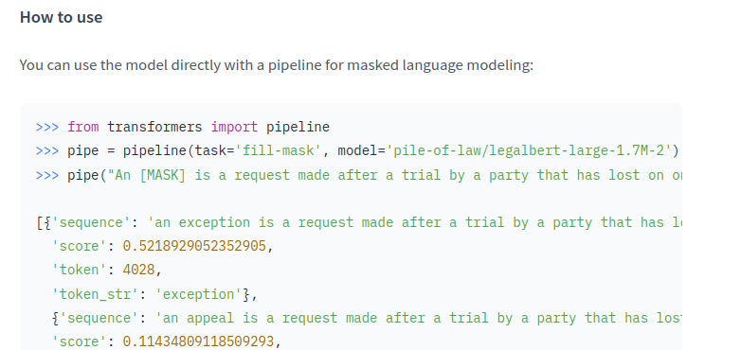
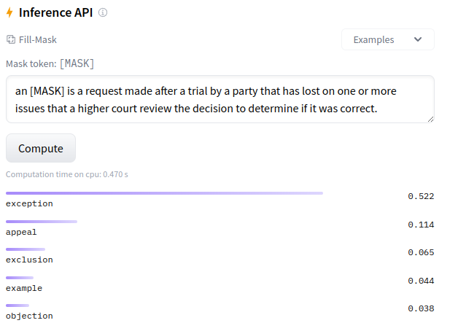
6 Mask Prediction
https://www.youtube.com/watch?v=CnGrp23iEws&t=31s
Mask Prediction by Inference API of Pile of Law (19:51-19:55/48:34)
https://huggingface.co/pile-of-law/legalbert-large-1.7M-2
Legal BERT words prediction:
Left: “an exception is …” for training data. Right: “an [Mask] is …” and click compute to predict.

Slide 5
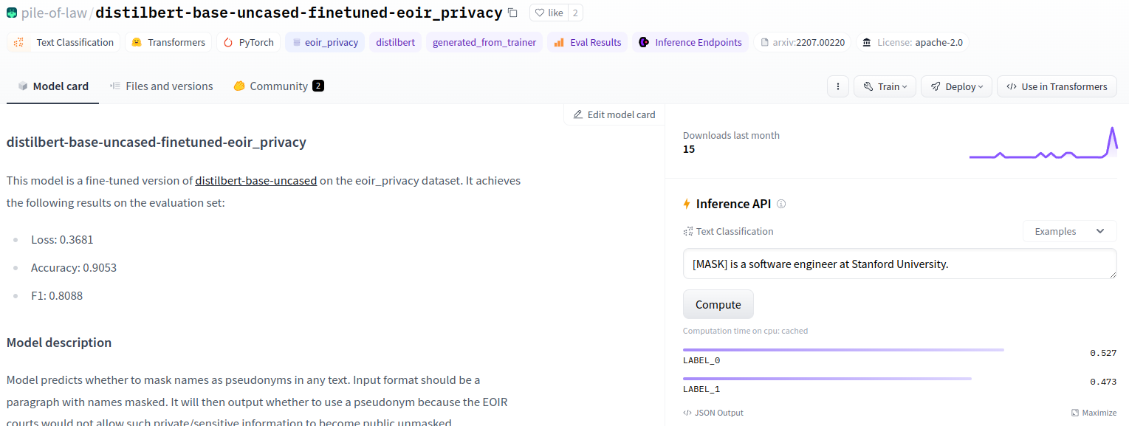
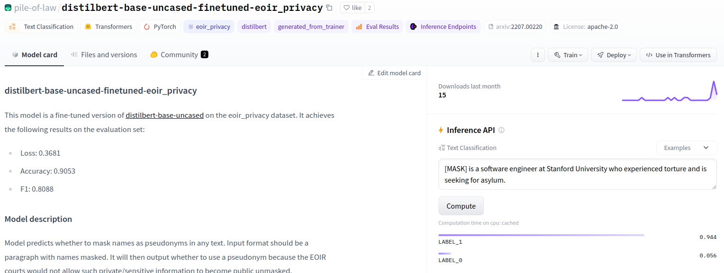
6 Mask Prediction
https://www.youtube.com/watch?v=CnGrp23iEws&t=31s
Mask Prediction by Inference API of Pile of Law (19:56-20:00/48:34)
pile-of-law/distilbert-base-uncased-finetuned-eoir_privacy
We can replace LABEL_0 by “Don’t need pseudonym.”
Replace “LABEL_1” by “Need pseudonym.”

Slide 6
End

