Slide 1
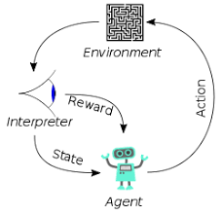
7 Filter Out Toxic Word

Slide 2

7 Filter Out Toxic Word
https://www.youtube.com/watch?v=CnGrp23iEws&t=31s
Filter Out Toxic Word (20:17-20:40/48:34)
https://arxiv.org/abs/2207.00220
We talk about the filter out the toxicity.
For example, if our model learn the word with “anti-Muslim”, we want to detect the “anti-Muslim” in the dataset and remove the “anti-Muslim” word.
The “anti-Muslim” word should be removed from the data and model should never find it.
So the model will never learn about this words and generate the legal content.

Slide 3
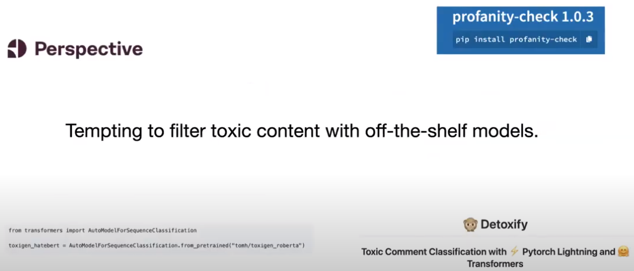
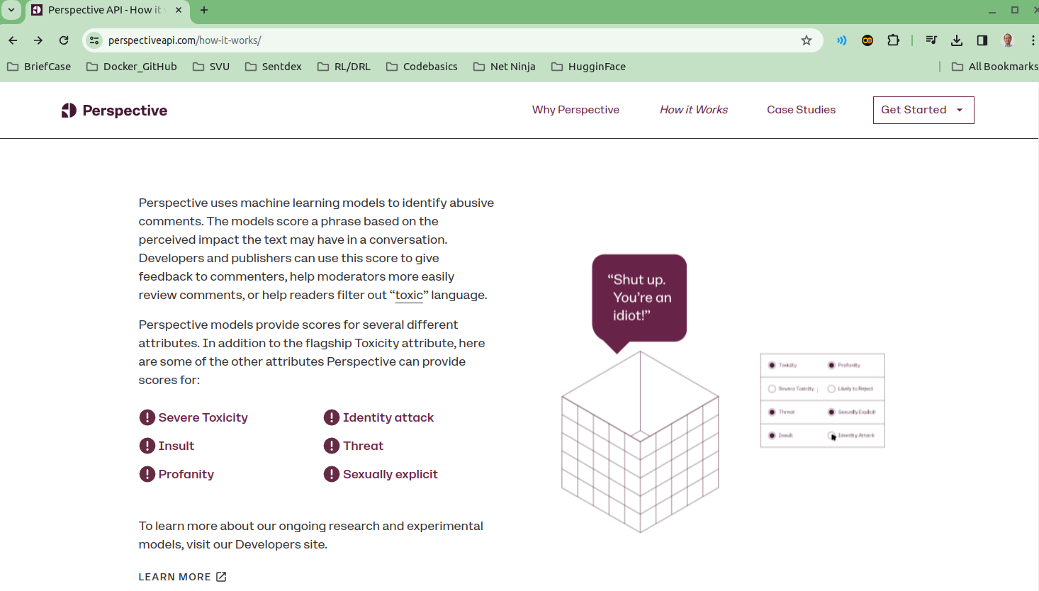
7 Filter Out Toxic Word
https://www.youtube.com/watch?v=CnGrp23iEws&t=31s
Filter Out Toxic Word (20:01-20:40/48:34)
https://arxiv.org/abs/2207.00220
Google Perspective provides free API that helps you host better conversations online.
What is Google Perspective?
Google Perspectives is a Google project that wants you to see real people's ideas and discussions across the web with off-the-shelf language model.
For example, “anti-Muslim” word should be removed from the content of the documents.
So the model will never learn about this words and generate the legal content.

Slide 4
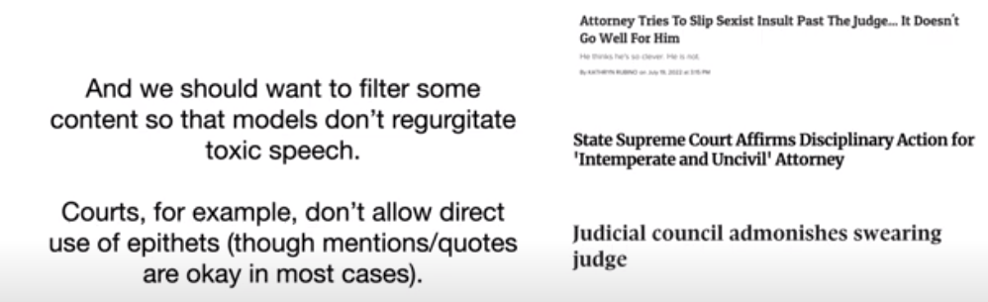
7 Filter Out Toxic Word
https://www.youtube.com/watch?v=CnGrp23iEws&t=31s
Filter Out Toxic Word (20:57-22:30/48:34)
https://arxiv.org/abs/2207.00220
The courts do not allow the toxic speech and epithets.
The Legal Dataset to train the Legal Model should never have:
1. toxic speech
2. epithets (绰号) that are used by attorney or judge.
3. The court will quote the offensive opinions.
Regurgitate (反流): We filter out the content so that the model do not flow back (regurgitate) the the toxic speech.
Epithets are not acceptable in courts even the attorneys and judges use that words in the court.
We make sure no such words (toxic words, epithets, offensive words) in the training dataset.

Slide 5
End

