Slide 1
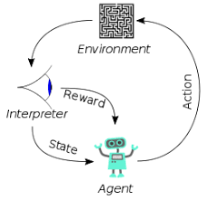
8 Three Problems

Slide 2

8 Three Problems
https://www.youtube.com/watch?v=CnGrp23iEws&t=31s
Three Problems (22:14-22:40/48:34)
https://arxiv.org/abs/2207.00220
We have three major problems caused by redact (remove or modify) the toxic content.
Problem 1: Missing important value words: case of “discrimination” protection
Problem 2: False-Positive (Remove Data from Dataset but get the Positive Prediction):
We miss the important cases: Virginia law for Intermarry between the “white” person and “colored” person.
3. Problem 3: False-Negative (Remove Data and Model cannot predict)
We miss data in dataset to train model: Get bad prediction from “pseudo-toxic” words input and predict the bad result.
How to fix?
1. We can add some “content warning” in the dataset for legal opinions.
2. There are more complicated issues when we do the research in law modeling.

Slide 3
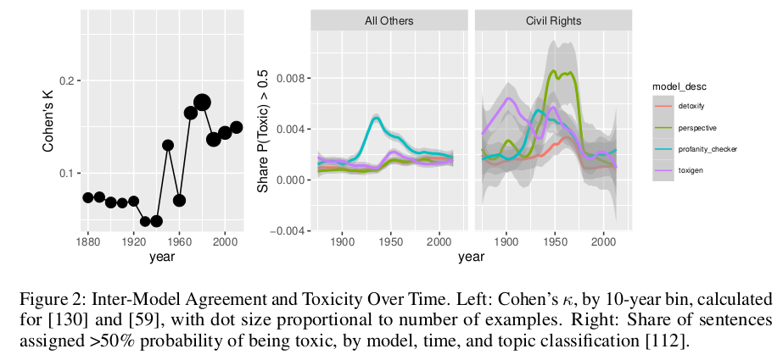
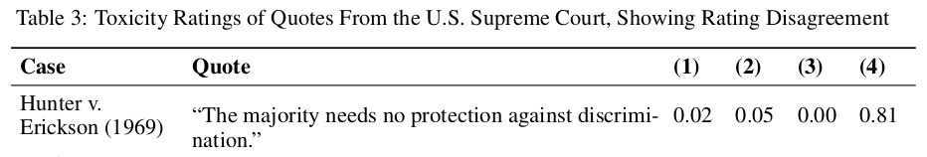
8 Three Problems
https://www.youtube.com/watch?v=CnGrp23iEws&t=31s
Three Problems (22:14-23:14/48:34)
https://arxiv.org/abs/2207.00220
Problem 1: Filter out “discrimination” mislead the value judgment.
Toxic words encode value judgment. The toxic words encode the important information.

Slide 4
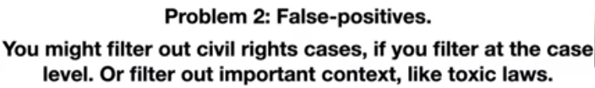

8 Three Problems
https://www.youtube.com/watch?v=CnGrp23iEws&t=31s
Three Problems (23:15-24:00/48:34)
https://arxiv.org/abs/2207.00220
Problem 2: False-Positive (Remove Data from Dataset but get the Positive Prediction)
Below you can see the toxic words in the civil right cases in 1950s to 1960s.
If we filter out the toxic words in the case level or filter out the important context, then miss the important case.
It is important to have the toxic law which is not constitutional to keep the cases in training dataset.

Slide 5
8 Three Problems
https://www.youtube.com/watch?v=CnGrp23iEws&t=31s
Three Problems (24:01-24:30/48:34)
https://arxiv.org/abs/2207.00220
Problem 2: False-Positive (Remove Data from Dataset but get the Positive Prediction)
Below it the Virginia example, which is toxic but it overturned (颠覆) the law.
“White person intermarry (通婚) with colored person … should be guilty of felony and shall be confinement (禁闭) in the penitentiary (监狱).
If we remove the toxic words or toxic case from dataset and train the model, the model cannot make prediction with sense.

Slide 6

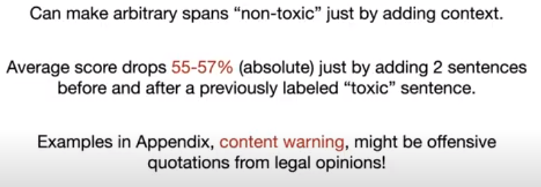
8 Three Problems
https://www.youtube.com/watch?v=CnGrp23iEws&t=31s
Three Problems (22:14-25:30/48:34)
https://arxiv.org/abs/2207.00220
Problem 3: False-Negative (Remove Data and Model cannot predict)
If we remove the toxic words from dataset, it can cause worse problem.
If we add some “non-toxic” words, because the model never train with toxic words and very bad prediction.
We can add some “content warning” in the dataset for legal opinions. There are more complicated issues when we do the research in law modeling.

Slide 7
End

