Slide 1
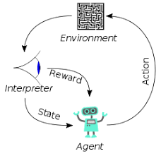
9 Legal Task/Reasoning

Slide 2

9 Legal Task/Reasoning
https://www.youtube.com/watch?v=CnGrp23iEws&t=31s
Legal Task/Reasoning (25:57-26:20/48:34)
https://arxiv.org/abs/2207.00220
We focus on the difficulty of machine learning community in legal task.

Slide 3
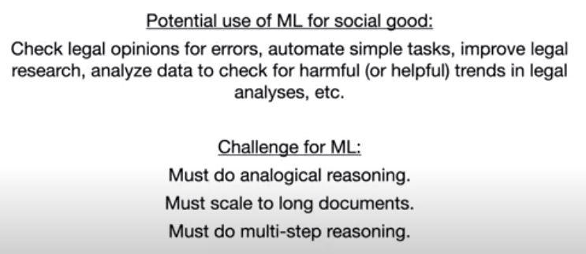
9 Legal Task/Reasoning
https://www.youtube.com/watch?v=CnGrp23iEws&t=31s
Legal Task/Reasoning (25:57-28:00/48:34)
https://arxiv.org/abs/2207.00220
Why do we care about the legal reasoning or legal tasks?
This model is able to analyze pattern of data. The model can help attorney for justice and can help legal opinions error, however, the legal system may become more complicated in reasoning. We can automate simple tasks for formatting and research. We can analyze the data to check for harmful or helpful trends in legal analysis, for example, we use here for contextualized standard for pseudonymity in the immigration courts.

Slide 4
9 Legal Task/Reasoning
https://www.youtube.com/watch?v=CnGrp23iEws&t=31s
Legal Task/Reasoning (28:01-29:30/48:34)
https://arxiv.org/abs/2207.00220
There are challenge for machine learning
1. do analogical (类比的) reasoning, for example, apply the reasoning to a fact pattern
2. to read very long document, for example, to summarize 200 pages of paper
3. multi-step reasoning, how to find multiple evidence and apply the rules and create a chain of reasoning.
These challenges are great goal for Machine Learning research.
This is the reason that we aggregate the “pile of law” dataset for machine learning research.

Slide 5
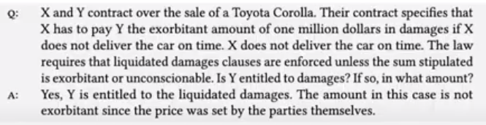
9 Legal Task/Reasoning
https://www.youtube.com/watch?v=CnGrp23iEws&t=31s
Legal Task/Reasoning (29:53-30:50/48:34)
https://arxiv.org/abs/2207.00220
Below is the contract:
X and Y have the contract of Toyota Corolla sale.
If X failed the contract, X pay 1 million dollars to Y.
The exorbitant (高昂) amount is not reasoning well and the answer is incorrect.
In this example. the analogical reasoning of machine learning has to improve.

Slide 6
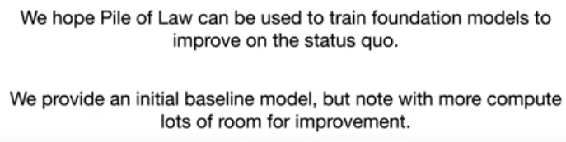
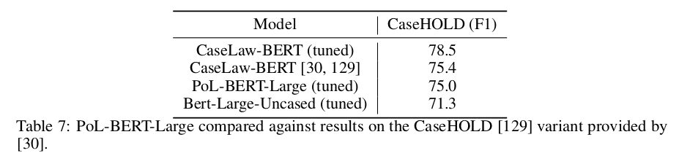
9 Legal Task/Reasoning
https://www.youtube.com/watch?v=CnGrp23iEws&t=31s
Legal Task/Reasoning (30:54-30:50/48:34)
https://arxiv.org/abs/2207.00220
HuggingFace has free models:
1. https://huggingface.co/pile-of-law/legalbert-large-1.7M-1/ and
2. https://huggingface.co/pile-of-law/legalbert-large-1.7M-2/,
We train the small model and used in legal reasoning (or legal task).
Model Cards are hosted on the HuggingFace website along with the models.
We use refugee cases to test. Table 7 shows the results.

Slide 7
End

