Slide 1

04.08 LC: Conversation Buffer Memory
Peter H. Chen

Slide 2
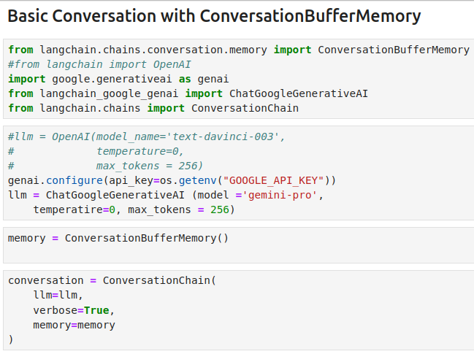
04.08 LC: Conversation Buffer Memory
https://www.youtube.com/watch?v=X550Zbz_ROE&list=PL8motc6AQftk1Bs42EW45kwYbyJ4jOdiZ&index=4
LC: Conversation Buffer Memory (07:31-08:00/20:27)

Slide 3
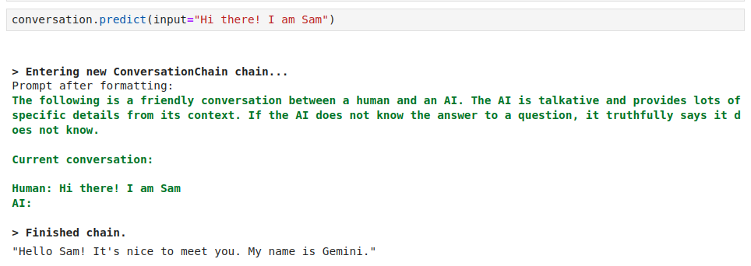
04.08 LC: Conversation Buffer Memory
https://www.youtube.com/watch?v=X550Zbz_ROE&list=PL8motc6AQftk1Bs42EW45kwYbyJ4jOdiZ&index=4
LC: Conversation Buffer Memory (08:01-08:30/20:27)

Slide 4
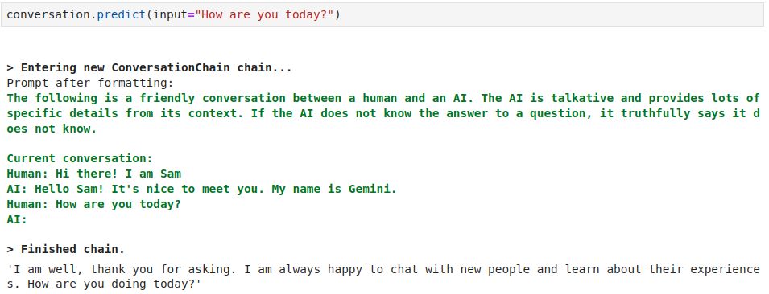
04.08 LC: Conversation Buffer Memory
https://www.youtube.com/watch?v=X550Zbz_ROE&list=PL8motc6AQftk1Bs42EW45kwYbyJ4jOdiZ&index=4
LC: Conversation Buffer Memory (08:31-09:00/20:27)

Slide 5
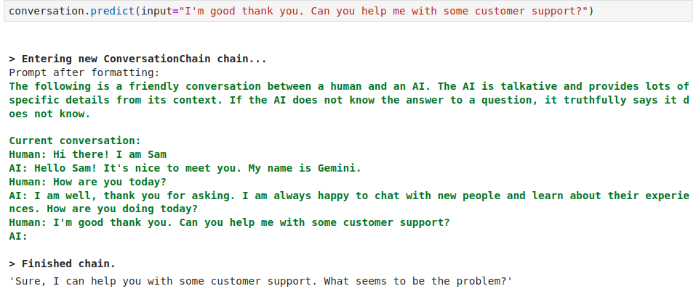
04.08 LC: Conversation Buffer Memory
https://www.youtube.com/watch?v=X550Zbz_ROE&list=PL8motc6AQftk1Bs42EW45kwYbyJ4jOdiZ&index=4
LC: Conversation Buffer Memory (09:01-09:30/20:27)

Slide 6
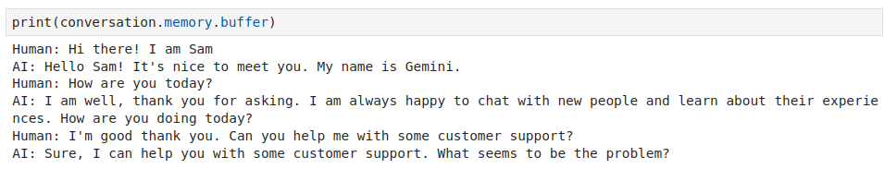
04.08 LC: Conversation Buffer Memory
https://www.youtube.com/watch?v=X550Zbz_ROE&list=PL8motc6AQftk1Bs42EW45kwYbyJ4jOdiZ&index=4
LC: Conversation Buffer Memory (09:31-10:00/20:27)

Slide 7
End

