Slide 1

04.12 LC: Knowledge Graph
Peter H. Chen

Slide 2
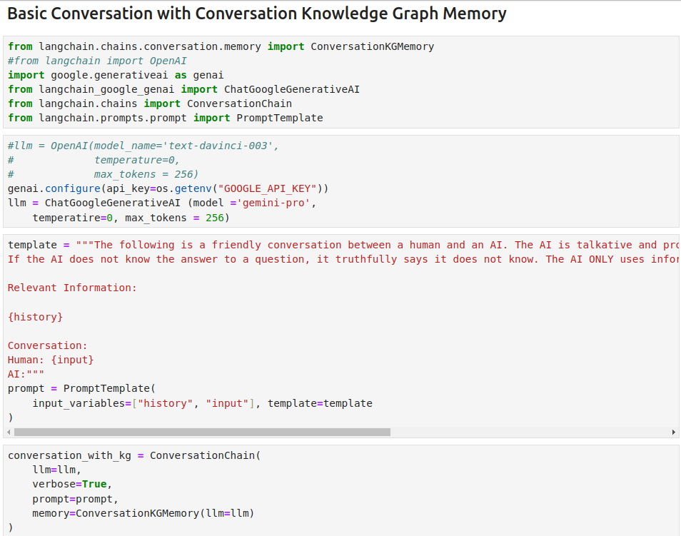
04.12 LC: Knowledge Graph
https://www.youtube.com/watch?v=X550Zbz_ROE&list=PL8motc6AQftk1Bs42EW45kwYbyJ4jOdiZ&index=4
LC: Knowledge Graph (17:31-18:00/20:27)

Slide 3
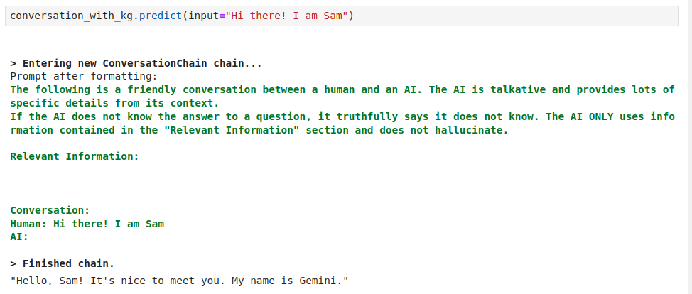
04.12 LC: Knowledge Graph
https://www.youtube.com/watch?v=X550Zbz_ROE&list=PL8motc6AQftk1Bs42EW45kwYbyJ4jOdiZ&index=4
LC: Knowledge Graph (18:01-18:30/20:27)

Slide 4
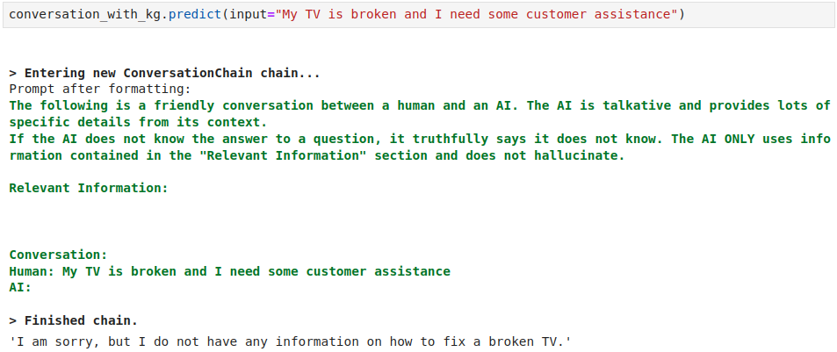
04.12 LC: Knowledge Graph
https://www.youtube.com/watch?v=X550Zbz_ROE&list=PL8motc6AQftk1Bs42EW45kwYbyJ4jOdiZ&index=4
LC: Knowledge Graph (18:31-19:00/20:27)

Slide 5
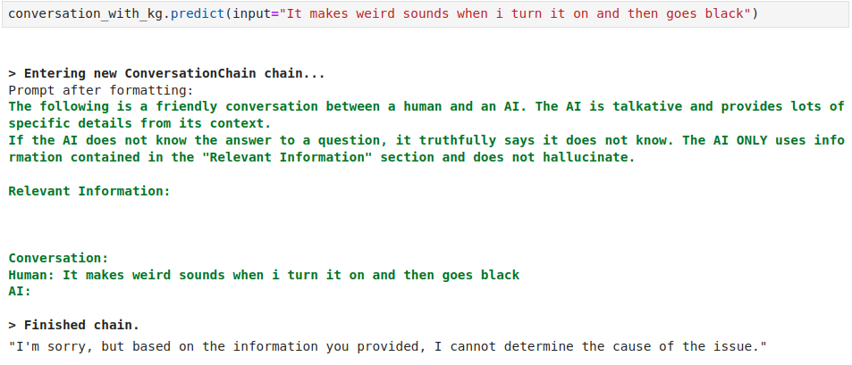
04.12 LC: Knowledge Graph
https://www.youtube.com/watch?v=X550Zbz_ROE&list=PL8motc6AQftk1Bs42EW45kwYbyJ4jOdiZ&index=4
LC: Knowledge Graph (19:01-19:10/20:27)

Slide 6
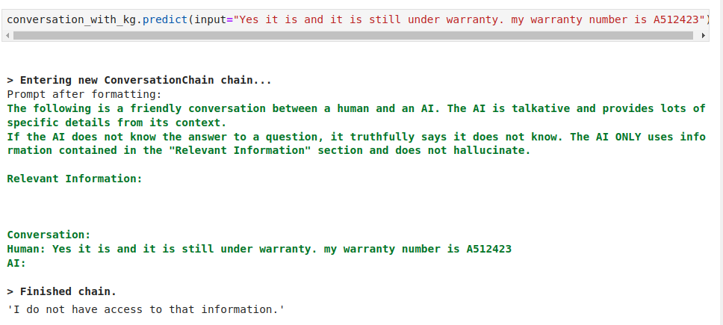
04.12 LC: Knowledge Graph
https://www.youtube.com/watch?v=X550Zbz_ROE&list=PL8motc6AQftk1Bs42EW45kwYbyJ4jOdiZ&index=4
LC: Knowledge Graph (19:11-19:20/20:27)

Slide 7
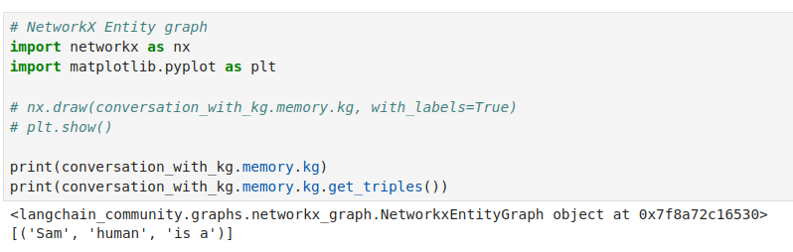
04.12 LC: Knowledge Graph
https://www.youtube.com/watch?v=X550Zbz_ROE&list=PL8motc6AQftk1Bs42EW45kwYbyJ4jOdiZ&index=4
LC: Knowledge Graph (19:21-19:30/20:27)

Slide 8
End

