Slide 1

11.02 Setup Environment
Peter H. Chen

Slide 2
11.02 Setup Environment
https://www.youtube.com/watch?v=qZWymdgDLv0&list=PLZoTAELRMXVNbDmGZlcgCA3a8mRQp5axb&index=11
Setup Environment (05:16-06:00/19:21)
1. > conda create --name gemini
2. (base) > conda activate gemini
3. (gemini) >

Slide 3
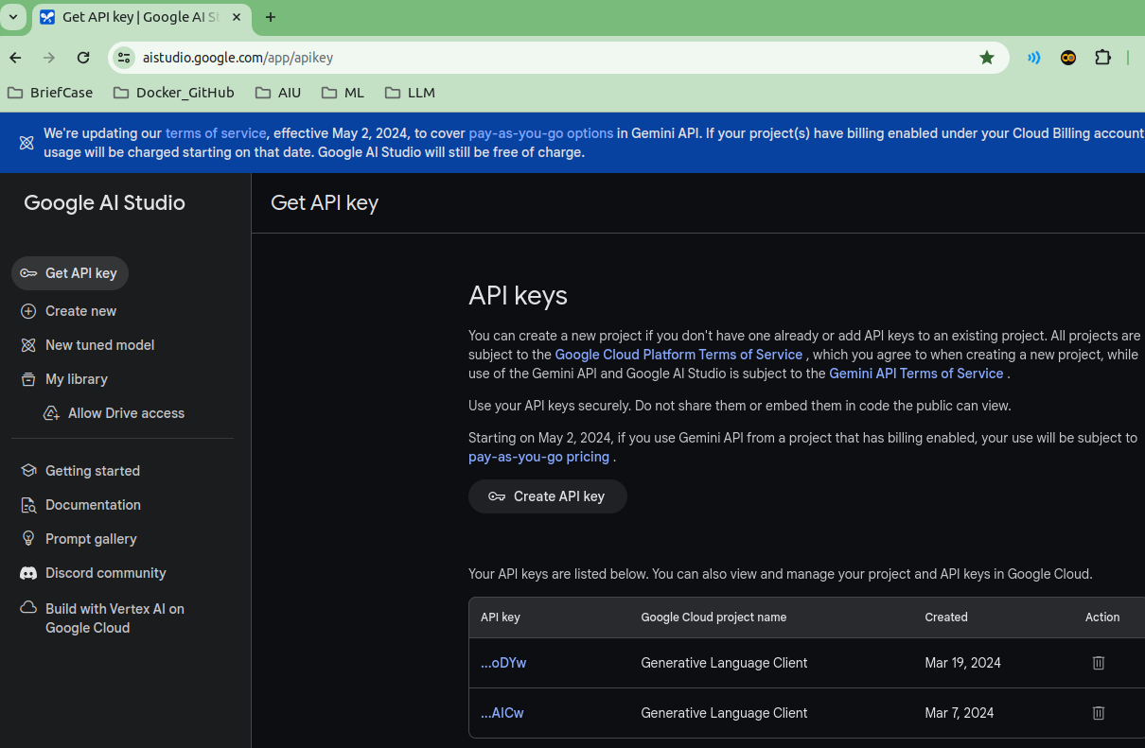
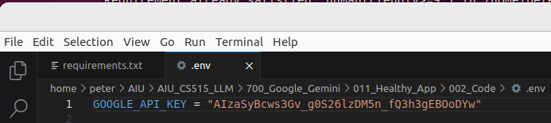
11.02 Setup Environment
https://www.youtube.com/watch?v=qZWymdgDLv0&list=PLZoTAELRMXVNbDmGZlcgCA3a8mRQp5axb&index=11
Setup Environment (06:01-06:30/19:21)
1. Create API Key.
2. Copy and Paste the API Key in .env file.
1
2

Slide 4
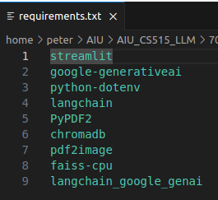
11.02 Setup Environment
https://www.youtube.com/watch?v=qZWymdgDLv0&list=PLZoTAELRMXVNbDmGZlcgCA3a8mRQp5axb&index=11
Setup Environment (06:31-07:30/19:21)
Requirements:
1. streamlit: GUI
2. generative AI: Gemini
3. python-dotenv: python get all the environment variables.
4. langchain: multiple libraries interface
5. pyPDF2: PDF Reader from PDF to text.
6. chromadb: Vector database server
7. pdf2image: PDF into image
8. faiss-cpu: Facebook AI similarity Search in CPU mode.
9. langchain genai: Langchain Gemini Interface.

Slide 5
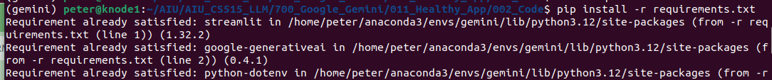
11.02 Setup Environment
https://www.youtube.com/watch?v=qZWymdgDLv0&list=PLZoTAELRMXVNbDmGZlcgCA3a8mRQp5axb&index=11
Setup Environment (07:31-08:10/19:21)
Install requirements
> pip install -r requirements.txt

Slide 6
End

