Slide 1

11.09 Test Health App
Peter H. Chen

Slide 2
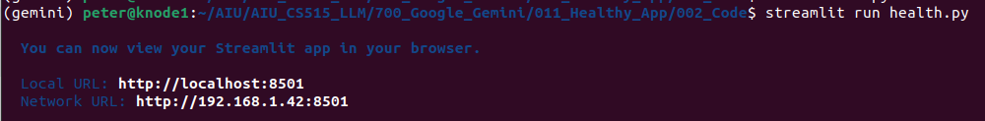
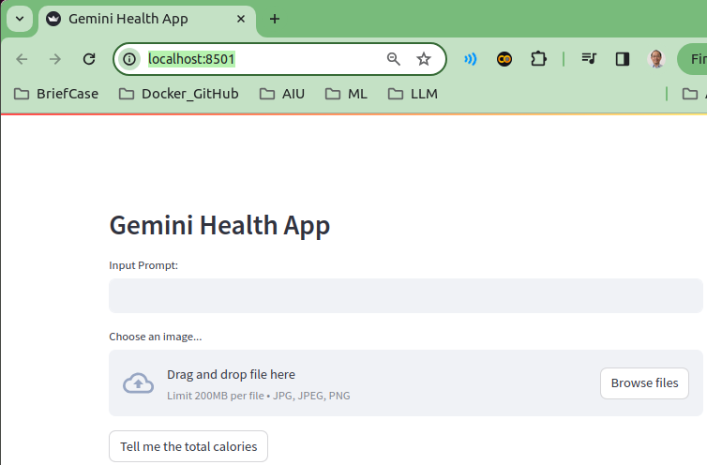
11.09 Test Health APp
https://www.youtube.com/watch?v=qZWymdgDLv0&list=PLZoTAELRMXVNbDmGZlcgCA3a8mRQp5axb&index=11
Test Health App (17:31-18:00/19:21)
> streamlit run health.py

Slide 3
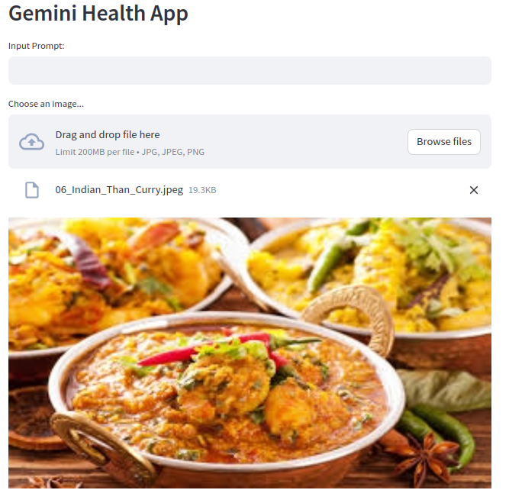
11.09 Test Health APp
https://www.youtube.com/watch?v=qZWymdgDLv0&list=PLZoTAELRMXVNbDmGZlcgCA3a8mRQp5axb&index=11
Test Health App (18:01-18:30/19:21)
Load Than Curry

Slide 4
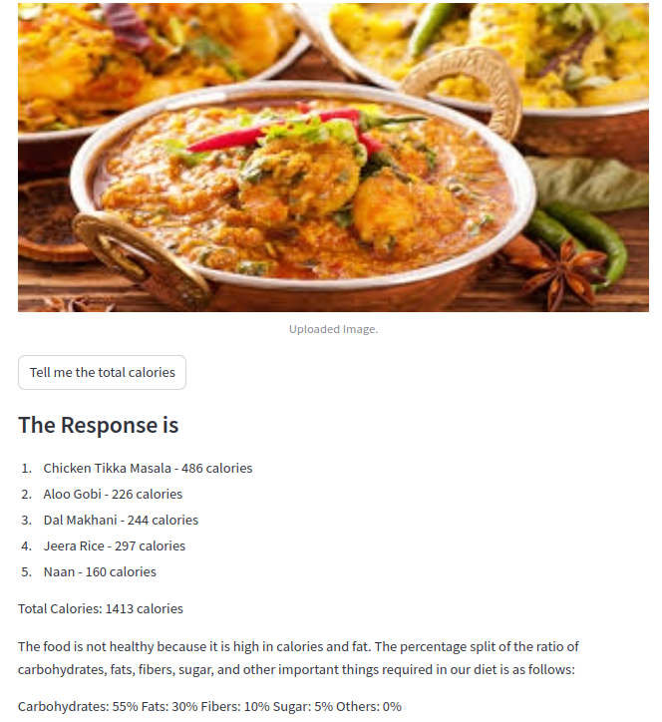
11.09 Test Health APp
https://www.youtube.com/watch?v=qZWymdgDLv0&list=PLZoTAELRMXVNbDmGZlcgCA3a8mRQp5axb&index=11
Test Health App (18:31-19:21/19:21)
We have input_prompt.
We don’t need the user input.
Tell me about calorie

Slide 5
End

