Slide 1

4 Gemini QA ChatBot
Peter H. Chen

Slide 2
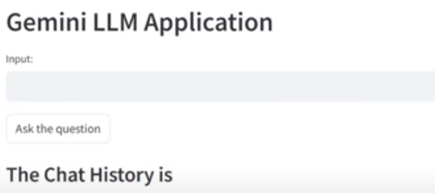
4 Gemini QA ChatBot
https://www.youtube.com/watch?v=o4ZhXSVuPyc&list=PLZoTAELRMXVNbDmGZlcgCA3a8mRQp5axb&index=4
Gemini Conversational QA ChatBot (00:00-00:40/14:32)
We create the conversational QA (Question and Answer) ChatBot with the help of Gemini-pro API.
Previously, we ask the question and response. Not everyone like this kind of input and response without the memory.
The conversational Q&A chatBot with history log, i.e., Input and response with history as the memory.
What is Conversational QA (Question and Answer)?
1. Conversational question answering (QA) requires the ability to correctly interpret a question in the context of previous conversation turns.
2. The conversational QA task need to have memory (history) of context of the sequences, the sequence to sequence with different time.

Slide 3
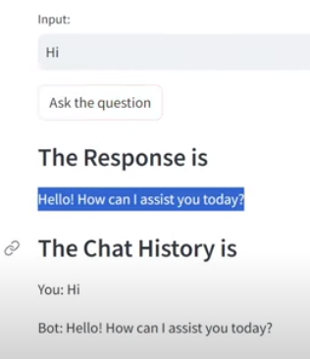
4 Gemini QA ChatBot
https://www.youtube.com/watch?v=o4ZhXSVuPyc&list=PLZoTAELRMXVNbDmGZlcgCA3a8mRQp5axb&index=4
Gemini Conversational QA ChatBot (00:41-00:50/14:32)
Below is the example of conversational chatbot.
1. Human: Hi
2. ChatBot: Hello! How ca I assist you today?

Slide 4
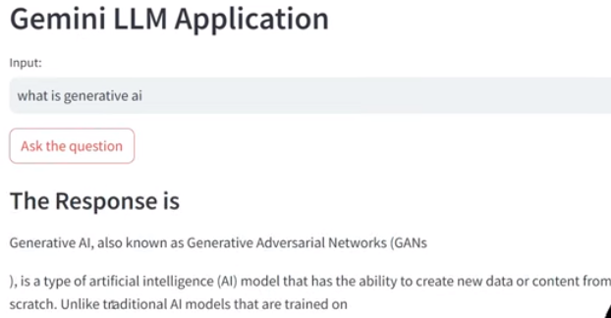
4 Gemini QA ChatBot
https://www.youtube.com/watch?v=o4ZhXSVuPyc&list=PLZoTAELRMXVNbDmGZlcgCA3a8mRQp5axb&index=4
Gemini Conversational QA ChatBot (00:51-01:10/14:32)
Below is the example of conversational chatbot.
1. What is the generative AI?
2. ChatBot: ...

Slide 5
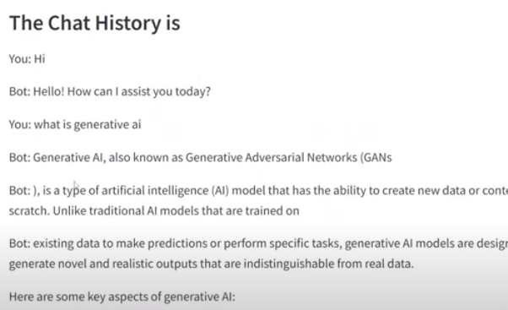
4 Gemini QA ChatBot
https://www.youtube.com/watch?v=o4ZhXSVuPyc&list=PLZoTAELRMXVNbDmGZlcgCA3a8mRQp5axb&index=4
Gemini Conversational QA ChatBot (01:15-01:30/14:32)
Before, we only have input and response in some particular timestamp, i.e., without history.
Now, we can view the chat history.
We will implement the conversational QA chatBot step-by-step.

Slide 6
4.01 Setup API Key

Slide 7
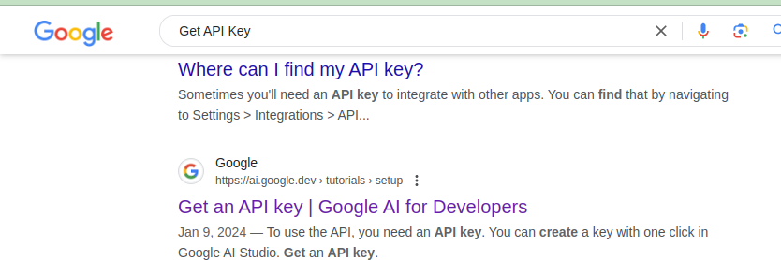
4.01 Setup API Key
https://www.youtube.com/watch?v=W0rNUAfqGFc&list=PLZoTAELRMXVNbDmGZlcgCA3a8mRQp5axb&index=2
Setup API Key (01:31-01:32/14:32)
Google Search “Get API Key”.
Carefully browse and click “Get an API Key | Google AI for Developers”
https://ai.google.dev/tutorials/setup

Slide 8
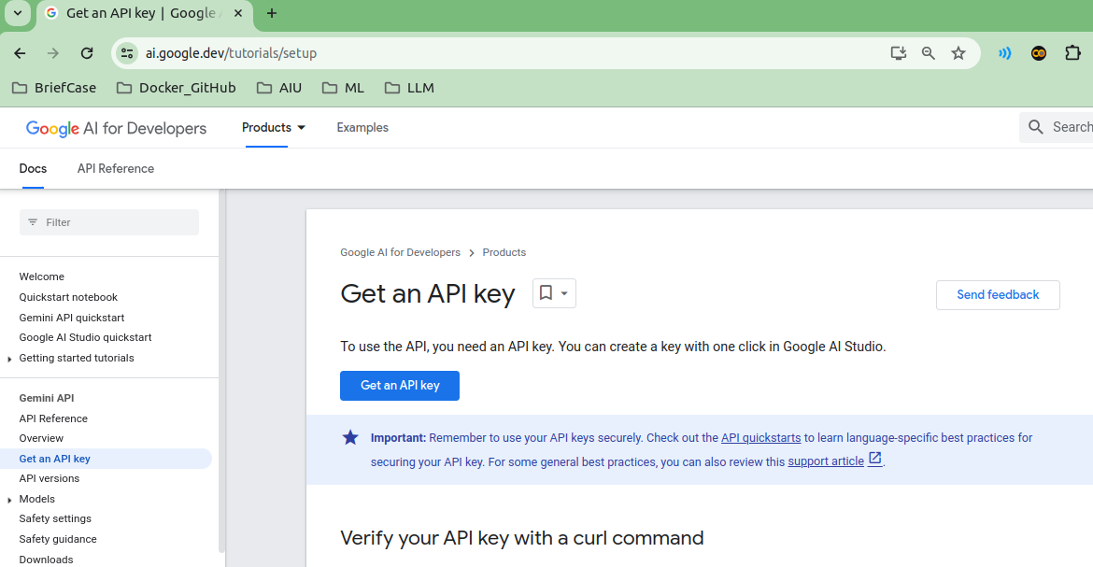
4.01 Setup API Key
https://www.youtube.com/watch?v=W0rNUAfqGFc&list=PLZoTAELRMXVNbDmGZlcgCA3a8mRQp5axb&index=2
Setup API Key (01:33-01:34/14:32)
Click “Get an API Key”.
https://ai.google.dev/tutorials/setup

Slide 9
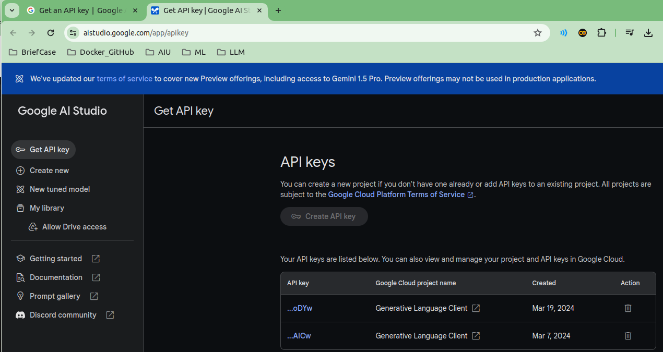
4.01 Setup API Key
https://www.youtube.com/watch?v=W0rNUAfqGFc&list=PLZoTAELRMXVNbDmGZlcgCA3a8mRQp5axb&index=2
Setup API Key (01:35-01:36/14:32)
Now, create API Key.
Copy the API Key into “.env” file.

Slide 10
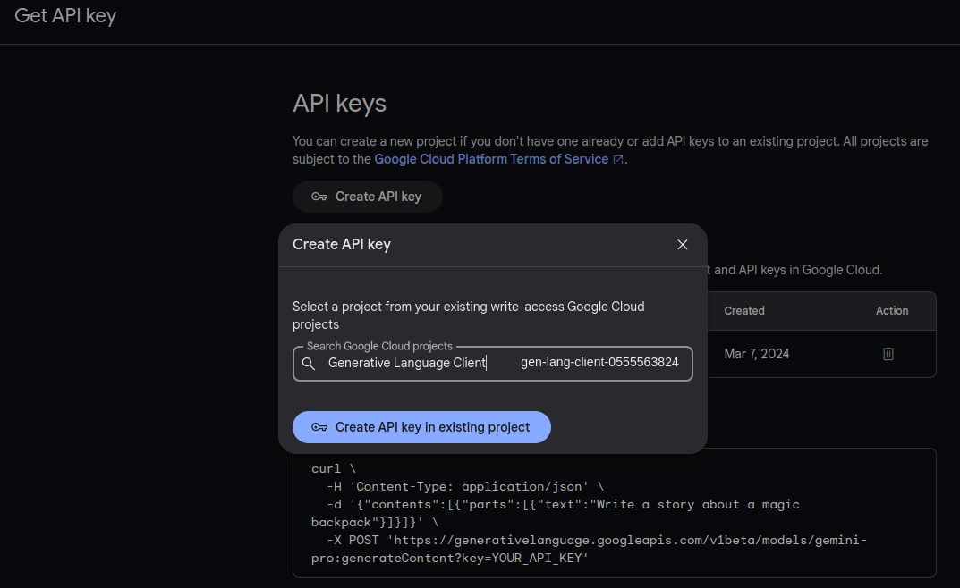
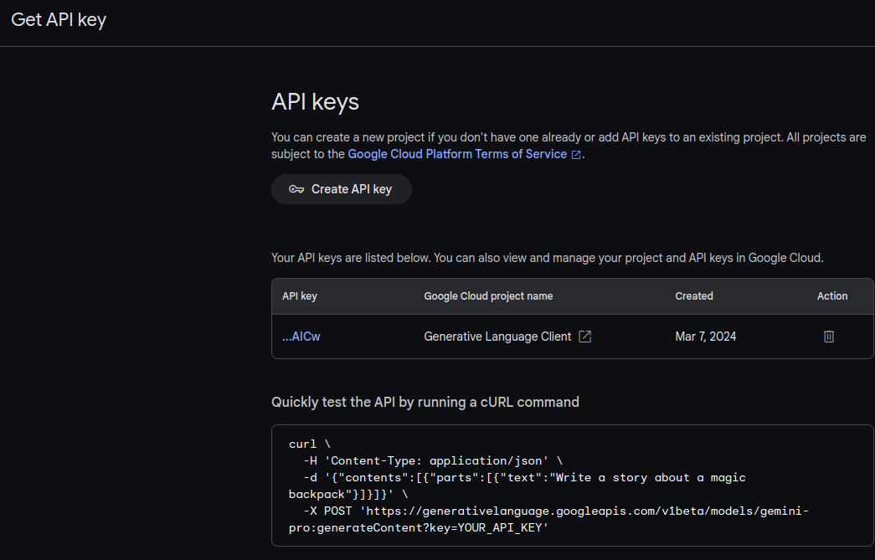
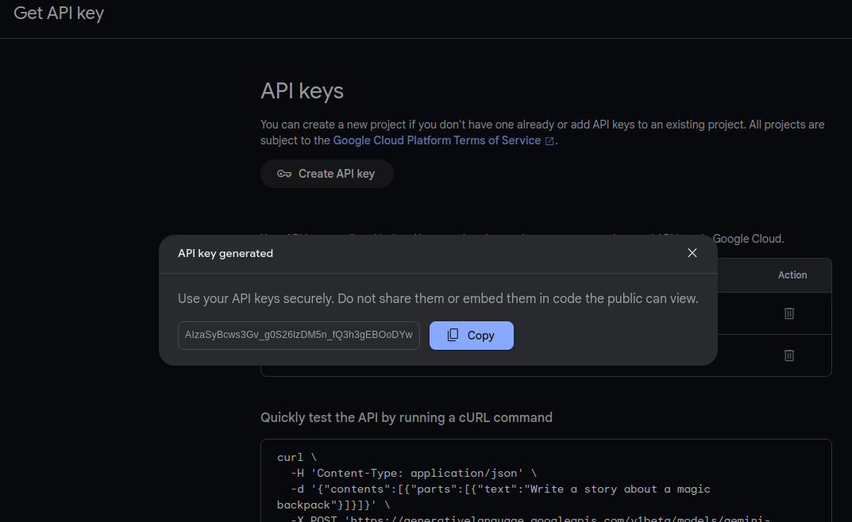
4.01 Setup API Key
https://www.youtube.com/watch?v=W0rNUAfqGFc&list=PLZoTAELRMXVNbDmGZlcgCA3a8mRQp5axb&index=2
Setup API Key (01:37-01:38/14:32)
Now, we setup API Key.

Slide 11
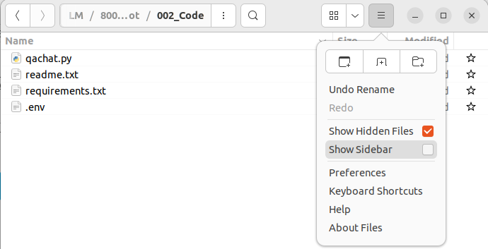
4.01 Setup API Key
https://www.youtube.com/watch?v=W0rNUAfqGFc&list=PLZoTAELRMXVNbDmGZlcgCA3a8mRQp5axb&index=2
Setup API Key (01:39-01:40/14:32)
If we use local computer, we store the API key in “.env” file.
Click “Show Hidden Files” to see the “.env” file.
We can save the created API Key in the “.env” file if you use local computer.
We will need load_dotenv() to load the API key from “.env’.

Slide 12
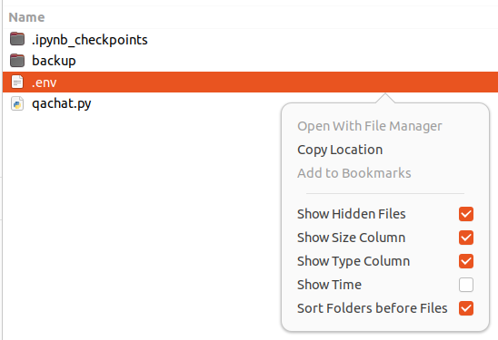

4.1 Google API Key
https://www.youtube.com/watch?v=o4ZhXSVuPyc&list=PLZoTAELRMXVNbDmGZlcgCA3a8mRQp5axb&index=4
Google API Key (01:41-01:50/14:32)
First, we need the Google API Key.
1. Open the Ubuntu File Manager, turn on the “Show Hidden Files”.
2. > Code
3. Open file “.env” with GOOGLE_API_KEY.

Slide 13
4.02 Import Libraries

Slide 14
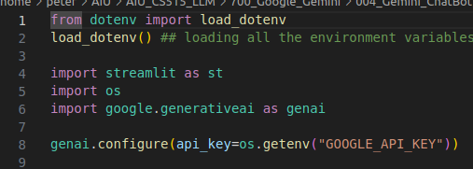
4.02 Import Libraries
https://www.youtube.com/watch?v=o4ZhXSVuPyc&list=PLZoTAELRMXVNbDmGZlcgCA3a8mRQp5axb&index=4
Import Libraries (02:01-03:30/14:32)
1. import load_dotenv
2. load_dotenv()
3. import streamlit
4. import os
5. import generate AI

Slide 15
4.03 Load API Key

Slide 16
4.03 Load API Key
https://www.youtube.com/watch?v=o4ZhXSVuPyc&list=PLZoTAELRMXVNbDmGZlcgCA3a8mRQp5axb&index=4
Import Libraries (03:31-04:10/14:32)
Load API Key
1. load_dotenv()
2. genai.configure(api_key = os.getenv(“GOOGLE_API_KEY”))

Slide 17
End

