Slide 1

4.04 Create Gemini-pro Model
Peter H. Chen

Slide 2
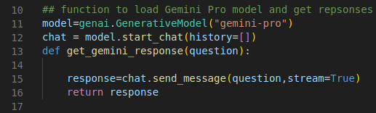
4.04 Create Gemini-pro Model
https://www.youtube.com/watch?v=o4ZhXSVuPyc&list=PLZoTAELRMXVNbDmGZlcgCA3a8mRQp5axb&index=4
Create Gemini-pro Model (04:11-06:30/14:32)
We
1. Create Generative Model with “gemini-pro” or “gemini-pro-vision”.
2. Create chat with start_chat() with empty history.
2.1 Here, We maintain the history in the history log.
2.2 We can have another way to keep the log with the streamlit.
2.3 We also can keep the history in the database.
3. Get response with input question. Here, we create a function get_model_response (question). Here, we set the stream to True.

Slide 3
4.05 Create GUI

Slide 4
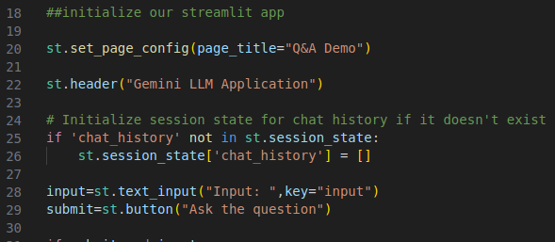
4.05 Create GUI
https://www.youtube.com/watch?v=o4ZhXSVuPyc&list=PLZoTAELRMXVNbDmGZlcgCA3a8mRQp5axb&index=4
Create GUI (06:31-08:00/14:32)
We create GUI with streamlit.
1. Create page title “Q&A Demo”
2. Create header “Gemini: LLM Application”
3. Initialize the session state to store the chat history: We keep the conversations in the session stack.
4. Create the Input label and text field. Key (optional string or integer): unique key for widget (input text field). If you have multiple input, then each widget requires unique name or integer. Here, we use input as the variable name.
5. Create the submit button.

Slide 5
4.06 Submit and Response

Slide 6
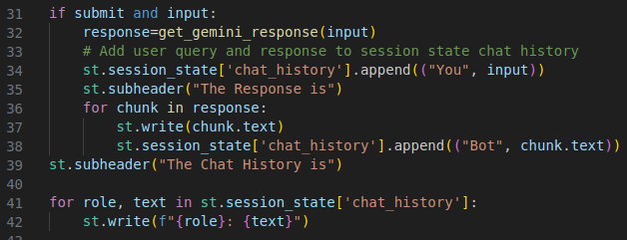
4.06 Submit and Response
https://www.youtube.com/watch?v=o4ZhXSVuPyc&list=PLZoTAELRMXVNbDmGZlcgCA3a8mRQp5axb&index=4
Submit and Response (08:01-11:30/14:32)
We
1. Get the response of user input
2. Store the input into the session_state
3. Store the response into the session_state
4. Display the “Chat History” header
5. Display the streamlit in the session_state.

Slide 7
End

