Slide 1

4.16 Create App
Peter H. Chen

Slide 2
4.16 Deploy App
https://www.youtube.com/watch?v=qMIM7dECAkc&list=PLZoTAELRMXVORE4VF7WQ_fAl0L1Gljtar&index=5
Deploy App (1:01:51-1:02:30/1:18:23)
Finally, we deploy the application.
We create a simple Q&A chatbot with LangChain and Google Gemini LLM.

Slide 3
4.17 Install Requirements

Slide 4
4.17 Install Requirements.
https://www.youtube.com/watch?v=qMIM7dECAkc&list=PLZoTAELRMXVORE4VF7WQ_fAl0L1Gljtar&index=5
Install Requirements (1:02:31-1:02:40/1:18:23)
Conda Create/activate gemini
1. > conda create --name gemini
2. > conda activate gemini
We have conda create environment “Gemini” for python environment.

Slide 5
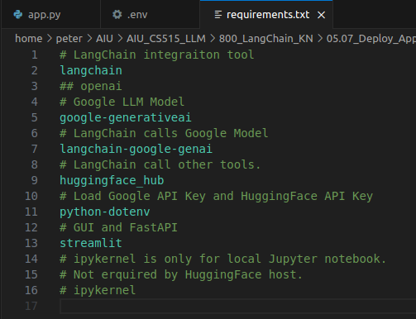
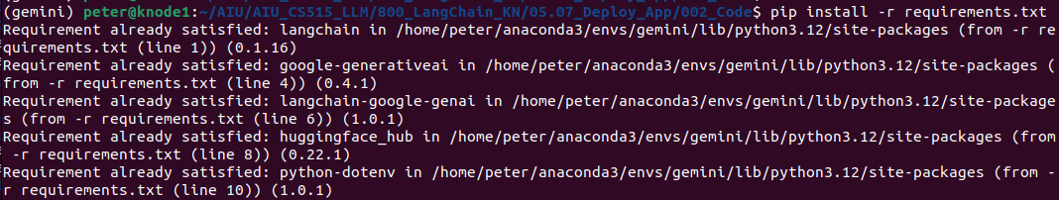
4.17 Install Requirements.
https://www.youtube.com/watch?v=qMIM7dECAkc&list=PLZoTAELRMXVORE4VF7WQ_fAl0L1Gljtar&index=5
Install Requirements (1:02:41-1:03:10/1:18:23)
> pip install -r requirements.txt
1. langchain: LangChain Integration tool
2. google-generativeai: Google Generative AI
3. langchain-google-genai: LangChain calls Google Model
4. huggingface_hub: LangChain call other language models
5. python-dotenv: load environment variables
6. streamit: GUI and fastAPI

Slide 6
4.18 Get Google/HuggingFace API Key

Slide 7
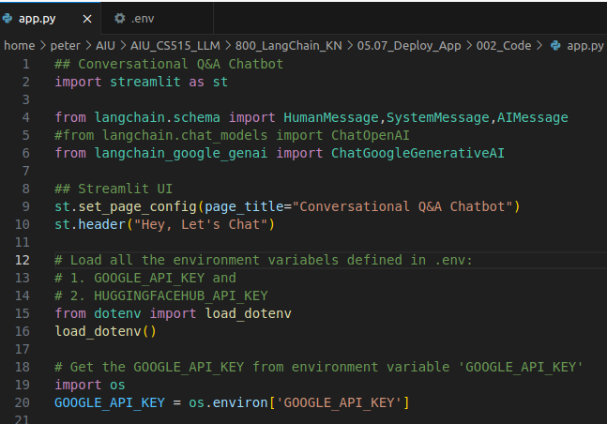
4.17 Create Google/HuggingFace API Key
https://www.youtube.com/watch?v=qMIM7dECAkc&list=PLZoTAELRMXVORE4VF7WQ_fAl0L1Gljtar&index=5
Create Google/HuggingFace API Key (1:03:11-1:05:00/1:18:23)
We load_dotenv() to load the environment variables from “.env”file:
1. GOOGLE_API_KEY (Google LLM Gemini) and
2. HUGGINGFACEHUB_API_KEY (LangChain calls all the tools in the HuggingFace).

Slide 8
4.19 Get Google Chat Response

Slide 9

4.19 Get Google Chat Response
https://www.youtube.com/watch?v=qMIM7dECAkc&list=PLZoTAELRMXVORE4VF7WQ_fAl0L1Gljtar&index=5
Get Google Chat Response (1:05:01-1:06:30/1:18:23)
Below is a simple example to get Google Chat Response.

Slide 10
4.20 Streamlit GUI

Slide 11
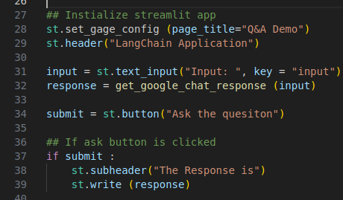
4.20 Streamlit GUI
https://www.youtube.com/watch?v=qMIM7dECAkc&list=PLZoTAELRMXVORE4VF7WQ_fAl0L1Gljtar&index=5
Streamlit GUI (1:06:31-1:12:00/1:18:23)
1. Create Input text field.
2. Create Submit button.
3. Get input from text input.
4. Get response from get_google_chat_response(input)
5. display response.

Slide 12
4.21 Test Google Chat Response

Slide 13
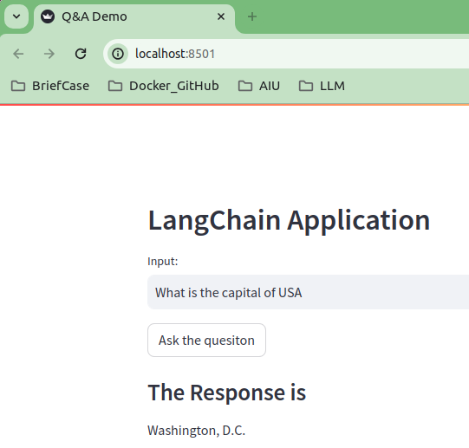
4.21 Test Google Chat Response
https://www.youtube.com/watch?v=qMIM7dECAkc&list=PLZoTAELRMXVORE4VF7WQ_fAl0L1Gljtar&index=5
Test Google Chat Response (1:12:01-1:13:00/1:18:23)
Test Google Chat Response
> streamlit run app.py
Question: What is capital of USA?
Answer: Washington DC

Slide 14
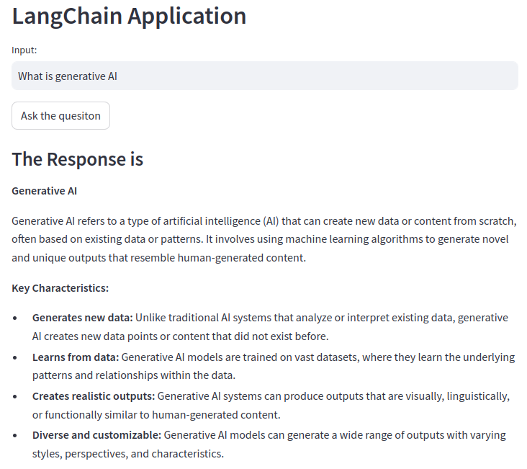
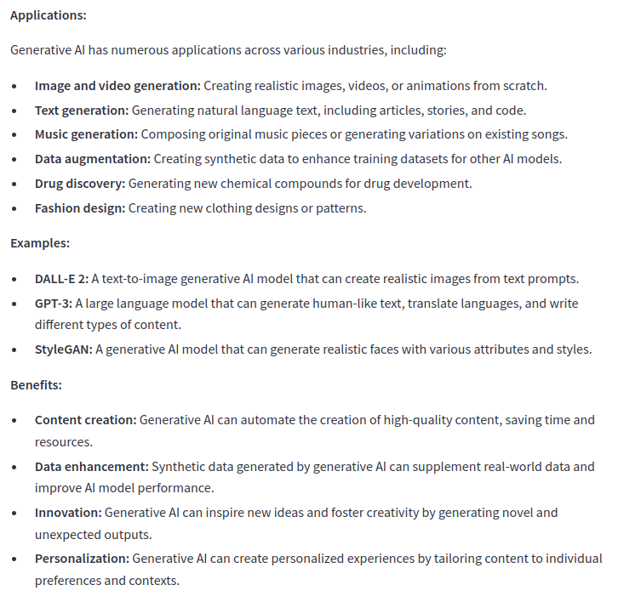
4.21 Test Google Chat Response
https://www.youtube.com/watch?v=qMIM7dECAkc&list=PLZoTAELRMXVORE4VF7WQ_fAl0L1Gljtar&index=5
Test Google Chat Response (1:13:01-1:13:30/1:18:23)
Question: What is Generative AI?

Slide 15
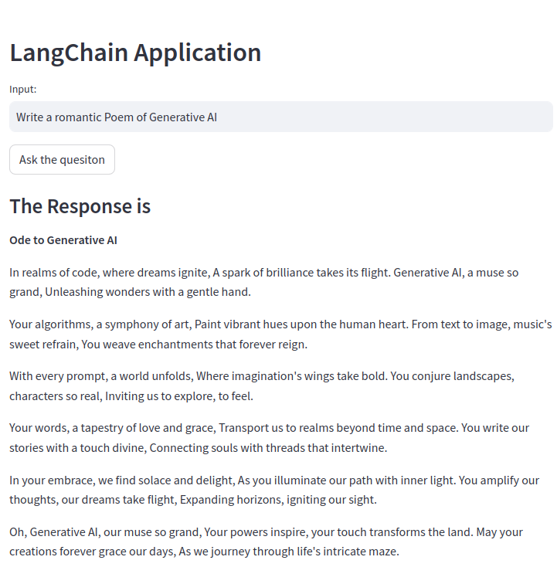
4.21 Test Google Chat Response
https://www.youtube.com/watch?v=qMIM7dECAkc&list=PLZoTAELRMXVORE4VF7WQ_fAl0L1Gljtar&index=5
Test Google Chat Response (1:13:31-1:15:00/1:18:23)
Question: Write a romantic Poem of Generative AI.

Slide 16
End

