Slide 1

1 Multi-PDF and Gemini Overview
Peter H. Chen

Slide 2
1 Multi-PDF and Gemini Overview
https://www.youtube.com/watch?v=uus5eLz6smA
LangChain, Multi-PDF, and Gemini Overview (00:00-01:00/29:20)
We create end-to-end project of chatBot: We use LangChain to integrate Google Gemini Pro to read multiple PDF documents.
There are two major technologies inside the project:
1. vector embedding technique. There are many vector embedding technique. We will use Vector embedding from Facebook.
2. Gemini Pro

Slide 3
1.1 GUI

Slide 4
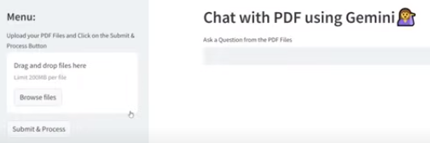
1.1 GUI
https://www.youtube.com/watch?v=uus5eLz6smA
GUI (01:04-01:10/29:20)
Below is the GUI will be:

Slide 5
1.2 Drag and Drop PDF Documents

Slide 6
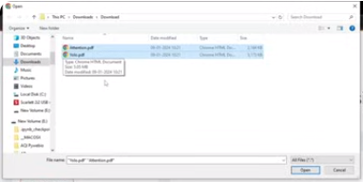
1.2 Drag and Drop PDF Documents
https://www.youtube.com/watch?v=uus5eLz6smA
Drag and Drop PDF Documents (01:11-01:20/29:20)
When we chat with multiple PDF, we drag and drop the PDF files.
We browse the the folder with multiple PDFs:
1. Attention.pdf
2. Yolo.pdf

Slide 7
1.3 Generate Vector Embedding

Slide 8
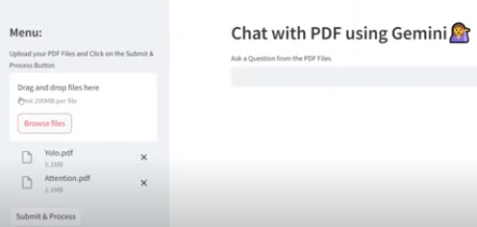
1.3 Generate Vector Embedding
https://www.youtube.com/watch?v=uus5eLz6smA
Generate Vector Embedding (01:23-01:30/29:20)
After we drop
1. Attention.pdf
2. Yolo.pdf
We click “Search & Process” to submit.

Slide 9
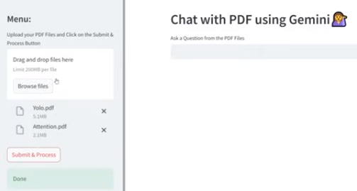
1.3 Generate Vector Embedding
https://www.youtube.com/watch?v=uus5eLz6smA
Generate Vector Embedding (01:31-02:00/29:20)
Now, the chatBot will process all the PDF files.
1. Convert the PDF documents into vector embeddings.
2. Store in local drive in vector database format.
When we see the process is done.

Slide 10
1.4 Ask Quesiton of Attention Paper

Slide 11
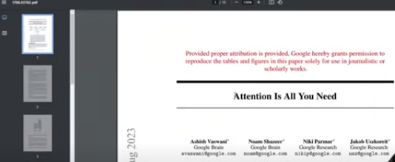
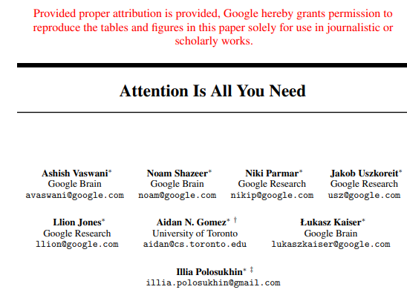
1.4 Ask Quesiton of Attention Paper
https://www.youtube.com/watch?v=uus5eLz6smA
Ask Question of Attention Paper (02:01-02:15/29:20)
Now, we have the vector words embedding in the vector database.
We can ask any questions about the content of PDF documents.

Slide 12
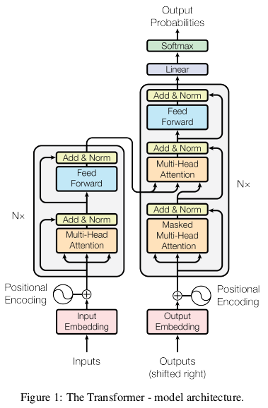
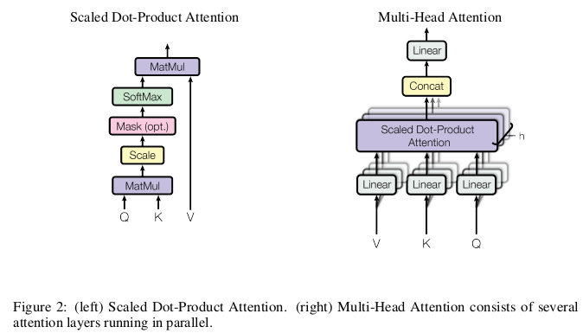
1.4 Ask Quesiton of Attention Paper
https://www.youtube.com/watch?v=uus5eLz6smA
Ask Question of Attention Paper (02:16-02:17/29:20)
We can ask any quesiton of the content of PDF documents.

Slide 13
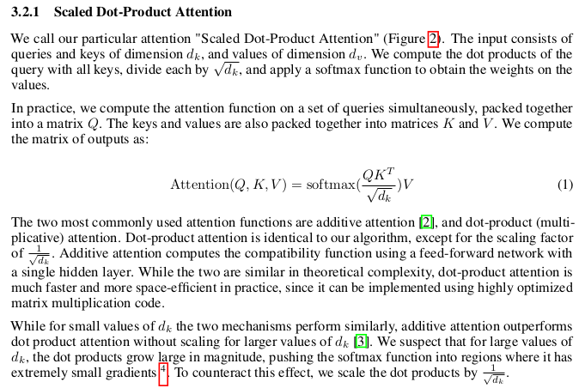
1.4 Ask Quesiton of Attention Paper
https://www.youtube.com/watch?v=uus5eLz6smA
Ask Question of Attention Paper (02:16-02:25/29:20)
For example, we can ask “what is scaled dot-product attention”?

Slide 14
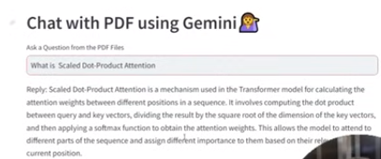
1.4 Ask Quesiton of Attention Paper
https://www.youtube.com/watch?v=uus5eLz6smA
Ask Question of Attention Paper (02:16-02:25/29:20)
For example, we can ask “what is scaled dot-product attention”?
We have response of question.

Slide 15
1.4 Ask Quesiton of Attention Paper
https://www.youtube.com/watch?v=uus5eLz6smA
Ask Question of Attention Paper (02:16-02:30/29:20)
For example, we can ask “what is scaled dot-product attention”?
We have response of question.

Slide 16
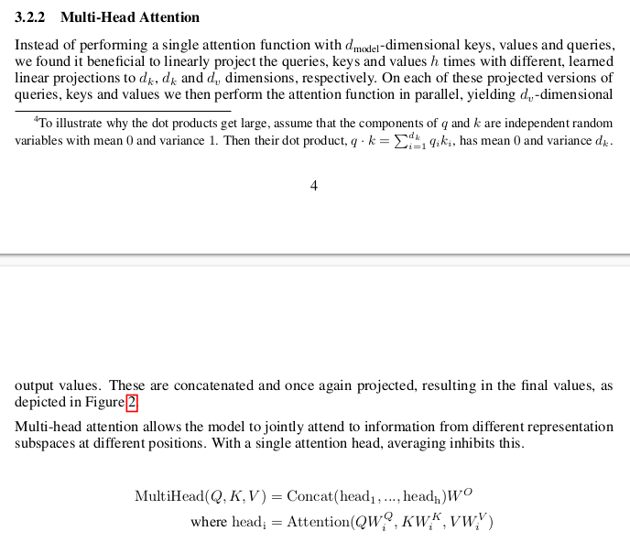
1.4 Ask Quesiton of Attention Paper
https://www.youtube.com/watch?v=uus5eLz6smA
Ask Question of Attention Paper (02:31-03:00/29:20)
We can see “Multi-Head Attention”

Slide 17
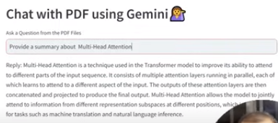
1.4 Ask Quesiton of Attention Paper
https://www.youtube.com/watch?v=uus5eLz6smA
Ask Question of Attention Paper (03:01-03:30/29:20)
We can ask “Please provide a summary about multi-head attention”.
This is the reply from Gemini.

Slide 18
1.5 Ask Quesiton of YOLO Paper

Slide 19
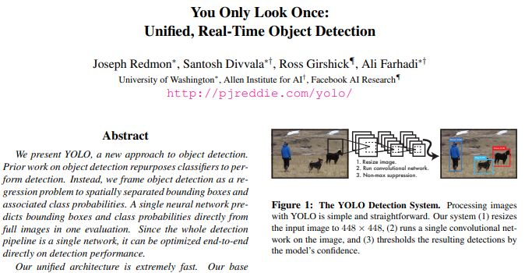
1.5 Ask Quesiton of YOLO Paper
https://www.youtube.com/watch?v=uus5eLz6smA
Ask Question of YOLO Paper (03:31-04:00/29:20)
Below is the YOLO paper.

Slide 20
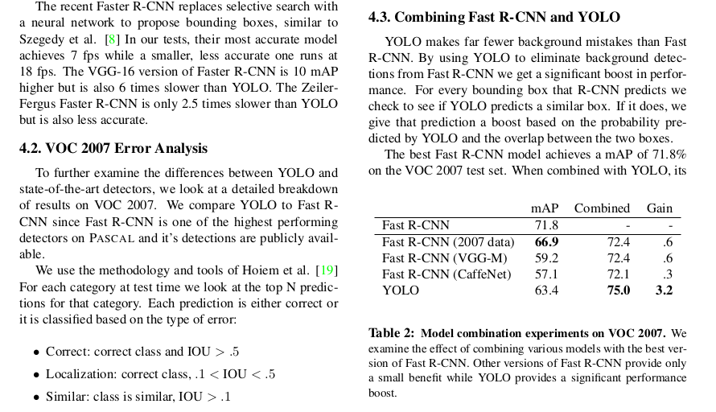
1.5 Ask Quesiton of YOLO Paper
https://www.youtube.com/watch?v=uus5eLz6smA
Ask Question of YOLO Paper (04:01-04:10/29:20)
Here, we can ask “Provide the detail summary of VOC 2007 Error Analysis.”

Slide 21
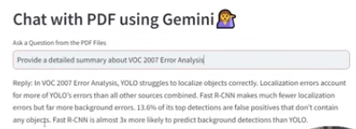
1.5 Ask Quesiton of YOLO Paper
https://www.youtube.com/watch?v=uus5eLz6smA
Ask Question of YOLO Paper (04:11-04:20/29:20)
Here, ask “Provide a detailed summary about VOC 2007 Error Analysis.”

Slide 22
End

