Slide 1

3 Install Packages
Peter H. Chen

Slide 2
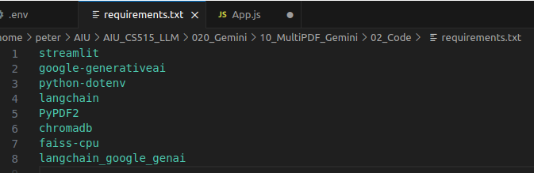
3 Install Packages
https://www.youtube.com/watch?v=uus5eLz6smA
Install Required Packages and Libraries (07:58-09:00/29:20)
We have requirements.txt define for the below libraries:
1. streamit: GUI
2. Google-generativeai: Google generative AI.
3. python .env: Python for .env
4. langchain: LLM integration
5. PyPDF2: We transfer PDF to text.
6. chromadb: Vector embedding database
7. FAISS for CPU: we have only one file, we use FAISS CPU. If we have more then one file, then we use FAISS GPU.
8. langchain_google_genai: Langchain for google generative AI. This is important library for LangChain and Google generate AI Application interface.
These are the important libraries for the project.

Slide 3
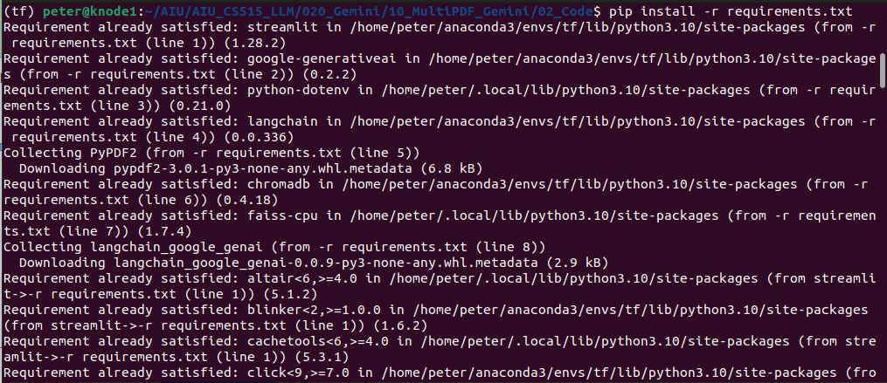
3 Install Packages
https://www.youtube.com/watch?v=uus5eLz6smA
Install Required Packages and Libraries (09:01-09:10/29:20)
We Install all the requirements.txt
> pip install -r requirements.txt

Slide 4
End

