Slide 1

4 Import Package
Peter H. Chen

Slide 2
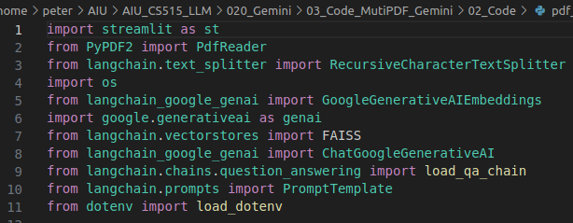
4 Import Packages
https://www.youtube.com/watch?v=uus5eLz6smA
Import Packages (09:29-12:20/29:20)
1. Import GUI streamlit
2. Import PDF Reader.
3. import LangChain Text splitter. We use recursive character text splitter.
4. import os for operating system operation.
5. We use google generative AI. We will use Google Generative AI Embeddings technique from langchain.
We need to import below five different libraries:
6. FAISS: Facebook AI Similarity Search. This is for vector embedding from langchain vector.
7. ChatGoogleGenerativeAI: Chat for Google generative AI.
8. load_qa_chain: Question and Answer Chain.
9. promptTemplate: Prompt Template
10. load dot env: load .env.

Slide 3
End

