Slide 1

5 Get Google API Key
Peter H. Chen

Slide 2

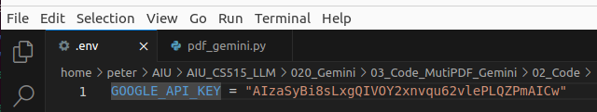
5 Get Google API Key
https://www.youtube.com/watch?v=uus5eLz6smA
Get Google API Key (12:22-13:00/29:20)
1. Now, we load the environment variable from file .env.
2. We get the defined Google API Key by os.getenv(“GOOGLE_API_KEY”)
3. We passed the API Key for generative AI configuration.

Slide 3
End

