Slide 1

6 Read PDF into Chunks of Text
Peter H. Chen

Slide 2
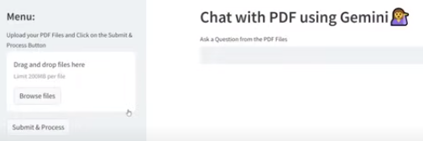
6 Read PDF into Chunks of Text
https://www.youtube.com/watch?v=uus5eLz6smA
Read PDF into Chunks of Text (13:11-13:30/29:20)
We have
1. Drag and drop PDF files in the left side.
2. Right hand side user input text area.

Slide 3
6.1 Read PDF into Text

Slide 4
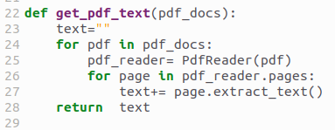
6.1 Read PDF into Text
https://www.youtube.com/watch?v=uus5eLz6smA
Read PDF into Text (13:34-15:40/29:20)
Define a function to translate the PDF into text.
We read the pdf and then go through every pages, extract the text, put together, and return the text.
1. We input the pdf_docs
2. pdf in pdf_docs.
3. we use pdf_reader = PdfReader (pdf)
4. for page in pdf_reader.pages:
5. translate each pdf page into text.
6. Extract text in each page and append into text.
6. return text of pdf_docs.

Slide 5
6.2 Split Texts into Smaller Chunks

Slide 6
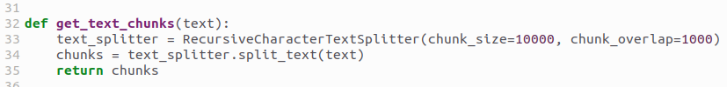
6.2 Split Texts into Smaller Chunks
https://www.youtube.com/watch?v=uus5eLz6smA
Split Text into Smaller Chunks (15:41-16:30/29:20)
We define another function, We get the text and split into smaller chunks of text.
The get_pdf_text (pdf_docs) and get_text_chunks(text) will apply to all the pdf files.
In get_text_chunks(), we use RecursiveCharacterTextSplitter() to split all the text into chunks.
The smaller chunks size is 10,000 will summarize the details of text.
Why do we need to split text into smaller chunks of text?
1. Easier understanding of content: Breaking a large piece of text into smaller chunks of sentences makes it easier for the reader to understand the content.
2. Enhanced accuracy: By breaking the text into smaller sentence chunks, you can create a more accurate dataset that can be used to make more accurate predictions.

Slide 7
End

