Slide 1

7 Chunks of Text into Vectors
Peter H. Chen

Slide 2
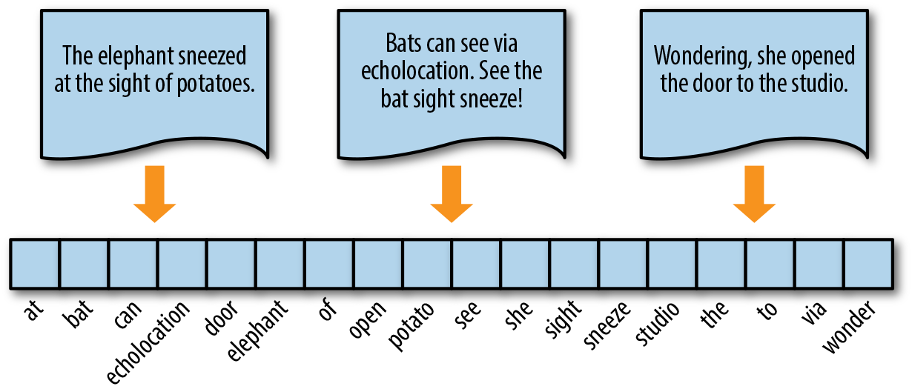
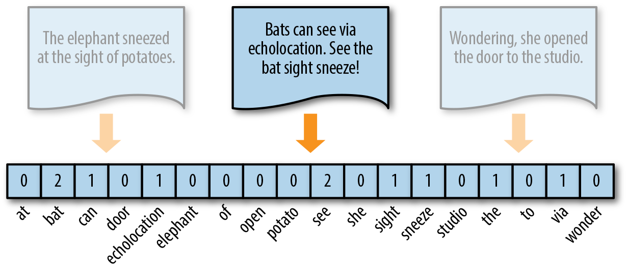
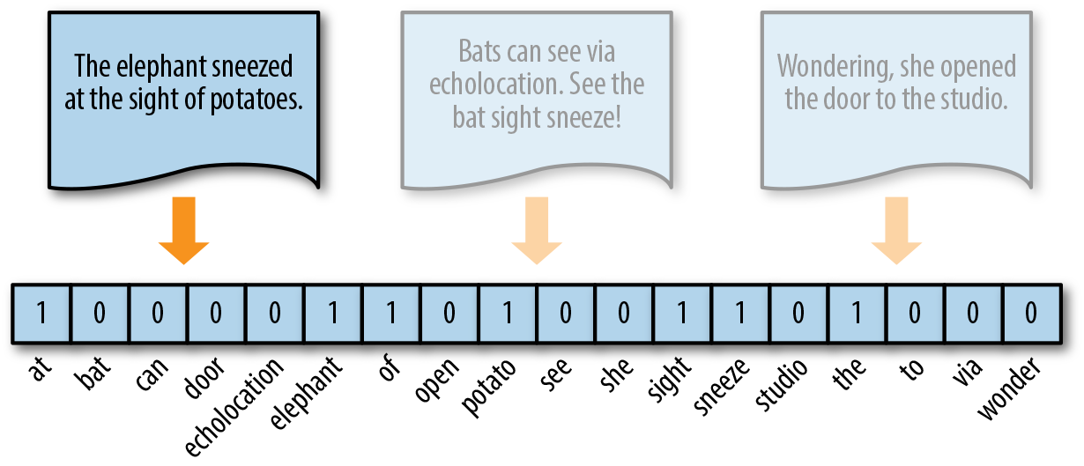
7 Chunks of Text into Vector
https://www.youtube.com/watch?v=uus5eLz6smA
Checks of Text into Vector (17:28-17:30/29:20)
Now, we have chunks of text.
We want to convert chunks of text into vectors.
Why do we need to convert the text into vectors?
1. Text vectorization is important because ML (Machine Learning) and DL (Deep Learning) models require numerical data as inputs to accomplish their tasks.
2. The ML and DL models cannot process the data directly as humans do.
Encoding documents into vectors
Vector encoding
1-hot encoding

Slide 3
7.1 Vector Embedding and Dimension Reduction

Slide 4

7.1 Vector Embedding and Dimension Reduction
https://www.youtube.com/watch?v=uus5eLz6smA
Vector Embedding and Dimension Reduction (17:35-19:50/29:20)
We input the text_chunk
1. GoogleGenerativeAIEmbedding(): We use google generative AI embedding technique to convert into the vector of number called vector embedding.
2. FAISS (Facebook AI Similarity Search): Reduce dimension by Facebook AI Similarity Search technique.
3. After convert into vector number and dimension reduction, we save into the index vector embedding model called “faiss_index”.
The “faiss_index” is the folder that store vector information. The format is unreadable. We can use Python pickle to read information.
What is Vector Embedding?
1. Vector: array of floating-point numbers.
2. Embeddings: convert texts into numbers.
What is FAISS (Facebook AI Similarity Search)?
Reduce the high dimension into lower dimensions.

Slide 5
End

