Slide 1

8 Prompt Chain
Peter H. Chen

Slide 2
8 Prompt Chain
https://www.youtube.com/watch?v=uus5eLz6smA
Prompt Chain (19:51-20:30/29:20)
We get the conversational chain (or Prompt Chain).

Slide 3
8.1 Define Prompt

Slide 4
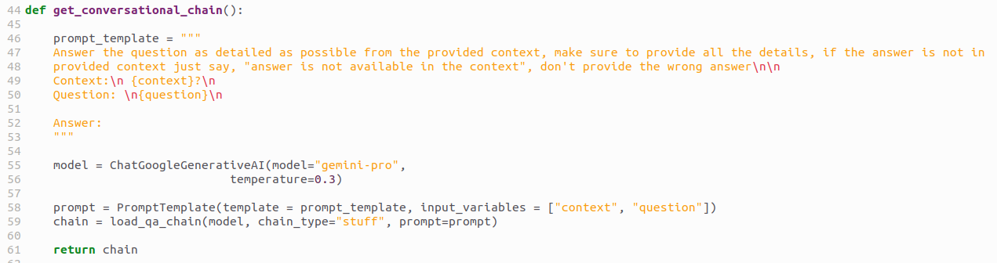
8.1 Define Prompt
https://www.youtube.com/watch?v=uus5eLz6smA
Define Prompt (19:51-21:10/29:20)
We define the prompt template.
Let’s define some meaningful prompt.
We give the question and answer:
prompt_template = “””Answer the question as detailed as possible from the provided context, make sure to provide the details. If the answer is not in the provided context, just say, “answer is not available in the context”, do not provide the wrong answer
Context: {context} \n
Question: {question}
Answer:
“””

Slide 5
8.1 Define Prompt
https://www.youtube.com/watch?v=uus5eLz6smA
Define Prompt (21:15-21:30/29:20)
We use ChatGoogleGenerativeAI for google “gemini-pro” model and temperature 0.3.
What is temperature in Gemini AI?
1. Lower temperatures are good for prompts that require a less open-ended or creative response.
2. Higher temperatures can lead to more diverse or creative results.
3. A temperature of 0 means that the highest probability tokens are always selected.

Slide 6
8.1 Define Prompt
https://www.youtube.com/watch?v=uus5eLz6smA
Define Prompt (21:31-22:10/29:20)
1. We use PromptTemplate () which is available from from langchain.
2. We use template = defined prompt_template.
3. Our input variables is “context” and “question”.
These are my information with respect to the prompt template.

Slide 7
8.1 Define Prompt
https://www.youtube.com/watch?v=uus5eLz6smA
Define Prompt (22:16-23:05/29:20)
Once these are done, we are going to create our Q&A chain.
Here, we create
1. chain
2. model “gemini-pro”
3. chain type = “stuff”
4. prompt = prompt created by PromptTemplate().
5. Finally, we return chain. This is the conventional chain (or conversational prompt).
This are all functionality of prompt. We load the gemini-pro model, create the template, create the chain.

Slide 8
End

