Slide 1

9 User Input and Display
Peter H. Chen

Slide 2
9 User Input and Display
https://www.youtube.com/watch?v=uus5eLz6smA
User Input and Display (23:06-23:10/29:20)
Now, finally, we need to define the user input and display.

Slide 3
9.1 Define User Input

Slide 4
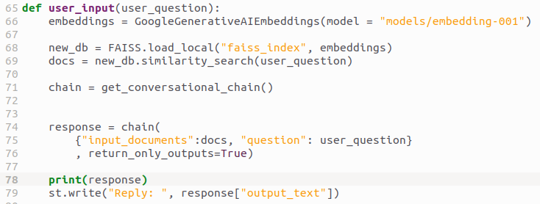
9.1 Define User Input
https://www.youtube.com/watch?v=uus5eLz6smA
Define User Input (23:14-23:20/29:20)
We get the “user_input”
1. We load in the Google Gemini (Generative AI Embedding).
2. We combine both the local FAISS database “faiss_index” (PDFs vector embedding) and Google Gemini (Generative AI Embedding) into a new_db.
3. Then, we use new_db (Gemini and PDF Embedding) to process the user_question (user query) to perform the similarity search, then we get the most similar answer and put into docs.
What is Similarity Search?
FAISS (Facebook AI Similarity Search) Library: FAISS enables efficient similarity search.
1. Given a set of vectors, we can index them using FAISS library.
2. then using another vector (query vector), we search for the most similar vectors within the index.

Slide 5
9.1 Define User Input
https://www.youtube.com/watch?v=uus5eLz6smA
Define User Input (23:14-24:50/29:20)
1. We perform the get conversational chain (or conversational prompt).
2. We input docs (based on most similar vectors), user_question, and get the response.

Slide 6
9.2 User Display

Slide 7
9.2 User Display
https://www.youtube.com/watch?v=uus5eLz6smA
User Display (24:51-24:54/29:20)
We
1. print out the response and
2. Display with with streamlit.

Slide 8
End

