Slide 1

10 GUI/Main Function
Peter H. Chen

Slide 2
10 GUI/Main Function
https://www.youtube.com/watch?v=uus5eLz6smA
GUI/Main Function (24:54-25:00/29:20)
Now, we implement the main function.
This is the implementation of streamlit.

Slide 3
10.1 Define GUI: User Input

Slide 4
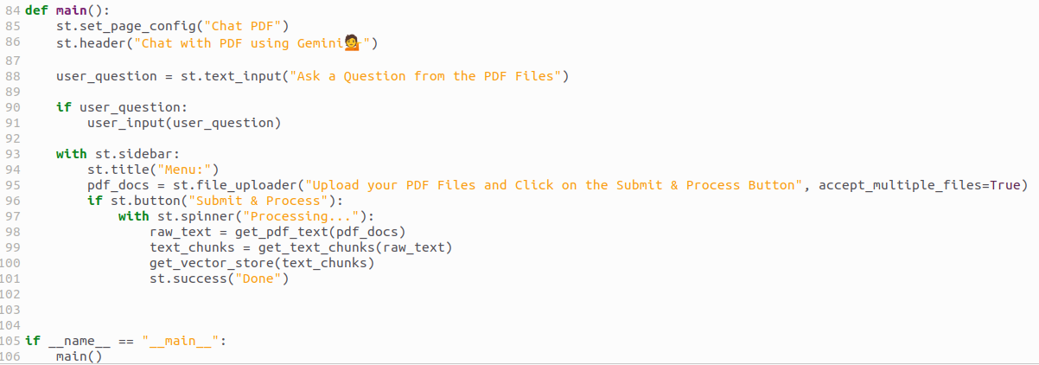
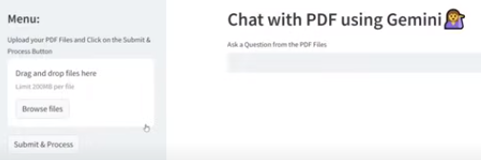
10.1 Define GUI: User Input
https://www.youtube.com/watch?v=uus5eLz6smA
Define GUI: User Input (25:01-25:40/29:20)
We
1. set the page config “Chat PDF” (or “Chat with Multiple PDF”).
2. set header with “Chat with PDF using Gemini” (or “Chat with Multiple PDF using Gemini”).
3. set label display “Ask a Question from the PDF Files”.
4. Check if user input some question.
5. If user input some question, then we use user input to get answer from both Google LLM (Gemini) and PDF vector embedding (Facebook similarity search).

Slide 5
10.2 Define GUI: Side Bar

Slide 6
10.2 Define GUI: Side Bar
https://www.youtube.com/watch?v=uus5eLz6smA
Define GUI: Side Bar (25:41-26:40/29:20)
We also have the side bar.
1. With sidebar
2. Set sidebar title “Menu”
3. Display file upload label and return the pdf documents.
4. As soon as, we click the “submit” button. We display the“processing…” message.
5. We translate the pdf into text, text into chunk, and into vector embeeding.

Slide 7
End

