Slide 1

11 Run Multi-PDF Gemini
Peter H. Chen

Slide 2
11 Run Multi-PDF Gemini
https://www.youtube.com/watch?v=uus5eLz6smA
Run Multi-PDF Gemini (26:44-26:50/29:20)
Now, we run the Multi-PDF inputs and Gemini.

Slide 3
11.1 Conda TensorFlow

Slide 4
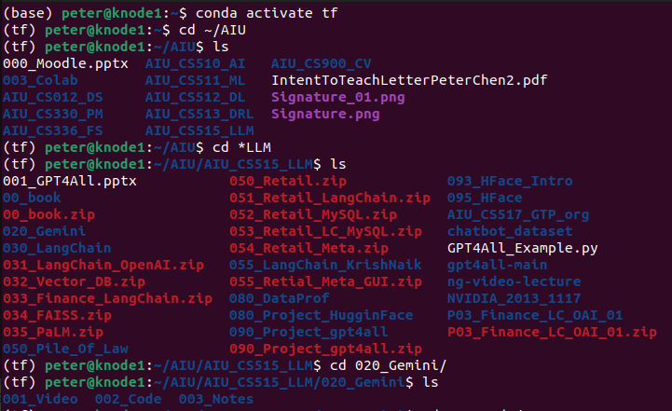
11.1 Conda TensorFlow
https://www.youtube.com/watch?v=uus5eLz6smA
Conda Tensorflow (26:54-26:55/29:20)
Open terminal:
> conda activate tf
> cd ~/AIU/*LLM/020_Gemini/002_Code

Slide 5
11.2 Check Env

Slide 6

11.2 Check Env
https://www.youtube.com/watch?v=uus5eLz6smA
Check Env (26:56-27:00/29:20)
Check the .env file
> ls -a
We should able to see “.env” which define the Google API Key.

Slide 7
11.3 Streamlit Run Application

Slide 8
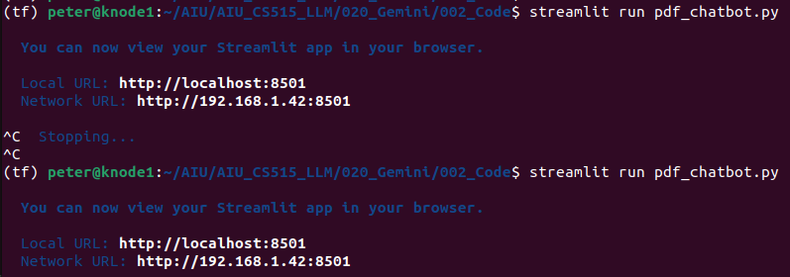
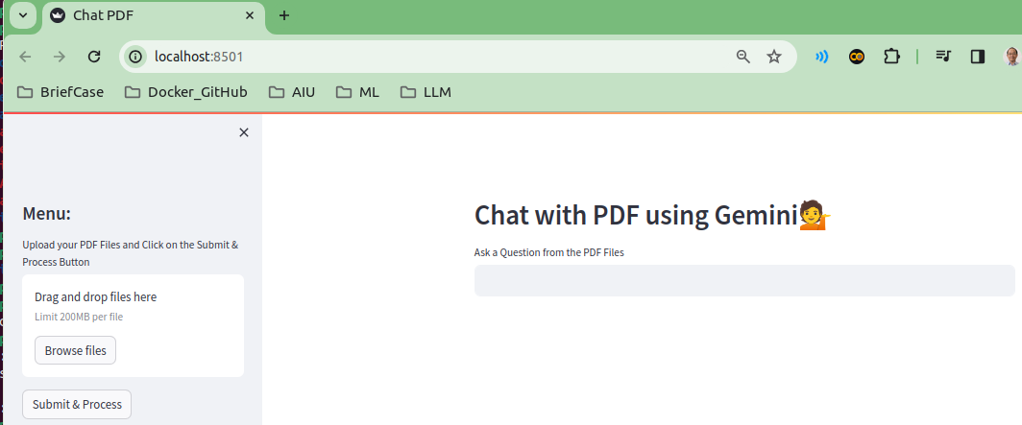
11.3 Streamlit Run Application
https://www.youtube.com/watch?v=uus5eLz6smA
Streamlit Run Application (27:01-27:02/29:20)
streamlit run <python-file>:
> streamlit pdf_chatbot.py

Slide 9
11.4 Browse PDF Files

Slide 10
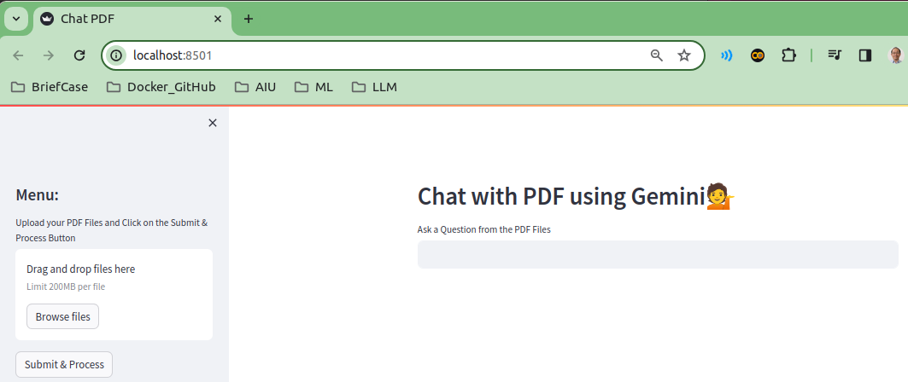
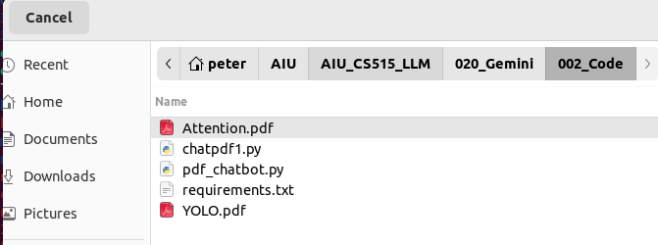
11.4 Browse PDF Files
https://www.youtube.com/watch?v=uus5eLz6smA
Browse PDF Files (27:03-27:05/29:20)
Click button “Browse files”.

Slide 11
11.5 Drag and Drop PDF Files

Slide 12
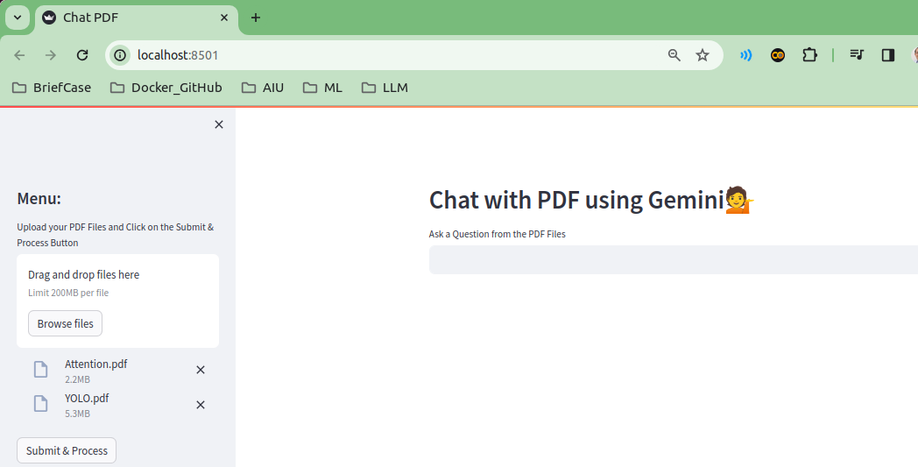
11.5 Drag and Drop PDF Files
https://www.youtube.com/watch?v=uus5eLz6smA
Drag and Drop PDF Files (27:05-27:20/29:20)
1. Drag and Drop PDF Files (Attention.pdf and YOLO.pdf) in the Upload Area.
2. We should see the Attention.pdf and YOLO.pdf are displayed.

Slide 13
11.6 Process PDF Files

Slide 14
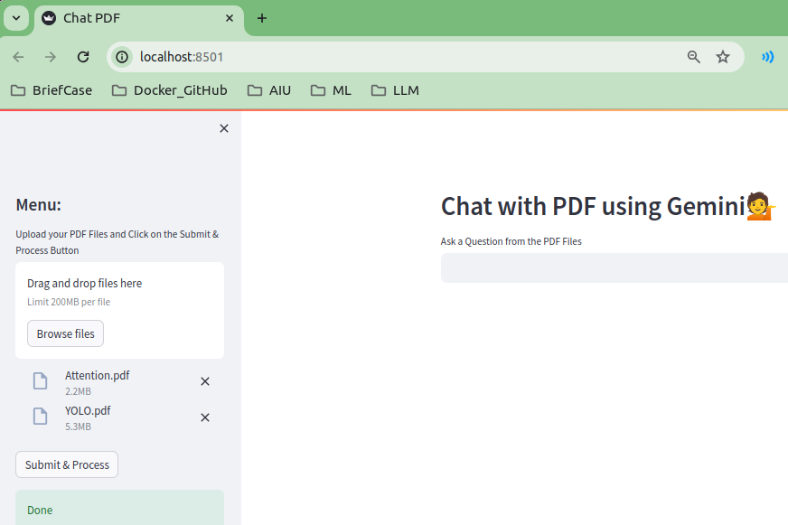
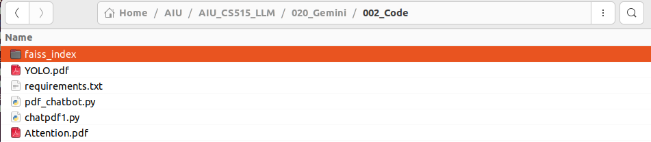
11.6 Process PDF Files
https://www.youtube.com/watch?v=uus5eLz6smA
Process PDF Files (27:21-27:35/29:20)
Click button “Submit & Process”.
When processing is done, the button “Done” is displayed.
We can see “faiss_index” folder is generated.

Slide 15
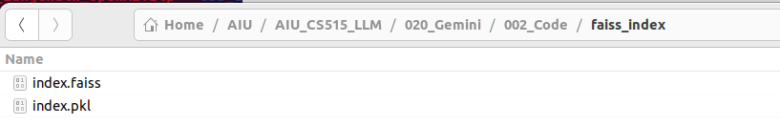
11.6 Process PDF Files
https://www.youtube.com/watch?v=uus5eLz6smA
Process PDF Files (27:35-27:50/29:20)
Double Click “faiss_index” folder, we can see files
1. index.faiss: Stored Vector Database for Embedding File for Similarity Search.
2. index.pkl: pickle file.

Slide 16
11.7 Question and Answer

Slide 17
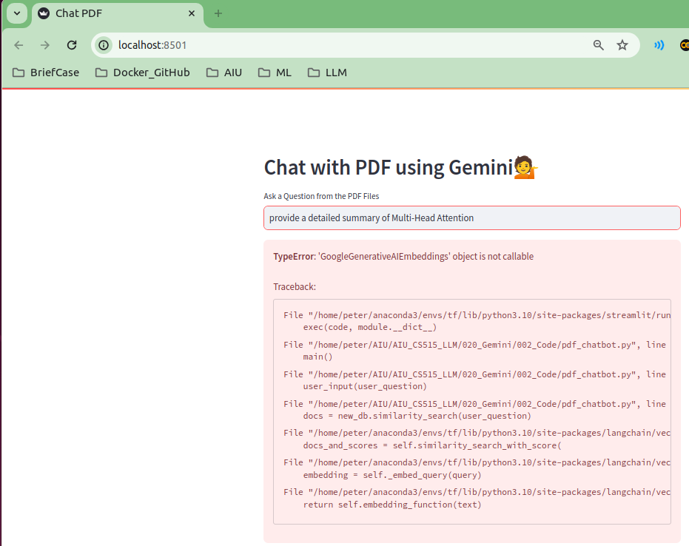
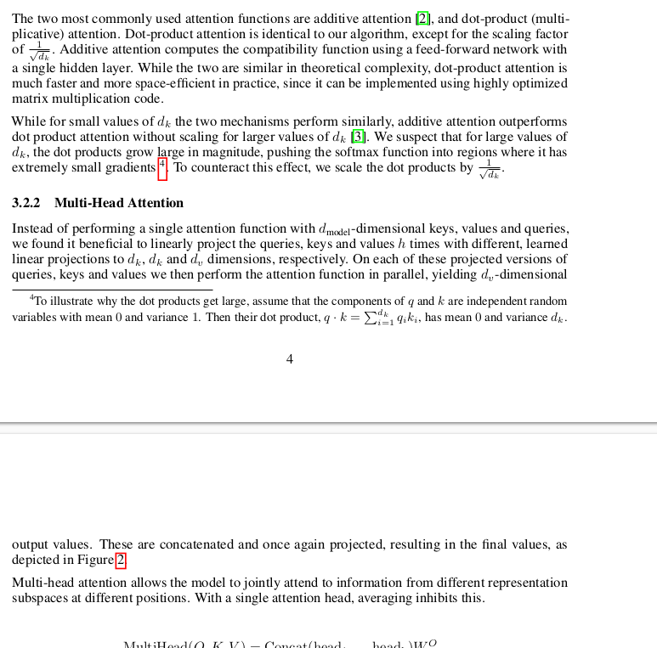
11.7 Question and Answer
https://www.youtube.com/watch?v=uus5eLz6smA
Question and Answer (27:55-28:10/29:20)
Open the “Attention.pdf” file.
My Quesiton is “Provide the detailed summary of Multi-Head Attention”
I have error: “TypeError: 'GoogleGenerativeAIEmbeddings' object is not callable
Update langchain and run again.

Slide 18
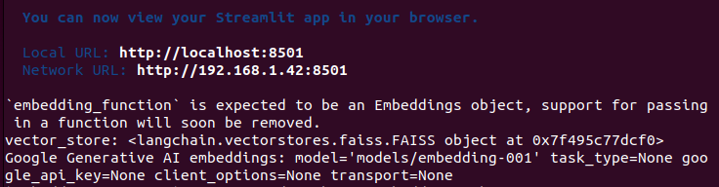
11.7 Question and Answer
https://www.youtube.com/watch?v=uus5eLz6smA
Question and Answer (28:11-29:20/29:20)
Update langchain and run again.
The Google API Key become “None”.
Google API Key may reach daily limit.
Will run again tomorrow (or run easier cases in FAISS).

Slide 19
End

